Slide 1

Participant Selection:
Where My Peeps At?
Research Methods
PSYC/NEURO2001 Weds 14:30-17:30
Jordan Schoenherr
Carleton University

Slide 2
Pre-Lecture Warning
Today is the day that I… show you movies!
I’ll be talking about animal participants and I will show you a variety of clips to illustrate how they can perform task
But first, some math!

Slide 3
Overview of Lecture
Population and Sample Population
Sampling Techniques
Representativeness of Sample
Animal Models

Slide 4
Human Participant Selection
“Population, when unchecked, increases in a geometrical ratio.”
- Thomas Malthus

Slide 5
Population
Population: The set of individuals of interest to a researcher. A set of entities concerning which statistical inferences are to be drawn.
  Living Things
  Humans
  Ottawa Residents
  The students registered in PSYC 2001 A & T at Carleton University
In psychology, we typically try to obtain samples that represent the general population, we also frequently consider special populations:
  e.g., Children, Dangerous Offenders, Dyslexics, Developmentally Delayed

Slide 6
Sampling
For multiple reasons, it is not typically possible to test entire populations. Instead, samples are obtained.
Sample. A subset of a population.
Sampling. The variety of ways of selecting individuals to participate in a research study.
How can we know that a sample actually reflects the entire population?

Slide 7
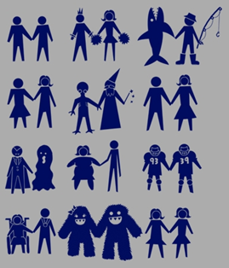
Representative Sample
Representative sample: A sample whose characteristics reflect those of the population.
Representative |  | Biased
Sample characteristics = Population characteristics |  | Sample characteristics ≠ Population characteristics
Notes:
http://www.threadless.com/product/2801/Love_is_Love/tab,guys/style,shirt

Slide 8
Probability Sampling
Probability sampling. The population is known and each individual has a specifiable probability of being selected.
Random. A sampling process that ensures that each individual in the population has an equal chance of being selected.
Other probability sampling methods include:
Systematic |  | Stratified random
Proportionate random |  | Cluster

Slide 9
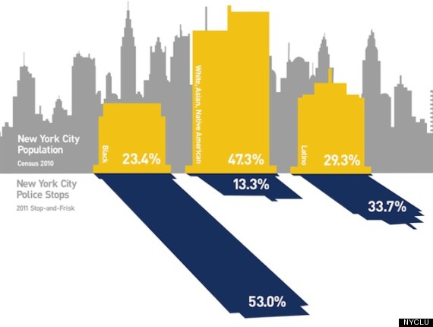
Non-Random Sampling
New York City police department has adopted a stop-and-frisk program to reduce crime
Is the sample population (those stopped) proportional to the general population?
Notes:
http://www.huffingtonpost.com/2012/05/13/nypd-stop-and-frisks-15-shocking-facts_n_1513362.html?ref=new-york&ref=new-york
http://abcnews.go.com/US/nypds-controversial-stop-frisk-policy-racial-profiling-proactive/story?id=19084229#.UZOTQ7WThAo

Slide 10
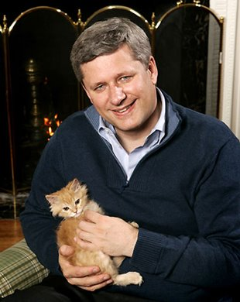
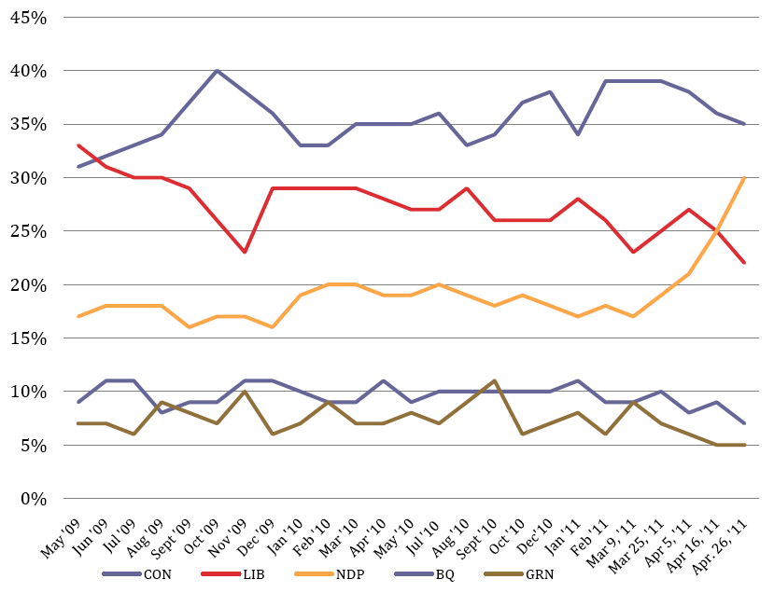
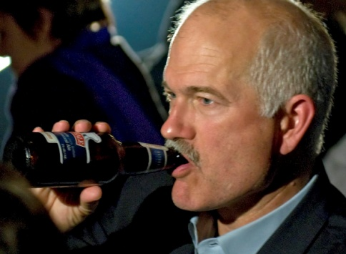
Representative Sample: Validity Revisited
Predictive validity
(this guy won)
A fine-grained analysis prior to election
Sample appears representative, given that patterns are stable, over time
Is this measure valid? Think about outcomes.
Note that the data is more variable at this level of analysis.
Notes:
http://www.angus-reid.com/wp-content/uploads/2012/03/2012.03.22_Politics_CAN.pdf

Slide 11
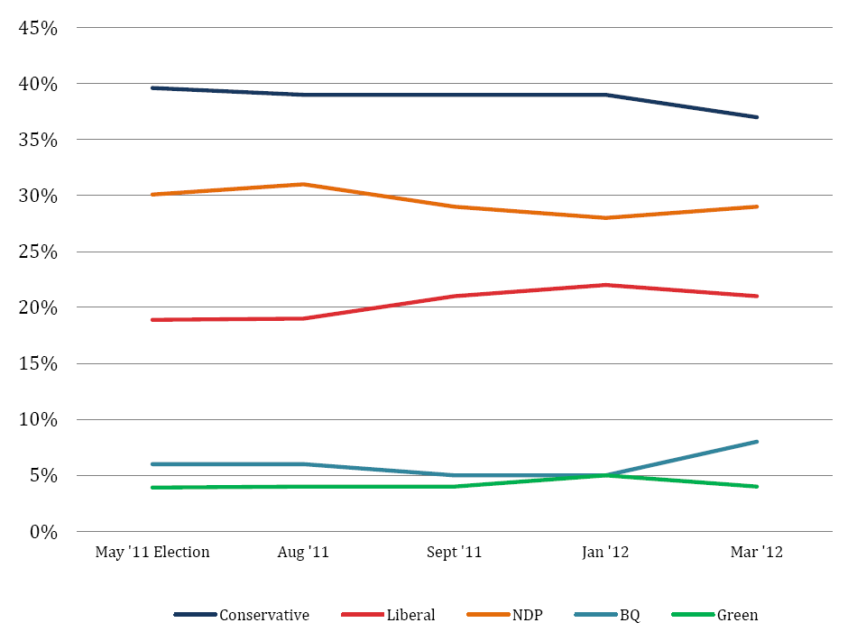
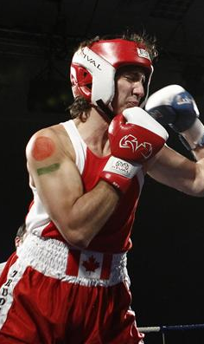
Representative Sample: Validity Revisited
Construct validity?
NDP leaderless after Layton’s Death
Robocalls
Justin Trudeau boxes
Justin Trudeau boxes
Remember, correlation does not equal causation!
Notes:
http://www.angus-reid.com/wp-content/uploads/2012/03/2012.03.22_Politics_CAN.pdf

Slide 12
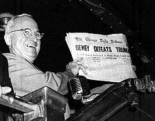
Unrepresentative Sampling:
Dewey Defeats Truman!(?)
Sampling methods can introduce error:
  e.g., lack of predictive validity
Unrepresentative sample (telephone users) led to an overestimation of the Republican vote.
Nincompoop (Harry Truman) holding
Chicago Tribune, November 3, 1948

Slide 13
Rationale for Single Samples?
Problem. Again note that we do not want (or are unable) to test the entire population. What does a sample from this population tell us?
If I use the sample mean from a single sample of observations to make an estimate about the mean for the entire population, how likely am I to make a serious mistake?

Slide 14
Rationale for Single Samples?
It turns out that the error in basing a conclusion about the entire population on a small sample is likely to be quite small.
Importantly, this vital conclusion follows from the fact that the distribution of all possible sample means is a normal curve.

Slide 15
Rationale for Single Samples?
Again, we come back to wondrous probability theory!
We assume that attributes (e.g., height, intelligence, personality traits) are distributed in a population normally
  i.e., there are fewer tall and short people then there are people of average height
Thus, the mean and standard deviation are important parameters for a probability distribution

Slide 16
Deviation Scores
Previously, we learned how to compute a mean
We also learned how to obtain a deviation score
Again, there is a problem. Summing the deviation score gives us 0
  That gives us zero help!
Grade | Score – Mean | Deviation Score
A | 89-84.3 | 4.7
 | 84-84.3 | -0.3
 | 80-84.3 | -4.4
B | 74-73 | 1
 | 73-73 | 0
 | 72-73 | -1

Slide 17
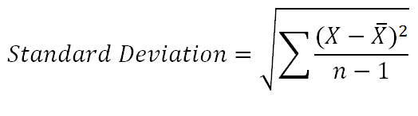
From Deviation Scores to
Standard Deviation
The deviation score alone won’t help us. We need to change it into something more useful
Given that we want to compare our results to others, we want to standardize it. By doing so, we obtain a:
  Standard deviation. The average amount the scores in our sample differ from the mean (ignoring the sign difference), i.e., one sample from the population

Slide 18
From Deviation Scores to
Standard Deviation
1. X, is an observation (an obtained value, e.g., your quiz score)
, is the mean (average across values, e.g., your class’ average performance)
We square our deviation score to ensure that we don’t obtain 0!
We divide by the sample size minus 1. We reduce by one because you are estimating the mean. This gives us the average squared deviation score.
Finally, we take the root to eliminate our earlier squaring operations… et voila!

Slide 19
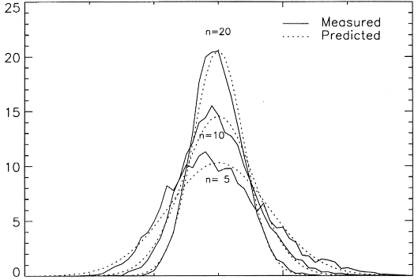
Distribution of Sample Means
Variability is even more reduced
Variability is reduced
Considerable variability
The values of the sample means will have a frequency distribution represented by the normal curve.
The central limit theorem:
  As n gets larger, the sample mean should approximate the population mean with mean 0 and variance σ².
Notes:
http://ars.els-cdn.com/content/image/1-s2.0-S0262885698001012-gr2.gif

Slide 20
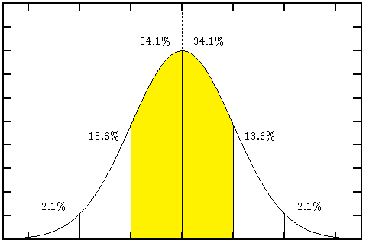
The Relationship Between a Sample Mean and a Population Mean
There is a 68.2% chance that it is ± 1 SD from the population mean.

Slide 21
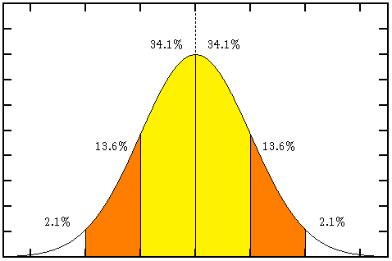
The Relationship Between a Sample Mean and a Population Mean
There is a 95.4% chance that it is ± 2 SD from the population mean.

Slide 22
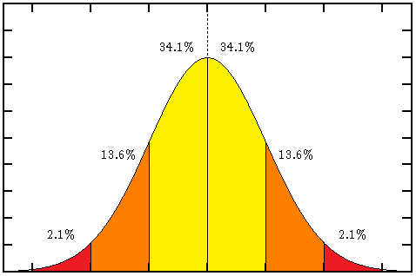
The Relationship Between a Sample Mean and a Population Mean
There is a 99.6% chance that it is ± 3 SD from the population mean.

Slide 23
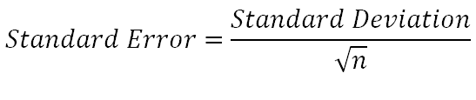
Estimating the Population Mean from
the Sample Mean
It is possible to calculate the SD of sample means with the following formula:
If the sample n ≥ 30, then the standard error provides a reliable estimate of the SD for the population. It accounts for sampling across all possible samples of size n.

Slide 24
Estimating the Population Mean from
the Sample Mean
Characteristics of total population that we want to estimate.
N = 141
Mean = 66.82
SD = 13.48

Slide 25
Sampling Grades
First, we sample 30 grades at random and we calculate the sample mean and SD.
Remember:
Our population mean was 66%!

Slide 26
Sampling Grades
We calculate the standard error.
√

Slide 27
Sampling Mean
65.02
- 5.52
+ 5.52
Mean +/- (2*SE) = 95% Interval
65.02 +/- (2 * 2.76) = +/- 5.52
The population mean will be between 59.5 and 70.54 (95% of the time!). Remember that the real population mean was 66.82.

Slide 28
Conclusions About Inferential Statistics
Many inferential statistics work in a similar way:
  The sample is used to estimate some aspect of the population (e.g. the mean) with a given degree of confidence (typically 95% or 99%).
  In hypothesis testing, a null hypothesis is put forward and it is determined whether the data are strong enough to reject it.
    Null Hypothesis: Could we have obtain our results by chance? i.e., nothing is going on.

Slide 29
How Typical are Samples?
In general, experimental psychologists use non-random sampling:
  Convenience
  Quota
How can researchers tell if their results generalize to the population?
  Replication!
  We need to additionally consider the population characteristics for the attribute in question

Slide 30
Cultural Limitations: What is Normal?
“Nobody realizes that some people expend tremendous energy merely to be normal.”
- Albert Camus

Slide 31
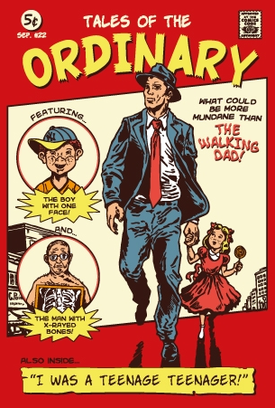
Problems with (Some) University Research
Again, our overriding concern is that our sample that we have selected reflects the population that we want to make inferences about
In some instances, it is possible to find research paradigms wherein using university (and North American) sample populations do not generalize to other cultures
Notes:
http://www.threadless.com/product/3591/Tales_of_the_Ordinary/tab,guys/style,shirt

Slide 32
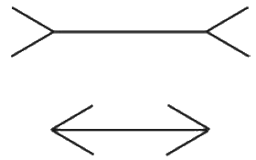
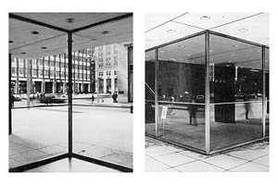
Constructivism and Illusions
Gregory (1970; 1980): Müller-Lyer illusion
  The line with the inward pointing arrows appears larger
  Attributed to regularities in our environment
Are these findings generalizable to other populations?

Slide 33
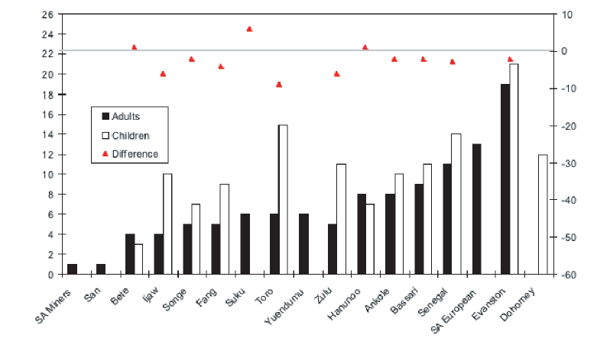
Cross-Cultural Differences
Time taken in Seconds to de-bias
Cross-cultural evidence suggests that if you don’t grow up in an environment with 90^{O} walls, you will not produce the bias to the same extent (Segall, Campbell, & Herskovits, 1966)
Note the continuous nature of the bias

Slide 34
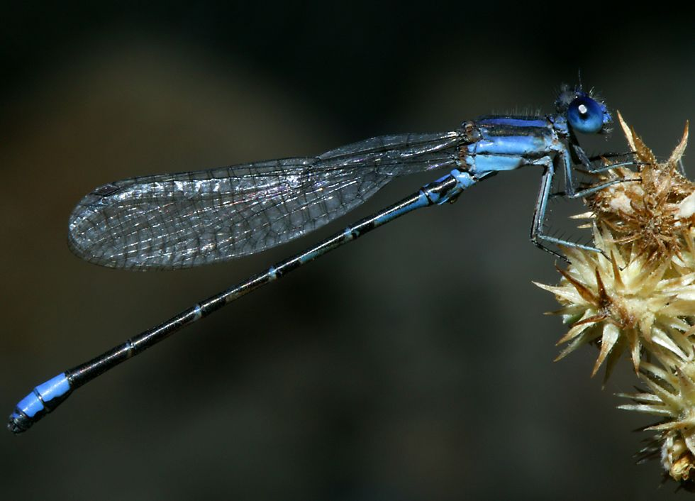
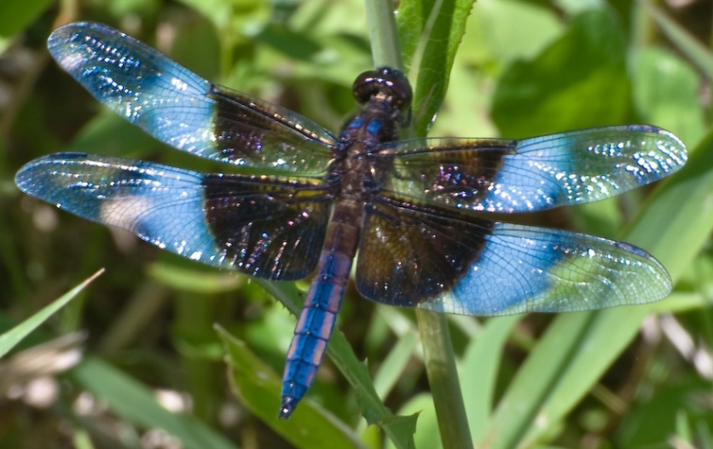
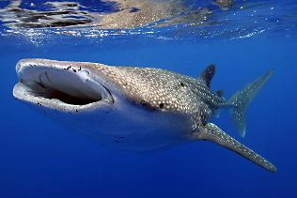
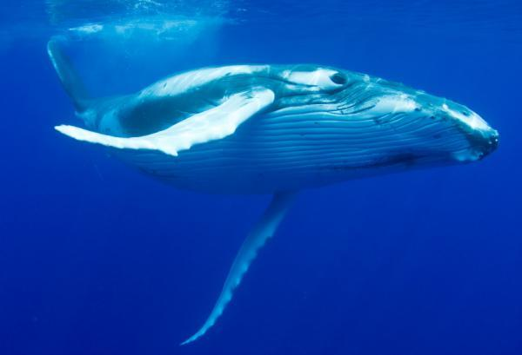
Folkbiological Classification
Category:
Same
or
Different
Damselfly
Dragonfly
Category:
Same
or
Different
Whale Shark
Humpback Whale

Slide 35
Category Levels across Culture
Rosch et al. (1976) observed a basic-level for categorization (e.g., fish, tree)
  “…rich bundles of perceptual and functional attributes occur that form natural discontinuities and that basic cuts in categorization are made at these discontinuities,” (p.385)
Contrasted against a superordinate level (e.g., aquatic animal, plant) and a subordinate level (e.g., trout, pine tree).

Slide 36
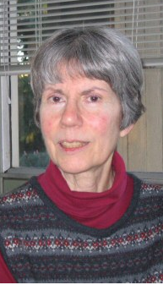
Category Levels across Culture
For instance, Rosch et al. (1976) found that only a few additional features were provided when going from the basic level to a subordinate level:
  Basic level (e.g., fish; bird),
    9 stimulus features generated
  Subordinate level (e.g., kitchen table; pike, tuna)
    Only 10.3 stimulus features generated

Slide 37
A Basic Level in Folkbiology?
Do we observe the same pattern across cultures?
Berlin (Berlin, 1976, 1992; Berlin & Tyler, 1968) found a different pattern:
  They found that other cultures preferred a folk-generic (e.g., tiger, trout, oak)
Rosch | Berlin
Superordinate | Kingdom
Basic Level | Lifeform
Subordinate | Generic
- | Specific

Slide 38
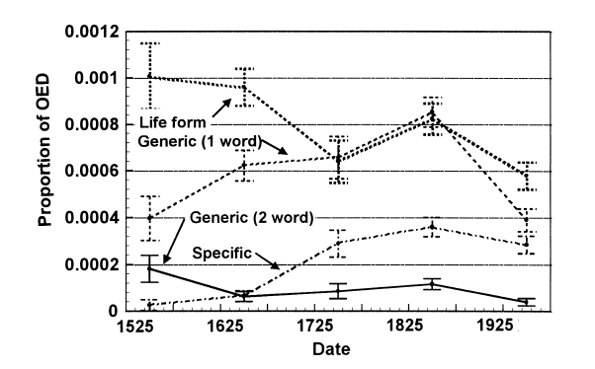
Wolff, Medin and Pankratz (1999):
Devolution of Folkbiological Knowledge
Used quotations from the Oxford English Dictionary (OED) to examine whether references to category levels changed.
Wolff et al. (1999) found that, in our era, life form level (i.e., subordinate members that have specific information) decreased.

Slide 39
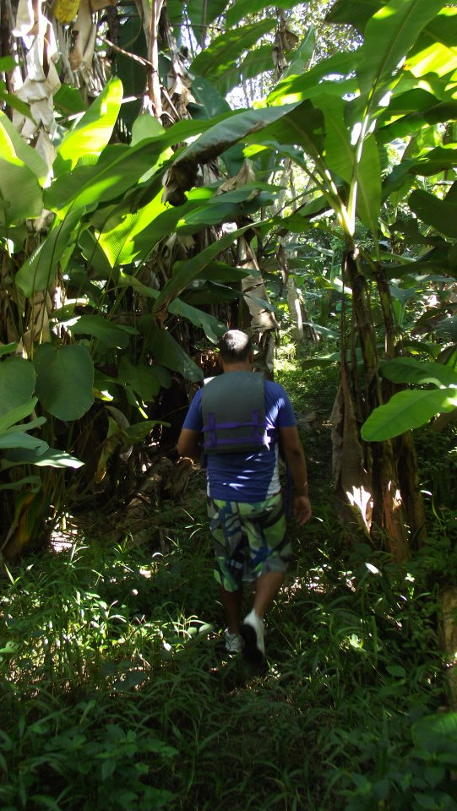
Sisters from Another Mister,
Brothers from Another Mother
Now, what happens when we examine another population,
Mayan (pre-Columbian) civilization flourished from 2600 BCE To 900 CE,
Maya dialects and culture still exist! e.g., Guatemala

Slide 40
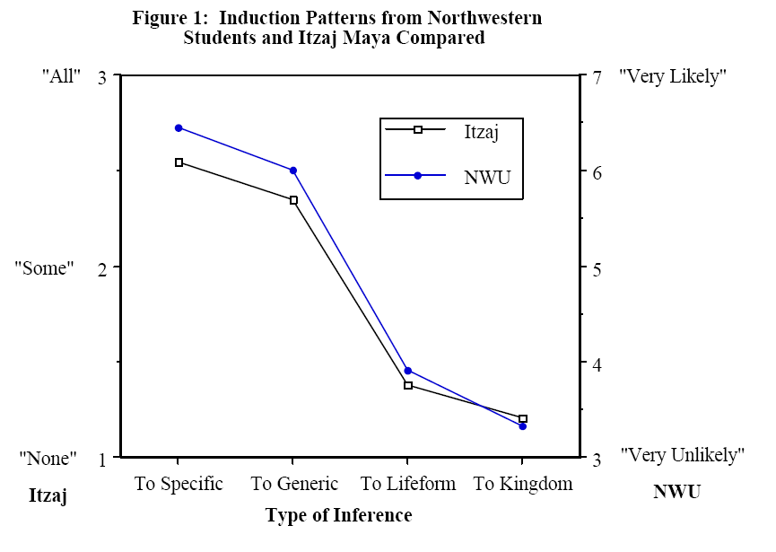
A Basic Level in Folkbiology?
Coley, Medin, Proffitt and Lynch (1991) examined whether patterns of induction were affected by the level
  Itzaj and American students compared
Participants given names for biota at different levels of specificity (e.g., Specific, Kingdom)
  Asked to indicate whether ‘All’, ‘Some’, or ‘None’ of a particular organism had a particular attribute
  e.g., How many [birds/jays] have [feathers]?
e.g., ‘Tuna’
e.g., ‘Fish’

Slide 41
A Basic Level in Folkbiology?
Coley, et al.s’ (1991) results show that both American and Itzaj participants found the same level most informative
Thus, although folkbiological classification systems differ, humans appear to attribute features/traits to animals in the same fashion
e.g., ‘Tuna’
e.g., ‘Fish’
Although inferences to specific and generic level are high, the largest increase is between generic-lifeform level.

Slide 42
Biased Samples?(!)
In this case, the take home message should not be that our sample does not have ecological validity
Rather, we need to be mindful of the expertise of the individual and the domain we are considering
Failure to acknowledge these differences will lead to erroneous conclusions about human thinking, behaviour, and feelings as a whole

Slide 43
Animal Subjects: The Other Sample
“The theory of evolution by cumulative natural selection is the only theory we know of that is in principle capable of explaining the existence of organized complexity.”
- Richard Dawkins

Slide 44
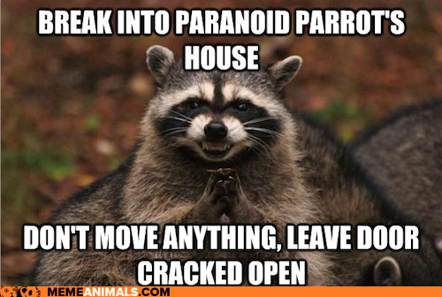
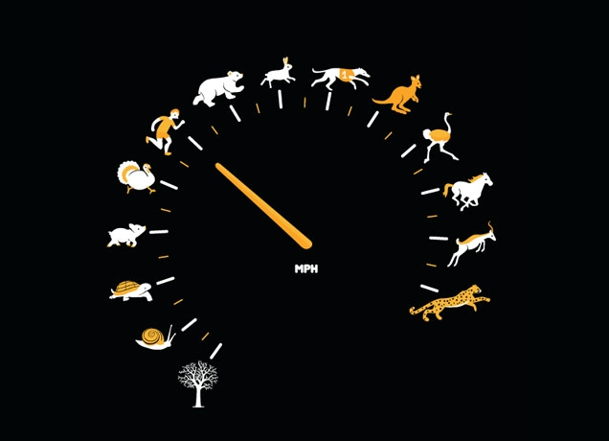
Animal Models
Two extreme approaches are generally adopted in our perception of animals:
  They are nothing like us,
  They think very much like we do.
Animals have some cognitive and physiological systems that are much like our own
Notes:
http://www.threadless.com/product/1784/As_Fast_As_I_Can/tab,guys/style,shirt

Slide 45

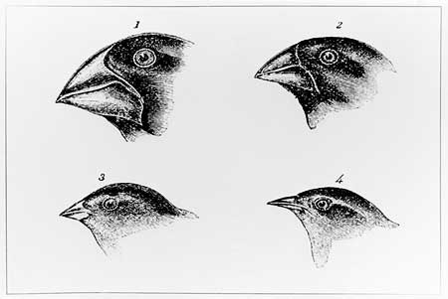
Darwin, Evolution and Finches
To understand why animals might be useful models, we need to consider evolution
After observing how various finches had specialized beaks that were effective at cracking open seeds located on their respective islands, Darwin (1859; see also Wallace, 1859) suggested that species could be related, stemming from a common ancestor

Slide 46
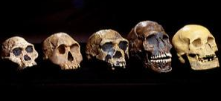
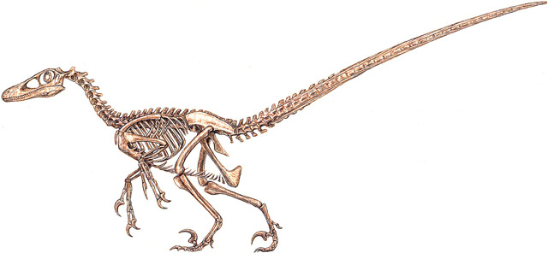
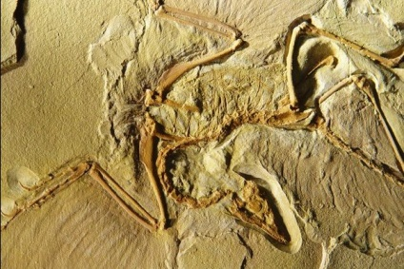
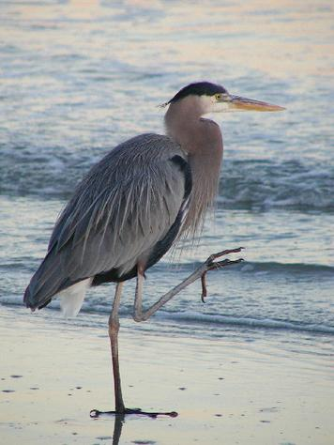
Evidence for Evolution
a) Anatomical Similarity: many animals appear similar, sharing features. Suggests the possibility of a common ancestry.
b) Comparative Embryology: At an early stage of development, embryos have a similar appearance. We differentiate from a single cell, into complex multicellular lifeforms.

Slide 47
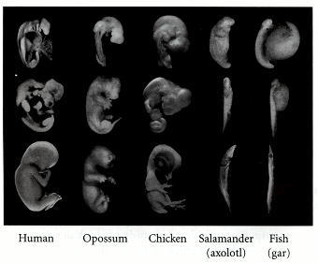
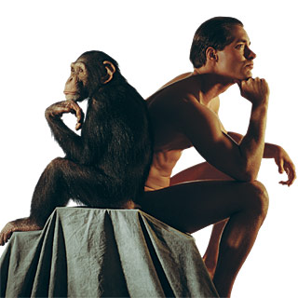
Evidence for Evolution
Fossil records: Layers of earth are stratified. Newer layers are located atop older layers. We find morphologically similar fossils that show progression and they are located in these different layers.
Genetics: Genetic codes are highly similar. Morphologically similar animals have similar genes! For instance, our genes are 99% similar to those of chimpanzees.
Notes:
http://www.scientificamerican.com/media/inline/what-makes-us-human_1.jpg

Slide 48
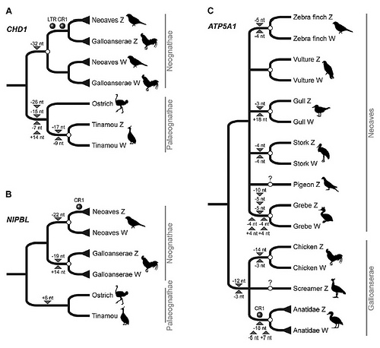
Evidence for Evolution
Most importantly, it is not simply the kind of evidence that we have but that it converges on a story.
Remember: evolution is a theory. It is believable by virtue of the weight of evidence: converging from multiple sources.
We see the same pattern of results, across all species.
Notes:
http://farm7.static.flickr.com/6091/6276021227_c312a7410e.jpg

Slide 49

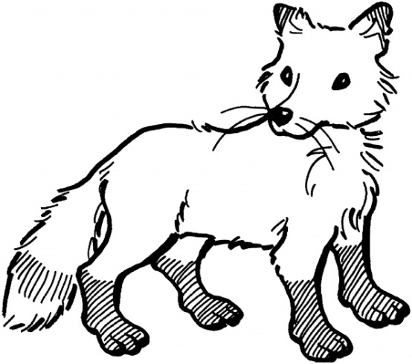

Evolution and Natural Selection:
In a Nutshell
HUNGRY!!
Three main components:
  Replication
  Variation
  Selection (and competition)
Imagine an environment that has dark colours
There are two animals: foxes (predator) and ducks (prey)
  They both ‘want’ to survive
Uh-oh
Notes:
http://wwwcdn.net/ev/assets/images/vectors/afbig/fac24e4bf118b391be3575a3b29a24e5-tree-silhouettes-clip-art.jpg

Slide 50
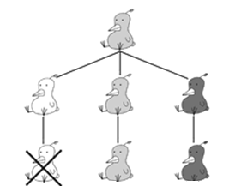

Evolution and Natural Selection:
In a Nutshell
To survive, the fox needs to eat the duck; To survive, the duck needs to stay alive
If we allow for variation in the colour of the ducks feathers, we see that it is more likely that the light coloured ducks will be detected and the dark coloured ducks will go undetected
Yum!
Sorry, dude!

Slide 51
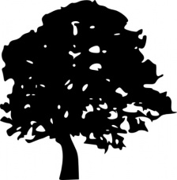
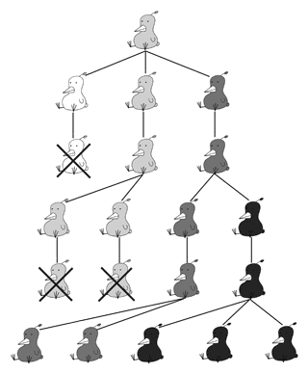

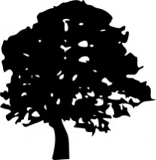
Evolution and Natural Selection:
In a Nutshell
As successive generations come along (replication) we find that every time the 'light coloured' genes occur (variation), foxes are more likely to detect them (selected against)
Eventually, we find mostly darker coloured ducks

Slide 52



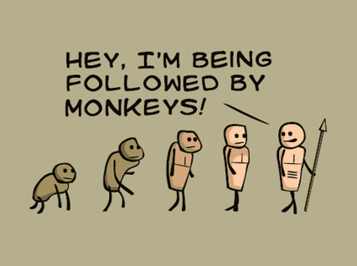
Adaptive Traits: A Temporary Solution
Importantly, evolution does no make claims about moral implication
  We are not ‘better’ than a fox, or a duck (nor are we worse)
  From an evolutionary perspective, animals and their features can only be judged as ‘adaptive’, i.e. does a feature help us to survive
  Adaptive, therefore, is relative to a given environment
Where’d he go?
Sucker!

Slide 53
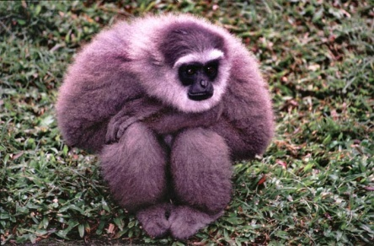
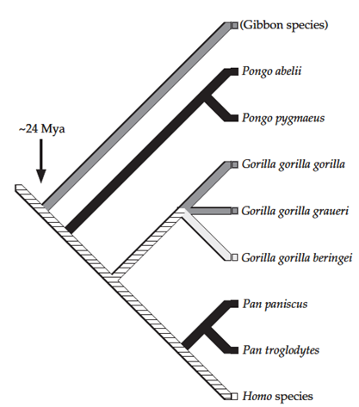
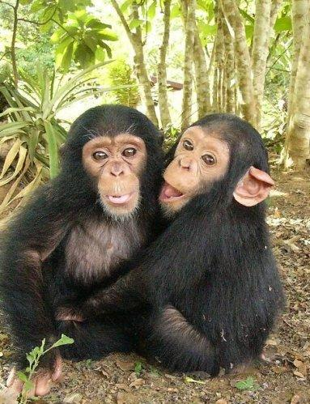
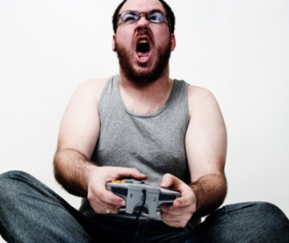
Animal Models
Thus, based on an evolutionary argument, we might be able to draw inferences from our closest relatives, e.g., Chimps
We assume that 1) some features are shared as a result of a common ancestry, and 2) some similar features have a different evolutionary origin
Notes:
http://www.cites.org/gallery/speciespics/mammal/large/javan_gibbon_L.jpg

Slide 54
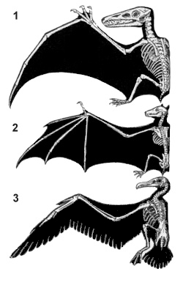
Animal Models
Homologous Traits: The same organ, feature, etc. in different animals. A common ancestor is required.
  e.g., hands, flippers, wing = general genotype
Analogous Traits: An organ, feature, etc. that performs the same function in different animals. Convergent evolution is required.
  e.g., types of wings = specific genotype
Notes:
http://en.wikipedia.org/wiki/File:Homology.jpg

Slide 55
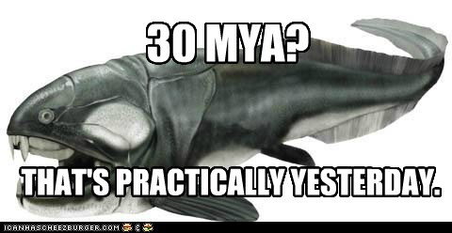
Issues with Timescale
Evolution is necessary slow, occurring over a large timescale.
Humans (and some other animals) have developed dynamic learning systems that allow us to adapt more rapidly to our immediate environment.
Nevertheless, we need to consider how animals respond to tasks as well as the degree of relationship (e.g., ancestry & genetics) to ourselves in order to draw inferences that are applicable to us

Slide 56
Animal Models: Collaborative Behaviour
Evolutionary theory allows us to draw inferences about how the behaviour of our animal cousins might relate to our own (homologous or analogous traits)
For instance, chimpanzees have been shown to collaborate in the wild
  If a call from unknown male is heard, chimps will only approach if there are enough males in their group to outnumber the other group
  Chimps coordinate to hunt monkeys
Explanation: Is it a possibility of reciprocity or more complex social cognition (homologous trait?)

Slide 57
Collaborative Behaviour:
Melis et al., (2006)
Melis, Hare, and Tomasello (2006) examined the adaptive nature of chimps collaborative behaviour
  Could chimps collaborate in a novel task that could only be solved when other chimps were recruited?
  Would chimps learn that collaboration was necessary in future tasks of a similar nature?
Melis et al., (2006) created a task wherein chimps, were given one of two conditions: one in which they needed to collaborate to obtain food, and another where only problem solving was required

Slide 58
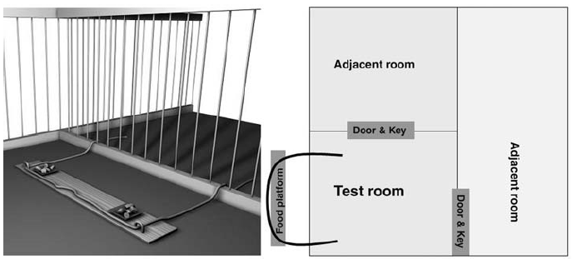
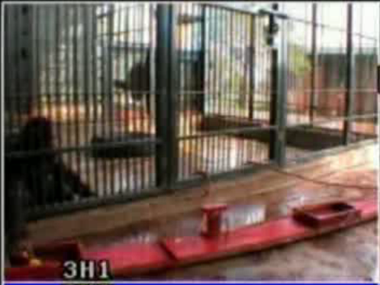
Melis et al., (2006)
The collaboration condition: “The subject and partner watched from separate rooms adjacent to the testing room as the baited food platform and ropes were positioned so that the two ends of the rope were placed 3 m apart: too far for one individual to pull both simultaneously.”
The solo condition: “The two ends of the rope were placed 55 cm apart, so that a subject did not need help in obtaining the food because she could potentially pull both rope ends simultaneously by herself.” (p. 1298)

Slide 59

Melis et al., (2006)
In their first experiment, they found that more chimps recruited another chimp to assist them when the ropes were far apart than when the were closer together
In the second experiment, they found the previous collaborators that were effective were recruited in another session
Chimps not only collaborate, they also retain memory of successful collaboration

Slide 60

Cognitive Ethology:
Problem Solving in Animals
The fact that human share abilities with other animals can also be demonstrated with distinctly, non-human animals (analogous traits?)
One of the most widely studied animals is the octopus
  Octopi can adapt to use their camouflage to blend into the background of numerous environments, taking on many shapes
It also possesses other, more intriguing abilities

Slide 61

Cognitive Ethology:
Problem Solving in Animals
Recently, research have found that octopi are exceptional problem solvers
  Opening jars: when given a crab in a jar, octopi will find means to open it to remove the crab
  Coconut shells: octopi will pick-up, carry and use coconut shells; a relatively recent behaviour (Finn et al., 2009)

Slide 62

Creativity and Cognitive Ethology
Other animals have also been observed displaying complex problem solving abilities, e.g., crows (Bayern et al., 2009)
In all instances, the animal must have a mental representation of the problem space, develop a solution and use existing skills in a new fashion
  Requires working memory and metarepresentations
  Implies some level of conscious awareness

Slide 63
W2L1b Review
Sampling from a population allows us to make inferences about a general population.
Understanding sampling methods is important to ensure that our population is representative.
Animal models are used to examine the abilities of animals thought to share a common ancestor (homologous) or more general abilities (analogous)

