Slide 1

The Science of Measurement:
Validity and Reliability
Research Methods
PSYC/NEURO2001 Mon and Weds 14:30-17:30
Jordan Schoenherr
Carleton University

Slide 2
Overview of Lecture
Validity: Construct Sufficiency
Variability, Measurement, and Error
Reliability

Slide 3
Validity and Scale Development
“The only relevant test of the validity of a hypothesis is comparison of prediction with experience.”
- Milton Friedman

Slide 4
Assessing Scales and Measurement
Having developed a measure, or scale, we have assigned a characteristic (e.g., personality trait) or response (e.g., correct or incorrect)
The extent to which we can infer anything from these findings to support or reject or hypotheses will be dependent on two factors:
  Validity: How closely they relate to our construct?
  Reliability: How consistent are our results when using a given measure?

Slide 5
Varieties of Validity
Face Validity: Measurement procedures superficially appear to measure the construct that it claims to be measuring.
  Does your measure make sense?
  e.g., imagine a measurement scale developed (by vegetarians) to examine restaurant preference but excludes any mention of main courses containing meat.
Construct Validity: Scores obtained by measurement procedure behave the same as the variable itself.
  Does the measure conform to what you’d expect of the construct?
  e.g., If you are measuring personality, do people that act differently, score differently? Do different items on a test get different responses?

Slide 6
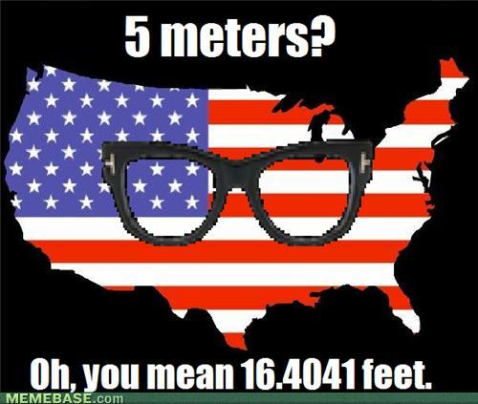

Varieties of Validity
Concurrent Validity: Measurement procedures from a new measure produce similar patterns to another measure
  Does your measure of a construct respond to task manipulations like someone else measure of the same construct?
  e.g., If you are measuring someone’s confidence, does a word scale (e.g., ‘Guessing’, ‘Moderately Certain’, ‘Certain’) match a numeric scale (e.g., 50%, 75%, 100%)?
Notes:
http://chzmemebase.files.wordpress.com/2011/09/memes-hipster-america.jpg
http://www.remonline.com/home/wp-content/uploads/2011/11/measure1.jpg

Slide 7
Varieties of Validity
Convergent and Divergent Validity: Two different measures thought to examine the same, or different, construct produce similar, or different, patterns of results, respectively.
  e.g., if two test are thought to examine memory capacity, does an individual score high (or low) on both?
  e.g., if one test is designed to measure psychopath and another academic performance, are responses they unrelated?

Slide 8
Varieties of Validity
Predictive Validity: Obtained scores on a measure accurately predict behaviour (or reported thoughts, beliefs and feelings) to a theory
  Does your measure respond in a manner predicted by your theory?
  e.g., Do those who are outgoing, talkative, etc. score higher on your set of ‘extroverted’ items?

Slide 9
Validity: Scale Development
Imagine we want to develop a scale to assess people’s preference for music
The construct we select is preference for contemporary music
  We examine top-ten lists and select a random sample of names
How would we go about doing this? What items would we use?

Slide 10



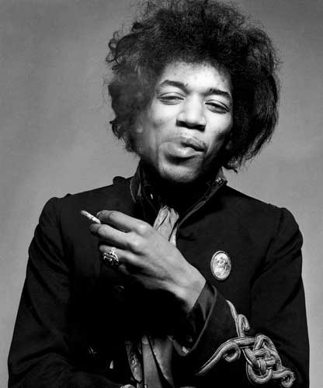
Validity: Scale Development
Contemporary | Not Contemporary
Rihanna | Bob Dylan
Frank Ocean | Neil Young
Ke$ha | Jimi Hendrix
Lana Del Ray | The Beatles

Slide 11
Validity: Scale Development
Contemporary | Not Contemporary
Rihanna | Bob Dylan
Frank Ocean | Neil Young
Ke$ha | Jimi Hendrix
Lana Del Ray | The Beatles
Contemporary?
Not Contemporary?
Does this scale have face validity?
Does the scale have construct validity?
  Proves to be rather complex

Slide 12
Validity: Scale Development
Contemporary | Not Contemporary
Rihanna | Bob Dylan
Frank Ocean | Neil Young
Ke$ha | Jimi Hendrix
Lana Del Ray | The Beatles
Female-Male Bias?
Genre Bias?
Cultural Bias?
Is there convergent/divergent validity?
Could the scale(s) have predictive validity?

Slide 13
Validity: Scale Development
Development of a scale usually entails a two-step process:
  Exploratory Analysis: After we use intuitions or (hopefully) some source of data to identify an initial set of items, we give them to experts to narrow down the items, and then we provide them to a set of participants.
  Confirmatory Analysis: Once we’ve devised a scale, we give our refined items to a new set of participants to test.

Slide 14
Scale Development:
Romantic Love
“Don't sweat the petty things and don't pet the sweaty things.”
- George Carlin

Slide 15
The Quantification of Phenomena
Everything can be subjected to measurement.
It’s a question of finding an appropriate construct to examine part of the phenomena.
Rubin (1970) conducted research in
“an attempt to introduce and validate a social-psychological construct of romantic love,” (p.265)”

Slide 16
The Quantification of Phenomena
Rubin identifies a need:
  “Loving" is merely intense liking (Heider, 1958),
  Not an aspect of “interpersonal attraction” (Newcomb, 1960),
  “Liking” is instead used in measures of “romantic” attraction (Walster, 1965),
  Love as attachment (Harlow, 1958),
  Sublimated sexuality (Freud, 1955).

Slide 17
Rubin (1970)
“The present research was predicated on the assumption that love may be independently conceptualized and measured. In keeping with a strategy of construct validation […], the attempts to define love, to measure it, and to assess its relationships to other variables are all seen as parts of a single endeavor. An initial assumption […] is that love is an attitude held by a person toward a particular other person, involving predispositions to think, feel, and behave in certain ways toward that other person. This assumption places love in the mainstream of social-psychological approaches to interpersonal attraction, alongside such other varieties of attraction as liking, admiration, and respect […].(Rubin, 1970, p. 265)”.

Slide 18
Operationalizing Love
Broader conception by Orlinsky (1970): common elements… in “filial love, marital love, love of God”
Romantic love as a scientific construct: “…may be defined simply as love between unmarried opposite-sex peers of the sort which could possibly lead to marriage.” (Rubin, 1970, p. 265)”.
“LOVE” | “LIKE”
Exclusiveness and absorption Affiliative and dependent need Predisposition to help | Feelings of respect and trust Desire to affiliate Perception of similarity

Slide 19
Initial Validation
Groups of students and faculty categorized tests items into love and liking, e.g., L₁ = Love item; L₂: Like item
  L₁: “I feel that I can confide in ____ about virtually everything.”
  L₁: “I find it easy to ignore ____’s faults.”
  L₂: “I think that ____ is unusually well-adjusted”
  L₂ : “I have great confidence in _____’s judgment.”
Validated items were then presented to participates ($1):
  Asked to rate their relationship with boyfriend/girlfriend (“lovers”)
  Asked to rate their relationship with “platonic friend”
Items rated on a Likert-scale:
  1-9 from “Not at All True” to “Completely True”

Slide 20
Love Questionnaire Experiment
Hypotheses: If the scale measures romantic love, then:
  People engaged in couples should love their boyfriends/girlfriends more than their best friend.
  The romantic love measure should be related to other certain behaviours and attitudes (e.g., wanting to get married).
  Couples who are in love should spend more time gazing into each other’s eyes.

Slide 21
Friend v. Partner
Index | Mean Women | Mean Men
Love for Partner | 89.46 | 89.37
Liking for Partner | 88.48 | 84.65
Love for Friend | 65.27 | 55.07
Liking for Friend | 80.47 | 79.10
Women liked their partner more than they were liked in return
Men were not liked more in general (see ‘Friend’)

Slide 22
Initial Validation
Rubin found that participants’ responses to certain items showed a great deal of correspondence (i.e., highly correlated):
  Exclusiveness and absorption
    “If I could never be with ____, I would feel miserable”
    “It would be hard for me to get along without_____”
  Affiliative and dependent need
    “If ______ were feeling badly, my first duty would be to cheer him/her up”
    “I would do almost anything for _____”
  Predisposition to help
    “I feel very possessive toward ____”
    “I feel that I can confide in ____ about everything.”

Slide 23
Initial Validation
More generally, items in the love scale showed considerable correspondence to one another
Of equal importance, items in the love scale did not show the same correspondence with those in the liking scale
Discriminant validity – the pattern of responses to one set of items (love scale items) associated with one construct (love) differs from the pattern observed for another set of items (like scale items) associated with another construct (liking)

Slide 24
Correlations between Love and Other Behaviour and Attitudes
Index | 1 | 2 | 3 | 4
Women
1. Love for partner
2. Liking for partner | .39
3. "In love" | .59 | .28
4. Marriage probability | .59 | .32 | .65
5. Dating length | .16 | .01 | .27 | .46
Men
1. Love for partner
2. Liking for partner | .60
3. "In love" | .52 | .35
4. Marriage probability | .59 | .35 | .62
5. Dating length | .04 | -.03 | .22 | .38

Slide 25
Gazing Experiment
Individuals came in to the lab and were asked to read a paragraph concerning "a couple contemplating marriage“
  Two groups: Partners (Together) and Individuals (Apart)
They were told that there would be a pause while the experimenter set up a tape recorder
Two raters recording the duration that each partner looked at one another

Slide 26
Gazing Time (in seconds)
Group | n | X | SD
Strong together | 19 | 44.0 | 9.8
Weak together | 18 | 34.7 | 14.0
Strong apart | 21 | 35.3 | 14.6
Weak apart | 20 | 32.5 | 9.4
Together couples that rated themselves high on the love scale gazed at each other longer

Slide 27
Conclusions
The three hypotheses were supported:
  People love their partners more than they love their friends
  Love scale scores are associated with related behaviors
  Love and mutual gazing is stronger in couples who are more in love
Love as a psychological construct is now established and can serve in other studies on love.
In 2012, Rubin (1970) had been cited 501 times in the published work of other psychologists (ISI Web of Knowledge).
  Suggests that the measure is reliable

Slide 28
Reliability:
Results May Vary
“Simplicity is prerequisite for reliability. ”
- Edsger W. Dijkstra

Slide 29
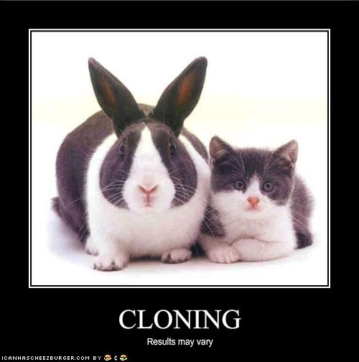
Reliability
Now that we have considered our construct in developing measurements and scales, some issues remain
Even if our measure is well-calibrated, and our constructs are validity, we still need to ensure that our measures do not have other sources of error
Error can best be understood as variability that is not attributable to our construct

Slide 30

Variability
Consider our score example:
  ‘As’ and ‘Bs’ are each composed of 3 scores
  Suppose we want to arrive at a conclusion about ‘A’ and ‘B’ students, we already know that the mean performance differs by virtue of the category (A and B!)
  We must first obtain an average, or mean:
Grade | Score
A | 89
 | 84
 | 80
B | 74
 | 73
 | 72

Slide 31
Variability
Consider our score example:
  ‘As’ and ‘Bs’ are each composed of 3 scores
  Suppose we want to arrive at a conclusion about ‘A’ and ‘B’ students, we already know that the mean performance differs by virtue of the category (A and B!)
  Just by visual inspection, it seems that As are more variable then Bs
Grade | Score | Mean
A | 89 | 84.3
 | 84
 | 80
B | 74 | 73
 | 73
 | 72

Slide 32
Variability
To see how much variability there is in a given group, we simply obtain the difference between the obtained score and the mean
Next lecture, we’ll see how we can use this information to draw inference. For now, let’s consider what this might mean.
Grade | Score – Mean | Deviation Score
A | 89-84.3 | 4.7
 | 84-84.3 | -0.3
 | 80-84.3 | -4.4
B | 74-73 | 1
 | 73-73 | 0
 | 72-73 | -1

Slide 33
Variability
Ideally, we hope that the measures we are using measure the constructs we have initially intended.
Thus, we want to ensure that the differences between these conditions are meaningful and not the results of chance, or error
Grade | Score – Mean | Deviation Score
A | 89-84.3 | 4.7
 | 84-84.3 | -0.3
 | 80-84.3 | -4.4
B | 74-73 | 1
 | 73-73 | 0
 | 72-73 | -1

Slide 34
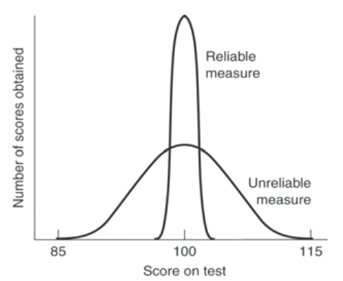
Variance and Reliability
If chance or error creeps into our measure, we will see a greater dispersion of scores around a range
For example, average IQ is 100 so if we take someone with an average IQ, we should find that their scores group around that mean

Slide 35
Variance and Reliability
In general, an obtain measure is determined by two elements:
Measured Score = True Score + Error
  True score is the hypothetical value that we would expect to find when measuring a construct
  Error can arise from numerous sources
Reliable measures have less measurement error associated with them

Slide 36
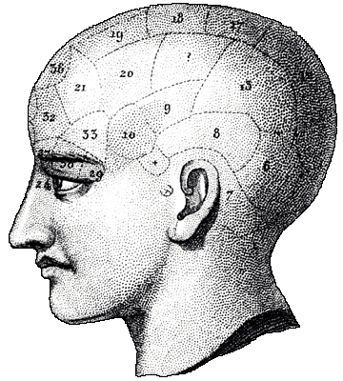
Variance and Reliability
  Importantly, true score need not accurately represent the phenomena
  It is possible to produce a test that is reliable without being valid.
  Phrenology
Validity without reliability is not possible.

Slide 37
Variance and Reliability
Five sources of error:
  Transient States (participant): Unsystematic/unstable, participant-centered factors
    e.g., your mood and alertness
  Stable Attributes or Traits: Systematic/stable, participant-centered factors
    e.g., paranoid, unmotivated, disagreeable, not conscientious
    Some consider this bias rather than error

Slide 38
Variance and Reliability
Five sources of error:
  Situational (environment): Systematic/stable, context-related factors
    e.g., friendly/surly experimenter alter mood, extreme room temperature
  Measurement/Scale: Systematic/stable, test-related factors
    e.g., vague or ambiguous questions, length of test, negative affect : e.g., McGinnies (1949) study

Slide 39
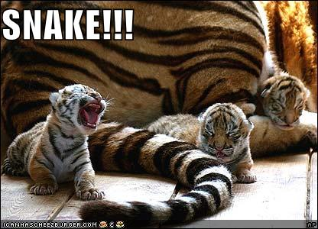
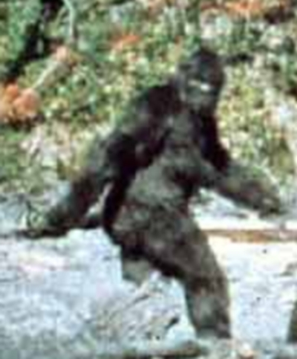
Variance and Reliability
Five sources of error:
  Observer Error (mistakes): Unsystematic, experimenter-related factors
    e.g., mistakes produced from misinterpretation of response by experimenter
    Error implies that this is unintentional. Intentional failure to record measurements properly is referred to as research misconduct

Slide 40
Reliability and Error
Thus, in the absence of error, reliability represents the variability in our measure associated with the characteristic that we wish to study
Reliability then represents the stability or consistency of a measure from one administration of a test to another. This requires identical conditions for the same participant.
  Again, reliability can be broken up into several forms.

Slide 41
Types of Reliability
Sources of error | Example | Assessment
Time sampling | Same test given at two point in time | Test-Retest
Item sampling | Different items used to assess the same attribute | Alternate forms
Internal consistency | Consistency of items within the same test | Split-half / Cronbach’s Alpha
Interrater | Different observers record the same behavior | Adjusted agreement
41
Notes:
Kaplan, R. M. & Saccuzzo, D. P. (1989). Psychological testing, 2nd Edition. Brooks/Cole Publishing Company: California

Slide 42
Reliability and Error
All forms of reliability require that at least two observations are made
One test of reliability is to assess the extent to which measures from one individual, set of items or administration of a test compare to those of another individual, set of items, etc.
Correlation is used
  A measure that describes the degree of relationship between two variables

Slide 43
Variability
Returning to our grades example:
  Imagine that in addition to the first quiz, we administered a second quiz
  Do the values two obtained by each student correspond to one another?
Grade | Q1 | Q2
A | 89 | 87
 | 84 | 86
 | 80 | 82
B | 74 | 76
 | 73 | 72
 | 72 | 74

Slide 44
Reliability of Multiple Observations
If we consider some real data, we can compare the reliability of tests in a course
A strong, positive relationship between average quiz performance and final grade
  My tests are reliable!
  Is my construct valid?

Slide 45
Validity and Reliability: Final Thoughts
Scientists spend a lot of time thinking about reliability and validity:
  Does my measure give me the same results every time (Is the test robust? – Is it easy to replicate my results?)
  I am measuring what I purport to be measuring?
The quality of a scientific theory is directly related to the quality of measurement.

Slide 46
In-Class Experiment
The first ‘in-class’ experiment will be provided next class
Due to the nature of the study (personality test), I will make it available electronically
  Anonymity of responses preserved
  Do not respond randomly... I can tell
Simply use your student number to indicate that you have participated
Again, you have until the deadline (23:59, Friday) to complete it to get your grade

Slide 47
W2L1b Review
Prior to drawing conclusions about what whether our results support a theory, we need to consider their validity
Our measures must also show a considerable degree of consistency from one time to another
A measure can be reliable, but need not be valid
A straightforward means to examine reliability is to examine the correlation between one administration of a test (or ratings by an observer) with another

