Slide 1

The Science of Measurement:
Initial Considerations
Research Methods
PSYC/NEURO2001 Mon and Weds 14:30-17:30
Jordan Schoenherr
Carleton University

Slide 2
PMC & Volunteer Notetakers
PMC student contact coordinator ASAP re. accommodations
The Paul Menton Centre for Students with Disabilities is looking for a Volunteer Notetaker for this class. The criteria for being a Volunteer Notetaker include:
  Attending all assigned classes
  Taking complete and legible notes typing up lecture notes and submitting them electronically within 48-hours after each Class (math & other formula heavy notes can be scanned at the Notetaking Office)
  Maintaining confidentiality
Interested students should email the volunteer notetaking coordinator(volunteer_notetaking@carleton.ca) or stop by the Notetaking Office located in 501 University Centre (Paul Menton Centre).

Slide 3
Week 1 Recap
Science uses multiple modes of knowledge acquisition
We operationalize theories by creating constructs that are tested through hypotheses
Science progresses with (more or less) incremental changes in theories, methods and data (+ social factors, e.g., peer review)
Theories cannot be proven, however, we attempt to falsify theories with data

Slide 4
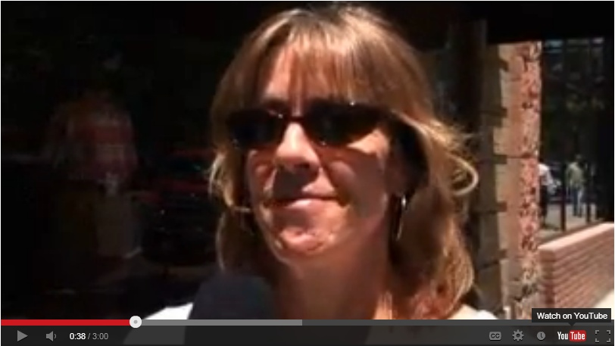
The Power of Disconfirming Evidence
To illustrate how the search for disconfirming can affect people’s beliefs, consider this recent video about lay-beliefs concerning homosexuality: Do you choose to be gay or are you born that way?

Slide 5
Overview of Lecture
Defining Measurement
Precision and Calibration
Scale Development: Two Historical Examples
  Speed of Light
  Confidence / Subjective Awareness

Slide 6
Pre-Lecture Caveat
Today is the day that I offend your sensibilities… with science!
I’ll be showing you dirty words and discussing a quantitative measure of love.
I will warn you in advance.

Slide 7
Measurement Development
“There are two possible outcomes: if the result confirms the hypothesis, then you've made a measurement. If the result is contrary to the hypothesis, then you've made a discovery.”
- Enrico Fermi

Slide 8
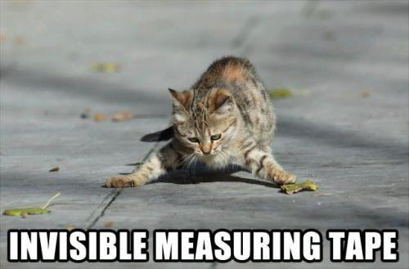
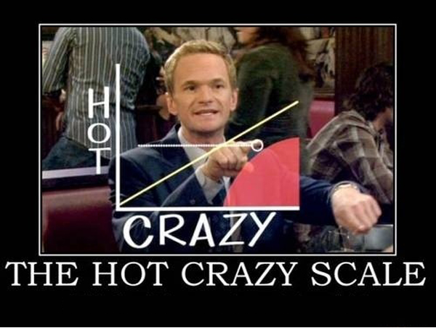
Defining Measurement
When people criticize the techniques of science, much of it centers around assumptions regarding the source of data, i.e., measurement
Measurement: the assignment of numerals to objects or events according to rules (p. 677; Stevens, 1946)
Understanding the theory behind selection of data method is essential
Notes:
Taken from: http://www.buzzlol.com/the-hot-crazy-scale.html

Slide 9
Variables Defined
Independent Variable (IV)
Dependent Variable (DV)

Slide 10
Variables Defined
Independent Variable (IV) | The variable that is manipulated (or controlled) by the researcher. It is independent of the participant and experimental setting.
Dependent Variable (DV) | The variable that is observed for changes to assess the effects of manipulating the independent variable. It is dependent upon the individual and independent variable.

Slide 11
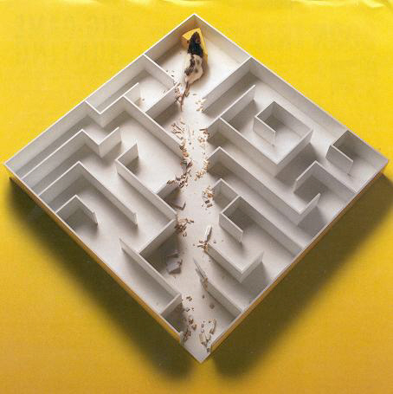
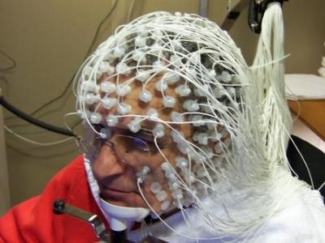
Common Dependent Measures:
Modalities of Measurement
Self-Report and Scale Ratings (e.g., personality, preference scaling): Participants are presented with a series of items thought to be related to a construct. They either respond in a free-form manner or rate items on a scale.
Behavioural Measures (e.g., cognition, social, neuropsychology): Participants provide a response and are assigned a score (in terms of correct or incorrect) or a percentage. The time it takes them to provide the response is recorded.
Physiological Measures (e.g., neuropsychology, cognition): Frequency or strength of a signal in the nervous system or skin (e.g., skin conductance (GSR), fMRI, ‘brain waves’).
Notes:
http://crayfisher.files.wordpress.com/2012/02/ratmaze1.jpg
http://my.braintumorcommunity.org/assets/nbts/blogs_/94/5994/images/posts/171710/EEG_20110830041412_400.jpg

Slide 12
Measurement Considerations
Operationalization (of theoretical constructs). To establish a clear relationship between the theoretical construct and its empirical basis in the operations producing the data.

Slide 13
Measurement Considerations
Operationalization (of theoretical constructs). To establish a clear relationship between the theoretical construct and its measurement.
Measurement is defined as the assignment of numerals to objects or events according to rules (Stevens, 1946, p. 677).
IQ test (WISC III) | Love scale (Rubin, 1970)
Personality test (NEO PI-R) | Confidence Scale

Slide 14
Measurement Considerations
Operationalization (of theoretical constructs). To establish a clear relationship between the theoretical construct and its measurement.
Four important considerations:
  Does the measurement instrument have the potential to measure a given object? (calibration)
  How precise is the measurement? (scale properties)
  How strong is the relation between the measurement and the theoretical construct? (validity)
  How consistent is the measurement? (reliability)

Slide 15
Measurement Considerations
Calibration refers to the process of determining the relation between the output of a measuring instrument and the value of the input
  A measure that is well calibrated, means that there is correspondence between what is being measured and the method of measurement
Can the measurement technique (or instrument) measure what it is designed to measure?
  Precision (e.g., coarse v. fine-grained measurement)
  Range (e.g., limited to visible light spectrum)

Slide 16

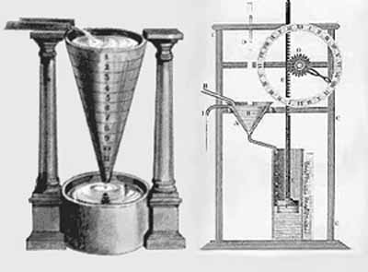
Developing a Measure of
the Speed of Light
Light was thought to travel instantaneously from one point in space to another – ‘Speed of Light’ introduced
Galileo (1667) was the first scholar who attempted to measure the speed of light.
  Galileo with the aid of an assistant used lanterns atop hills
  Once Galileo flashed his lamps, the assistant was to do the same
  Galileo measured time (with a water clock) and suggested that light travelled nearly instantaneously: 10 x speed of sound
Notes:
http://www.colorado.edu/physics/2000/waves_particles/lightspeed_evidence.html

Slide 17
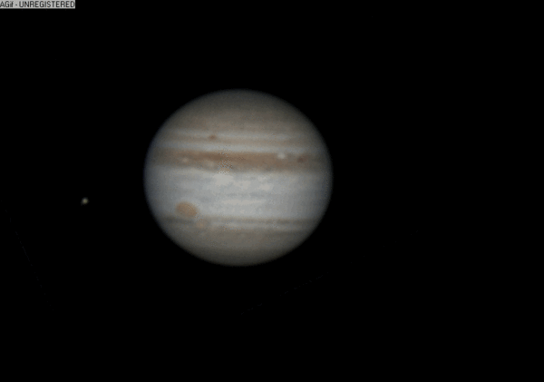
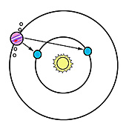
Developing a Measure of
the Speed of Light
Roemer (1670’s) observed that, depending on the distance of the Earth from Jupiter, the orbit of its moons either seemed to decelerate or accelerate
Using deductive reasoning, Roemer suggested that the change was a function of the time it took for the light to travel from Jupiter’s moons to the Earth
‘Slower’ rotation
‘Faster’ rotation
220, 000 km/s
Notes:
http://aapod.astronomy.fm/2010-10-02_Jupiter-GIF-Rotation-with-Great-Red-Spot-and-Europa-moon!.html

Slide 18
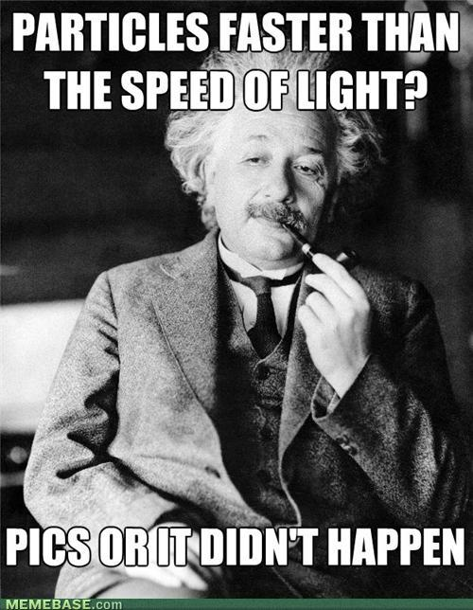
The Speed of Light: Later Developments
Later developments used different measurement tools
  e.g., Hippolyte Louis Fizeau (1849): wheel rotated, light bounced off mirror, measured speed at which light was not reflected back (i.e., the wheel was spinning too fast for light to pass through)
Modern techniques involve measuring lazer, radiowaves, etc. in a vacuum.
Speed of Light has been used as the ‘gold standard’... That’s changing

Slide 19
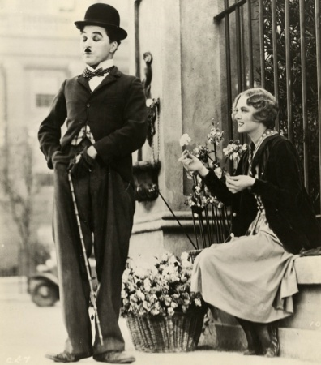
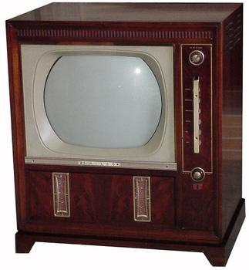
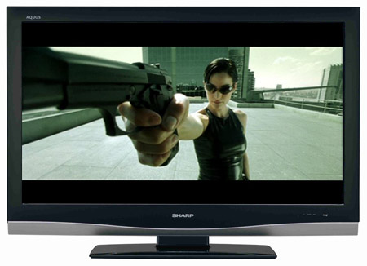
‘Moving Pictures’ Analogy of
Precision of Measurement
An analogy can be drawn with the advent of ‘moving pictures’.
Initially, we start off with low-fidelity representations such as cave drawings, illustrations, etc.
As technology improves, we begin to use pictures that move that more closely approximate reality.
Each method of presenting pictures increases in its precision.
Notes:
http://images.sodahead.com/polls/002136453/943888542_Philco_tv123_xlarge.jpeg
http://blurayguide.org/wp-content/uploads/2008/03/hdtv.jpg

Slide 20
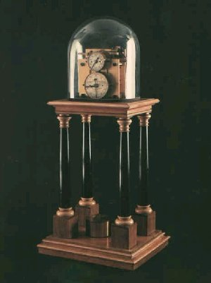
Mental Speed and the Chronoscope
Psychology was affected by the same process in the development of measure of ‘mental speed’ or reaction time;
Initially developed to determine the velocity of projectiles (Wheatstone), the chronoscope was later used to measure the time taken for participants to respond to an event or perform a task.

Slide 21
From Methods to Theory
We can view the chronoscope within the framework of paradigm change (i.e., Laudan),
  Chronoscope represents a new method,
  Mental speed can now be recorded with greater fidelity allowing for the detection of shorter events giving rise to a new source of evidence,
  Later researchers would use these observations to infer unconscious processes and automaticity changing theories in cognitive psychology

Slide 22
Developing a Measure of Subjective Awareness
“A man's thinking goes on within his consciousness in a seclusion in comparison with which any physical seclusion is an exhibition to public view.”
- Ludwig Wittgenstein

Slide 23
Measuring Awareness
The concept of consciousness, or subjective awareness, has long been of interest to people
Quantifying this phenomena has turned out to be notoriously difficult
Historically, a shift from intuitions about consciousness
  Information available (objective measures), or
  Correspondence of these measures with a participant’s feelings (subjective measures)

Slide 24
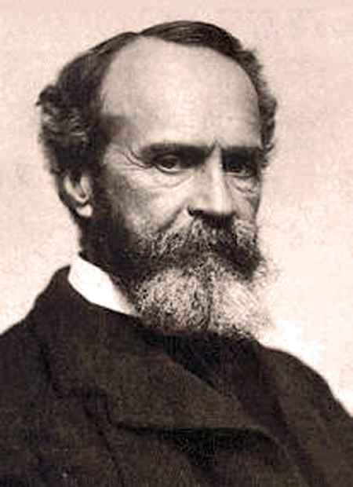
Introspection:
A Failed Subjective Measure?
Introspection was one of the first methods used to assess mental operations
Consider James (1890):
“Introspective Observation is what we have to rely on first and foremost and always… Every one agrees that we there discover states of consciousness… I regard this belief as the most fundamental of all the postulates of Psychology, and shall discard all curious inquiries about its certainty as too metaphysical,” (p.185)
    William James

Slide 25
Dreams of the Objective:
McGinnies (1949)
McGinnies (1949) wanted to examine the factors affecting perception of stimuli
  Specifically, he noted that there appear to be perceptual filters (i.e., defensive mechanisms)
  Argument based on stimulus threshold
    the intensity of the stimulus required for our detection of it within the environment
  We might have a higher threshold for aversive stimuli, i.e., we need to present the stimuli for a longer duration for the participant to detect it

Slide 26
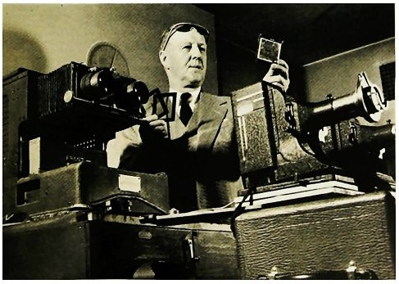
McGinnies (1949): Stimuli
What stimuli could McGinnies use?
How should we present the stimuli?
What differences would you expect to find in one condition relative to another?
Neutral | Emotional
Apple Broom Child Sleep | Kotex Belly Penis Bitch
Participants provided with 11 neutral and 9 critical/emotional words
Tachistoscope used
GSR and exposure time required
Notes:
http://www.enter.net/~torve/critics/Renshaw/rengraph/tachistoscope.jpg

Slide 27
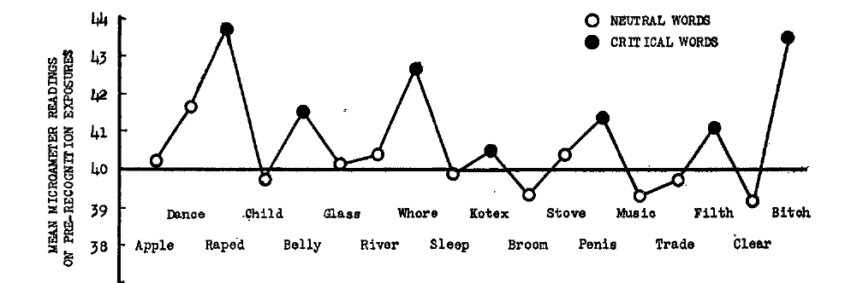
McGinnies (1949): Results
In terms of GSR, we find that participants demonstrated STRONGER reactions to critical words relative to neutral words
  Some process was perceiving the words to produce this response

Slide 28
McGinnies (1949): Results
Important!
  What do we notice about the critical words and neutral words, respectively?
  There is variability in both the critical and neutral words
  Multiple words are necessary to ensure that we reduce any measurement error of a phenomena resulting from the use of a particular stimulus, also referred to as a replication

Slide 29
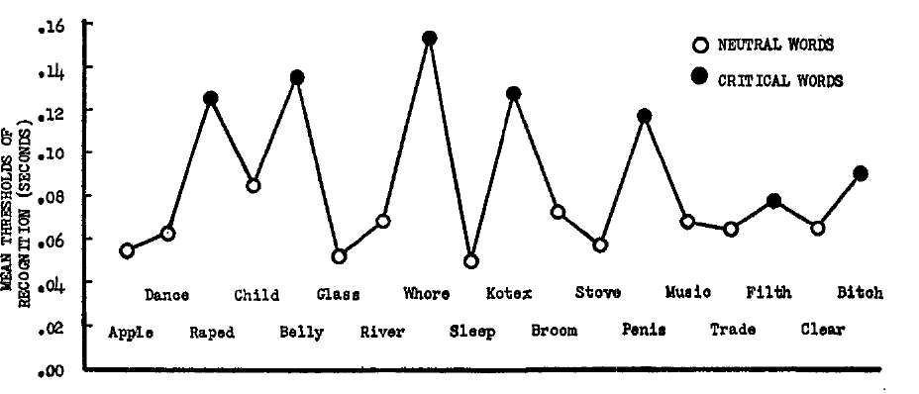
McGinnies (1949): Results
Moreover, the amount of exposure time to the stimuli was longer for critical words than for neutral words
  Converging evidence for the effect of words

Slide 30
McGinnies (1949): Conclusions
Even before publishing his results, alternative explanations were proposed
  Critical words are less frequent in our native language
  Demand characteristics
McGinnies (1949) concludes that:
  “Perceptual defense apparently is based upon conditioned avoidance of unpleasant or dangerous stimulus objects. That the individual actually discriminates the stimulus before he fully perceives it is evident in his increased emotionality before recognition.” (p. 250)

Slide 31
Storage of Words in Memory
Frequency Effects: With a greater number of exposures to a stimuli, stronger associations in memory (e.g., my car v. neighbours car)
  High-frequency are more rapidly identified than low-frequency words (e.g., Howes & Solomon, 1951)
  The process is thought to arise from having more memory traces of a given stimulus available for retrieval

Slide 32
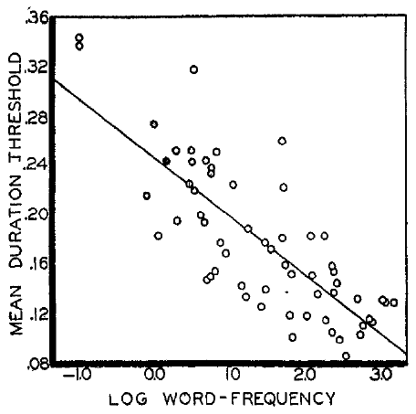
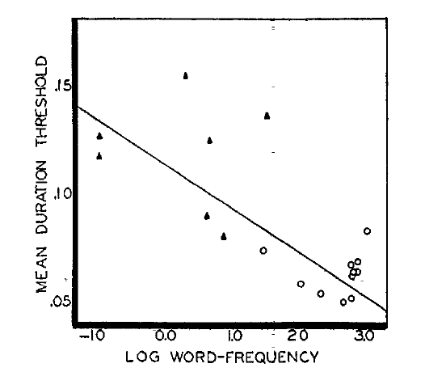
Additional Evidence
Howes and Solomon (1950) conducted a follow up study to examine how the words used by McGinnies compared to other words
  WF Effect observed in terms of a negative correlation
Triangles represent emotional/critical words, circles represent neutral words

Slide 33
Post-Scriptum: Unconscious Processing
Howes and Solomon (1950) demonstrated that participants response could be explained by alternate, more general, mechanisms
McGinnies (1950) still claimed that there was a qualitative differences between types of words
Zajonc (1962) examined whether responses were determined by the stimulus or the mode of response
  Used paired associates, e.g., Taboo-Neutral, Taboo-Taboo
  Participants response threshold was now dependent on the word used to respond

Slide 34
Post-Scriptum: Unconscious Processing
Shanks and St John (1994) note that the target task and the method used to provide a subjective report should tap the same set of mental operations
When verbal reports are used during the post-test phase they may not tap the same knowledge that was used to complete a task (Cleereman et al., 1998)
Verbal reports might not be an effective means to assess unconscious learning and awareness as they force people to verbalize knowledge
  e.g., riding a bike, catching a ball

Slide 35


Emergence of Subjective Awareness
Along with attempts to obtain ‘objective measures’ of performance, and after the demise of introspection, researchers still sought a means to use subjective reports
Confidence reports have been used throughout the history of experimental psychology
  Understanding mental operations
  Eye witness testimony
  Awareness of Knowledge
Recurrent issue is that people ignore the scale that confidence is reported on
Notes:
http://testsuccesscoach.com/wp-content/uploads/BubbleSheet1.jpg
http://i.ytimg.com/vi/OvOCUaDqgo4/0.jpg

Slide 36
Early Methods
Pierce and Jastrow (1884) wanted to assess confidence in a decision, i.e., subjective awareness of a response event
  Confidence assessed on a 4-point scale
    0 “it seemed nonsensical to answer at all.”
    1 “a distinct leaning to one alternative.”
    2 “some little confidence of being right.”
    3 “as strong a confidence as one would have about such sensations.”

Slide 37
Emergence of Subjective Awareness
Some common scales:
  1-5 Scales (e.g., Vickers & Packer, 1982),
  50-100 Scales (e.g., Lichtenstein & Fischhoff, 1977),
  0-100 Scales (e.g., Gigerenzer, Hoffrage, Kleinbolting, 1991; Balakrishnan & Ratcliff, 1996).
Note that scales vary along three dimensions:
  The number of categories used
  The range of values
  The interval (a function of range and number of categories)

Slide 38
Emergence of Subjective Awareness
Recall our notion of calibration
What pattern would we expect to see if participants were perfectly calibrated?
e.g., what would if we were 70% (i.e., p = 0.7) accurate in accurate in a given condition, how confident should we be?

Slide 39
Emergence of Subjective Awareness
Now, what pattern would we expect to see if participants were perfectly miscalibrated?
i.e., if participants confidence reports do not correspond to their accuracy

Slide 40
Emergence of Subjective Awareness
Calibration need not always be perfect for a measure to be effective
Systematic deviations can be used to infer underlying properties
  Overconfidence:
    Conf > Acc
  Underconfidence
    Acc > Conf

Slide 41
Emergence of Subjective Awareness
One assumption of confidence processing, like introspection, is that we could effortlessly obtain our level of awareness
  More importantly, this has lead researchers to believe that any scale can be used to report confidence
People have tried to infer what patterns of over/underconfidence ‘mean’,
  e.g., underconfidence suggest unconscious knowledge (e.g., Dawes, 1980; Ziori & Dienes, 2008)
  Before we jump to conclusions as to what overconfidence or underconfidence mean, we need to ensure that our scale allows us to draw meaningful conclusions

Slide 42
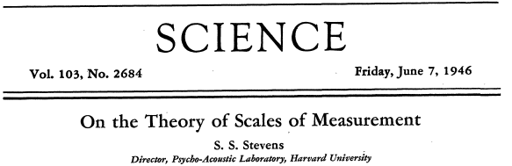
Scale Typology
Remember…
  Measurement: is defined as the assignment of numerals to objects or events according to rules (p. 677; Stevens, 1946)
There are different kinds of measurement available to us
  Steven’s developed a typology to classify ways of assigning numerals to people or events

Slide 43
Stevens’ (1946) Scale Typology
Nominal: People, events or objects assigned a numeral.
Ordinal: People, events or objects assigned a numeral on the basis of some ordering principle (e.g., arriving in a room, birth order, position in a race).
Interval: People, events or objects assigned a numeral on the basis of some ordering principle. The distance between each numeral is equivalent (e.g., temperature, sea level).
Ratio: People, events or objects assigned a numeral on the basis of some ordering principle. The distance between each numeral is equivalent. Zero has an absolute meaning (e.g., length, time).

Slide 44
Loss of Precision
Depending on the range of values and number of categories used, we can lose information
For example, if a student obtains a score on a test (e.g., 89.5%), but then she receive a letter grade (A) a portion of the available information is lost by compressing values in a range into a single category (A = 80-90%).
  Ratio Scale →→Interval Scale
Information lose can have a detrimental effect on our ability to draw conclusions from our data
Grade | Score
A | 89
 | 84
 | 80
B | 75
 | 73
 | 72

Slide 45
Scaling Subjective Awareness
In a recent study I conducted, we manipulated the range and number of categories
  Guessing-Certainty scale (50-100)
  Error-Certainty scale (0-100)
  Two other scales were used where participants used just the end points (50 and 100; 0 and 100)
Simple perceptual task used

Slide 46
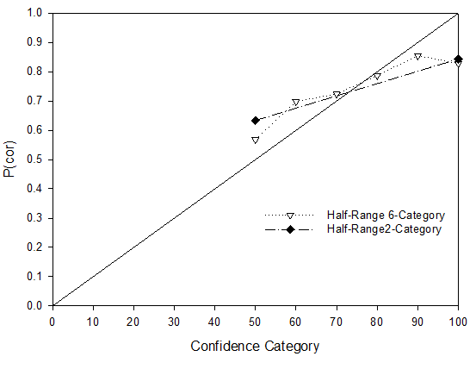
Scaling Subjective Awareness
First, we replicate earlier results:
  Participants demonstrated a reasonable degree of calibration
  Using either the full scale, or end-points, produced similar levels of calibration

Slide 47
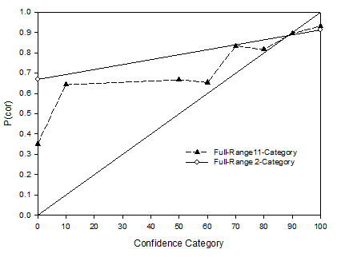
Scaling Subjective Awareness
Second, we find that participants exhibit less calibration when using the Error-Certainty scale (0-100)
Results indicated that using the Guessing-Certainty scale (50-100) produced the best results
Thus, if we’re trying to study a phenomena we need to ensure that we use an appropriate scale

Slide 48
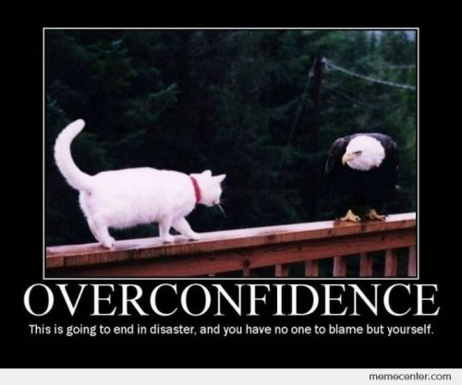
Subjective Awareness:
Final Considerations
Although we might obtained perfect calibration, this still leaves open the question of whether our construct (confidence) is actual measuring the phenomena.
Thus, we’re still left with the question of whether our measure is ‘valid’.

Slide 49
Misuse of Constructs
“All intelligent thoughts have already been thought; what is necessary is only to try to think them again.”
- Johann Wolfgang von Goethe
Notes:
!!!BREAK!!!

Slide 50
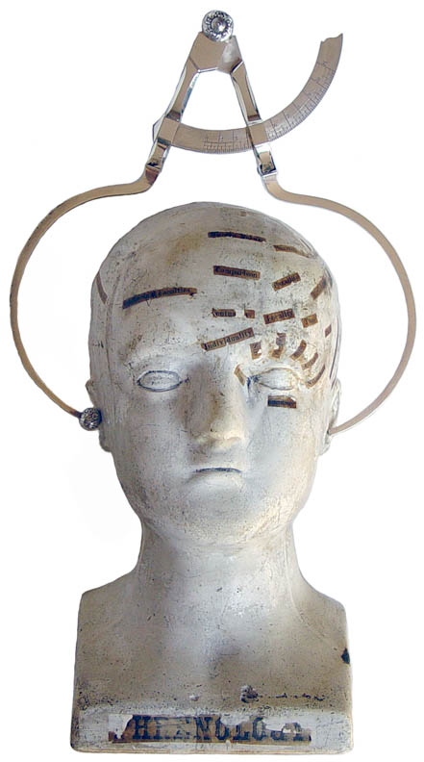
History of Intelligence Testing
Galton was the first to assess the intellect using 9,000 subjects
Like phrenology, he believed head size was related to intelligence
  Since women were generally smaller, they had smaller heads and were therefore less intelligent
How can we measure something like intelligence?
Notes:
http://antiquescientifica.com/phrenology_calipers_George_Combe_on_Wells_bust.jpg

Slide 51
History of Intelligence Testing
The Binet-Simon test:
  Alfred Binet and Theodore Simon defined intelligence as:
    Fundamental faculty important for practical life
    Faculty is judgment (good sense), practical sense, initiative, and adapting oneself to circumstances
    The ability to judge, comprehend, and reason well

Slide 52

Binet-Simon Test
Initial motivation for the study of intelligence was to assess normal and subnormal children
Test was developed to study attention, memory and verbal skills
Binet's initial assumption was that intelligence increased with age

Slide 53
Binet-Simon Test
Difficulty level increased with progressively higher items
Thus, older children should be capable of answering progressively more question from higher list positions
Norms were used to compare other children
AGE | ITEM
3 | Give family name
4 | Repeat three numbers
5 | Compare two weights
... | ...
9 | Name months of the year in order
10 | Criticize absurd statement
12 | Describe abstract words
15 | Give three rhymes for a word
Adult | Give three differences between a president and a king

Slide 54
Stanford-Binet Test
Gould (1981) notes that the translation of the test from French to English, brought with it a cost. Namely, violations of Binet core assumptions.
Binet asserted that:
  Scores were a pragmatic tool – not a universal standard
  Scale was meant to guide the identification of subnormal children, not a means to rank normal children
  Low scores should be used to localize what areas needs to attend to, not to identify children as incapable

Slide 55
Take Home Message
All experiments hinge on the precision of the measures used
The greater the precision, or calibration, the more likely it is that we can adequately measure our constructs
Considerations of range of attitudes, moods, and stimuli characteristics will ultimately dictate what measurement we adopt

Slide 56
W2L1a Review
Constructs need to be operationalized
Precision of a measurement scale is directly related to the conclusions one can draw: calibration
Constructs can be operationalized in numerous ways (e.g., objective or subjective measures)

