Slide 1

Theory, Theory Change, and the Emergence of Psychological Science
Research Methods
PSYC2001/NEURO2001 Mon/Weds 14:30-17:30
Jordan Schoenherr
Carleton University

Slide 2
Overview of Lecture
Can we Prove a Theory?
Theory Change and Scientific Progress
From Pseudo-science to Psychology

Slide 3
Proving Theories
"Science is facts; just as houses are made of stones, so is science made of facts; but a pile of stones is not a house and a collection of facts is not necessarily science.”
- Henri Poincaré

Slide 4
Theories and the Problem of Proof
As we noted earlier, theories can only be tested indirectly through hypotheses.
Thus, we speak of evidence providing support for or confirmation of a theory.
To illustrate why a theory cannot be proven, we need to consider logic.

Slide 5
Theories and the Problem of Proof
Consider a scenario in which we want to test a Theory:
  Theory A: Psychopaths are responsible for violent behaviour in our society.
To do this, we derive a hypothesis through deductive reasoning:
  Hypothesis A: In a prison population, we should find a greater instance of psychopathy in violent offenders.

Slide 6
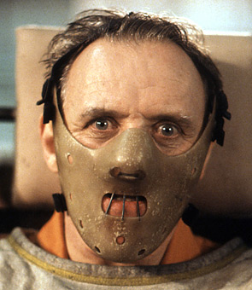


Theories and the Problem of Proof
Now, imagine that we conduct a study that obtains the following significant results:
  Average psychopath rating for violent offenders: 7.8/10;
  Average rating within the general population: 4.4/10.
What have we ‘proven’?
Notes:
http://images.hollywood.com/site/hanniballecter.jpg
http://unrealitymag.com/wp-content/uploads/2008/11/joker-wizard.jpg
http://www.sho.com/sho/dexter/home

Slide 7
Theories and the Problem of Proof
Consider our previous example, the Wason Selection Task can be re-written:
  If the card has a vowel on one side, then it will have an even number on the other side.
    We needed to select the card with a vowel (‘E’) on it to ensure that there was an even number of the other side, thereby confirming the rule.
    We needed to select the odd number (‘7’) on it to ensure that there wasn’t a vowel on the other side – such a finding would disconfirm our rule.

Slide 8
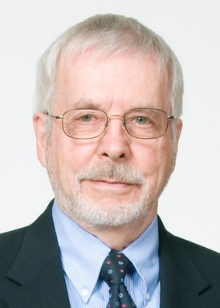
Theories and the Problem of Proof
Returning to our violent offender example, we can reframe our hypothesis as a logical rule:
  If someone is a psychopath then they will commit more violent crimes.
  Our finding re. violent offenders provides some confirmatory evidence
  BUT those that commit violent crimes, need not always be psychopaths (i.e., in terms of formal logic, it doesn’t necessarily follow that all violent crimes are committed by psychopaths; see also Hare, 1999).
Robert Hare
(not a psychopath)

Slide 9
Theories and the Problem of Proof
Notice though that if I find out that Hypothesis A is not supported but that it must follow from my theory, then I have grounds to reject Theory A.
The problem with this is that I could obtain evidence by chance that disconfirms my theory
  e.g., my sample population contains people that are high in psychopathy but also have considerable executive function to control their violent behaviour.
Thus, scientists are disinclined to reject a theory simply because a single (or few) experiments provide evidence to the contrary.

Slide 10
Theory Change in Science:
Changing Your Mind and
Changing Your Theory
"The man of science has learned to believe in justification, not by faith, but by verification.”
- Thomas Huxley

Slide 11
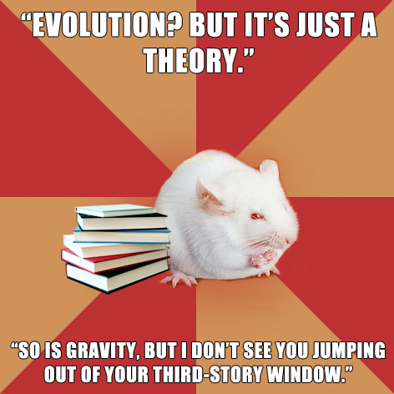
Theory and Theory Change
As we noted last class, there are significant differences between naïve theories and scientific theories.
However, scientific theories like naïve theories are subject to change and revision.
How these changes occur have important implications for the reliability of the products of science.

Slide 12
Roles of the Scientist in
Theory Change
Scientific Community
Individual
No experiment or theory is definitive.
Once theories and results have been communicated, we open the door to an extend network of researchers.
As other scientists digest information, they provide feedback and perform their own research.

Slide 13
Change in a Scientific Paradigm
Some have argued that ‘scientific progress’ does not really occur.
Kuhn (1962), among others, claims that rather than one theory replacing another, social factors are a main factor that dictates scientific change.
    Influence of Authority > Influence of Empirical ‘facts’
Incommensurability: two theories cannot be understood in each other’s terms and there is no principled way of mapping the constructs from one theory to another.

Slide 14
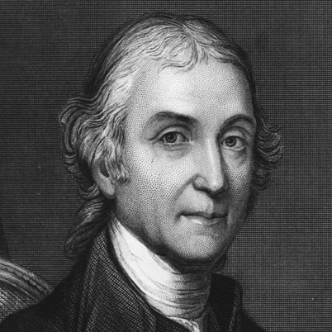
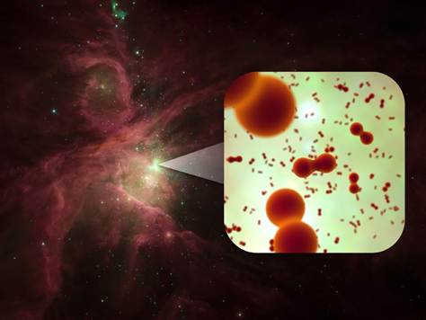
Change in a Scientific Paradigm
Phlogiston (Becher, 1667) versus oxygen (Scheele, 1772)
  Oxidation (rusting and combustion) was first thought to be caused by a mysterious substance stored within matter. When a substance was burned, matter was thought to release this substance, creating flames.
Incommensurability, if substantiated, could undermine the whole enterprise of science:
  We need to account for changes in a principled manner
Notes:
http://gamesofchance.files.wordpress.com/2012/02/priestly.jpg?w=402

Slide 15
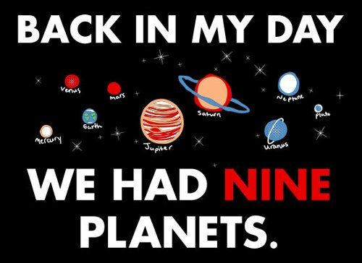

Theory Change
Most changes, when examined, represent numerous small steps:
  e.g., Pluto no longer classified as a planet resulting the definition of planet
  N.B., Pluto is still there!
Imagine someone from outside of this era who doesn’t have full access to the concepts and change.
  Pluto was a planet… and then it wasn’t! Now that’s a load of incommensurability.
Notes:
http://www.snorgtees.com/back-in-my-day-we-had-nine-planets
http://www.snorgtees.com/it-s-okay-pluto

Slide 16
Change in a Scientific Paradigm
Laudan (1984) proposed a solution.
If we ‘zoom in’ on paradigm change, we see developments in the:
  methods used;
  what is considered evidence/data; and,
  theory used to link and explain .
Method
Theory
Data

Slide 17
Psychological Sciences
“[T]he steepest obstacle to theory
construction in psychology is not the complexity of behavior. It is the mountain
of stereotypes deposited by centuries of prescientific attempts to comprehend
behavior and capped by the pronouncements of the academicians who
have always known in advance, apparently by divine inspiration, exactly what
kind of theory is possible and proper for psychology.”
William K. Estes

Slide 18
Precursors of Psychology
Like any discipline, Psychology did not emerge ex nihilo, rather it represented a synthesis of multiple disciplines:
Philosophy - e.g., Epistemology.
Physiology & Physics – e.g., neural anatomy and function, nerve conductance.
Clinical studies – e.g., unconscious ‘desires’ such as libido.

Slide 19
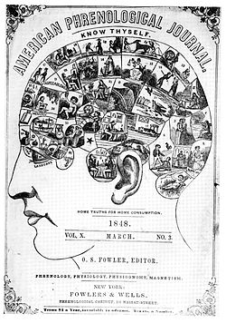
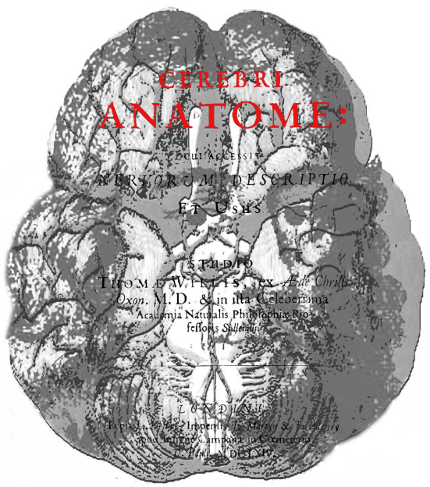
Psychological Change:
Brain Science
Change is a part of the psychological science
  Philosophers proposed a dualism: mind-body are distinct
  Early brain sciences looked at conductance along nerve fibers as ‘animal spirits’
  Later theoretical approaches found these spirits were related to electrical impulses
Evidence (electrical impulses), method (electrical stimulation) had to be brought together in a relationship with theory (brain is a set of specialized cells).

Slide 20
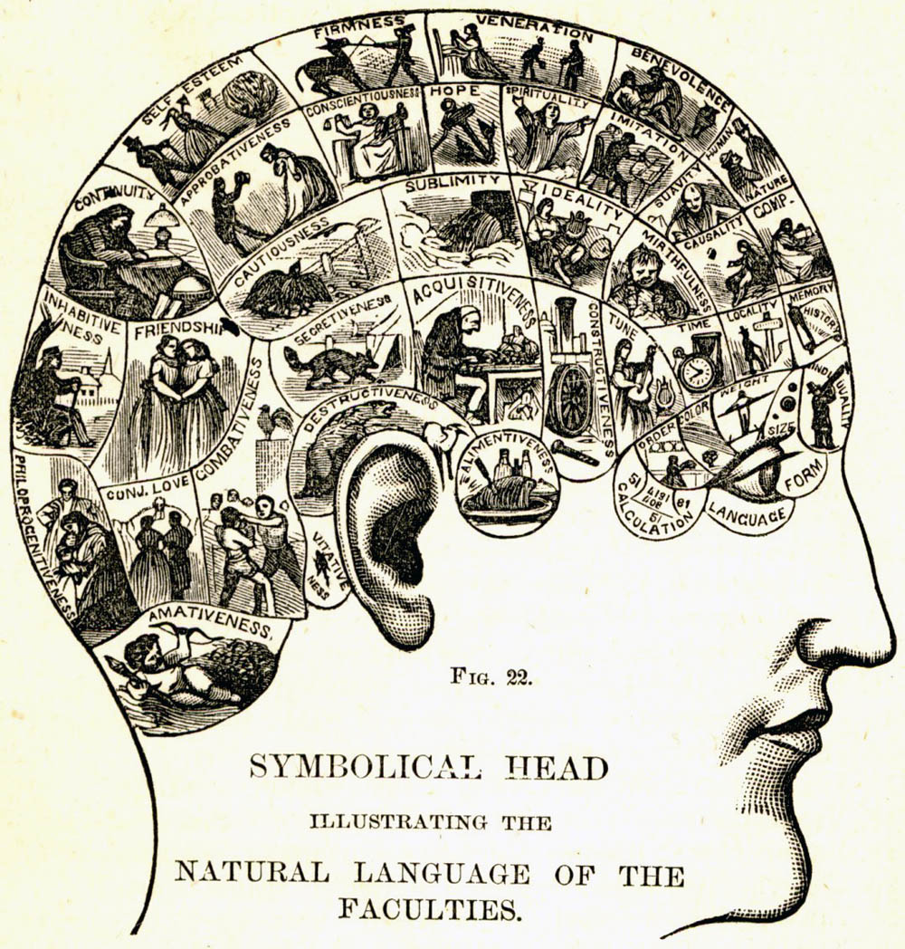
Phrenology and a Science of the Brain
Although often caricaturized as comedic, Phrenology was the first to offer the theory of localized function (e.g., Fodor, 1983).
  Regions of the brain performed particular activities
  Destruction of a given area reduced or eliminated function
  Individuals are defined on the basis of the activities of numerous regions

Slide 21
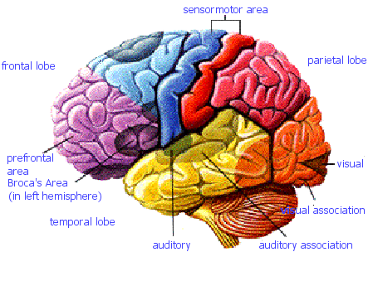
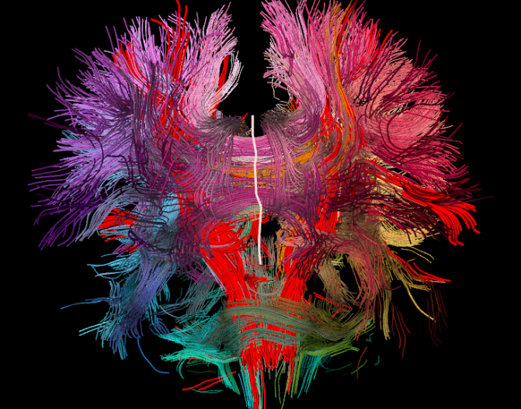
Failure of Phrenology and the Local Account
Phrenology, of course, failed in that it postulated that the skull reflected the extent to which each function was developed.
  Larger bumps = more developed faculty
Regions were not as well-defined as Phrenology believed (and not in the same way).
More generally, the intensely local account of brain function also appears to be incorrect:
  Processes are distributed as well as plastic
Notes:
http://www.mrc-cbu.cam.ac.uk/people/jessica.grahn/brain_lobes.gif
http://news.brown.edu/files/article_images/2D%20neural%20map%20image-cropped.jpg

Slide 22
Phrenology | Cognitive Science
Theory: The brain is the source of thought and behaviour; discrete regions have specialized to perform tasks (localized); Method: Measure skull topography; Data (Hypothesis): The size of a region of the brain will be proportional to the behavioural or personality attribute. | Theory: The brain is the source of thought and behaviour; function is distributed; neurons are connected to perform functions; Method: Measure activity levels (electrochemical); map neural pathway; Data (Hypothesis): Neural pathways will suggests which areas are connected to produce function; activity levels should be greater in regions that perform a task.

Slide 23
Multiple Theories or Levels of Function?
Neurons | Neurons small information processors; use input and output; function can be highly plastic
IP & Affective Systems | Systems perform specific function efficiently; some are innate while others can be learned
Cognitive Functions & Personality | Numerous systems function together to give rise to attention, memory, and decision-making
Social Cognition and Behaviour | Well-learned behaviours, predispositions as they relate to our interaction with others
Human Behaviour

Slide 24
The Remainder of the Course
In terms of Laudan’s (1984) taxonomy, we can consider theory, data and methods in the context of psychological science:
  Theory – Primarily covered in the respective courses. We will make references to theory on an ad hoc basis, taken from various research areas as necessary. We will discuss the overall assumptions of what dependent variables mean, e.g., survey responses, accuracy, response time.
  Data – Again, something that is best understood in the context of each research area. We will examine how data is collected, analyzed, and presented.

Slide 25
Precursors of Psychology
Methods – Focus of the course. Although specific materials will be discussed to contextual specific methods.
We will also consider the ethical implications of the methods we used and the best practices in psychology.

Slide 26
Quiz

Slide 27
Content
All materials covered this week: lecture, slides and textbook.
Questions will cover:
  Definitions,
  Application of a concept,
  Graph Interpretation.
Dates will not be examined, per se. When referring to an author, I will provide their name, the date of the relevant publication and some context.

Slide 28
Duration
Released Friday, 17:00 and closed next Friday 16:59
60 min for completion (6 min. / question)
10 questions, randomly sampled from a pool

Slide 29
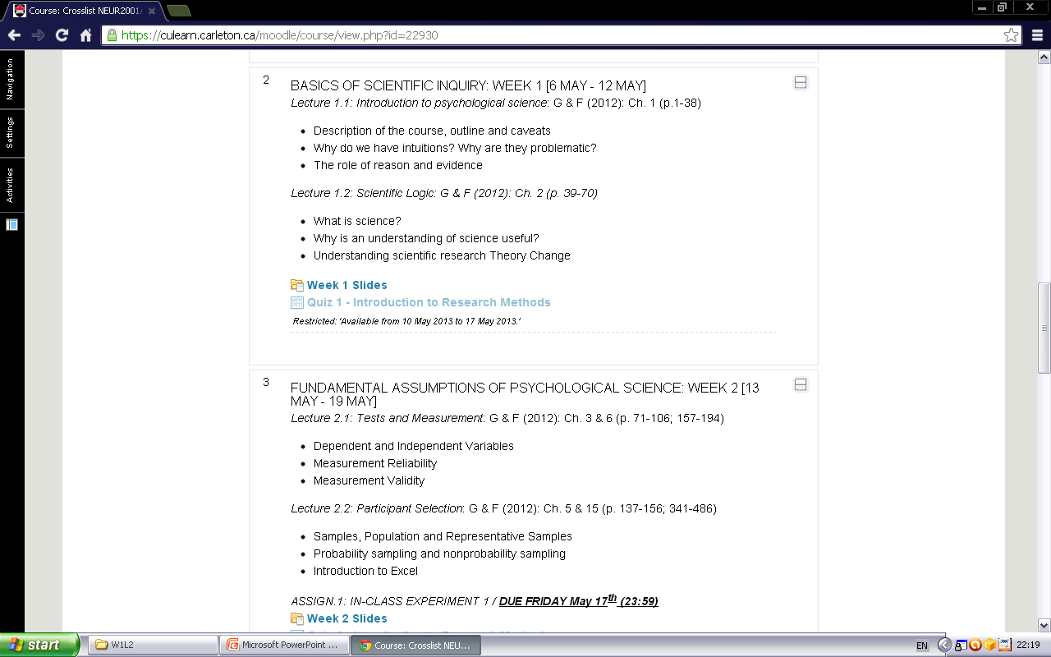
Once ‘active’ click on link and you will be redirected to the quiz.
This is the answer legend for your questions.

Slide 30
Duration
In general, to successfully complete the quiz, you will need to memorize the material and be able to abstract away from it.
Be prepared to interpret some graphs and answer questions about conjoint dependent measures (e.g., speed-accuracy trade-off).
  If you are having a hard time understanding the question, try making a table as I have in my slides.
Remember, although the average time for each question is 6 min, make sure to allocate more time for more difficult problems and less time to questions that use definitions.
Since you have a week to take the quiz, you don’t need to start it on Friday. Make sure you are comfortable with the material. Look over the questions that follow each lecture.

Slide 31
W1L2b Review
Science theories cannot be proven, only disproven. The weight of evidence must determine the acceptance or rejection of a theory given that a single experiment cannot disprove a theory.
Theory change is subject to social factors outside ‘objective’ truth claims but these rarely dictate theory change by themselves.
Psychological science emerges from different fields which considered aspects of the physiology and mental states.

