Slide 1

Scientific Methods:
Bringing it All Together
Research Methods
PSYC2001/NEURO2001 Mon/Weds 14:30-17:30
Jordan Schoenherr
Carleton University

Slide 2
Announcements
TAs are posted.
Link to survey: https://www.toofast.ca/takesurvey.php?SurveyID=6862
At the end of class, I will provide some basic information about the first quiz.

Slide 3
Overview of Lecture
Science Method
Scientific Research Process
Conducting a Literature Review
Science at a distance

Slide 4
What is Science?
“No amount of experimentation can ever prove me right; a single experiment can prove me wrong.”
- Albert Einstein

Slide 5
Scientific Research Process
The ‘methods’ for acquiring knowledge outlined in the last lecture (e.g., intuition and reason) are not rejected in favour of a scientific method.
Rather, science is the attempt to judiciously apply the methods at are disposal to obtain reliable knowledge about the world.
  Science represents the coordination of these activities
Science is a process.

Slide 6
Our Naïve Understanding of the World
A tentative definition:
  the goal of science is the explicit, formalized development of accurate theories and models of our world through rational and empirical methods.
What is the scientific method?
  How is it implemented in the context of psychology?

Slide 7
Scientific Research Process
5. Analyze the data
6. Interpret the data
7. Communicate the results
4. Conduct the experiment
1. Develop a research question
2. Embed the question in a theoretical context
3. Design the experiment

Slide 8
1. Developing a Research Question
Sources are multiple (intuition, observation, specific problems), but mostly, researchers pursue a program of research:
A set of highly interrelated questions in a specific area of knowledge.
Researchers:
  develop and refine methodological techniques
  gather empirical data
  evaluate theories
“Scientific revolutions” (Kuhn, 1962) are rare.

Slide 9
1. Developing a Research Question
External World
When considering where ideas come from, we can identify several sources:
  Sense information: Our experience with the world, (ideally) undifferentiated
  Prior knowledge: The regularities one observes in the world and derived rules
  Other’s knowledge: The experiences (sense or knowledge) of others
Empirical, rational, and authority.
Sense Information
Prior Knowledge / Expertise
Other’s Knowledge

Slide 10
2. Developing a Research Question
Theory: It is a set of logically organized constructs that serve to explain and predict empirical phenomena.
Construct: A scientific concept that is meaningful because it is part of a theoretical network.
Operationalization (of theoretical constructs): To establish a clear relationship between the theoretical construct and its empirical basis in the operations producing the data (Marx, 1963, p. 12).

Slide 11
2. Developing a Research Question
In science, questions are answered by posing hypotheses.
Hypothesis: A provisional explanatory proposition which makes certain definite predictions concerning empirical data (Marx, 1963, p. 7).

Slide 12
2. Inductive and Deductive Reasoning
INDUCTION
DEDUCTION
General
Specific
Specific
General
Environment

Slide 13
2. Inference in Theory Development
Inferential reasoning
Theory
Deduction
Induction
Data
An inference that draws a conclusion about a specific event on the basis of a general concept.
The conclusion necessarily follows if the structure of the argument is sound and if the premises are true.

Slide 14
2. Inference in Theory Development
Inferential reasoning
Theory
Deduction
Induction
Data
An inference that builds a general explanation about a phenomenon based on a subset of observations.
The strength of the induction is proportional to that of the evidence.

Slide 15
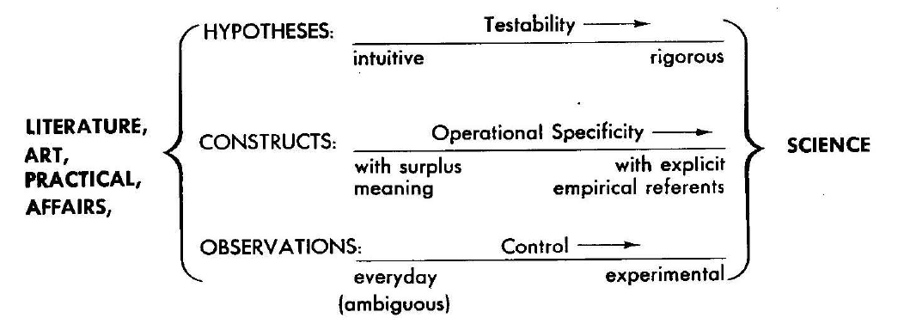
2. Inference in Theory Development
Thus, explaining Marx (1963), we see that the continued use of an inferential process permits us to refine our hypotheses, constructs, and observations.

Slide 16
2. Relationship between Theory and Data
Marx (1963) suggests that the relationship between theory and data can take one of four forms.
Model | Deductive theory | Functional theory | Inductive theory
Data | Data | Data | Data

Slide 17
2. ‘Pure’ versus Applied Research
As we’ve just noted, science prioritizes the use of controlled experiments to obtain results.
A standing debate concerns whether pure or applied research produces better results.
People often consider applied research to be superior to pure research as it has greater ecological validity.
  Ecological validity: The context, materials and methods used in research closely approximate the conditions in which we would normally observe a phenomena (i.e., ‘the real world’)

Slide 18
2. ‘Pure’ versus Applied Research
Applied research certainly yields a considerable amount of data but there are drawbacks.
As Garner (1950) notes, applied research
  “…is more time consuming, far more expensive, and frequently cannot control experimental factors, so that as a practical matter it is very difficult to do [applied research] which has a high degree of generality of prediction" (p. 2).

Slide 19
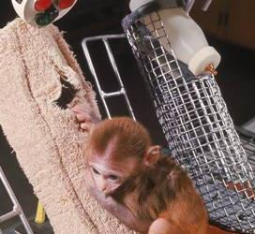
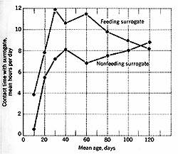
2. ‘Pure’ versus Applied Research
Consider a classic, controlled experiment: Harlow (1970)
  Monkeys were separated from their mothers for a number of days and presented with a cloth ‘mother’ warmed by a lightbulb or a wire ‘mother’ with food.
Baby monkey is unlikely to be presented with this scenario:
  Walls, wire mother, light bulb warmth, etc.

Slide 20
2. ‘Pure’ versus Applied Research
As Mook (1983) notes:
  “the purpose of collecting data in the laboratory is to predict real-life behavior in the real world (p. 381).
Specifically, pure research can be conducted:
  To see whether something can happen,
  To examine how robust the phenomena is by observing it in an artificial setting.

Slide 21
2. ‘Pure’ versus Applied Research
Mook also suggests questions to determine whether pure or applied research is the most appropriate to answer a research question:
  “Is it my intention to predict what would happen in a real-life setting (applied) or “target” class of such settings (pure)?” (p.387)
  “Am I trying to estimate from a sample characteristics of some population (applied)? Or am I trying to draw conclusions not about a population, but about a theory that specifies what these subjects ought to do (pure)?

Slide 22
2. ‘Pure’ versus Applied Research
Thus, the relationship between pure and applied research is best understood as complementary rather than assuming one is better than another:
  Applied research is useful to determine what factors exist within the world that we might want to control,
  Pure research permits a systematic investigation of how one or a few factors affects behaviour.

Slide 23
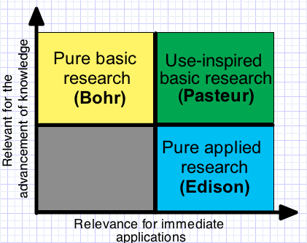
2. Stokes (1997): Pasteur’s Quadrant
Rather than a simple conceptualization of scientific research, Stoke’s (1997) proposed a 2D conceptualization.
Research varies in the extent to which it a) was developed with applied intentions, and b) has theoretical implications.

Slide 24
3. Experimental Design
There are multiple research designs. Selection depends on the state of the knowledge of the scientific community:
  Descriptive research and case studies
  Nonexperimental and quasi-experimental designs
  Correlational research
  Experimental research
The number of considerations will constitute the second half of the course.

Slide 25
4. Conducting an Experiment
The implementation of an experiment is guided by several considerations:
  What population do we want to recruit?
    e.g., age groups in a developmental study; levels of psychopath in an abnormal study
  What ethical considerations are there?
    Obtaining permission for Ethics Review Board
  What materials/setting will be best suited to allow measurement of constructs?
    e.g., items in a memory test; experimental setting in peer influence experiment
Again, we’ll consider this in the remainder of the course

Slide 26
5. Data Analysis
Two broad classes of statistics are used:
  Descriptive statistics: Methods for the simplification of data including organizing and summarizing
    Averages: mean, median, mode
    Dispersion: range, variance, standard deviation
    Tables, Graphs, and Figures
  Inferential statistics: Methods that allow us to infer general properties about a general population from a sample population
    e.g., T-Test, F-Test, Chi-Squared

Slide 27
5. Return of the Binomial Menace
Remember the following situation:
Given the reliability of the bus service, you have a 50/50 chance (p = 0.5) of catching a bus on schedule. To get to the pub/class, you have to catch three buses in a row to get there on time.
The probability for our events are:
  p(1 Bus) = 0.5
  p(2 Buses) = p(1 Bus)*p(1 Bus) = 0.5*0.5 = 0.25
  p(3 Buses) = 0.5*0.5*0.5 = 0.125

Slide 28
5. Data Analysis
The purpose of inferential is to confirm that our results didn’t occur by chance, i.e., they were highly improbable
We use a ‘p-value’ that indicates the probability of an events occurrence just by chance
p-value | Quality of the significance | Chance Results (Type I error)
p < .10 | trend (marginally sig.) | 1 chance out of 10
p < .05 | * | 1 chance out of 20
p < .001 | *** | 1 chance out of 1000

Slide 29
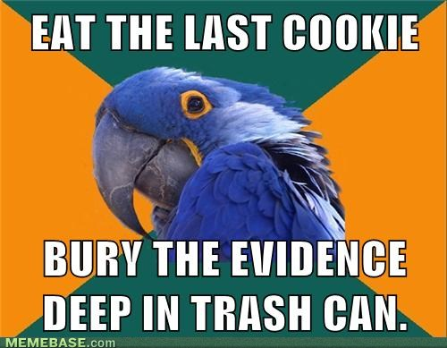
6. Data Interpretation
Once we have obtained results, need to interpret the patterns that we observe.
Broad questions:
  Did we obtain similar results to studies that are similar (replicate)?
  Did we find evidence that support our hypotheses?
  Did we find evidence that does not support our hypothesis?

Slide 30
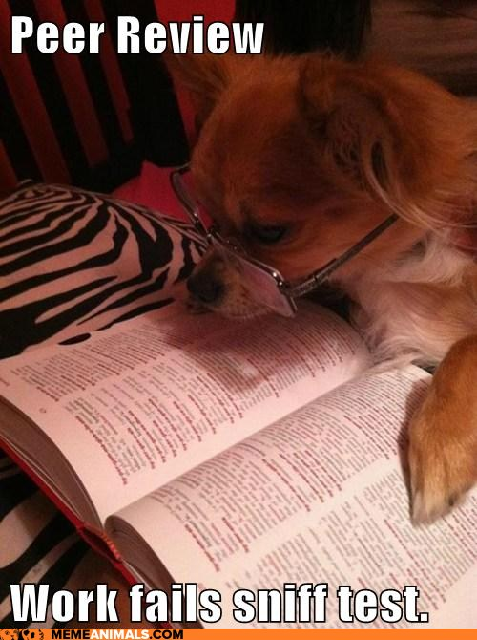
7. Peer Review
When communicating information at conferences or through journals, we rely on our peers for ‘quality control’.
Once an abstract (for a conference) or an article (for a journal) is submitted to a general editor, they select qualified persons to review document:
  Published in area
  Well respected

Slide 31
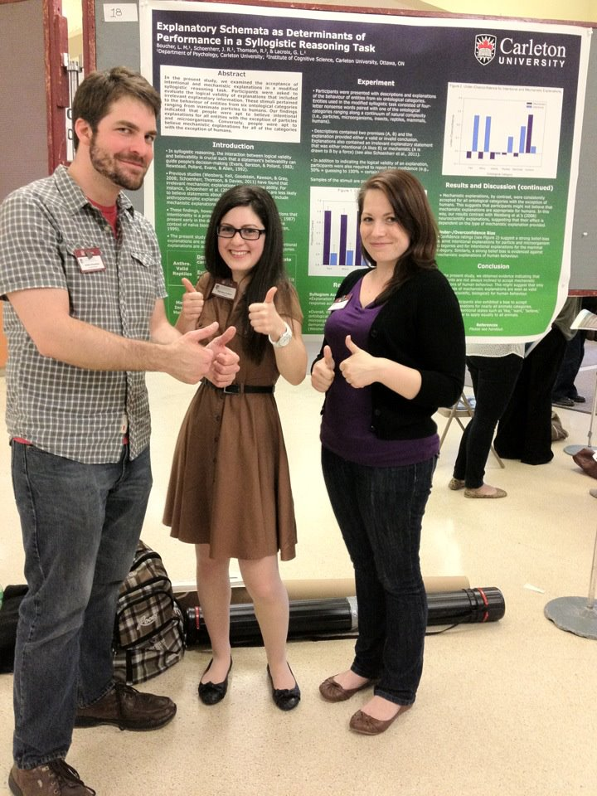
7. Scientific Communication
Finally, when the research has been conducted, psychologists communicate their data and their interpretations to the scientific community.
The main vehicles vary depending on the scientific discipline, but in psychology, they are:
  Talks and Posters,
  Conference Proceedings,
  Journal Articles & Books.

Slide 32
7. APA Style
The American Psychological Association (APA) style is prescribed way of presenting research in peer-reviewed journals.
It presents the research process in a logical / chronological order.
It facilitates the dissemination of scientific knowledge (to other experts!)
  Not necessarily more accessible to novices.

Slide 33
7. APA Manuscript Style
Introduction
  General interest
  Theoretical framework
  Hypotheses (given as “if, then” statements)
Method
  Participants
  Materials
  Procedure

Slide 34
7. APA Manuscript Style
Results
  Descriptive statistics
    Graphs and/or Figures
  Inferential statistics
Discussion
  Summary of results in relation to the hypotheses,
  Discussion of results in relation to the field.
See Chapter 16 in Gravetter and Forzano (2012).

Slide 35
7. Conference Presentation: Talks
Scientific conferences in all areas of science are organized regularly.
Scientists communicate informally (research in planning, results, networking, …).
Talks: Short formal oral presentations of one or a few experiments followed by a question period.

Slide 36
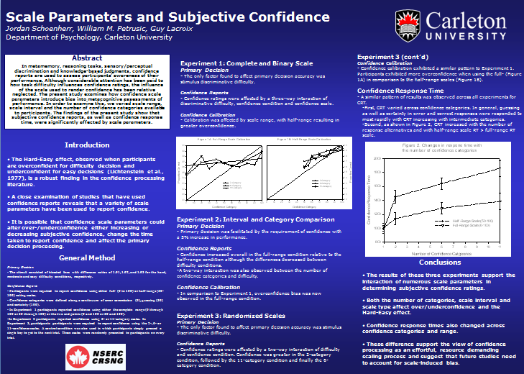
7. Conference Presentation: Talks
Posters also represent a formal presentation of results.
Minimal peer review of abstract.
Minimal information
  Basic theory
  Methods
  Results (stats?)
Audience limited to conference.

Slide 37
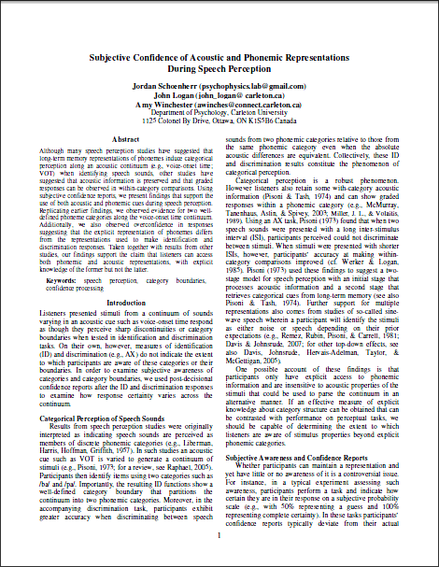
7. Conference Presentation: Proceedings
Like posters, proceedings are not archival publications:
  Not considered a final product
  Research can be published elsewhere
Shorter than a full paper and peer reviewed.
Faster communication with peers.
Reaches broad audience.

Slide 38
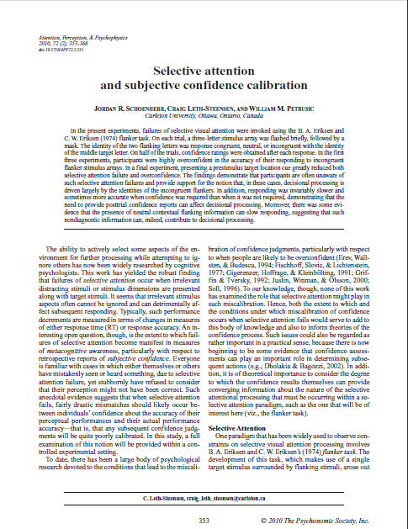
7. Peer Reviewed Journal Publication
This is most respected form of scientific communication in psychology:
  Varies widely in length
Written work constitutes science’s collective memory.
The peer-review process ensures that minimal scientific standards are met.
Reaches broad audience.

Slide 39

7. Open-Access Journals
Open-access journals are a new means to ‘peer-review’ and publish.
For a fee ($8 to $3,900), you can have your article published much more expediently.
“Many new open-access publishers are trustworthy. But not all,” (Butler, 2013)
Notes:
ww.nature.com/news/open-access-the-true-cost-of-science-publishing-1.12676

Slide 40
7. Open-Access Journals
There are associated issues of quality control,
  How can turn-around be so fast?
  What are the fees going toward?
  Why couldn’t the information be published elsewhere?
Some open-access journals (5-10%) appear to be scams!
Special Issue: "Advances in Skin Cancer"
Dear Dr. Jordan R. Schoenherr,
Please pay attention to our upcoming Special Issue on "Advances in Skin Cancer" (www.scirp.org/journal/jct), which will be published in the "Journal of Cancer Therapy" (JCT, ISSN: 2151-1942), a peer-reviewed open access journal. We cordially invite you to submit your manuscript to this special issue through our Online Submission System.
Notes:
http://www.nature.com/news/sham-journals-scam-authors-1.12681
http://www.nature.com/news/investigating-journals-the-dark-side-of-publishing-1.12666

Slide 41
Refining Research Ideas
“New ideas pass through three periods: 1) It can’t be done. 2) It probably can be done, but it’s not worth doing. 3) I knew it was a good idea all along!”
- Arthur C. Clarke

Slide 42
Locating Relevant Research
Although we could simply start from scratch, each member of the scientific community benefits from the products of other members.
How can we locate reliable information?
In the remainder of this portion of the lecture, I’ll provide some practical advice.

Slide 43
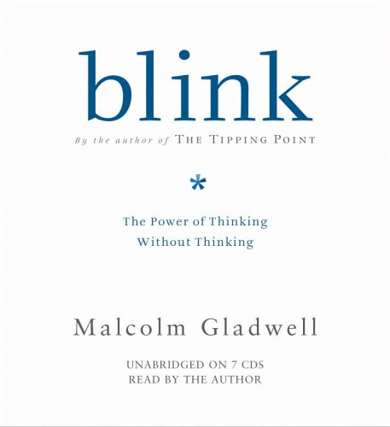
Locating Relevant Research
Places to avoid:
  Newspapers & Pop Books
    Although accessible, the information is not directed toward a scientific audience.
    Journalists might lack competence in a given research area.
    e.g., Malcolm Gladwell (New Yorker) is a respected journalist.
    Blink makes claims that individuals can (rightly) jump to conclusions based on intuitions.
Notes:
http://timgarratt.files.wordpress.com/2012/03/malcolm_gladwell_outliers.jpg

Slide 44
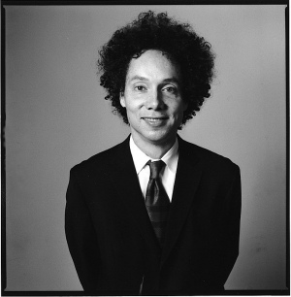
Don’t Blink
Gladwell on intuition:
  “...I think that what goes on in that first two seconds is perfectly rational. It's thinking--its just thinking that moves a little faster and operates a little more mysteriously than the kind of deliberate, conscious decision-making that we usually associate with "thinking.”...
  There are lots of situations--particularly at times of high pressure and stress--when haste does not make waste, when our snap judgments and first impressions offer a much better means of making sense of the world”
Notes:
http://www.gladwell.com/blink/index.html
http://www.abebooks.co.uk/images/books/malcolm-gladwell/malcolm-gladwell.jpg

Slide 45
Don’t Blink
Gladwell on medical intuition:
  “[Cook County Hospital in Chicago] instructed their doctors to gather less information on their patients: they encouraged them to zero in on just a few critical pieces of information about patients suffering from chest pain--like blood pressure and the ECG--while ignoring everything else, like the patient's age and weight and medical history. And what happened? Cook County is now one of the best places in the United States at diagnosing chest pain.”
Notes:
http://www.gladwell.com/blink/index.html
http://www.abebooks.co.uk/images/books/malcolm-gladwell/malcolm-gladwell.jpg

Slide 46
Locating Relevant Research
Gladwell on Blink: “There is a lot of psychology in this book. In fact, the core of the book is research from a very new and quite extraordinary field in psychology that hasn't really been written about yet for a general audience.”
Notes:
http://timgarratt.files.wordpress.com/2012/03/malcolm_gladwell_outliers.jpg

Slide 47
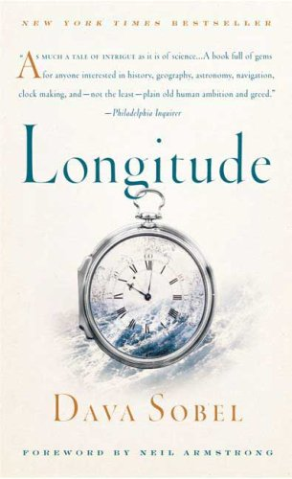
Locating Relevant Research
The attribution of ‘discoveries’ or insight to popular authors is common place.
Sobel Effect: The popularization of information within a discipline, usually associated with less academic rigour and oversimplification. Oversimplification takes the form of claiming a single individual, alone can be credited with a discovery (Miller, 2002).
In her book, Sobel writes a popular history of science that fails to acknowledge its sources the contribution of other researchers.
Previous Subtitle:
The True Story of a Lone Genius
who Solved the Greatest
Scientific Problem of His Time
Notes:
http://images.bookcloseouts.com/covers/large/isbn978080/9780802715296-l.jpg

Slide 48
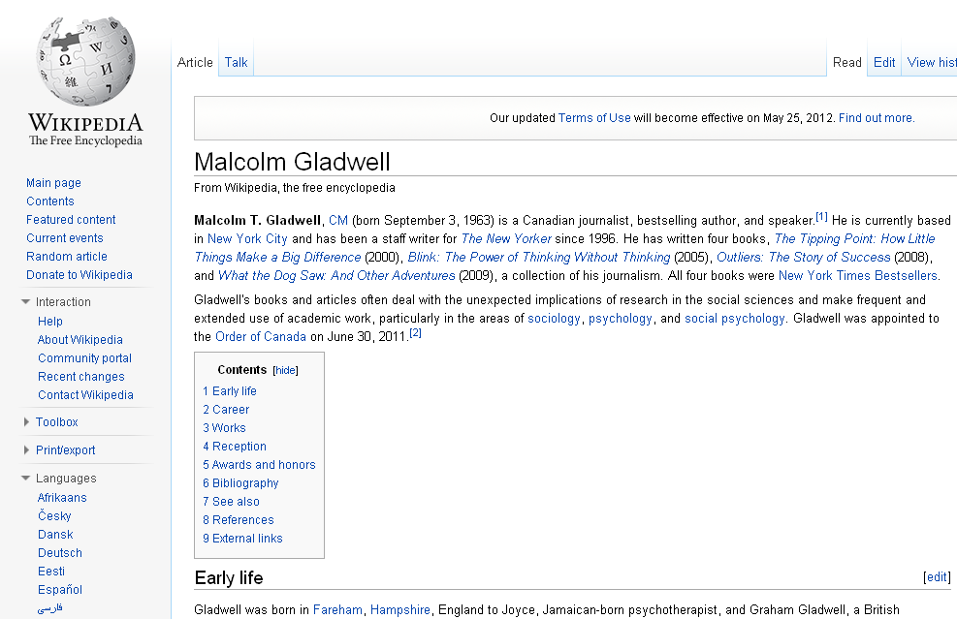
Locating Relevant Research
Places to avoid:
  Websites (e.g., Wikipedia)
    Although fast and easy to use, the information is often dubious (at best).
    The documents are only as good as the community of users that contributes.
    For quick ‘n’ dirty searches, it could work but not for formal research.
Notes:
http://timgarratt.files.wordpress.com/2012/03/malcolm_gladwell_outliers.jpg

Slide 49
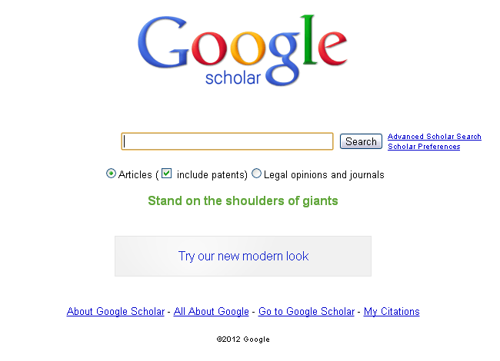
Locating Relevant Research
Google Scholar: (http://scholar.google.ca)
A search engine that accesses information sources of greater credibility.
  Links to author/publishers website
Faster than logging onto the library’s website and free.
Caveat: Not all articles are available, not all are peer reviewed.

Slide 50
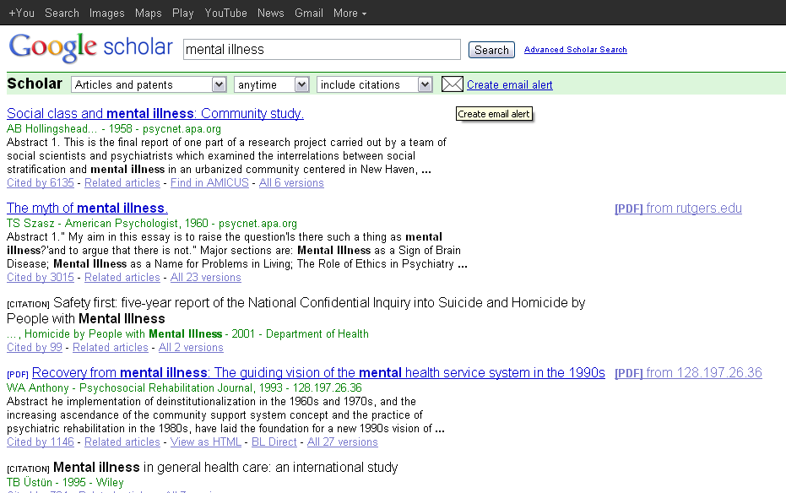
Locating Relevant Research
Type in a search term (highlighted)…
Search results yield:
Title,
Author
Date
The number of citations is also provided
Links to pdfs are also provided for quick access

Slide 51
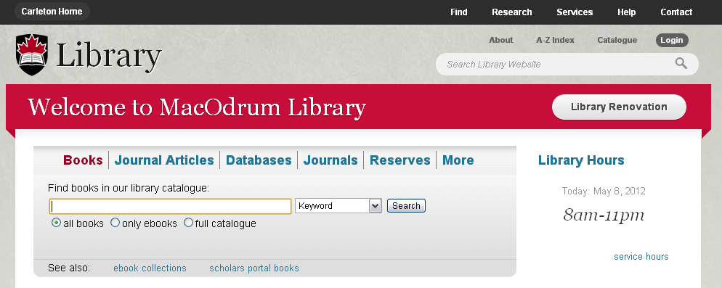
Locating Relevant Research
Library search engine is likely the most robust tool available to you
You can use it on campus, or log in via the libraries proxy server (student number & password required)

Slide 52
Locating Relevant Research
If you have a specific document in mind, simply look in ‘Books’ or ‘Journals’
If you are trying to find information on a topic, then you will need to search ‘Journal Articles’ or ‘Databases’

Slide 53
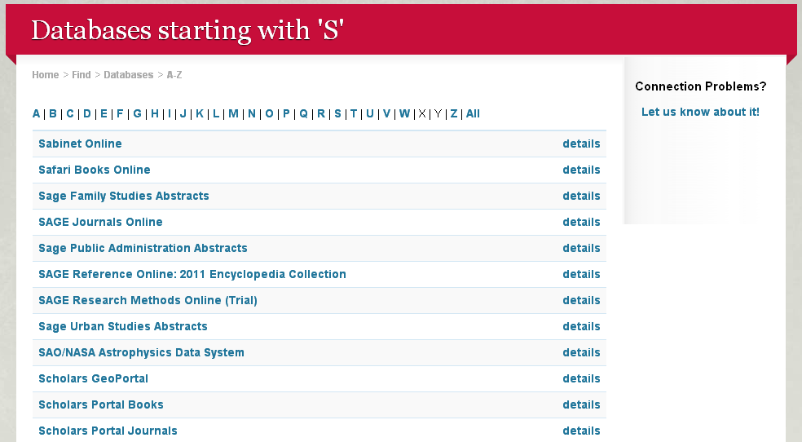
Locating Relevant Research
Useful starting points:
  EBSCO databases (older articles)
  PsycINFO
  Scholars Portal (Journals)
  Science Direct

Slide 54
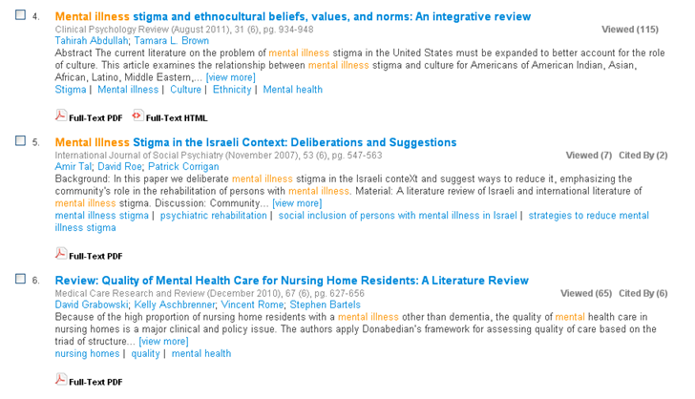
Library: Scholars Portal
Similar properties to Google Scholar:
Author, Date, times cited
We also have quicker access to pdf and keywords

Slide 55
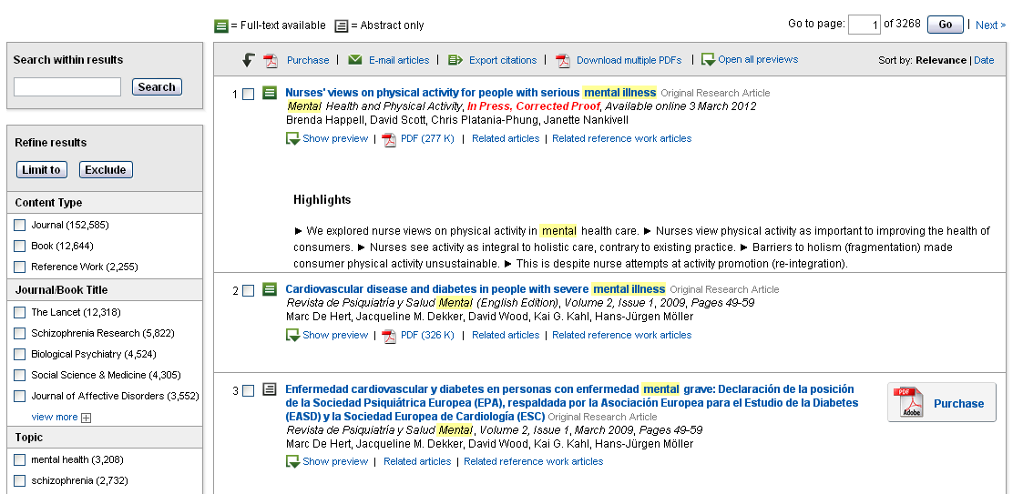
Library: ScienceDirect
Document highlights
Not all pdfs are freely accessible

Slide 56
Search Engines
Search engines can narrow down our search but they each have limitations and should be used in conjunction
Use keywords and number of citations
Considerable research needs to be done to learn what keywords are relevant in order to narrow down a research topic
  its best to resign yourself to that fate
Notes:
Last bullet sub-point: its = it’s
Next: 53

Slide 57
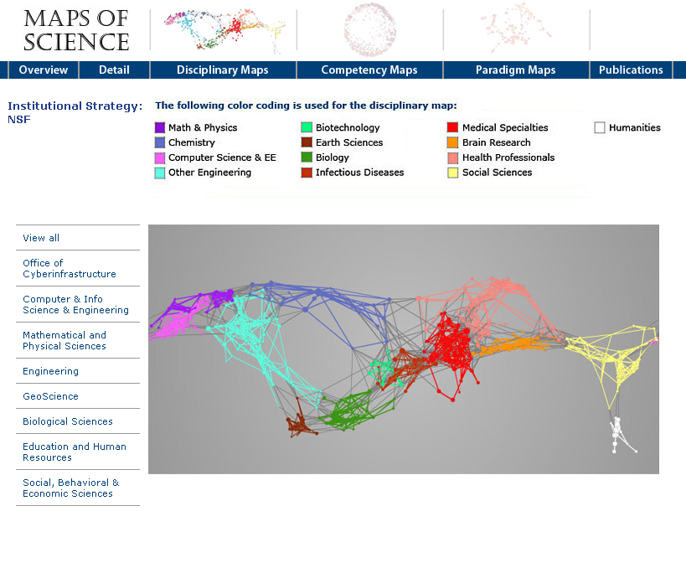
Scientific Communication:
The Big Picture
Patterns of citations can be used to determine the structure of science
We can obtain ‘maps’ of science by observing at which cites who and how many times articles or topics are cited
You are here.
Notes:
http://mapofscience.com/nsf.html#

Slide 58
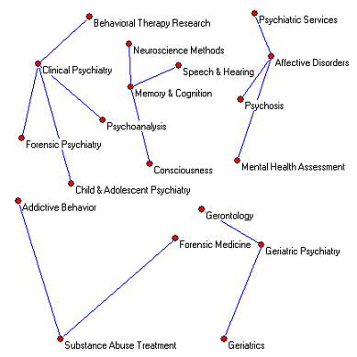
Disciplinary Maps
We can also see what topics are related at a disciplinary level using high citation rates
Notice that clinical, therapy and forensic cluster together.
Similarly, memory, speech and consciousness form other clusters.

Slide 59
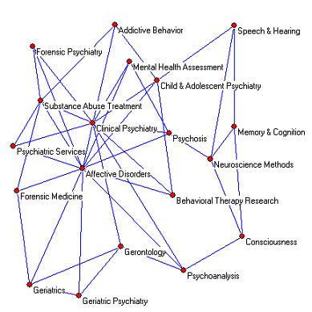
Disciplinary Maps
The criterion we use to make such clusters can be limited based on the number of citations to create isolated clusters
By reducing the number of citations needed to make a ‘connection’ between disciplines, we can see greater connectivity of research areas in cognition

Slide 60
W1L2a Review
Science does not represent a single method, but a process. Pure and applied research both have value.
Multiple steps are required from the initial formulation of a topic, the selection of participants and methods, to the analysis and communication of results
Many sources of information can provide information, some are more reliable than others
Scientific research represents a vast, interconnected network

