Slide 1

Intuition, Authority, and Understanding:
Fake It Until You Make It
Research Methods
PSYC/NEURO2001 Mon and Weds 14:30-17:30
Jordan Schoenherr
Carleton University

Slide 2
Overview of Lecture
Method of Intuition (and 'Tenacity')
Method of Authority
Method of Reason
Method of Empiricism

Slide 3
Our World at a Glance:
Psychology of Science
“Nothing in the world is more dangerous than sincere ignorance and conscientious stupidity.”
- Martin Luther King, jr.

Slide 4
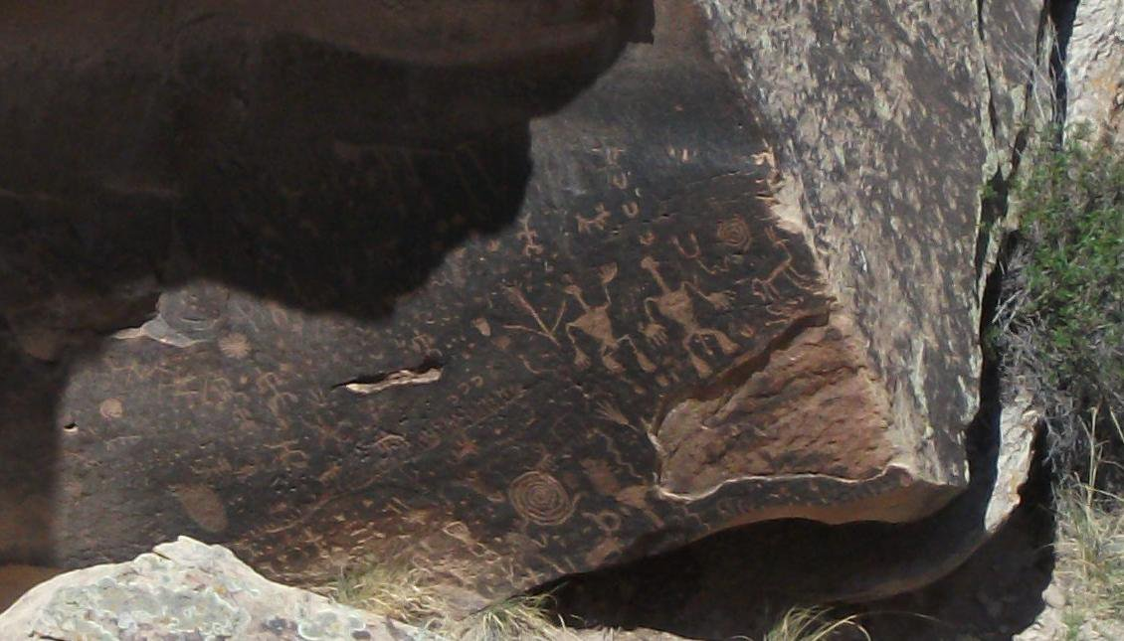



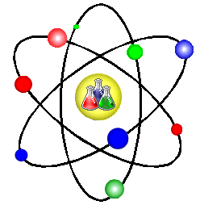
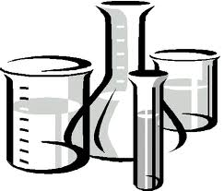

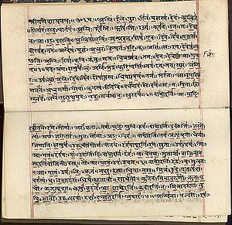
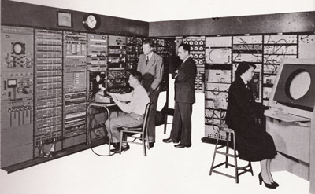
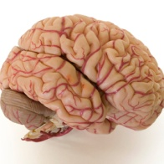
Understand the World
Since ‘prehistory’ humans have attempted to understand the world.
Whether through myths, religion, philosophy or science, there appears a human predisposition to comprehend and model the world.
Not surprisingly, this impulse is motivated by a need to survive in the world.

Slide 5
Scientific Precursors
Science is often caste as something wholly different then all other belief systems:
  e.g., "[S]cience is a very exceptional and peculiar activity..." (p.x, de Solla Price, 1975)
The elements of science (i.e., the scientific method) are evidenced across time and civilizations (Teresi, 2002), e.g.,
  Religion and Philosophy try to understand from a set of assumptions and logic,
  Alchemy and Engineering identify practical principles for interacting with the world.

Slide 6
Understand the World
Intuitions
Authority
Reason
Empiricism

Slide 7
Understand the World
Intuitions | Our initial responses to stimuli, situations, etc.
Authority | Taking, at face value, information from an individual respected within a social framework.
Reason | With the assumption of a set of premises (‘facts’), using rules to determine what necessarily follows.
Empiricism | Using natural observation and controlled experiments to obtained data.

Slide 8
The Scientific Imperative
As we’ll see (next class), science brings together these elements:
  Using intuition as a starting point, we have naïve theories that help us understand the world.
  By learning from existing knowledge provided by authorities, we narrow down new possible avenues to explore.
  Taking existing facts and using assumptions, we can derive new knowledge and check truth claims through reason.
  With additional experience, we can test our naïve theories, expert advice and reasoned conclusions to ensure that what we believe to be the case is in fact so.

Slide 9
'Gut Feelings' and 'Following your Heart'
“Intuition and concepts constitute... the elements of all our knowledge, so that neither concepts without an intuition in some way corresponding to them, nor intuition without concepts, can yield knowledge.”
- Immanuel Kant

Slide 10
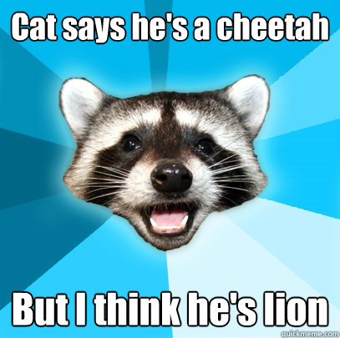
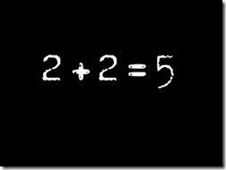
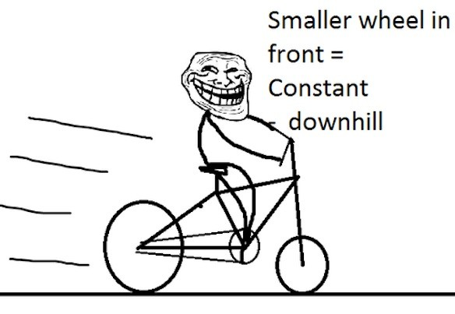
Understanding the World:
Our Naïve Theories
One of the first set of processes to develop concern naïve theories, or intuitions:
  Naïve Physics – predicting
  behaviour of objects in the
  environment
  Folkbiology – classifying
  biological life (botanical and
  zoological)
  Folk Psychology/Theory of Mind – how others think

Slide 11
Physical Models of the World:
Green, McCloskey, & Caramazza (1980)
If we want to consider a question such as how people intuitively perceive the mechanics of the world, what could we do?
  Who should participate?
  What materials should we use?
  What could we measure?
Participants consisted of students with varying degrees of experience with physics.
Provided them with physics problems.
Participants asked to draw (predicted) the results.

Slide 12
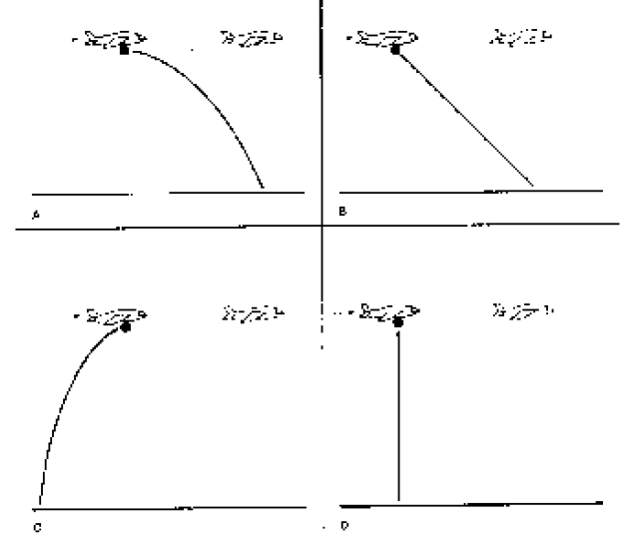
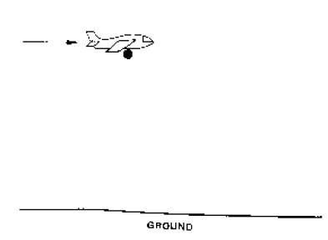
Drop the Bomb on Naïve Physics:
Green, et al. (1980)
“In the diagram, an airplane is flying along at a constant speed. The plane is also flying at a constant altitude, so that its flight path is parallel to the ground. The arrow shows the direction in which the plane is flying. When the plane is in the position shown in the diagram a large metal ball is dropped from the plane. The plane continues flying at the same speed in the same direction and at the same altitude. Draw the path the ball will follow from the time it is dropped until it hits the ground. Ignore wind or air resistance. Also, show as well as you can, the position of the plane at the moment the ball hits the ground.”

Slide 13
Green, McCloskey, & Caramazza (1980)
40 % selected forward arcs (A; correct)
60 % were wrong! (B, C, and D)
  36 %: downward motion (D)
  13 %: diagonal lines (B)
  11%: backward trajectory (C)
In later replications, they demonstrated that the amount of knowledge of physics was associated with correct responses (same patterns produced in all groups).
  None < High School Physics < College/University

Slide 14
Intuitions about Intuitions
Some might argue that physics is too esoteric :
  It requires an understanding of the fundamental laws of the universe,
  It requires math,
  It requires experiments.
If this is the case then (perhaps) we have better intuitions about other domains.

Slide 15


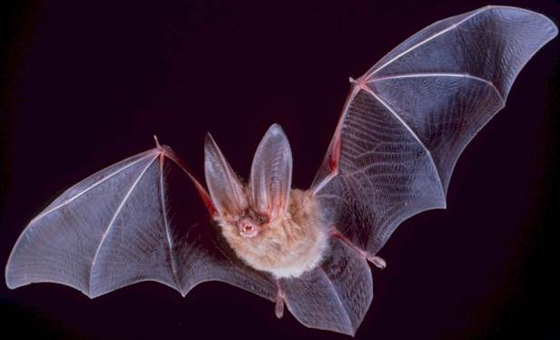
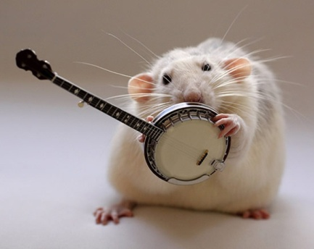
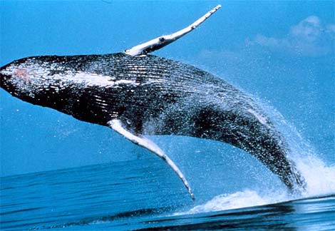
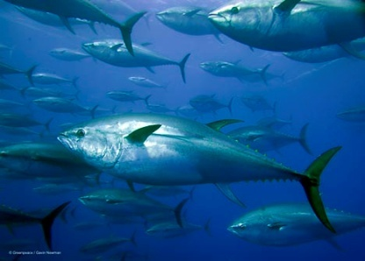
Folkbiology: An Example
Other domains elicit our attention in the environment out of the need to survive.
When we look at biota, we assume that things stand in relation to one another.
Importantly, we assume that our intuitions about the observed pattern could not be otherwise.

Slide 16
Folkbiology: An Example
Gelman, Coley, and Gottfried (1994)
  “People seem to assume that categories of things in the world have a true, underlying nature that imparts category identity . . . The underlying nature, or category essence, is thought to be the causal mechanism that results in those properties we can see. For example, the essence of tigers causes them to grow as they do—to have stripes, large size, capacity to roar, and so forth.” (p. 344)

Slide 17
Similarity- and Theory-Based
Intuitions
As the previous fish-whale example demonstrates, we are prone to defaulting to physical similarity.
One of the most robust findings in the literature on categorization (the grouping of individual entities into classes) is that people typically default to physical similarity.
  For instance, Keil (1989) has demonstrated that when children are asked to classify animals, they initially focus on physical similarity of offspring to parent and only later consider ‘internal’ properties of the animal

Slide 18

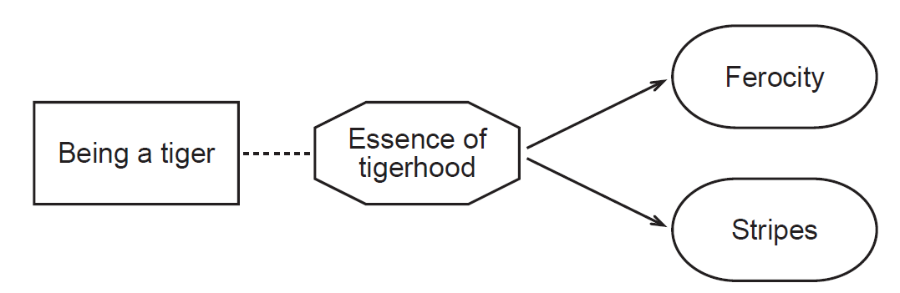
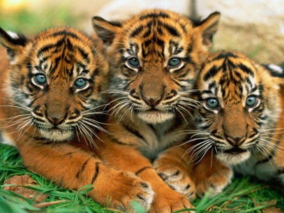
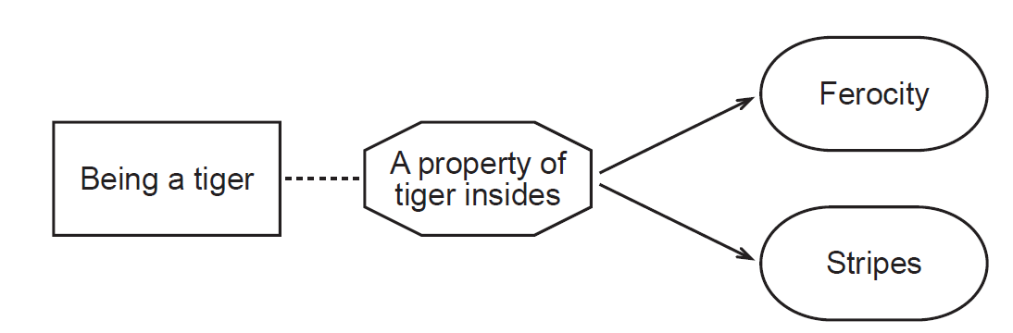
Folkbiology: A GGGreat Example
Keil (1989)
A classic experiment investigating essentialism:
  Children are told that there is an animal that has tiger parents and the ‘insides’ of a tiger, but looked like a horse.
  Conflict between internal properties (essence) and external properties (similarity).
  Children <7 yo, categorized the animal based on the appearance whereas children ≥7 yo categorized based on the internal properties.
Notes:
http://c1334242.cdn.cloudfiles.rackspacecloud.com/images/products/bs_65000/68731.gif

Slide 19
Folkwisdom and Folkpsychology
The idea that every member of a group, or class of objects in the world, has a defining set of qualities is referred to as essentialism.
Humans are, necessarily, a central group in our everyday lives so it's not surprising that we also have theories about how we function in the world:
  Folkwisdom / Folkpsychology concerns behaviour of members of groups
  Social cognition / Folksociology concern behaviour of groups

Slide 20
Folkwisdom and Folkpsychology
Consider the following:
“Birds of a feather flock together” – people that have similar personality traits, preferences, etc. are better matches for one another.
“Opposites attract” – people that have dissimilar personality traits, preferences, etc. are better matches for one another.
These statements are in direct opposition to one another, yet many people ascribe to both.
Worse still, people feel very confident that they are right.
People have the naïve believe that folkwisdom is the repository for past observations (i.e., a naïve science).

Slide 21
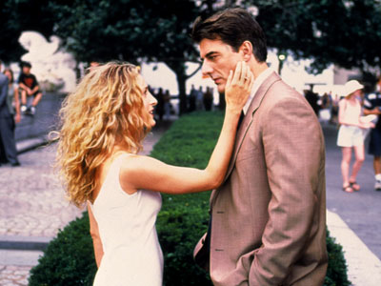
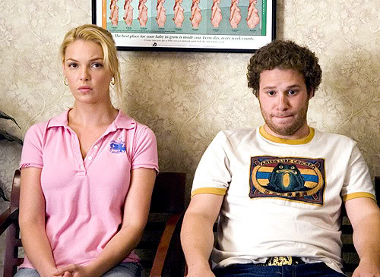
Knocked-Up or Fed Up?
Providing the plot for many Hollywood films, the notion that opposites attract permeates our culture.
Majority of studies demonstrate that those with similar personality traits are more likely to be attracted to one another (Lewak, Wakefield & Briggs, 1985) and befriend those that are similar (Nangle, et al., 2004).

Slide 22

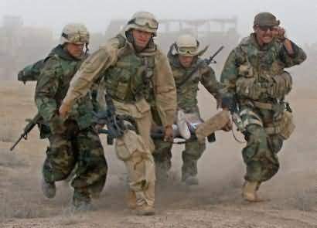
What Doesn’t Kill Me….
What doesn’t kill you…
  NY Time reported a phenomena referred to as “PTSD growth”
  Hobfoll et al. (2007) considered PTSD growth in NYC population and Israel found that although people reported doing well, they had a greater instance of psychological problems.
Notes:
To see brief report: http://blogs.scientificamerican.com/observations/2012/04/01/what-doesnt-kill-you-doesnt-necessarily-make-you-stronger-it-might-make-you-into-a-right-wing-extremist/

Slide 23
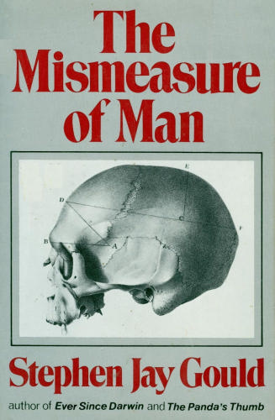
The Darker Side of Folkpsychology
Graver instances of naïve theories are evidenced in early attempts to understand human nature.
  Efforts to determine intelligence based on size of cranium, race, etc.
In-group-out-group bias: social psychology demonstrates that one perceives members of their group to be more diverse/unique relative to those outside one's group.

Slide 24
The Origin of Folk Theories
Considerable debate has concerned the origin of folk theories:
  Nativist/Innate: People are born with prepotent responses to stimuli due to our ancestors being exposed to stimuli, and surviving (natural selection)
    Method of Intuition
  General Learning: Due to continuous exposure to recurrent stimuli in our environment we learn how to respond to stimuli through a process of trial and error and through available information from other sources
    Method of Tenacity with extensive exposure

Slide 25
The Origin of Folk Theories
Many people find nativist accounts shockingly unimaginable.
Consider, however, your perceptual abilities:
  We can only see a limited range of the visible spectrum and hear a limited range of sounds.
Our nervous systems have adapted to process this information.

Slide 26
Authority: Taking People at their Word
“I have as much authority as the Pope, I just don't have as many people who believe it.”
- George Carlin

Slide 27
Authority
People also have naive theories about expertise and authority.
At least two arguments could be made for the acceptance of the advice of authorities:
  Evolutionary arguments: If an authority has survived or is respected within the community then their experiences provide useful information,
  Rational arguments: If someone has studied a topic for years, they likely know more than you.

Slide 28
Identifying Authority
The contents of one’s expertise necessarily differs depending on the domain/subject you are studying.
Experiences, Training, and Education:
  Priests (Catholic): 5 to 6 years
  PhD: 6.8 (Math.) to 9.6 years (Anthro.)
    According to APA, 5-6 years for PhD Psychology
In general, it takes 10 years to become an expert (Glaser & Chi, 1988).
Notes:
PHD: NSF, http://www.nsf.gov/statistics/infbrief/nsf06312/

Slide 29
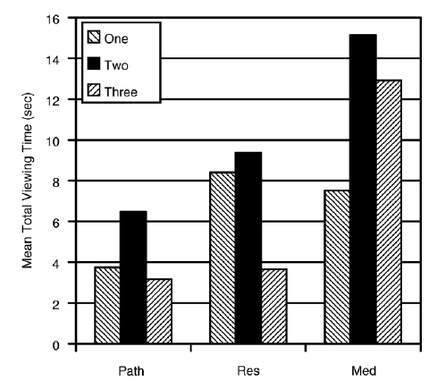
Medical Expertise
Are medical experts more thorough?
Krupinski et al. (2006) examined gaze time for three levels of expertise:
  Medical Students (Med)⁺
  Residents (Res)⁺⁺
  Pathology (Path)⁺⁺⁺
They found that expertise was inversely related to gaze time.
Expert
Novice
Notes:
Note that each bar represents an individual's mean gaze time

Slide 30
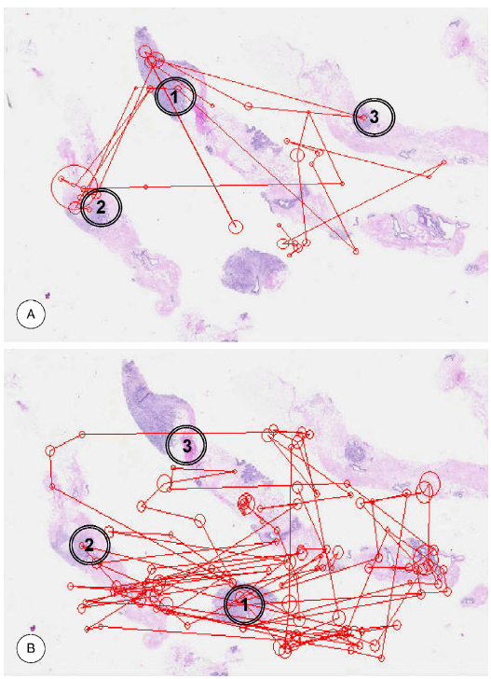
Expertise: Less is More
What were novices and experts considering?
  Eye fixation can be used as a proxy for attention allocation.
Krupinski et al. (2006) also examined the pattern of gazes.
  Residents (A) looked at fewer features than Medical Students (B).

Slide 31
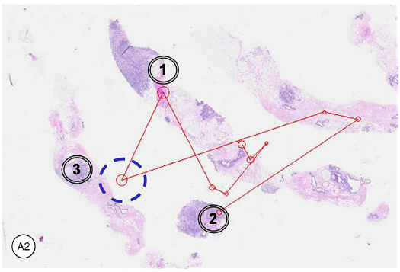
Expertise: Less is More
Krupinski et al. (2006) also examined the pattern of gazes.
  Pathologists (A2) looked at even fewer features than either Residents or Medical Students.
  Note also that one critical feature (3) didn't fall within foveal vision.

Slide 32
Accuracy as a Function of Knowledge?
Clinical diagnosis is one such area with two available techniques (Meehl, 1954):
  Clinical Prediction: “the typical procedure long used by applied psychologists and physicians, in which the judge puts data together using informal, subjective methods”.
  Mechanical Prediction: procedures including “statistical prediction (using explicit equations), actuarial prediction (as with insurance companies‘ actuarial tables), and what we may call algorithmic prediction (e.g., a computer program emulating expert judges), is by contrast well specified”.

Slide 33
Accuracy as a Function of Knowledge?
Meehl (1954) found that clinical diagnoses were actually less effective then mechanical.
In Grove, et al.’s (2000) metaanalysis they observed that:
  Nearly half of the studies (47%; n = 63) found the
  mech. > clinical advantage; nearly as many did not find any difference (n = 65); only eight studies found clinical > mech. advantage.
Training for ‘Medical judges’ or psychologists, did not affect effectiveness.

Slide 34
Should we Ever Trust an 'Expert'?
Norman, Eva, Brooks, & Hamstra (2006)
  Not the amount of information:
    Novice can recall the same amount of information as experts if given enough time.
  Not just experience:
    Presenting a diagnostic task before a similar one increases performance; when presented erroneous information, they made a diagnosis similar to the one that was in error.
Coordination of available knowledge and critical reflection is required.

Slide 35
Reasoning and Empiricism: The Way Out?
“The ultimate authority must always rest with the individual's own reason and critical analysis.”
- Dalai Lama

Slide 36
The Objects of Reason
Philosophy represents one of the first, concerted attempts to understand the world for a more objective stand point.
Philosophers want to derive general principles from the world by looking at a set of instances (inductive reasoning) and to use general principles to arrive at specific conclusions (deductive reasoning).
The problem is, people aren’t always effective in their use of reasoning.

Slide 37
Inductive Reasoning
INDUCTION
Once information is available, we can use it in two ways:
  Induction or deduction
Induction: An inference that builds a general explanation about a phenomenon based on a subset of observations.
The strength of the induction is proportional to that of the evidence.
General
Specific
Environment

Slide 38
Inductive Reasoning
The inductive method is a sure means to avoid bias from other people and intuitions.
It is costly both in time and resources: to get a reliable sample takes many observations.
Moreover, uniformly discarding the knowledge and experience of others seems unwise.
We might be inclined to use existing knowledge and theories and attempt to interpret data.

Slide 39
Deductive Reasoning
Environment
Deduction: An inference that draws a conclusion about a specific event on the basis of a general concept.
The conclusion necessarily follows if the structure of the argument is sound and if the premises are true.
Specific
General
DEDUCTION

Slide 40
Reasoning
INDUCTION
Environment
General
Specific
Specific
General
Environment
DEDUCTION

Slide 41
Wason Selection Task: Errors in Conditional Reasoning
One means to assess syllogistic reasoning is to change the format. Wason (1966) examined failures of conditional reasoning
Select cards to verify the Rule:
  The card has a vowel on one side and an even number on the other side.
Which card(s) would you select?
E | K | 4 | 7
FRONT

Slide 42
Wason Selection Task: Results
The Rule:
  The card has a vowel on one side and an even number on the other side.
Wason (1966) found:
  53% indicated E should be turned over;
  46% indicated the 4 card should be turned over (false);

Slide 43
Confirmation Bias
Performance in the Wason Task demonstrates the confirmation bias: a tendency to search for and use information that supports, rather than refutes, a hypothesis
Wason suggested that rather than seeking falsifying information (Popper, 1959), they instead seek confirmatory information in this task, thereby leading them to err

Slide 44
Falsification of Rules
E | K | 4 | 7
Again, consider our rule:
  The card has a vowel on one side and a even number on the other side.
Rather than selecting cards that confirm the rule, i.e., ‘E’, we need to select a card that disconfirms the rule
  If we find a card that violates the rule, we know the rule cannot hold
Consider turning over the cards.
  If we selected the ‘E’ we find that the rule is violated (it’s a vowel with an odd number on the other side)
  selecting the ‘7’ also disconfirms the rule (it’s an odd number with a vowel on the other side)
FRONT
7 | 4 | K | E
BACK

Slide 45
Confirmation Bias and Empiricism
Science reasoning pursues an eliminative strategy: we must seek to eliminate incorrect beliefs or alternatives.
As we’ll see next class, scientist frequently seek falsification: to demonstrate the condition under which a given hypothesis, or theory is false.
The main issue for us is that people often seek to obtain evidence (empiricism) to confirm their naïve theories.

Slide 46
The Role of Empiricism
Empiricism, in conjunction with the other modes, is the focus of the remainder of the course.
As we will see next class, the strength of an empirical approach is best understood as obtaining multiple observations of the same event or phenomena.
If we obtain one event, it might be by chance. As the number of events of a certain kind increase, it is harder to say that they have occurred by chance.

Slide 47
!!!WARNING!!!
The next series of slides contains math!
I am not responsible for any illness, mental or physical, resulting from exposure to math or its products.
Viewers that are sensitive to math are advised to avert their eyes.

Slide 48
Basics of Probability Theory
Think about the following situation:
You live in the suburbs, outside Ottawa (e.g., Kanata, Orleans) and you want to make it in to town to go to your favourite pub/class. Your car is broken so you have to take the bus. Given the reliability of the bus service, you have a 50/50 chance (p = 0.5) of catching a bus on schedule. To get to the pub/class, you have to catch three buses in a row to get there on time.
If we catch all three buses, how likely is it to have occurred by chance?

Slide 49
Basics of Probability Theory
We can breakdown our question, into 3 smaller questions:
  On the first transfer, what is the probability of catching one bus?
  What is the probability of catching two buses in a row?
  What is the probability of catching three buses in a row?
HINT: Catching one bus is independent of catching any other bus. Each event is equiprobable, the chances of catching a bus has the same probability as not catching a bus.

Slide 50
The Tree of Probability: 3 Buses
First Bus
Second Bus
Third Bus
p(1 Bus) = 0.5
p(2 Buses) = p(1 Bus)*p(1 Bus) = 0.5*0.5 = 0.25
p(3 Buses) = 0.5*0.5*0.5 = 0.125
Getting out of the house
p = 1.0
Catch Bus
p = 0.5
Catch Bus
p = 0.25
Miss Bus
p = 0.25
Miss Bus
p = 0.5
Catch Bus
p = 0.25
Miss Bus
p = 0.25
Miss Bus
p = 0.125
Catch Bus
p = 0.125
Catch Bus
p = 0.125
Miss Bus
p = 0.125
p = 0.5
p = 0.5
p = 0.5

Slide 51
Basics of Probability Theory
Notice that as we catch more buses, the probability of it happening progressively decreases: it gets more and more unlikely that it happens by chance.
Although catching the first bus is associated with a reasonable probability (0.5) catching all three is much lower (0.125)
  If we catch all 3, this might suggest that OC Transpo is running smoothly.

Slide 52
Perception of Randomness
In the absence of formal statistical procedures, people have difficulty identifying random sequences (e.g., Kahneman & Tverksy, 1972):
HTHTHTHTTTHHTHTTHTHHHTHTHTHTHTHT
HHHTHHHHHHHHHHHTTTTTTTHTTTTTTTTT
Prior knowledge and feedback can aid in feedback:
  Nickerson (2002) equiprobable, sequentially independent/unpredictable, irregular, and incompressible
People typically lack this prior knowledge

Slide 53
Empirical/Statistical Logic
Although we are not terribly good judges of randomness, we can use observations to identify whether and event appears to be random or not.
The basics of the statistical logic is simple:
  The less likely an event is to have occurred by chance, the more convinced we should be that out experimental procedures have identified a real phenomena.

Slide 54
From Naïve Theories to Scientific Theories
“Good tests kill flawed theories; we remain alive to guess again.”
- Karl Popper

Slide 55
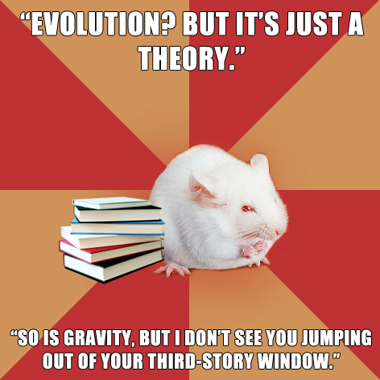
The Strength of a Theory
One frequent misinterpretation of the term ‘theory’ is that it is somehow an indictment of information, i.e., “It's just a theory”
As we’ve just seen there is a substantial difference between intuitive theories (e.g., essentialism) and those that are subjected to falsification
What separates a naïve theory from a scientific theory?

Slide 56
The Strength of a Theory
As Reichenbach (1938) points out, in the early development of a research area greater construct ambiguity is permitted (e.g., mind, libido).
The hallmark of science, however, is clarity in what is being studied, control of how that information is obtained, and the testability of hypotheses.

Slide 57
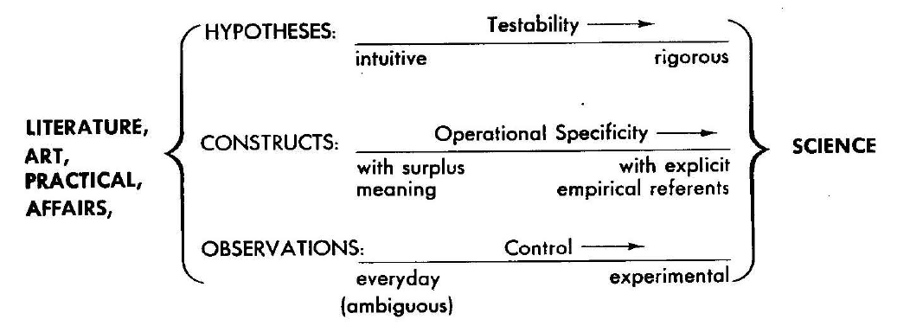
Intuitive and Scientific Theories
(Marx, 1963)
Observations – vary in their degree of control.
Constructs – vary in the degree to which we can specify relationship of an idea to observations.
Hypotheses – vary in the extent to which they can be tested.

Slide 58
Our Naïve Understanding of the World
Whereas we are inclined to produce theories about how certain aspects of the world function, those intuitions are rarely correct.
A tentative definition:
  the goal of science is the explicit, formalized development of accurate theories and models of our world through rational and empirical methods.

Slide 59
Science in Brief
Dissect our definition:
  Goal: Although a given theory, model or hypothesis can be in error, our objective is to produce something transparently accurate.
  Explicit: Although our naïve, domain-specific theories do model the world, they aren’t necessarily examined critically or explicated.
    We actively go out into the world and seek evidence (through observation, consider counterarguments, etc.) to ensure that we reach our goal.

Slide 60
Science in Brief
Dissect our definition:
  Formalized: Science isn’t a hobby, it requires the dedication of specific resources (e.g., time and money).
  Accuracy: A hypothesis, theory or model is judged in terms of how it can account for a given body of evidence . Requires a point of comparison/standard.
In the next class, we will see that neither is the scientific method a singular approach, nor does it always call upon the same data or theory.

Slide 61
W1L1b Review
There are a variety of methods for acquiring information in our world. Science brings together these modes.
Intuition is a strong force in our understanding of the world: good or bad.
Authority allows us to get some information for free, but it comes with the cost of reliance on others.
Rationality and Empiricism offer powerful, effortful mental tools but have their own costs.

