Slide 1
Introduction to Brain and Behaviour
NEUR / PSYC 2200

Slide 2
What are we going to do today?
Go over the course outline
Course expectations
Exams
Brief introductory lecture

Slide 3
Dr. Kim Hellemans
  Please call me Kim (preferable) or Dr / Professor Hellemans
I have a PhD in Psychology, specialization in behavioural neuroscience
  My area of research is was biological models of addiction
Email: kim_hellemans@carleton.ca
  Preferred mode of communication
  When emailing, please put course number in subject line
    Also helpful to put your name
  Avoid ‘text’ emails (“r u around?”)
What to expect from me as a prof?

Slide 4
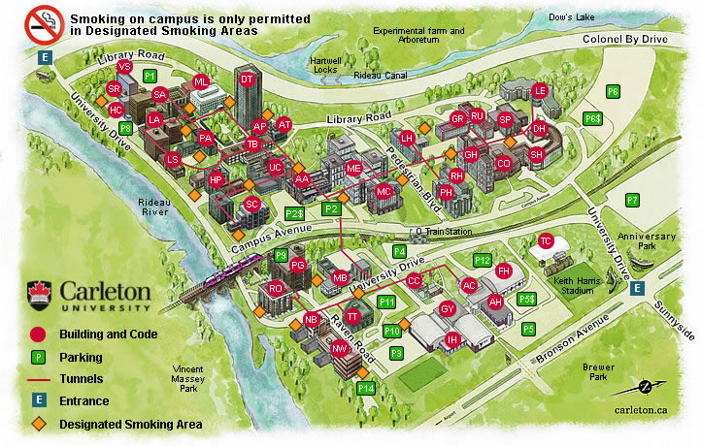
Communicating with Me
Office: SSRB 106E (next to VSim / HCI)
Office hours: Wednesdays, 2-3:30PM
Building ‘SR’

Slide 5
Course Content
Text: An Introduction to Brain and Behaviour, 3rd edition
  Kolb & Wishaw
  Publisher: Worth
  Available at bookstore
Some material will not come from text
  Lectures
  Posted on WebCT

Slide 6
Teaching Assistants
Patricia Van Roon (PatriciaVanRoon@cmail.carleton.ca) – Responsible for students with the last names beginning with Aa-Chaf
Faisal Al-Yawer (FaisalAlYawer@cmail.carleton.ca) - Responsible for students with the last names beginning with Ca-Faz
Catherine Smith (csmith@connect.carleton.ca) - Responsible for students with the last names beginning with Fe-Hy
Kristen Fennell (kfennel2@connect.carleton.ca) - Responsible for students with the last names beginning with I-McL
Rachel Comba (rcomba@connect.carleton.ca) - Responsible for students with the last names beginning with McM-Ral
Shaina Cahill (shainacahill@cmail.carleton.ca) -Responsible for students with the last names beginning with Ram-Spe
Rob Gabrys (rgabrys@connect.carleton.ca) Responsible for students with the last names beginning with Spf-Z

Slide 7
Topics – What to Expect
A lot of science: Biology, chemistry, pharmacology and anatomy
This is a challenging course
  If you do not have a science background, and are not a strong student, you may wish to reconsider this class
  That said, I do try very hard to have everyone feel comfortable with the material!
  Also, I have a B.A. in psychology…if I can do it, so can you ;-)
A note on cyberslacking…

Slide 8
Poll Everywhere

Slide 9
Midterms
Location TBD, 2 hours to write
Multiple choice, Definition of terms, Figure Labelling, Short Answer
Worth 25% (Midterm 1) and 35% (Midterm 2) of final grade
Sick? Consult course outline for specifics on deferred exams.

Slide 10
Final Exam
Cumulative
Greater focus on material after Midterm 2
During scheduled exam period
3 h in length
Worth 40%
Format: Multiple choice, Definitions, Figure Labeling, Short and Long answer

Slide 11
Bonus Marks!
Consult the Course outline for Details
You can earn up to 5% bonus marks for participating in an online study

Slide 12
Course Objective
By the end of this term, you should have a solid understanding of the link between brain and behaviour:
  Three sources of evidence:
    Evolution of brain and behaviour in diverse animal species
    How the brain is related to behaviour in normal people
    How the brain changes in people who suffer brain damage or other brain abnormalities

Slide 13
Why Study Brain and Behavior?
Many behavioral disorders can be explained and possibly cured by understanding the brain
The brain is the most complex living organ on Earth and is found in many different groups of animals
How the brain produces both behavior and human consciousness is a major unanswered scientific question

Slide 14
What Is Behavior?
Irenäus Eibl-Eibesfeldt:
  “Behavior consists of patterns in time.”
  Examples
    Movements, vocalizations, thinking
Can be:
  Relatively Fixed (Innate) Behaviors
    Dependent on heredity
  Relatively Flexible Behaviors
    Dependent on learning

Slide 15
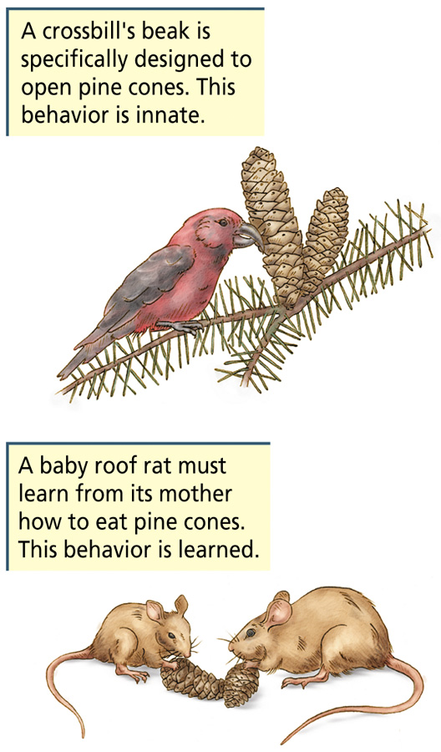

Slide 16
What Is Behavior?
Complexity of behavior varies considerably in different species
Simple
Nervous System
Narrow Range of Behavior
Depends on heredity
Complex
Nervous System
Wider Range
of Behavior
Depends on learning

Slide 17
A Brief History of the Brain
(yes, this will be on the exam)

Slide 18
Egyptian Mummification

Slide 19

Hippocrates
(460-379 BC)
Father of modern medical ethics
First to describe effects of head injuries
4 humours:
  Black bile → depressive
  Yellow bile → mood swings
  Phlegm → ‘sluggish’
  Sanguine (blood) → optimistic; tendency for mania

Slide 20
Aristotle (384-382 BC)
Brain a cooling agent for the heart; where the spirits circulated
  No role in producing behaviour
First use of term ‘common sense’
  Where the spirits come together (sensus communis)
  Psyche: Synonym for mind; an entity once proposed to be the source of human behavior
Mentalism: An explanation of behavior as a function of the nonmaterial mind

Slide 21
Galen
(131-201 AD)
Roman physician who worked in a gladiator school
  Regarded wounds as ‘windows into the body’
Correctly identified 7 of 12 cranial nerves
Taking of the pulse!
Concluded that the brain was the organ of the mind

Slide 22
Dark Ages (~1500 AD)
Period of religious dogmatism
  No scientific inquiry

Slide 23
Renaissance (“Re-Birth”)
Da Vinci laid the foundations for anatomical drawings

Slide 24
Rene Descartes
(1596-1650)
Dualism: Mind and brain are separate
  Both a nonmaterial mind and the material body contribute to behavior
Cogito Ergo Sum
HOWEVER: First to suggest link between mind and body.
Mind controlled movements, while body supplied mind with information via the senses
Notes:
Rene Descartes was a philosopher from the 17th C who speculated on the roles of the mind and brain in the control of behaviour. His view of the human body was like that of a machine. He described motor behaviour as a ‘reflex’ that did not require participation of the mind. Much like the other philosophers in this zeitgeist, he was a dualist: he believed that each person possessed a mind separate from the body. However, he was the first to suggest that a link exists between the human mind and the brain. Specifically, he believed that the mind controlled the movements of the body, while the body, through its sense organs, supplied the mind with information about what was happening in the environment.
Mind-Body Problem
Quandary of explaining a nonmaterial mind in command of a material body
Information between the mind and body passes through the brain
Mind is located in the pineal gland, which sits beside the brain’s fluid-filled ventricles
Mind controls rational behavior
Body and brain direct all other behavior via mechanical and physical principles
Examples: sensation, movement, digestion

Slide 25
Rene Descartes
(1596-1650)
Mind-Body Problem
  Quandary of explaining a nonmaterial mind in command of a material body
Information between the mind and body passes through the brain
Mind is located in the pineal gland, which sits beside the brain’s fluid-filled ventricles
Mind regulates
behavior by
directing the flow
of ventricular
fluid to appropriate
muscles

Slide 26
Problems with Descartes
Pineal gland is involved in biological rhythms, but not in intelligence or behavioral control
Fluid is not pumped from the ventricles to control movement
Nonmaterial influences on the body would violate the law of conservation of matter and energy

Slide 27
Luigi Galvani (1737-1798)
Demonstrated that nerves conduct electricity
  Not pipes!

Slide 28
Localization of Function: Hypothetically, the control of each kind of behaviour by a different specific brain area
  Not all parts of the brain do the same thing

Slide 29
Franz Gall (1758-1828)
Phrenology: Mental and moral faculties determined by shape of skull

Slide 30
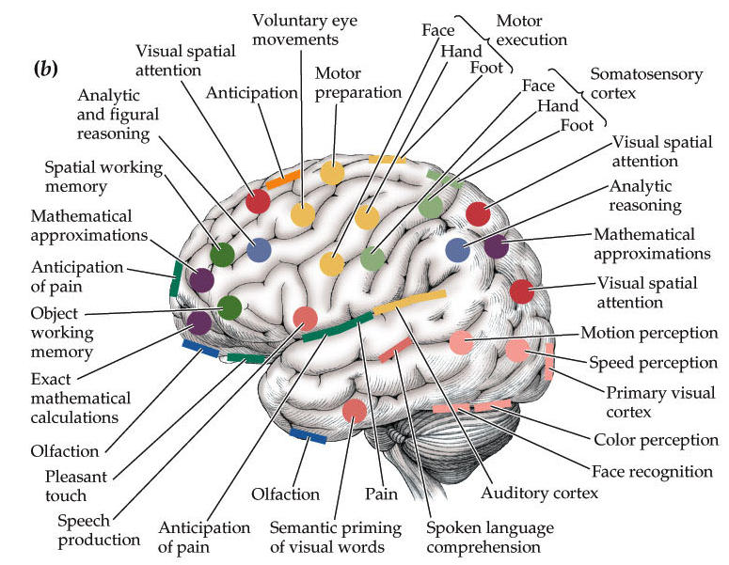
The New Phrenology?

Slide 31
Pierre Flourens (1794-1867)
Advocate of experimental ablation: remove part of brain and observe which behaviours remain

Slide 32
Paul Broca (1824-1880)
Observed stroke patient who had lost ability to speak
Autopsy revealed part of the right hemisphere missing
Concluded area important for speech production:
Broca’s Aphasia

Slide 33
William James (1842-1910)
Modern approach to biological psychology
Concepts of consciousness and human experience described as properties of the nervous system

Slide 34
Wilder Penfield
(1891-1976)
Neurosurgeon who invented the procedure to treat intractable epilepsy
Stimulated brain with electrical probes to observe their responses
Mapped out ‘homunculus’

Slide 35
Donald O. Hebb (1904-1985)
Father of modern behavioural neuroscience
Hebb Rule: “What fires together, wires together.”

Slide 36
Eric Kandel (1929- )
Nobel Prize (2000) for research in nerve transduction: Molecular mechanisms underlying learning and memory

