Slide 1
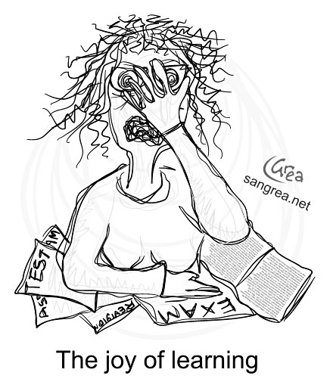
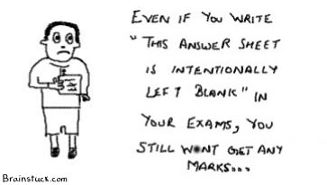
GEOG 2200 Final Examination
John Milton

Slide 2
The Exam
The final examination is worth 35% of your final grade – so it is important!
  At the same time, it is not designed to crush your spirit.
  If you invest time studying for the exam you will do well.
It is divided into two basic sections:
  Section 1 – examines your understanding of the key ideas that appeared over and over again
  Section 2 – examines your understanding of a selection of topics covered in the course.

Slide 3
Section 1
Section 1 of the examination is MANDATORY. This section will be worth 20 marks. It draws upon weeks 0, 1 and 12:
  Week 0. How are We Connected? Introducing Global Connections
  Week 1. The World Today. Who are We? The Geographic Expression of Unevenness: A World of Cores and Peripheries. Required Reading: Chapter 1
  Week 12. What Might the Future Hold? Emerging New Global Relations: Globalization and Localization and the Dynamics Between the Local and Global. Is the Nation State Obsolete? Required Reading: Chapter 10 (the questions from this last week will come from the chapter reading since we spent more time just talking and the course review.

Slide 4
Section 2
Section 2 of the examination will consist of 10 options (weeks 2 through 11).
  You must answer THREE of these sections.
  You cannot pick and choose questions between all 10. Each of these sections will be worth 20 marks (for a total of 60 marks).
  Remember that questions can also come from the videos we watched. So review these as well!

Slide 5
Section 2
Your choices in section two will be:
  Week 2. Connections through History OR Why History Matters! Required Reading: Chapter 2
  Week 3. Trade and Beyond: The Globalizing of Manufacturing. Required Reading: Jacob, F., and G. Strube. 2010. Why go Global? The Multinational Imperative.
  Week 4. Servicing the World. The Internationalization of Services. Why India? Required Reading: Mishra, S., S. Lundstrom and R. Anand. 2011. Service Export sophistication and Economic Growth. Washington, D.C.: The World Bank.
  Week 5. The International Connoisseur: Global Diets for the Global Citizen. Required Reading: Anderson, K. 2010. Globalization’s effects on world agricultural trade, 1960-2050. Philosophical Transactions of the Royal Society, Biological Sciences 365:3007-3021.

Slide 6
Section 2
Your choices in section two will be:
  Week 6. Are Nations becoming Obsolete? Required Reading: Chapter 6
  Week 7. Are we becoming an Urban Species? Cities in a Globalized World. Required Reading: Chapter 8
  Week 8. Are we National Citizens or Global Citizens? Culture and globalization. Required Reading: Chapter 9
  Week 9. The Climate Connection: Why should we all be concerned with climate change? Required Reading: Chapter 4, 5
  Week 10. Security and the Scepter of Terrorism. Required Reading: Chapter 3
  Week 11. Development as Freedom. Beyond Simple Economics. Required Reading: Chapter 7

Slide 7
Types of Questions
Questions will both factual and interpretative.
  Factual – regurgitating information presented in the lectures, the videos and readings.
  Interpretative – I ask you answer a question drawing upon one or more ideas.
  You may also be asked to draw a diagram – e.g., the typology of climate change outcomes.

Slide 8
Types of Questions
Example of a factual question: Why did China NOT rise to world dominance during the 16th century onwards while Europe did? (4 marks)
Scholars have presented several arguments to explain this. One argument was that China failed to take advantage of opportunities overseas. Some argue the apparent lack of interest in territorial expansion and exploration was China’s inward nature, focusing on itself as the ‘Middle Kingdom.’ Other scholars have argued that the dynastic rulers became increasingly focused on the Mongolian threat of the time and on the Japanese pirates that preyed on their coastal centres. Another group of scholars point to the centralization of the empire itself as the cause since it stifled the initiative of the thousands of towns and the diverse interest groups [including merchants] who might have driven exploration as was the case in Europe. Still other scholars point to the differences in the agricultural foundations of Europe and China.

Slide 9
Types of Questions
Example of an interpretative question: How do ‘fairer’ trade and ‘fair’ trade differ? (3 marks)
There is the issue of fairer trade. I have mentioned on more than one occasion the dependency of countries of the periphery on exports of raw resources and foodstuffs. Often, countries find themselves dependent upon one or two commodities. This has left many of these countries exposed to dramatic fluctuations in world prices. There is the need to move to a more equal global trading regime without subsidies and other forms of unfair supports Possible by core economies.
On the other hand, in the last decade, the ‘fair trade’ of agricultural products and food has emerged as an important tool to create markets for poor and small-scale farmers and simultaneously promote pro-poor development. This is based on an ethical relationship between Northern consumers and Southern producers. This is seen primarily from a Northern perspective.

Slide 10
You will have time!
You have three hours in which to write the examination so take your time. Do not rush through this just to “get outta Dodge” – it’s three hours of your life BUT your grades stay with you forever.
The exam will take place December 19 @ 2:00 pm
in the Raven’s Nest (Alumni Hall),
Athlectics Complex (Rows 26 through 40).

Slide 11
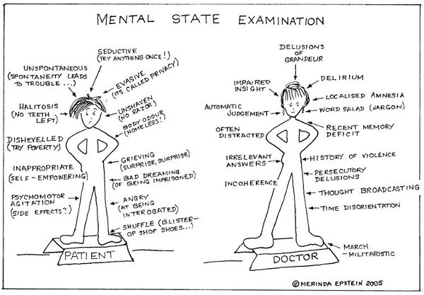
You will have time!

