Slide 1
PSYCHOLOGICAL DISORDERS
CHAPTER 14

Slide 2
Outline
What is a psychological disorder?
Where do disorders comes from?
Diagnosis
Types of psychological disorders
  Anxiety disorders
  Mood disorders

Slide 3
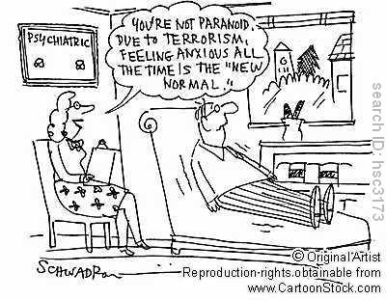
What is a disorder?
Where do we draw the line between normal and abnormal?

Slide 4
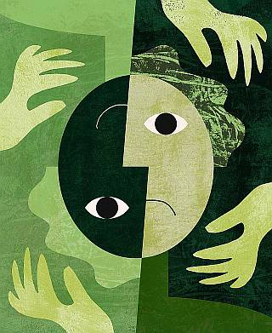
How do we define a disorder?
Ongoing patterns of thoughts, feelings, and behaviors that are:
  Deviant (different)
  Distressful
  Dysfunctional
Notes:
Feelings; depression. Behavioral: add adhd. Thoughts: thinking. Deviant: pattern must be against what we think is against the norm. disorders are not necessarily universal. Exception of 2. time matters. 1972 homosexuality was considered a psychological disorder. Distressful, pattern of thoughts feelings and behaviors causes person or significant others distress. Dysfunctional: interferes with your life.

Slide 5
Where do disorders come from?
Middle ages:
  Evil!
  Remove blood, hair teeth, that ought to take care of it….
1800’s
  A sickness
  Medical model
Notes:
Middle ages: people were possesed. Believed that is they could get rid of the evil they could get rid of the disorder (evil). 1800’s: considered a sickeness instead of a evil. People with disorders got treated in humain ways.

Slide 6
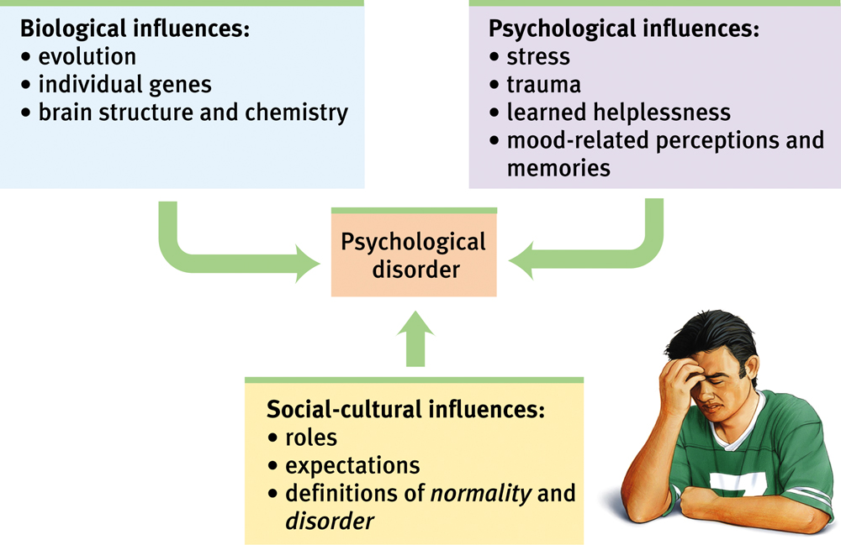
Bio-Psycho-Social Perspective

Slide 7
Cultural variations in mental disorders
Susto
  “fright sickness”
  Latent American
  Anxiety, restlessness, depression, weakness, rapid heartbeat
  Cause: contact with supernatural beings
Amok
  “furious attack”
  Malaysia
  Brooding followed by sudden outburst/attack. Followed by amnesia.
  Causes: stress, sleep lost, heat, alcohol use.

Slide 8
General Risk Factors for Psychological Disorders
Social Conditions:
  Poverty, homelessness, overcrowding, stressful living conditions
Family Factors:
  Parents who are immature, mentally ill, abusive, or criminal; poor child discipline; severe marital or relationship problems
Psychological Factors:
  Low intelligence, stress, learning disorders
Biological Factors:
  Genetic defects or inherited vulnerabilities; poor prenatal care, head injuries, exposure to toxins, chronic physical illness, or disability

Slide 9

Classifying psychological disorders
Diagnostic and Statistical Manual of Mental Disorders (DSM-IV-TR)
  Describes symptoms
  Statistics about gender, age of onset
  Effects of treatment
  Common treatment approaches
Requires specialized training to use
Notes:
Todays psychologists diganose sickness by using the DSM IV TR mostly focuses on describing the disorder. Gives therapists clues. Doesn’t specify causes. Used for assesment and diagnosis

Slide 10
Costs and benefits of classification
Benefits:
  Description of complex disorders
  Communication
  Identify treatment options
  Reliability
  Insurance
Costs:
  Too many behaviors are considered “symptoms”
  Causation
  arbitrary and subjective
  Labels are powerful
    Bias perceptions
    Self-fulfilling prophecy

Slide 11
Categories of Disorders
Anxiety Disorder: Feelings of fear, apprehension, anxiety, and distorted behavior that is anxiety related
Mood Disorder: Disturbances in affect (emotions)
Dissociative Disorder: Temporary amnesia, multiple personality, or depersonalization (like being in a dream world, feeling like a robot, feeling like you are outside of your body)
Psychotic Disorder: Severe psychiatric disorder characterized by hallucinations and delusions, social withdrawal, and a move away from reality
Personality Disorder: Deeply ingrained, unhealthy, maladaptive personality patterns

Slide 12
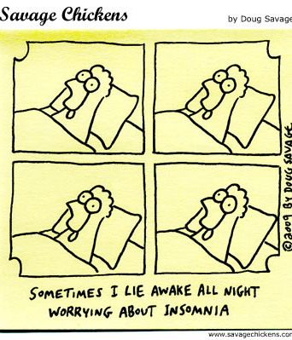
Anxiety Disorders
Characterized by distressing, persistent anxiety or maladaptive behaviors to reduce anxiety
Types:
  General anxiety disorder
  Panic disorder
  Obsessive compulsive disorder
  Social anxiety
  Post-traumatic stress disorder
  phobias
Notes:
Often accompanied by mal adaptive behaviours used to cope. Lots of types of anxiety disorders.

Slide 13
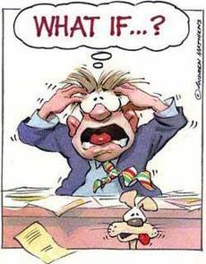
Generalized Anxiety Disorder
Chronic, uncontrollable, excessive worry about many things.
Symptoms:
  Difficulty concentrating
  Problems sleeping
  Agitated
  Physical symptoms
3.1%
Notes:
Worrying is different because it is excessive, persistant and intrusive.

Slide 14

Obsessive-compulsive disorder
Obsessions:
  Thoughts, images or impulses
Compulsions:
  Repetitive behavior
Example:
Obsession: terrified by the thought that cars might careen onto the sidewalk and run over you. Compulsion: walks as far away from the pavement as possible and wears red so that she will be visible.
Notes:
More common among teens and young adults. More common in males. Must take up to an hour doing compulsive actions a day

Slide 15
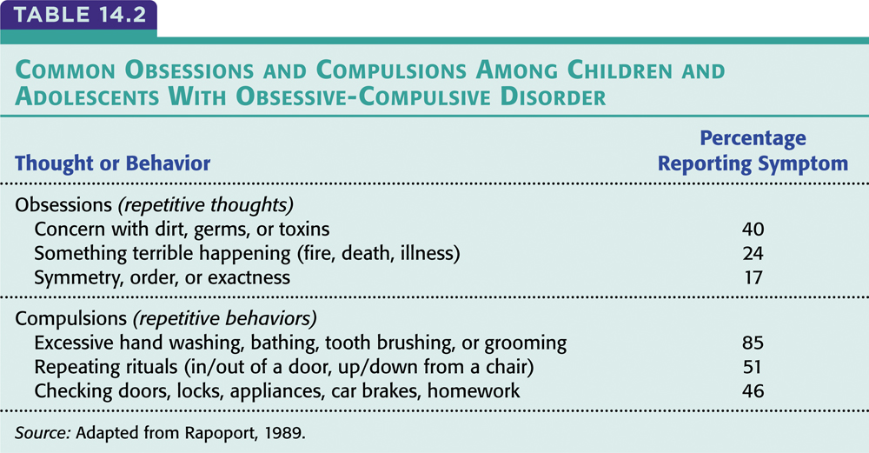

Slide 16
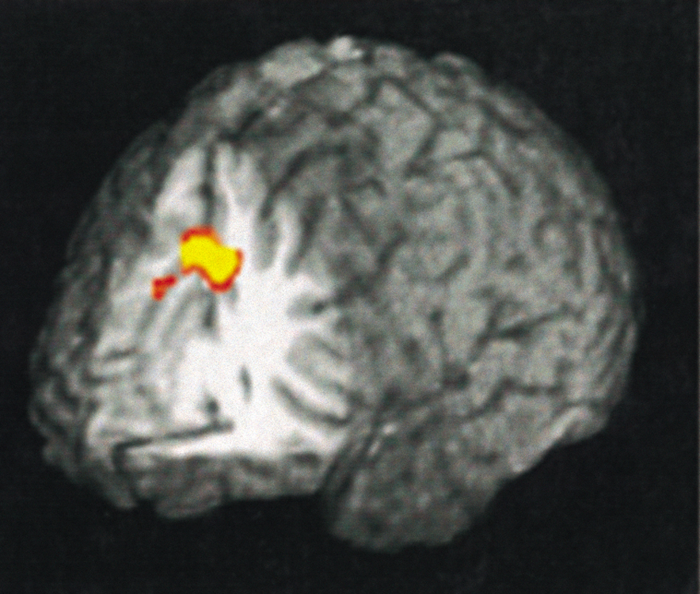
Causes of anxiety disorders
Learning perspective:
  Stimulus generalization
  Reinforcement
Biological perspective:
  Genes
  Brain structure
Notes:
Our anxieties fears and phobeas are things that are learned. Generalization, dog bites you youre not just afraid of that dog you are afraids of all dogs. Bio– genes, people who have an anxiety disorder has somone who sufferes from one as well or has high anxiety.

Slide 17
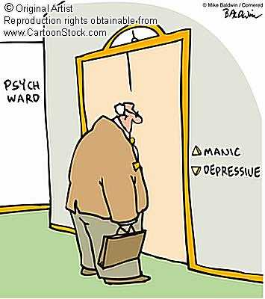
Mood Disorders
Characterized by changes in mood
Types:
  Major depressive disorder
  Bipolar disorder

Slide 18

Major depressive disorder
Two or more weeks of at least 5 of the following symptoms:
  sadness
  loss of interest/pleasure in usual activities
  Changes in appetite
  Changes in sleep
  Changes in sexual desire
  Difficulties concentrating
  Social withdrawn
  Worthlessness
  Thoughts/plans of suicide
Notes:
Called the common cold of psychological disorders. Most common. Number one reason people seek mental health care. Much more than sadness. Someone who has these dissorders don’t have these symptoms all the time.

Slide 19
Major depressive disorder
Example:
  I feel like the world is dark grey even when I am happy. I want to sleep even when I get enough sleep. I feel like crying or have a lump in my throat like I am going to cry, but I can't cry and don't know why. I take offence easily and have no patience. I feel like I am no good to anybody. And at its worst I feel like the people I love are getting so hurt by me that they would be better off if I wasn't here. Although I have had no actual thoughts of suicide, or attempts, I am told that this also is a sign.

Slide 20

Major depressive disorder
Any age (average 32)
Women twice as likely to experience depression.
Notes:
Most common between 18-50. much more common among women. Women are mor elikely to have internalized disorders. Women have a greater emotional memory. Women tend to over think. They replay negative events over and over.

Slide 21

Bipolar Disorder
Alternating between states of depression and mania
Mania: extreme state of euphoric, hyperactive, optimism
  Easily distracted
  Reckless behavior
  Little sleep
  Racing thoughts
  Talkative
  Easily irritated
Notes:
Mood is so elavated that it has many consequences. Easily irratable. Feel they can solve any problem. Don’t need sleep. Do high rsk activities. Lots of drugs.men and women are equally likely. Common between 20-30

Slide 22
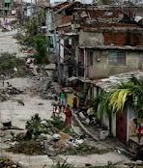
Factors influencing mood disorders
Environmental
  1 in 4 have experienced a negative life event
Biological
  Genes
  Neurotransmitters (norepinephrine, serotonin)
Notes:
People with depression have low levels of those neurotransmitters. Drugs that treat dperession try to increase them.

Slide 23
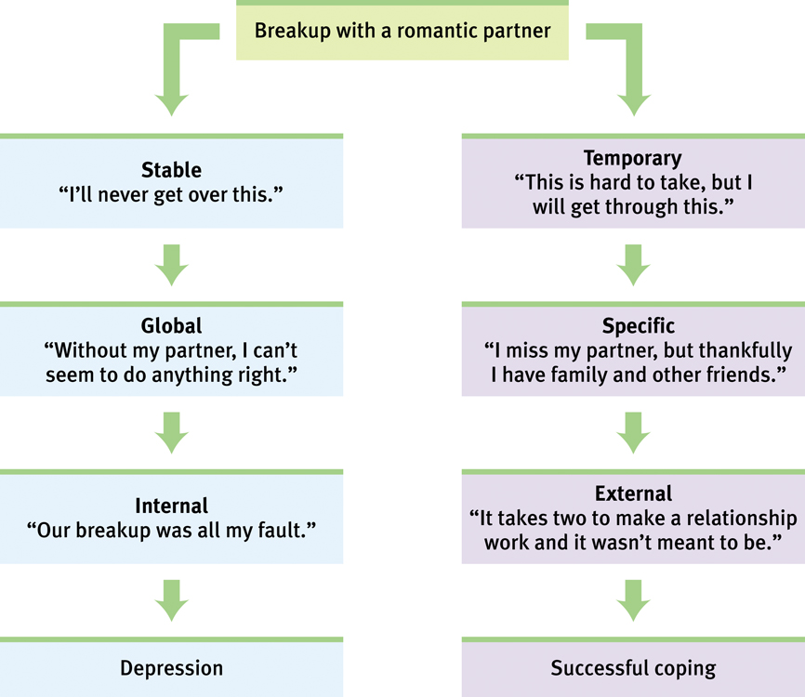
Factors influencing mood disorders
Cognitive factors
  Negative explanatory style
    Stable
    Global
    Internal

Slide 24
The cycle of depression
1
Stressful
experiences
4
Cognitive and
behavioral changes
2
Negative
explanatory style
3
Depressed
mood

