Slide 1
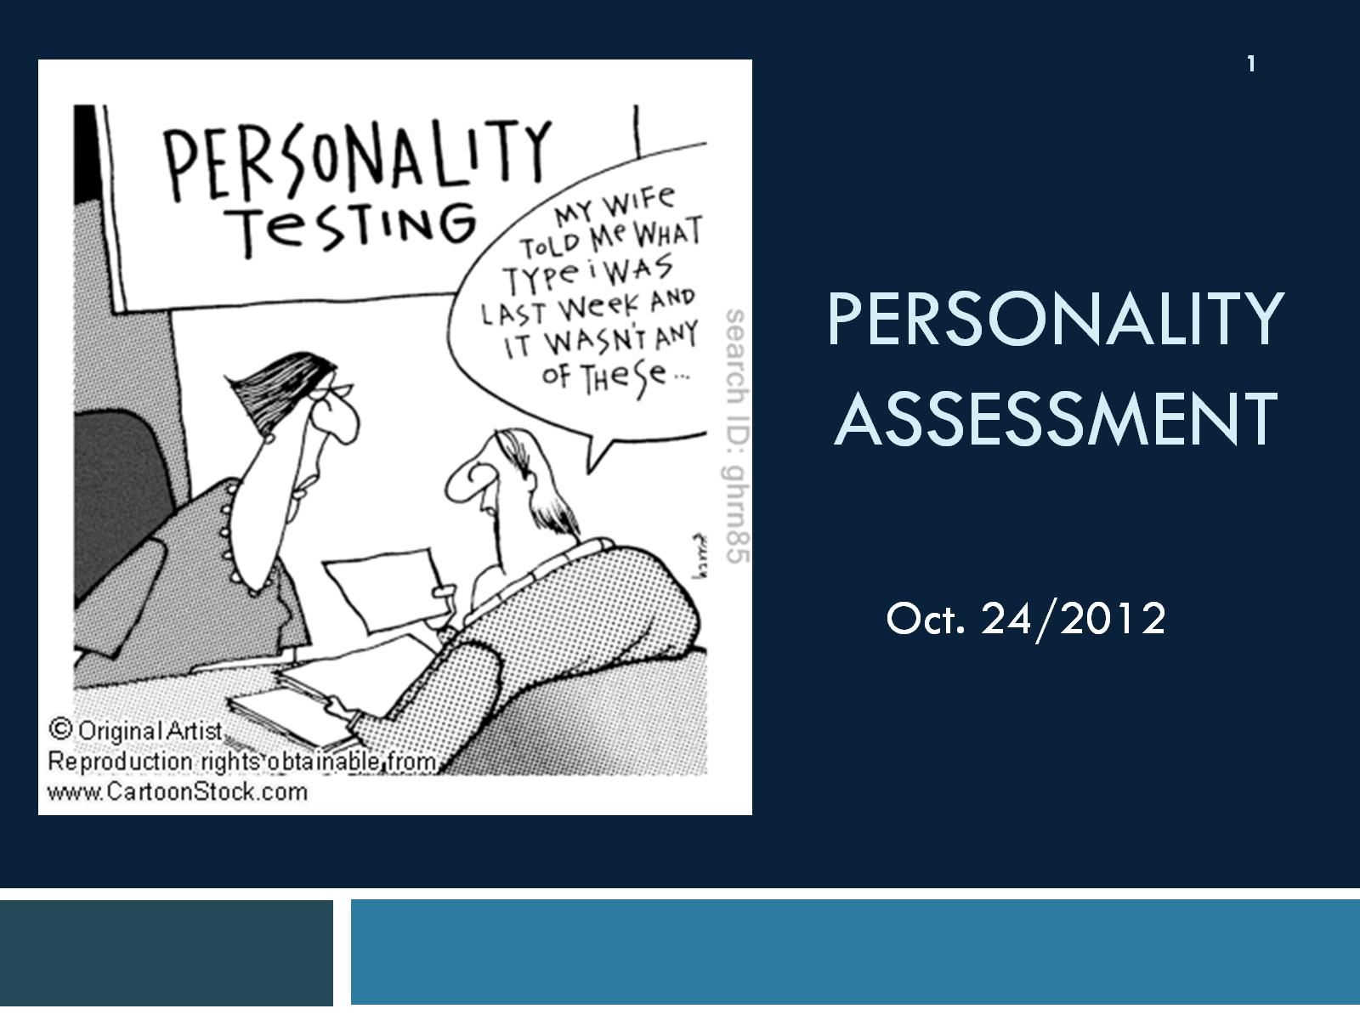
Personality
Assessment

Slide 2
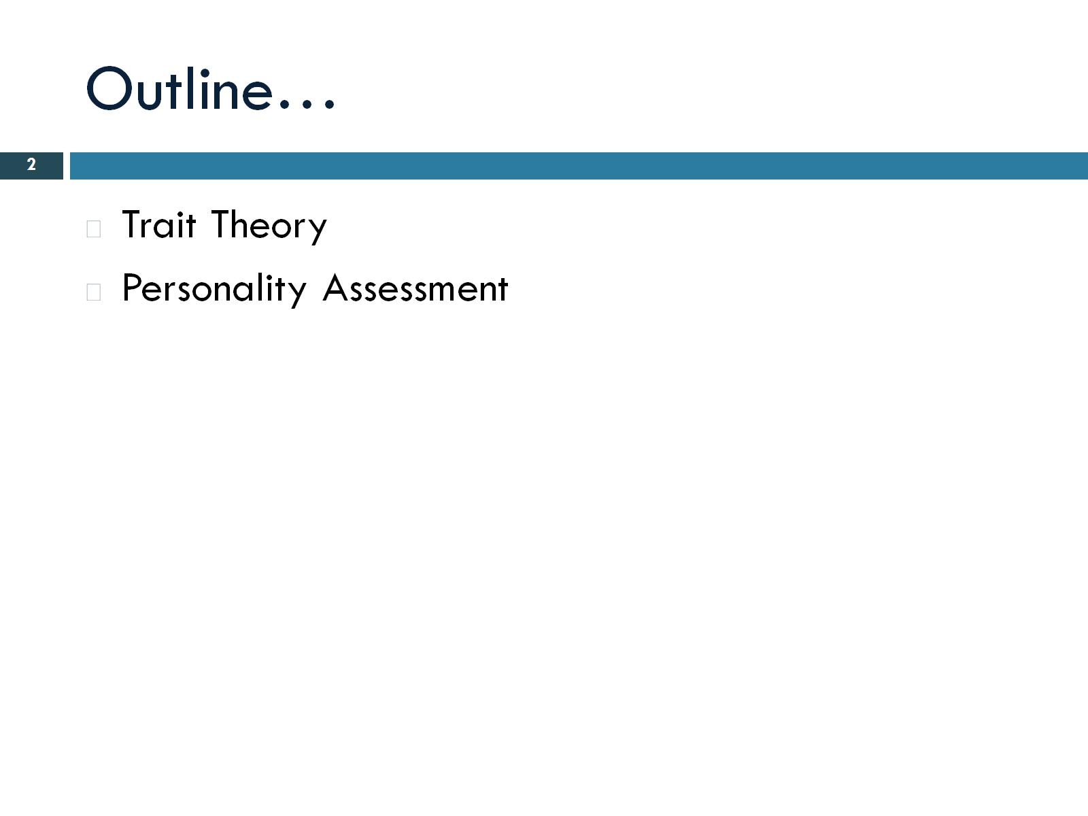
Outline…

Slide 3
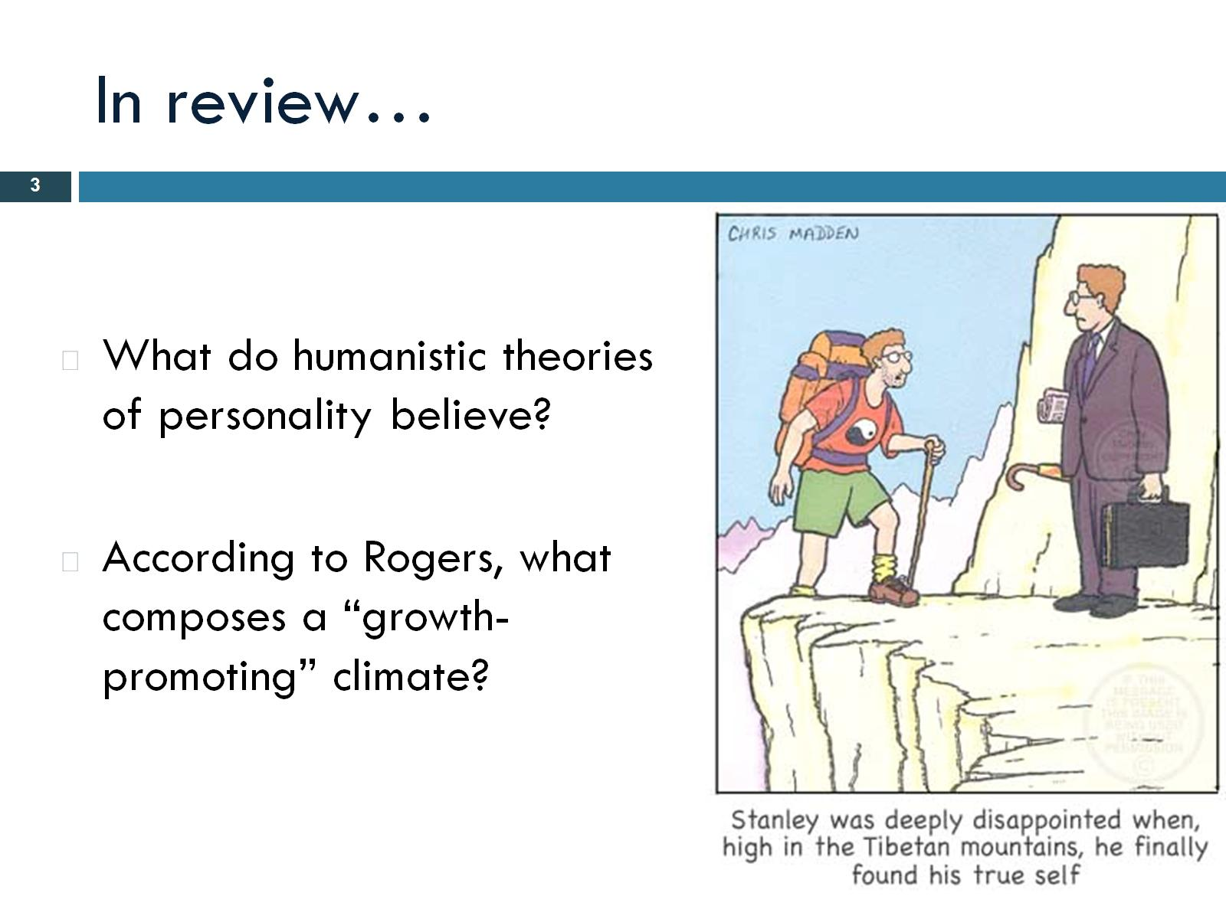
In review…
Notes:
Everyone is innately good. Personality is in our control. Conciouse experience. We need an environment that’s good enough. Three components= geniunness, positive regard-accepted-, empathy.

Slide 4
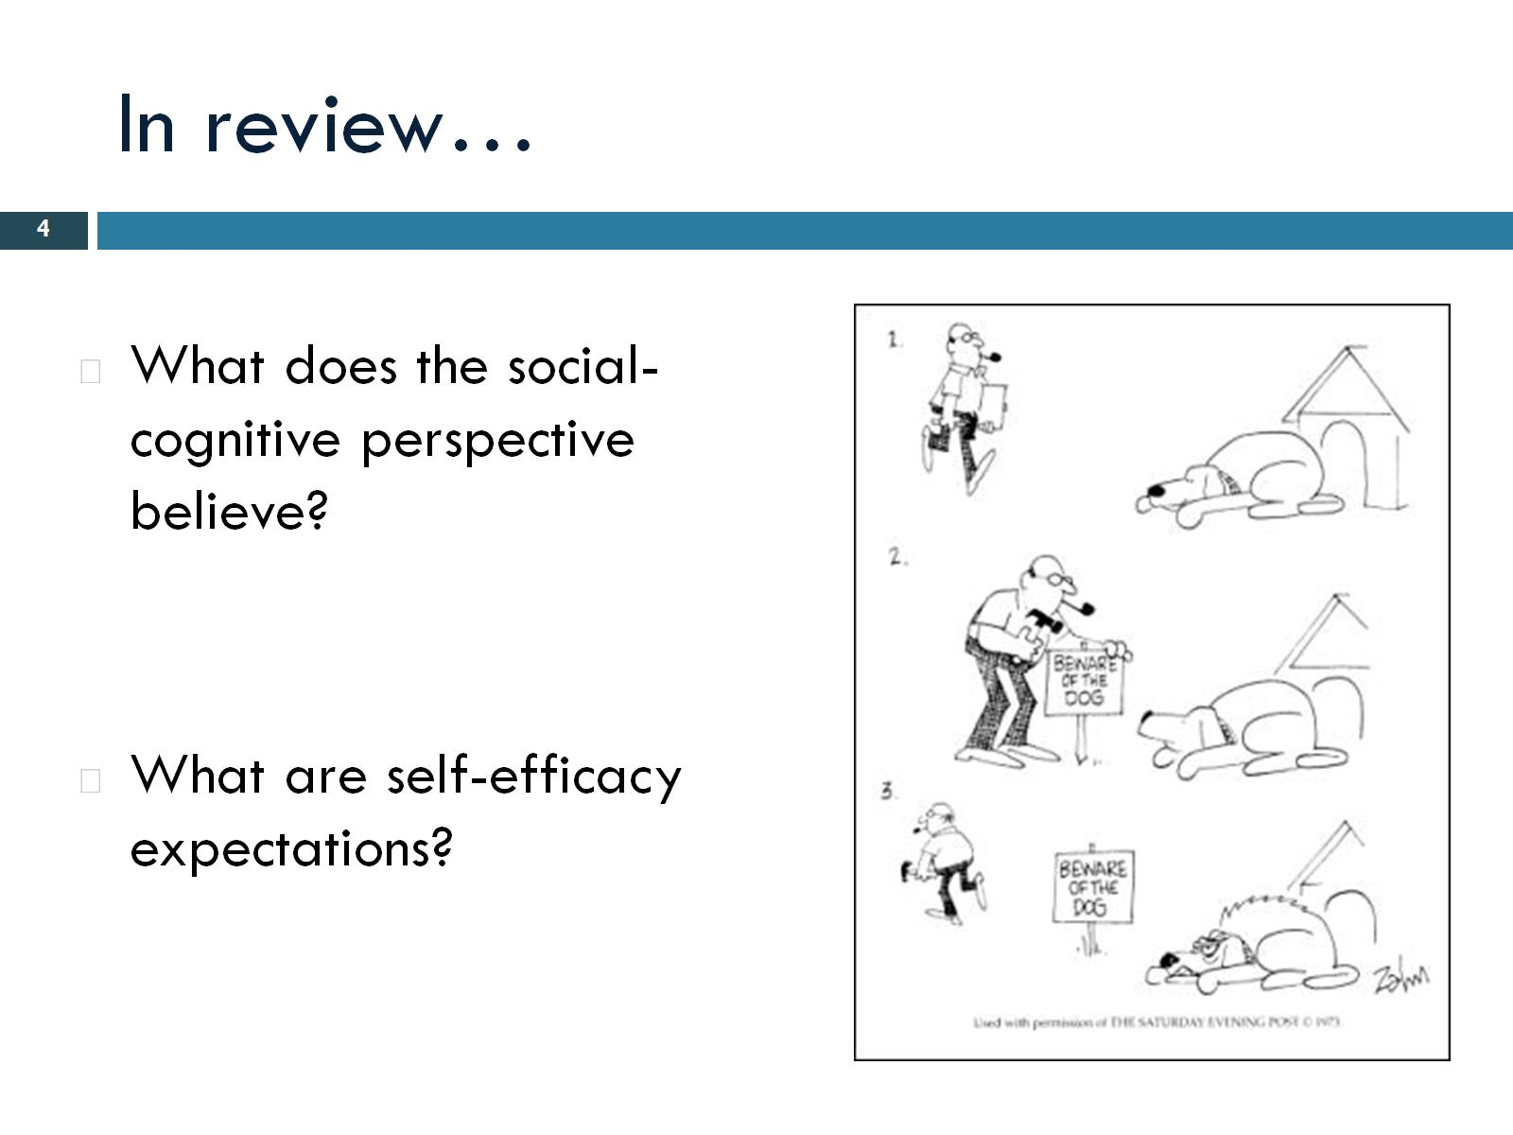
In review…
Notes:
Influenced by how we think. Belief that we can perform a behaviour

Slide 5
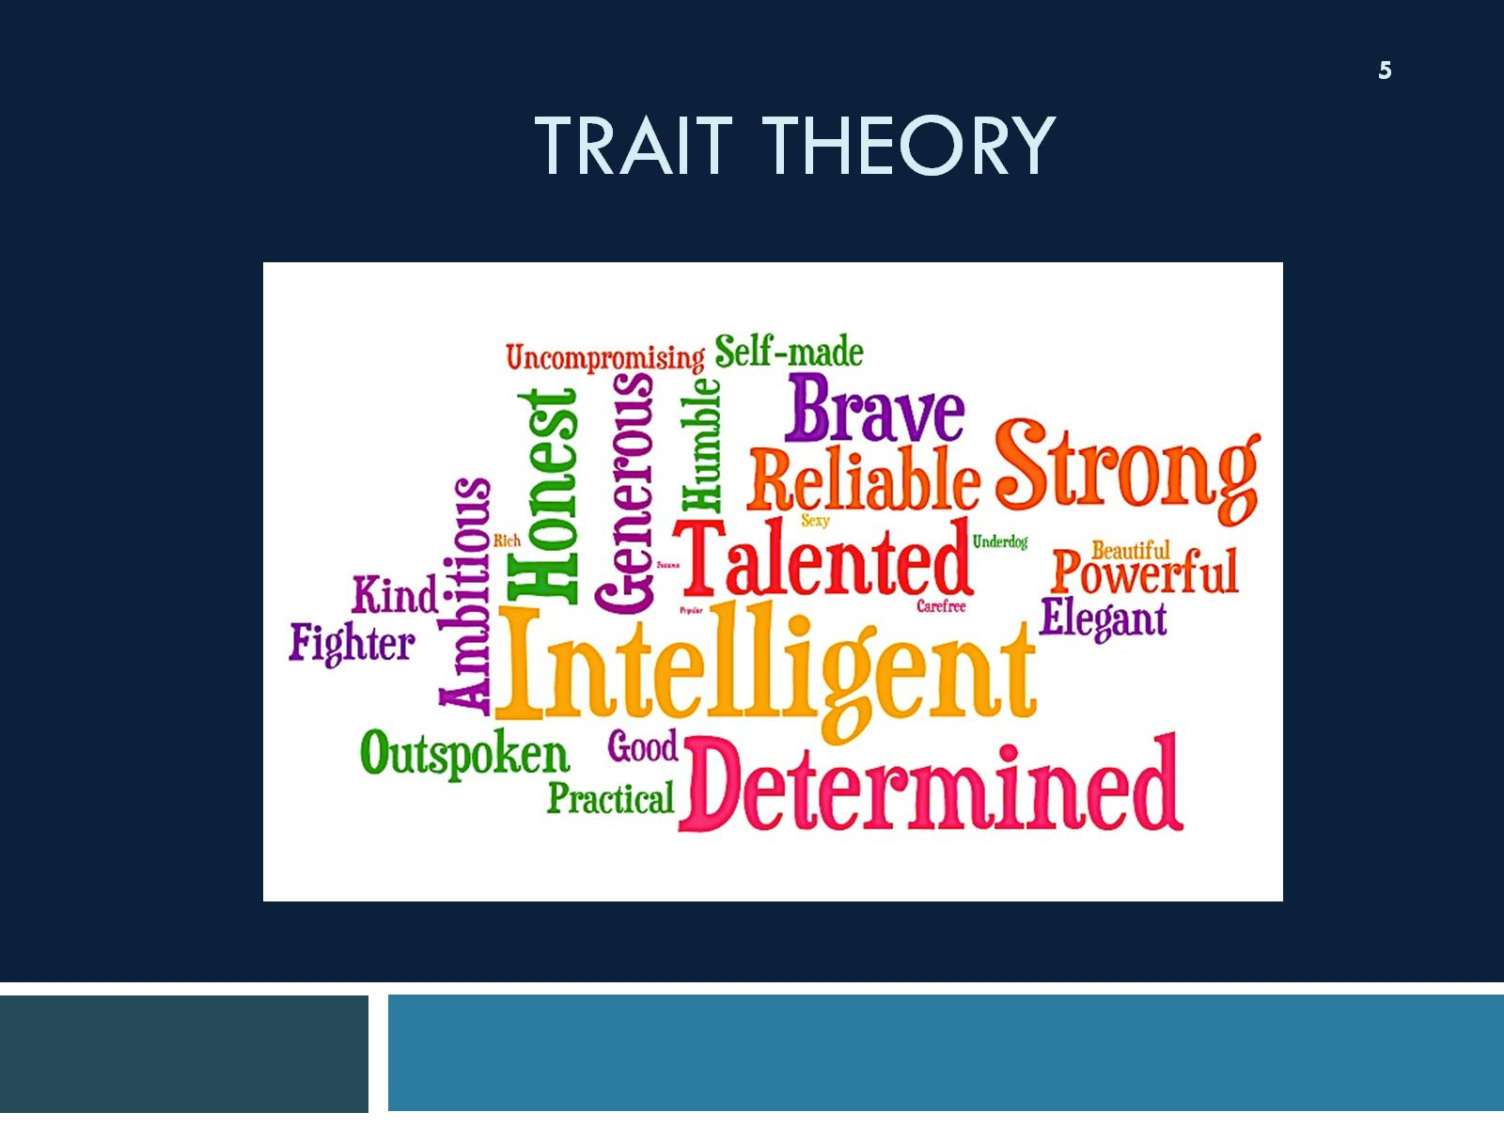
Trait Theory

Slide 6
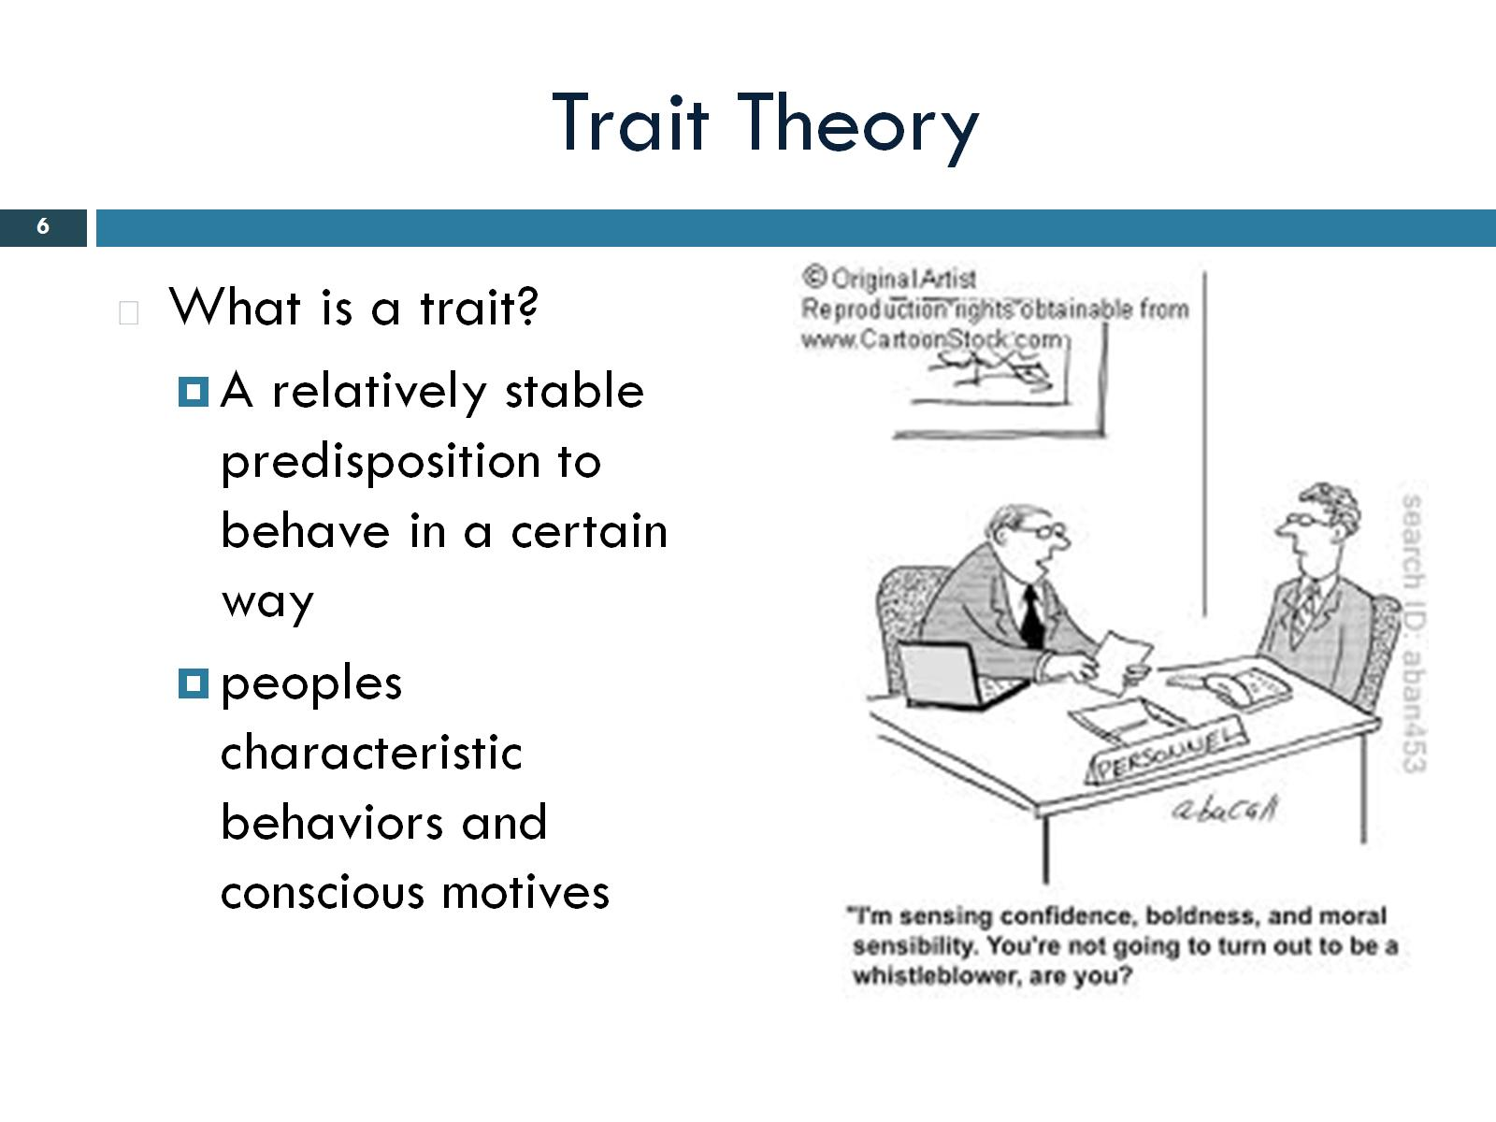
Trait Theory
Notes:
Makes us who we are. Permamnently evidence that is through our behaviour. Personality is composed of dispositions.

Slide 7
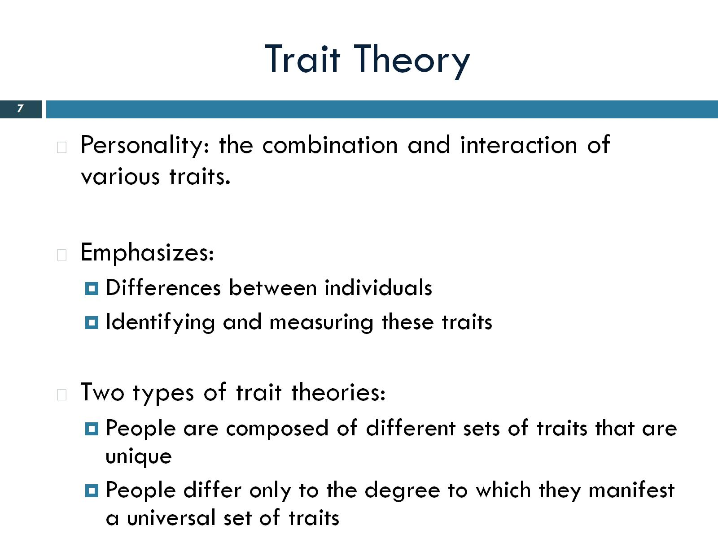
Trait Theory
Notes:
Believe everyone is going to have unique personality. Focused on ident and measuring traits. Just want to be able to describe traits. Two types of trait theories. Believe people are composed of different sets of traits that are unique. Second type beleievt here is a diffinitive number of traits. It’s the degree to which the traits are expresssed that determine personality

Slide 8
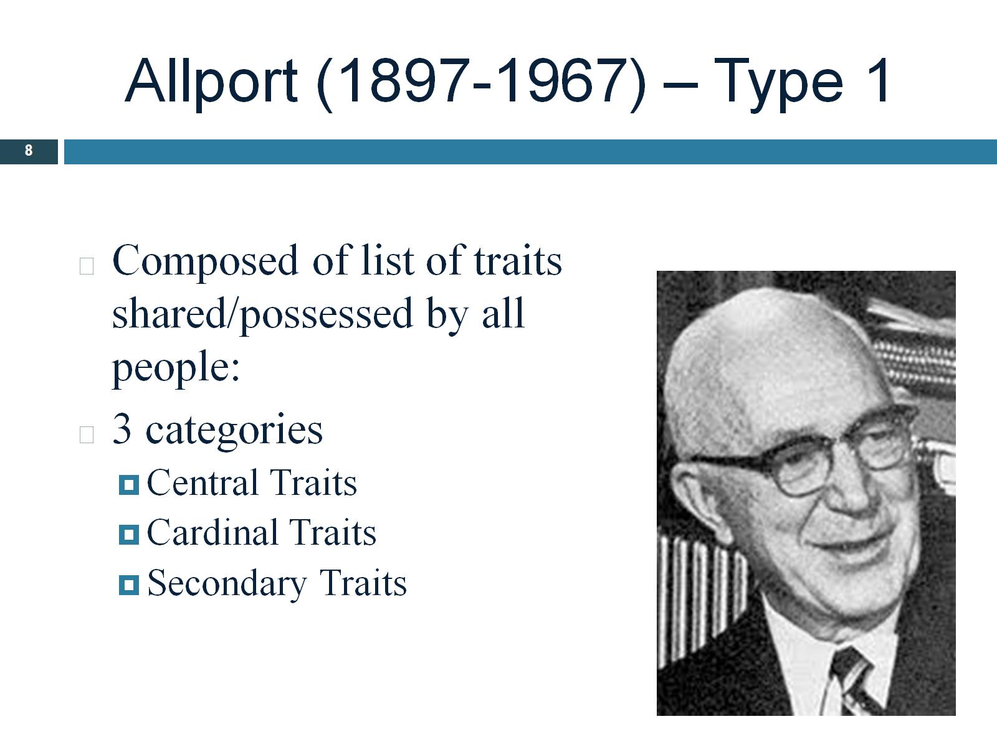
Allport (1897-1967) – Type 1
Notes:
Considered father of trait personality theory. Desided there where 4500 traits. Central traits- foundation of our personality. Cardinal traits- dominates entire personality. Secondary traits- traits that appear only in certain situations.

Slide 9
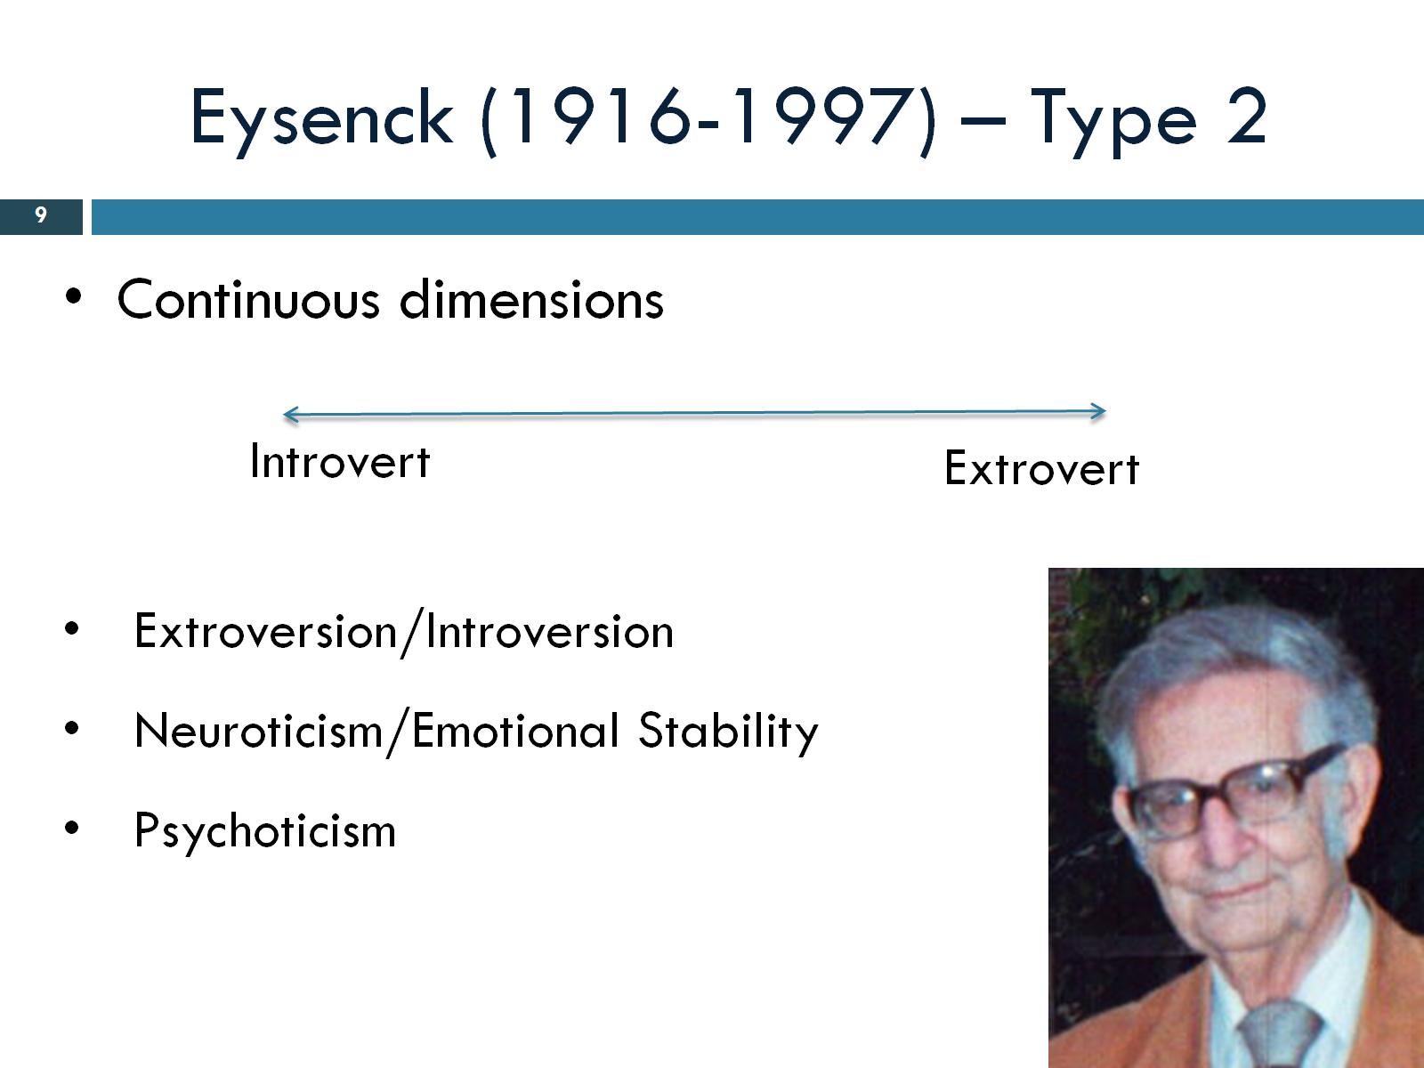
Eysenck (1916-1997) – Type 2
Notes:
First trait theorer to scientifically come up with character traits. Neurotic- unstable, mood swings. Psychoticism, difficulty dealing with reality.nnon empathetic. Extrovert- out going, party. Introvert, stay at home, independent. He believed this was genetic.

Slide 10
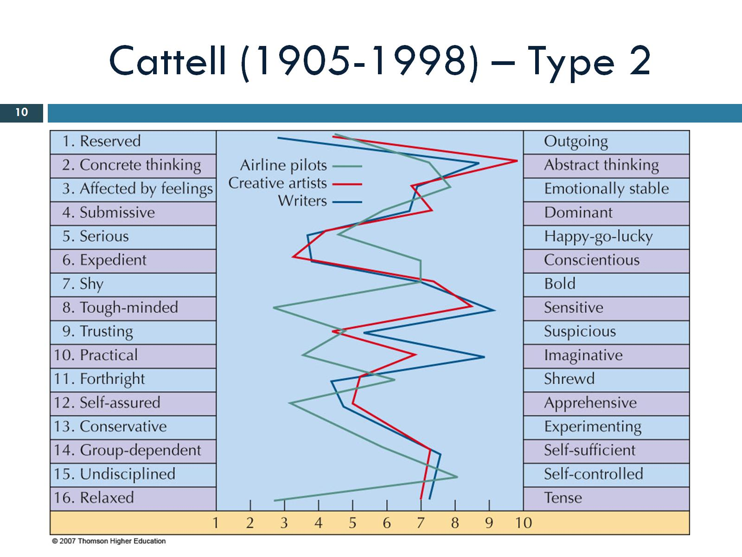
Cattell (1905-1998) – Type 2
Notes:
Reduced allports 4500 traits to 171. followed eysneck and did factor analyses. Cam up with 16 instead of three.

Slide 11
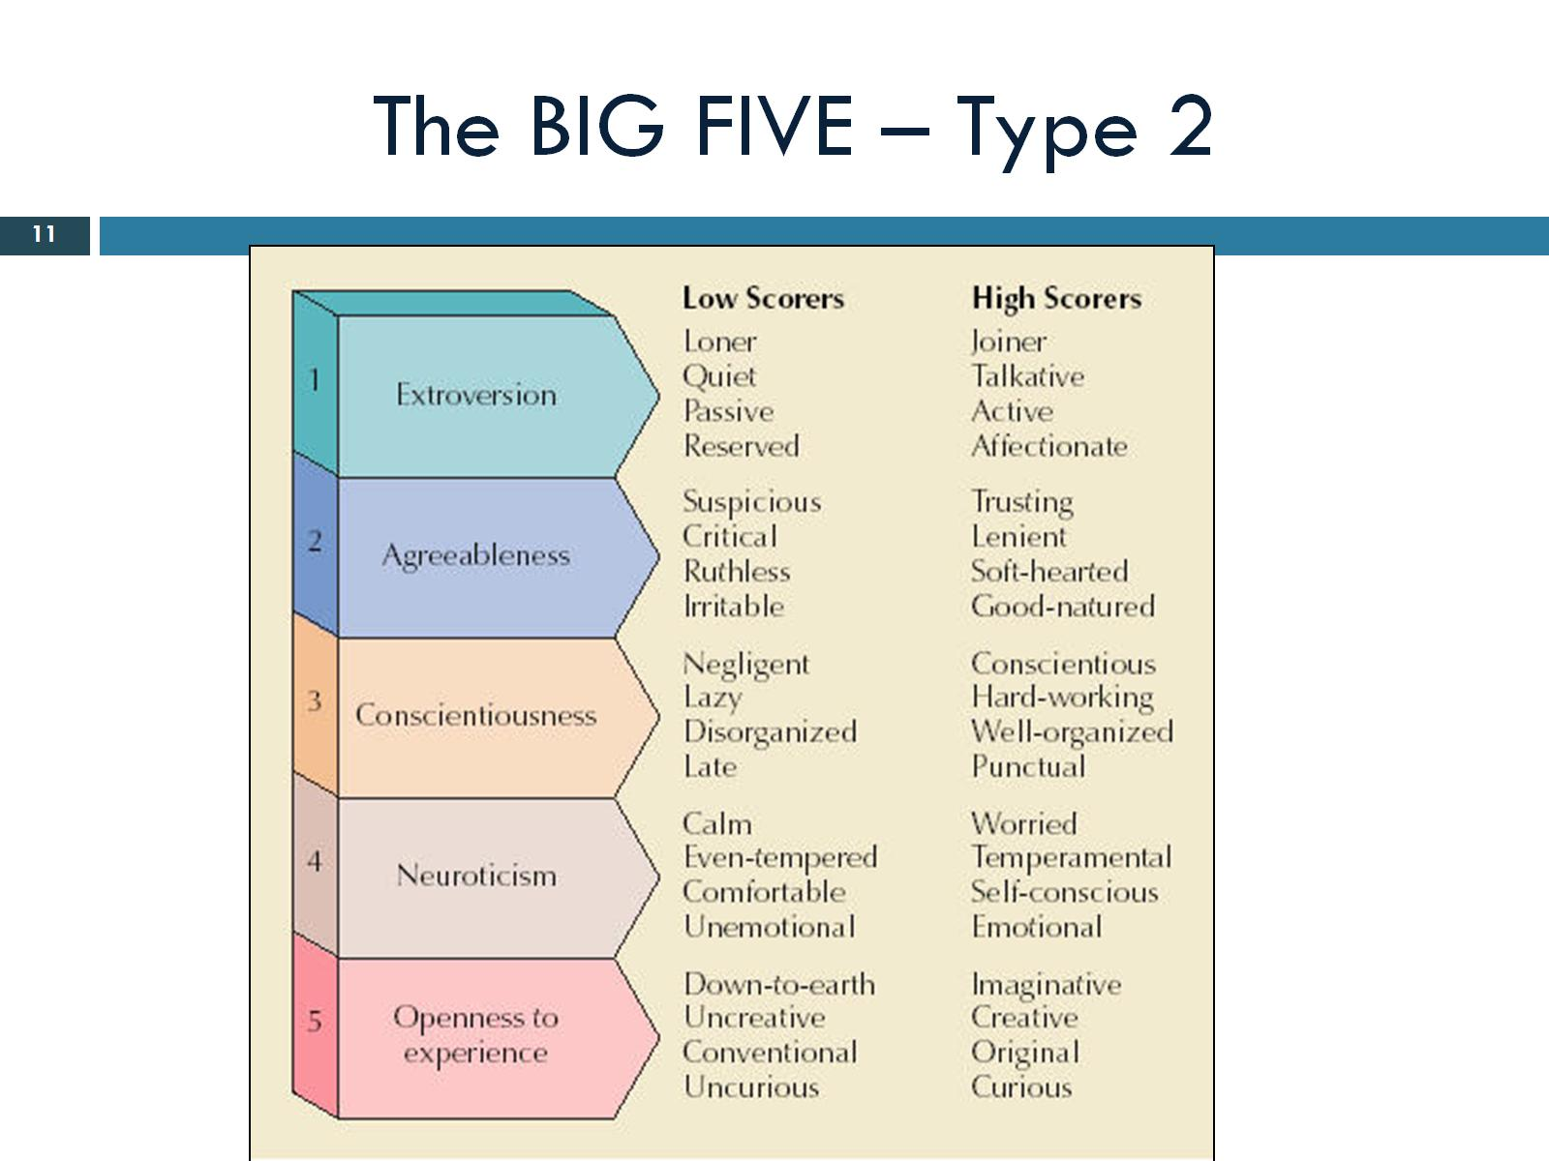
The BIG FIVE – Type 2
Notes:
Most widely accepted trait model. 5 super traits type two theory. Everyone has a score on all five, the range however differs. Basically universal. Found in almost all cultures, ages, ethnicities. Shown to have good stability. Average level stays the same

Slide 12
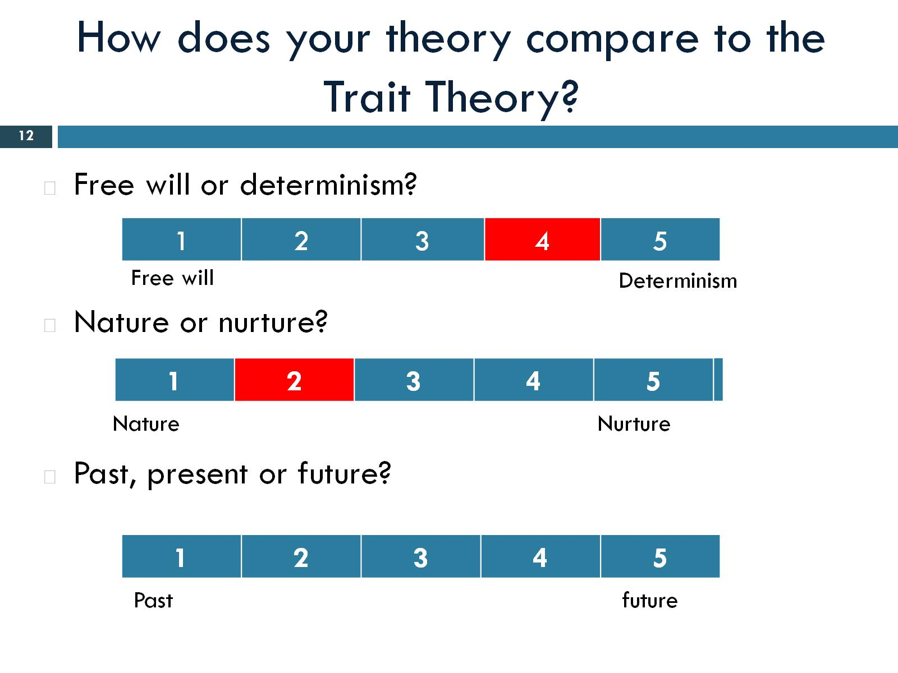
How does your theory compare to the Trait Theory?
Notes:
Determinism. Born with traits that make up our personality. Nature,

Slide 13
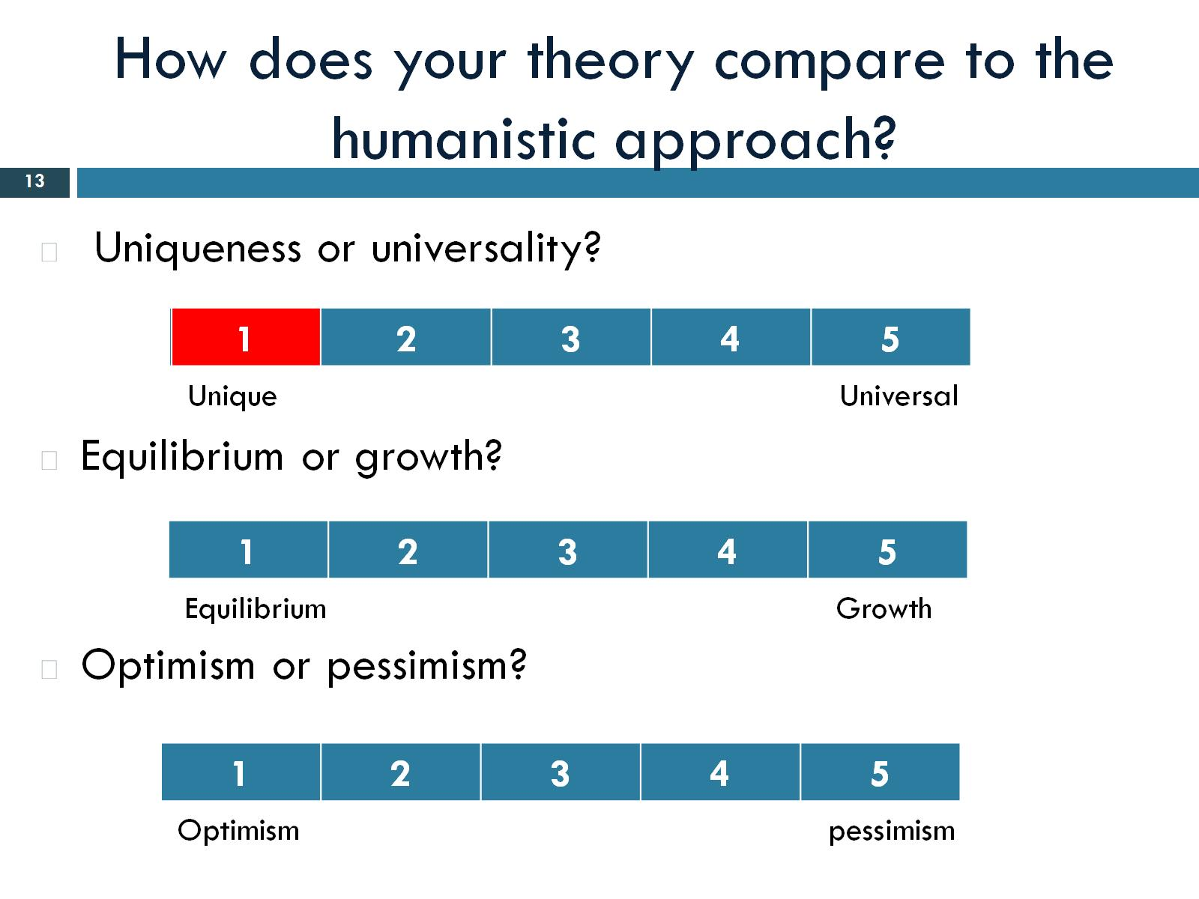
How does your theory compare to the humanistic approach?
Notes:
Uniqueness. don’t try to explain our personality. They just describe it.

Slide 14
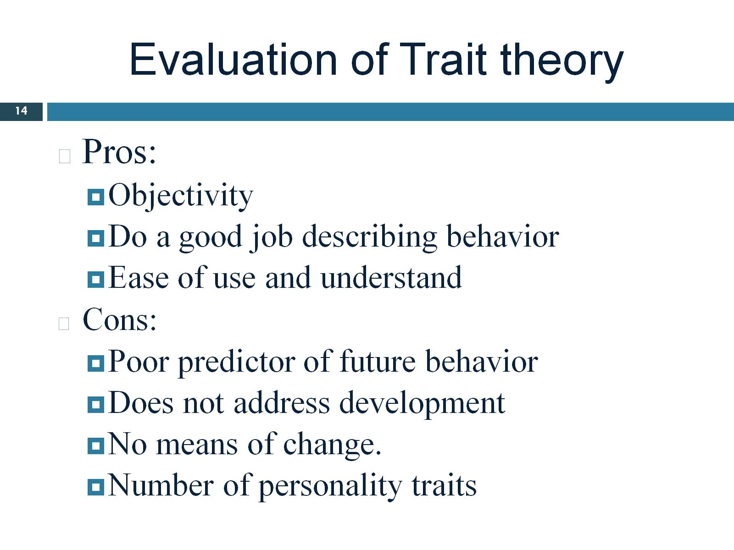
Evaluation of Trait theory
Notes:
Objectivity- relies on statistics and objective data. Continued to use now. Doesn’t predict future behaviour because it doesn’t take into acoount that we don’t always behave the same way in all situations.

Slide 15
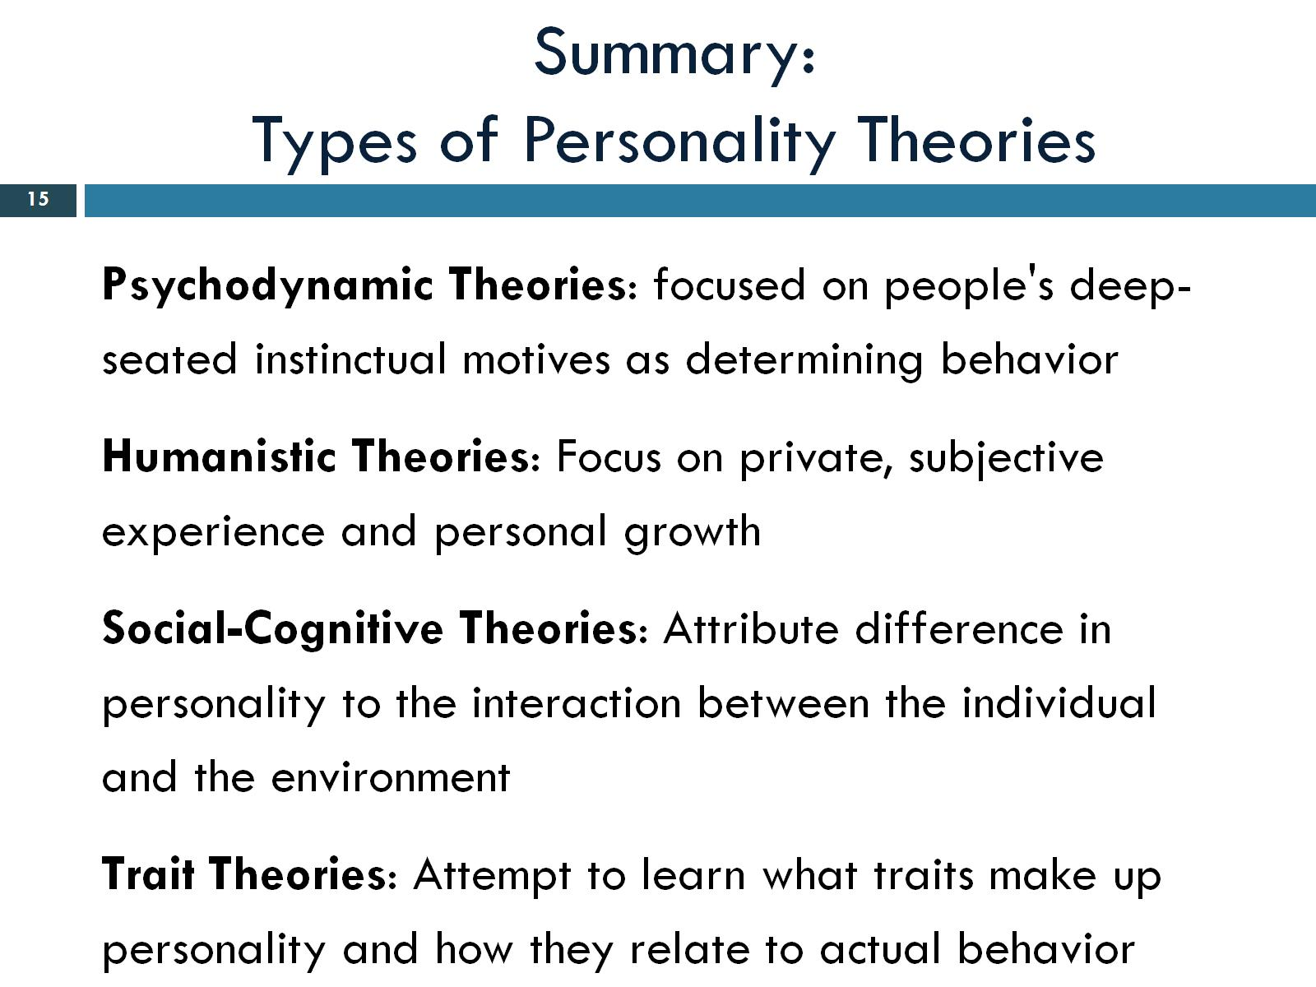
Summary:
Types of Personality Theories
Notes:
1. Freuds theory. Personality determined by unconscious.

Slide 16
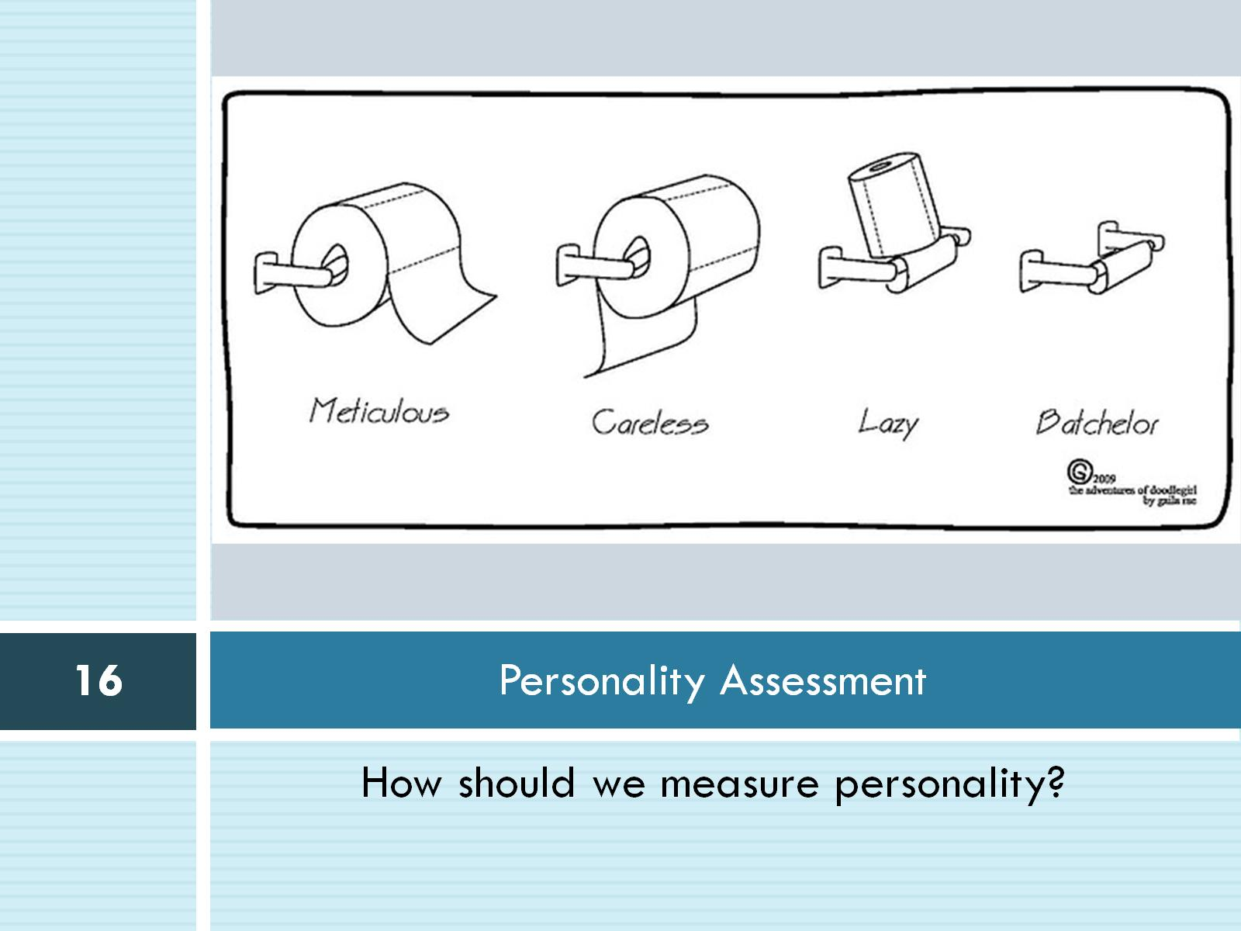
Personality Assessment

Slide 17
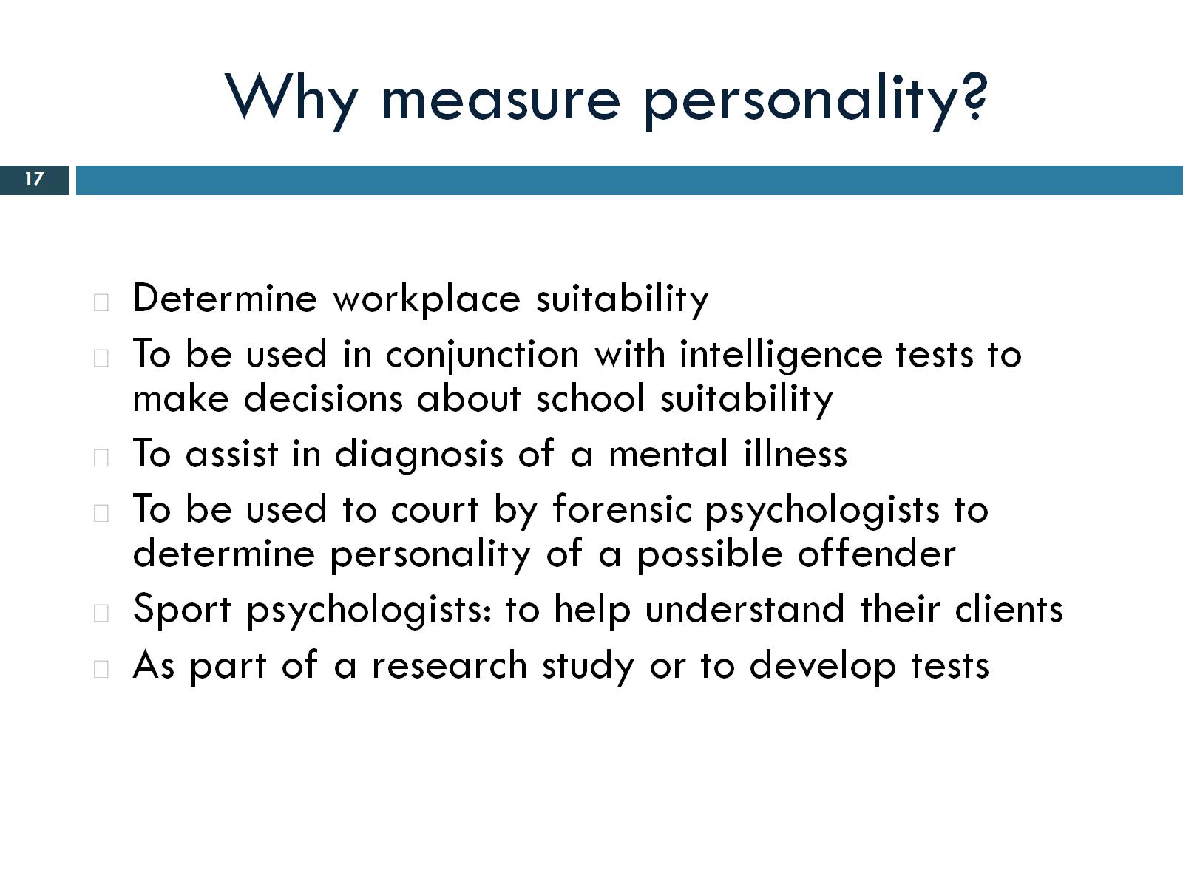
Why measure personality?

Slide 18
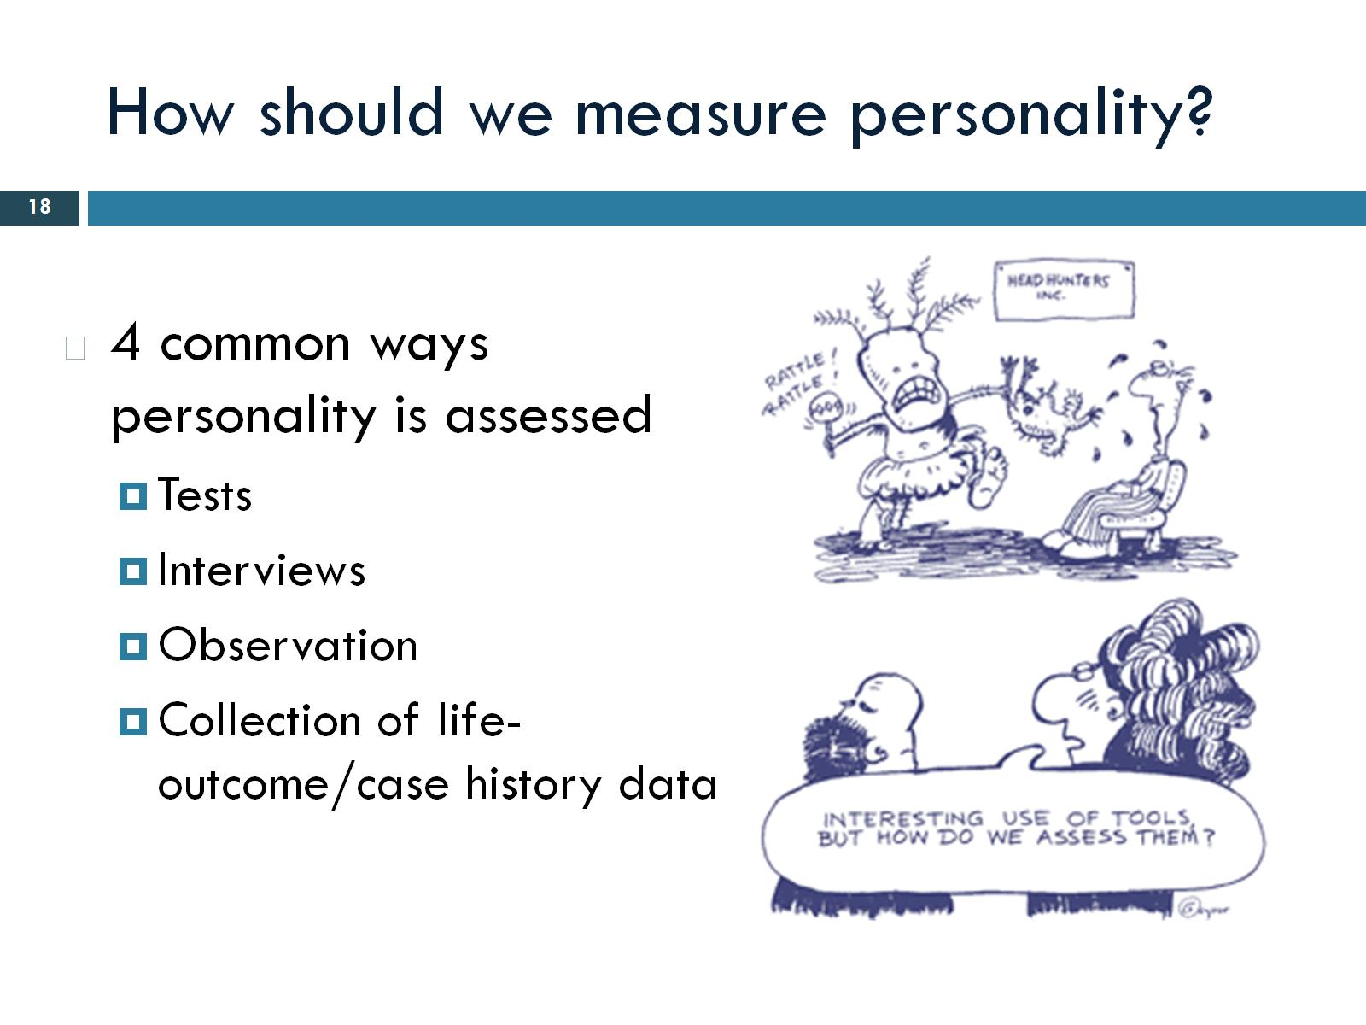
How should we measure personality?

Slide 19
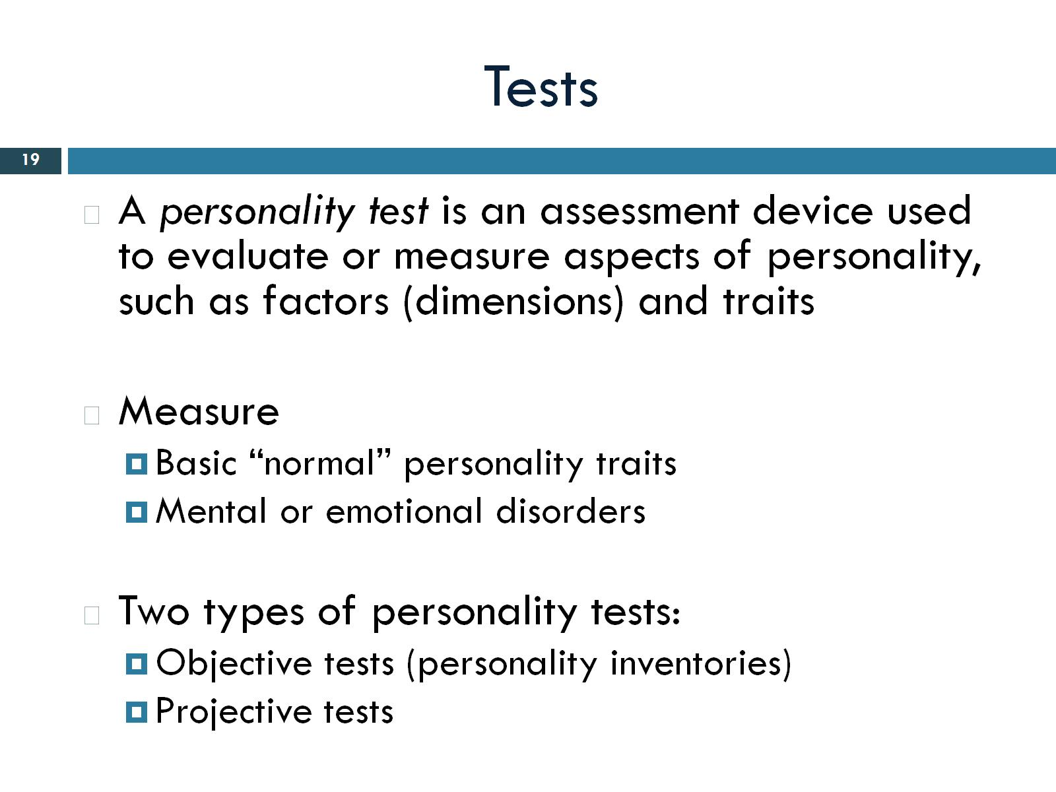
Tests
Notes:
Basically factors or traits. Measure basic personality traits or mental disorders. Two types of tests.

Slide 20
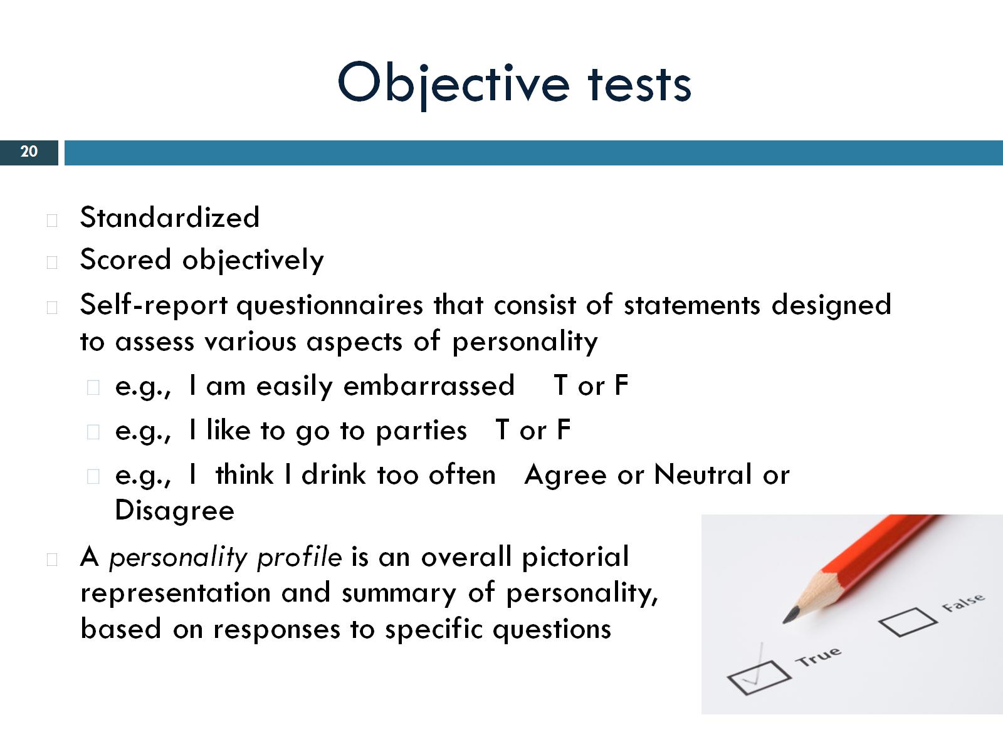
Objective tests
Notes:
Standardized. 3- covers feeling behaviors interests etc. etc.

Slide 21
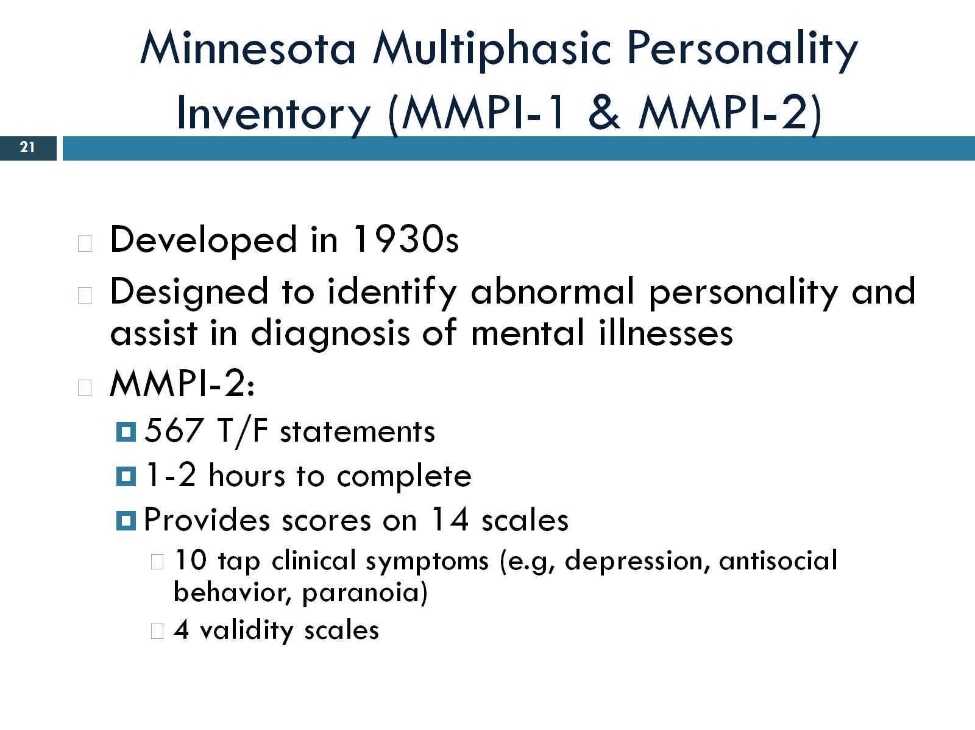
Minnesota Multiphasic Personality Inventory (MMPI-1 & MMPI-2)
Notes:
Designed to asses wether or not you have a mental disorder.

Slide 22
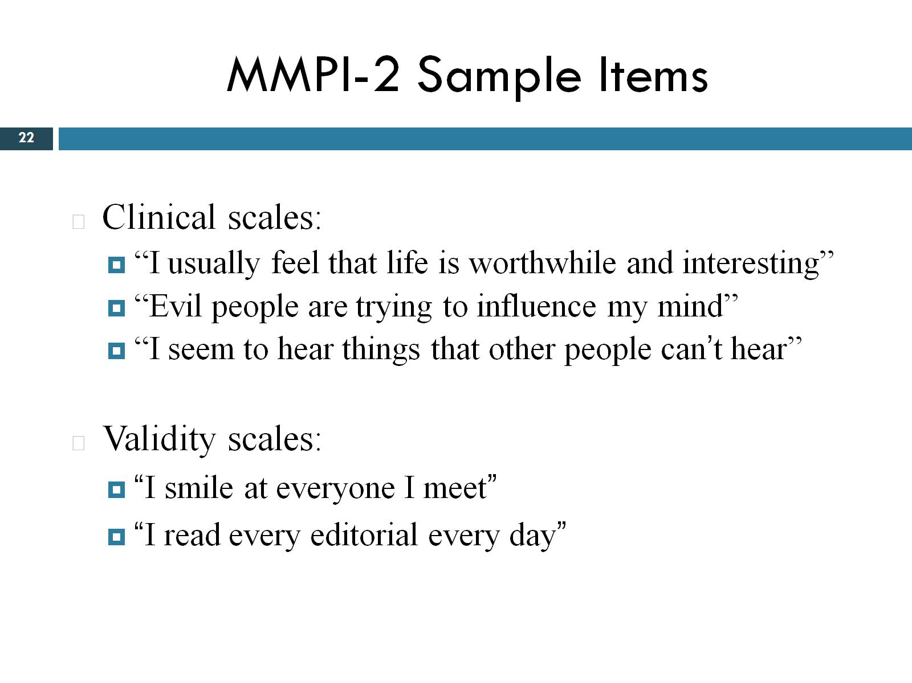
MMPI-2 Sample Items

Slide 23
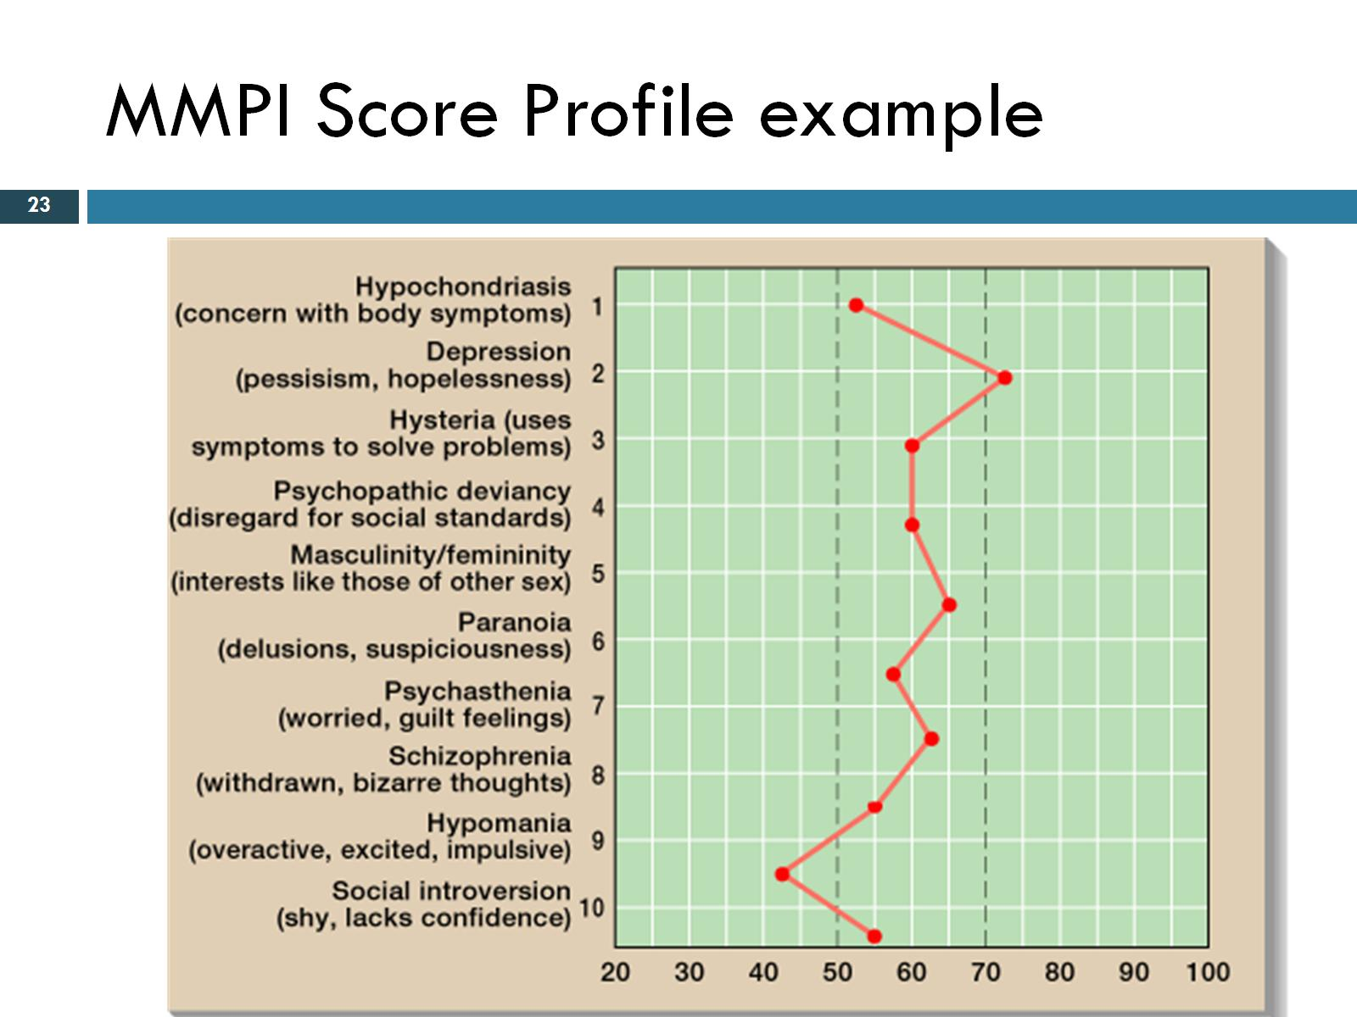
MMPI Score Profile example
Notes:
<70 and >50 considered clinically significant.

Slide 24
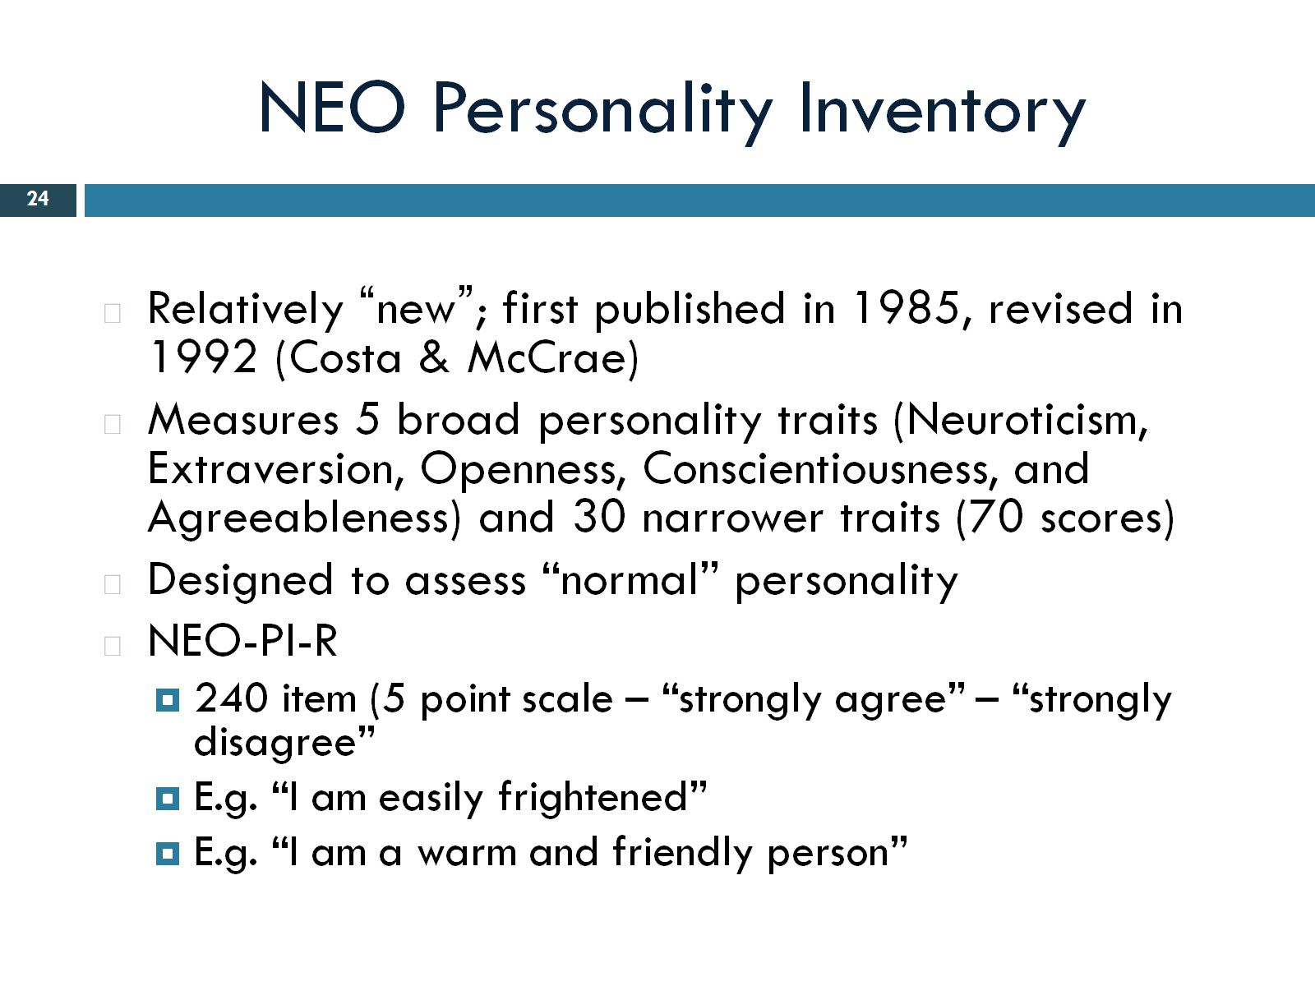
NEO Personality Inventory
Notes:
Widely used. Relatively new.

Slide 25
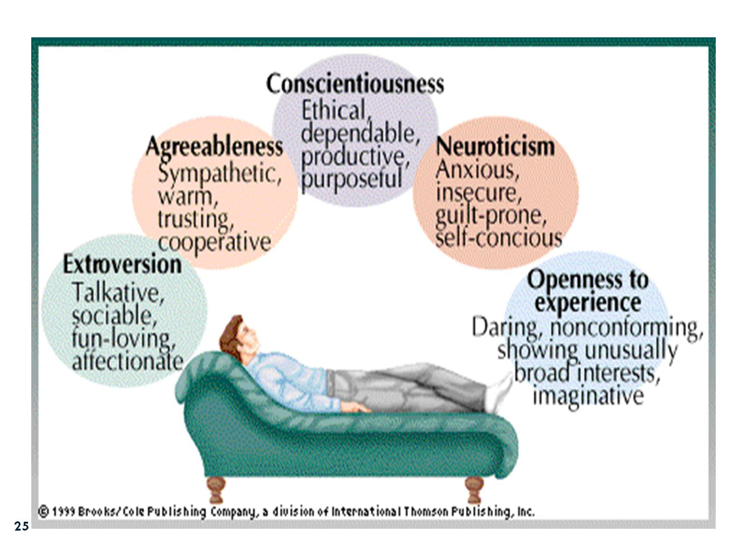

Slide 26
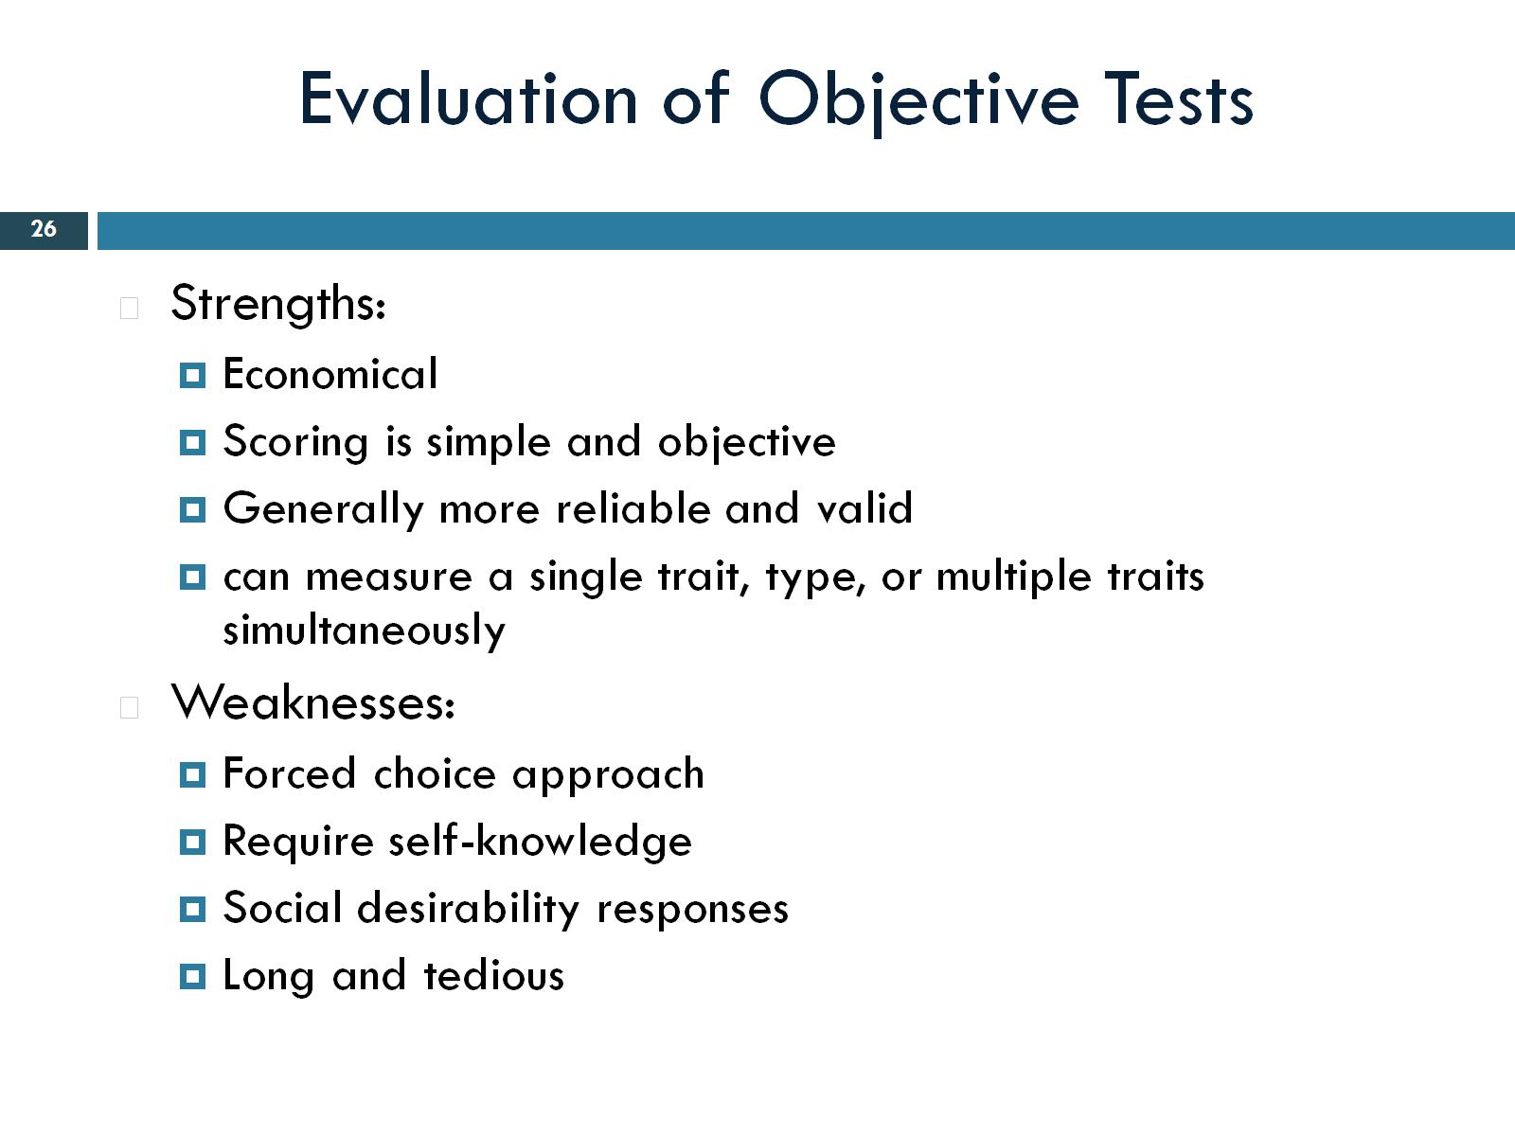
Evaluation of Objective Tests
Notes:
1- can’t explain their answers. May lead to misinterprete questions.

Slide 27
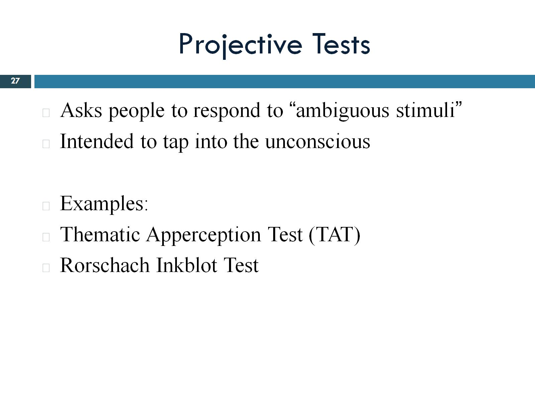
Projective Tests

Slide 28
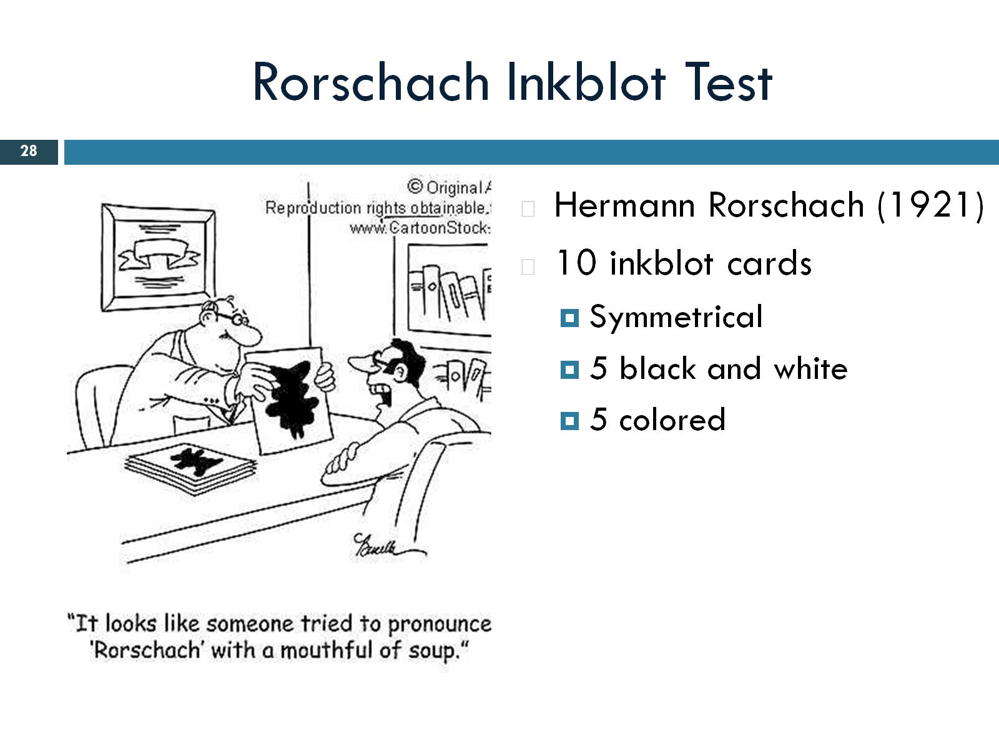
Rorschach Inkblot Test

Slide 29
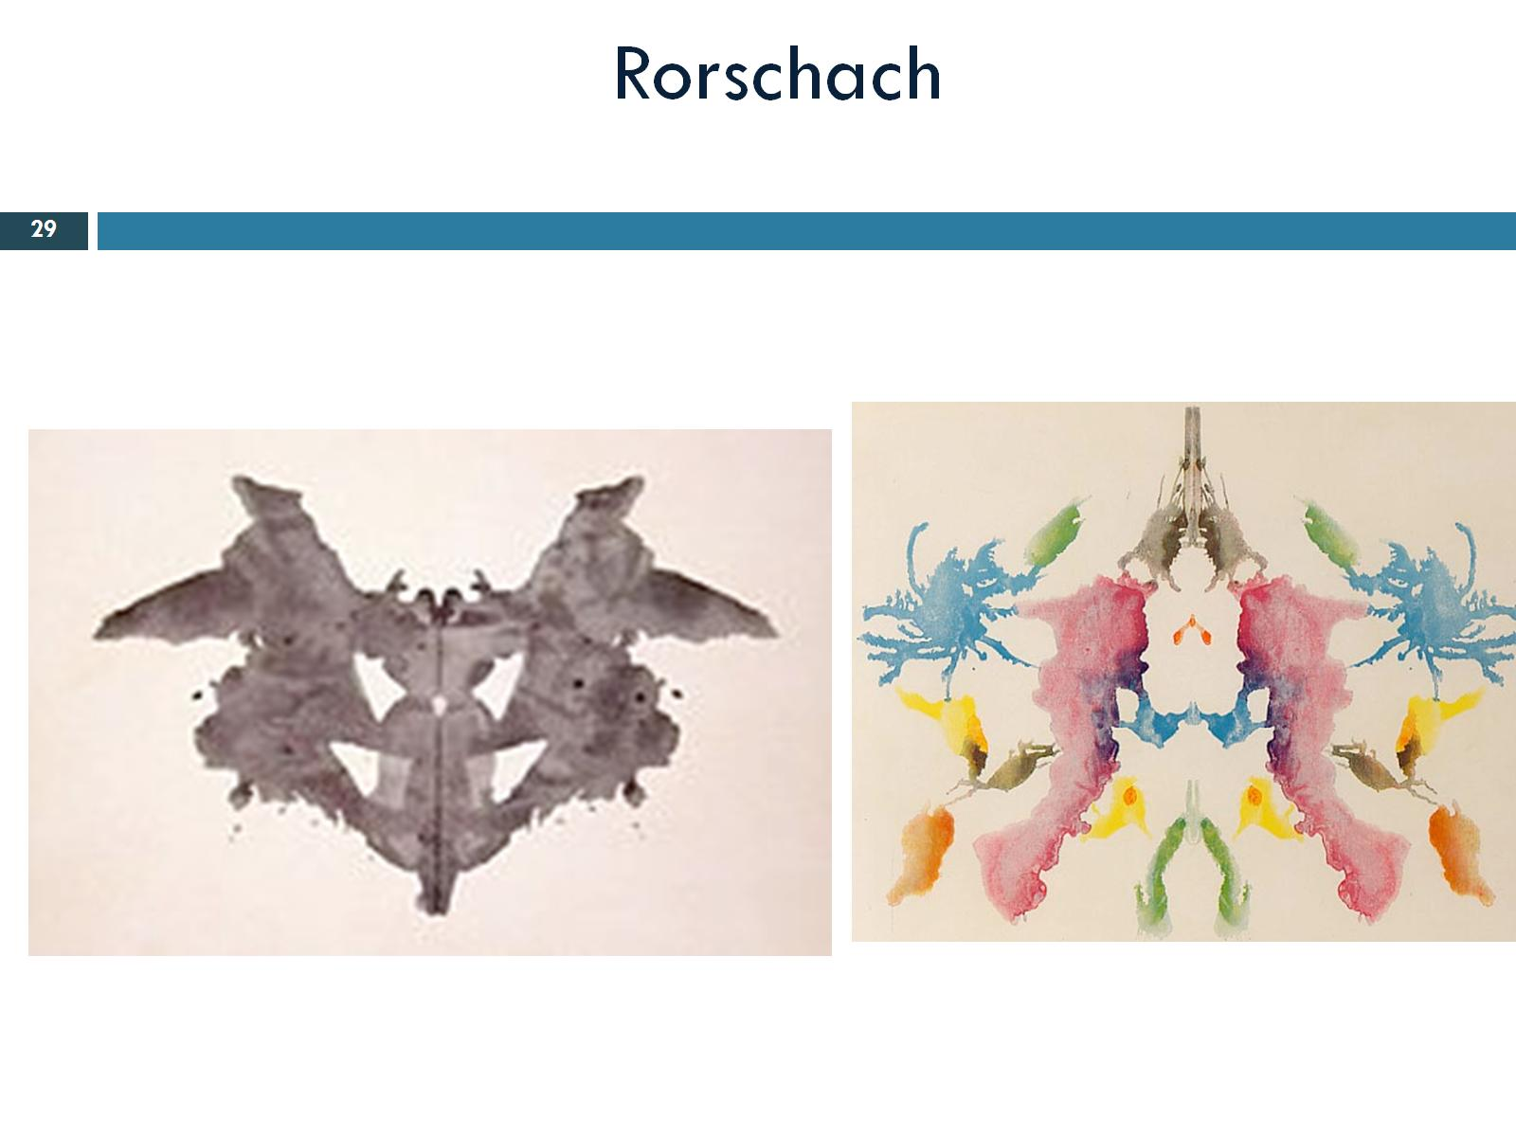
Rorschach

Slide 30
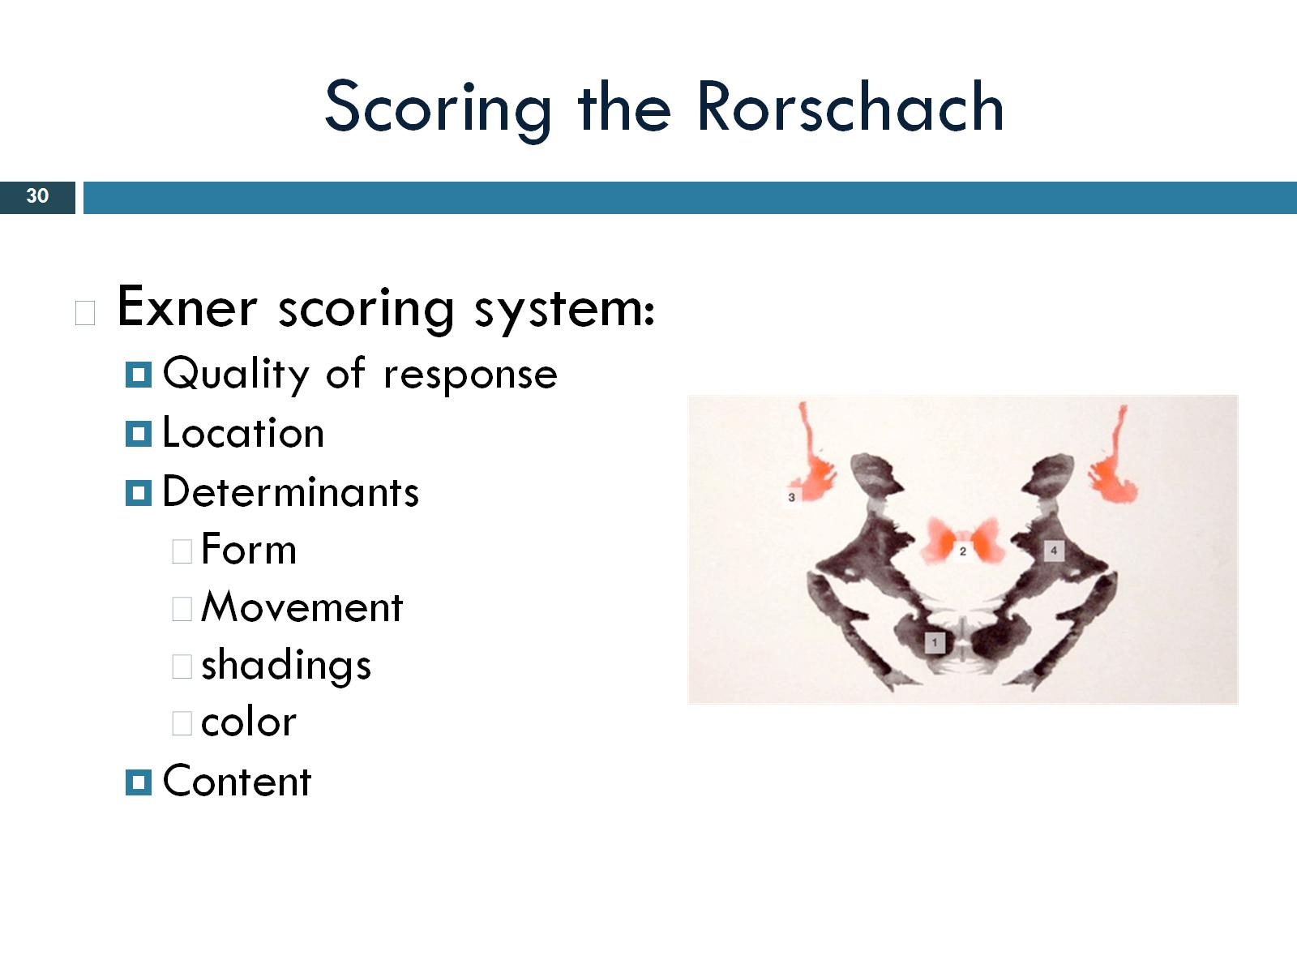
Scoring the Rorschach
Notes:
Most commonly used scoring system.

Slide 31
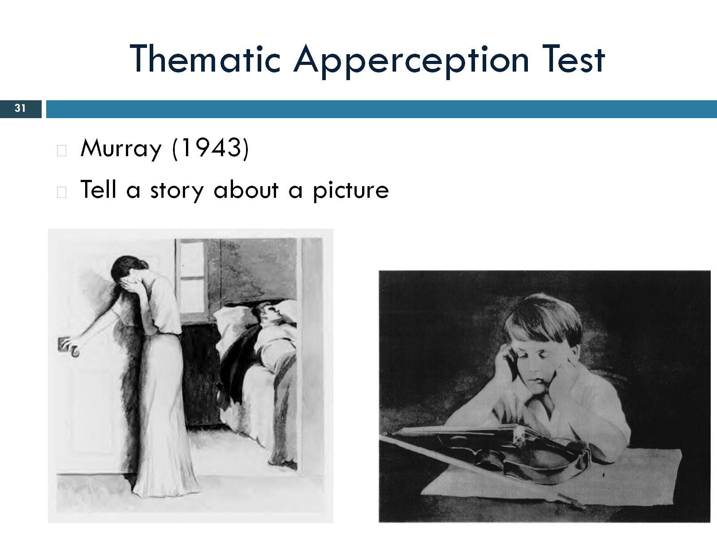
Thematic Apperception Test
Notes:
Tell me a story about each of these pics, tell me who the people are, whats happeneing, what leads up to the scene.

Slide 32
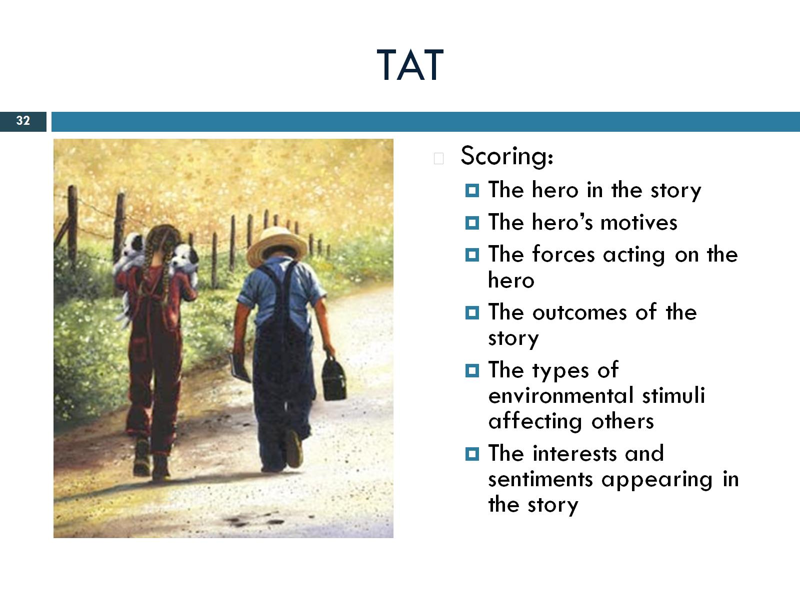
TAT

Slide 33
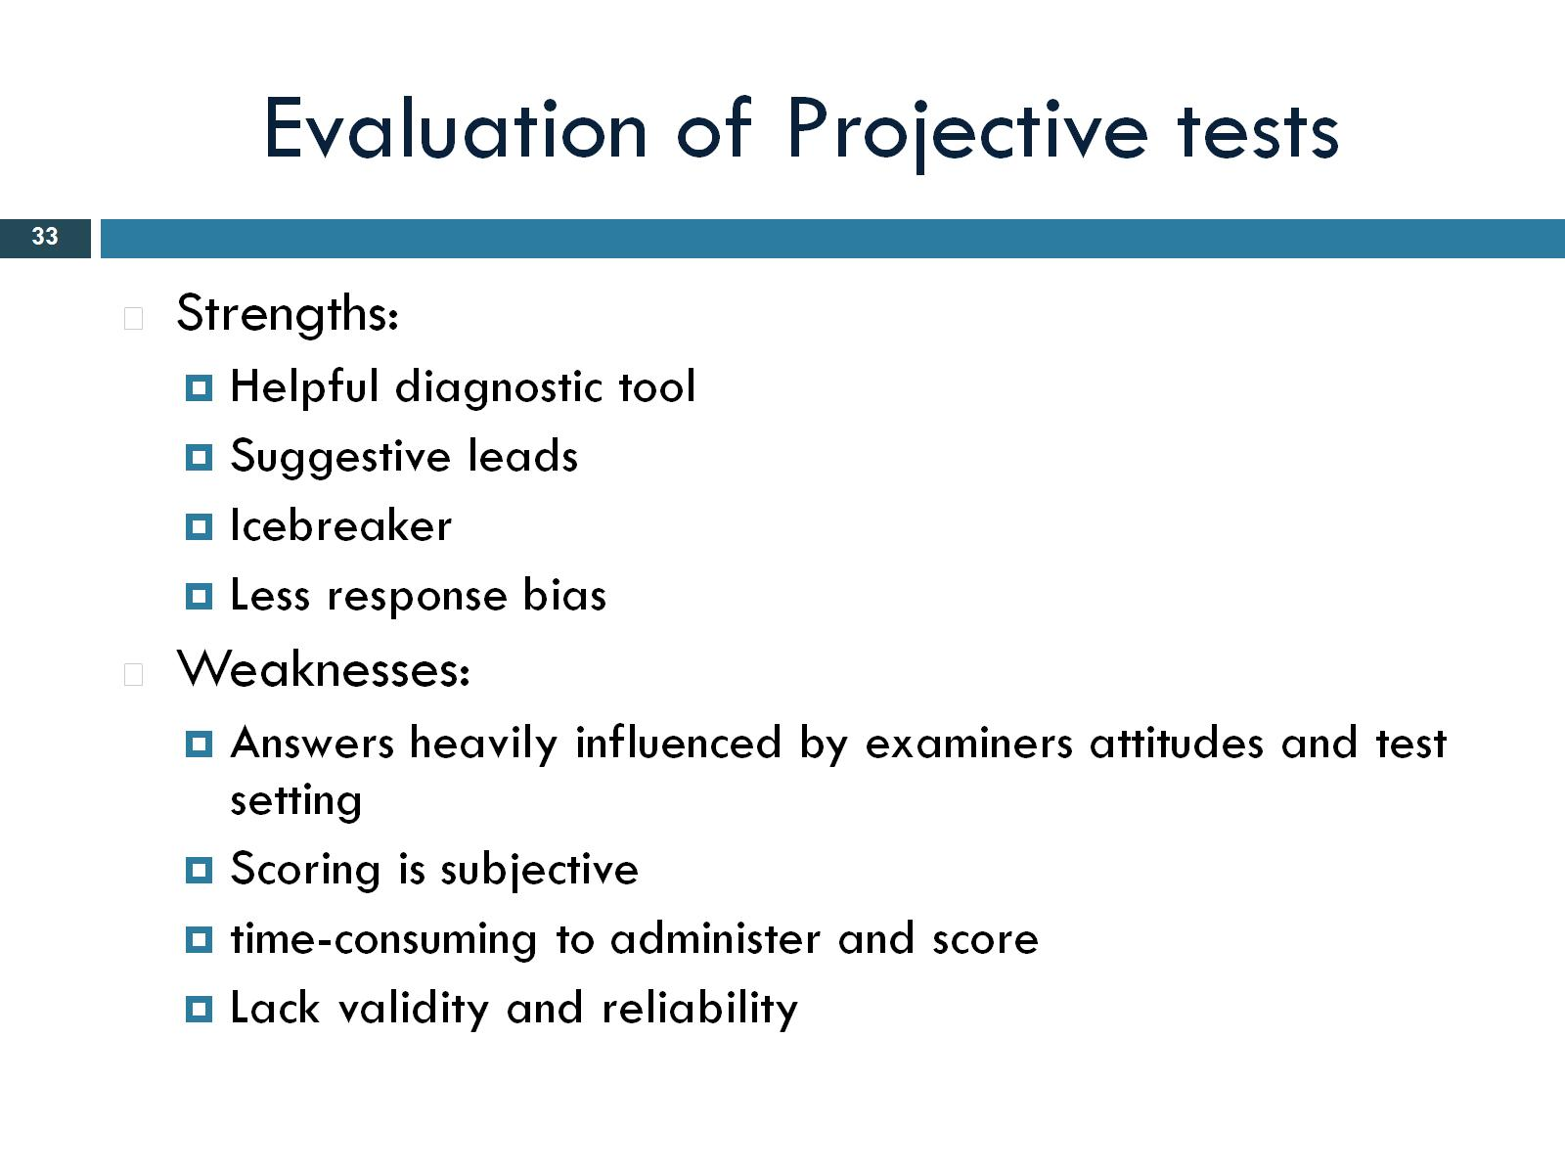
Evaluation of Projective tests

Slide 34
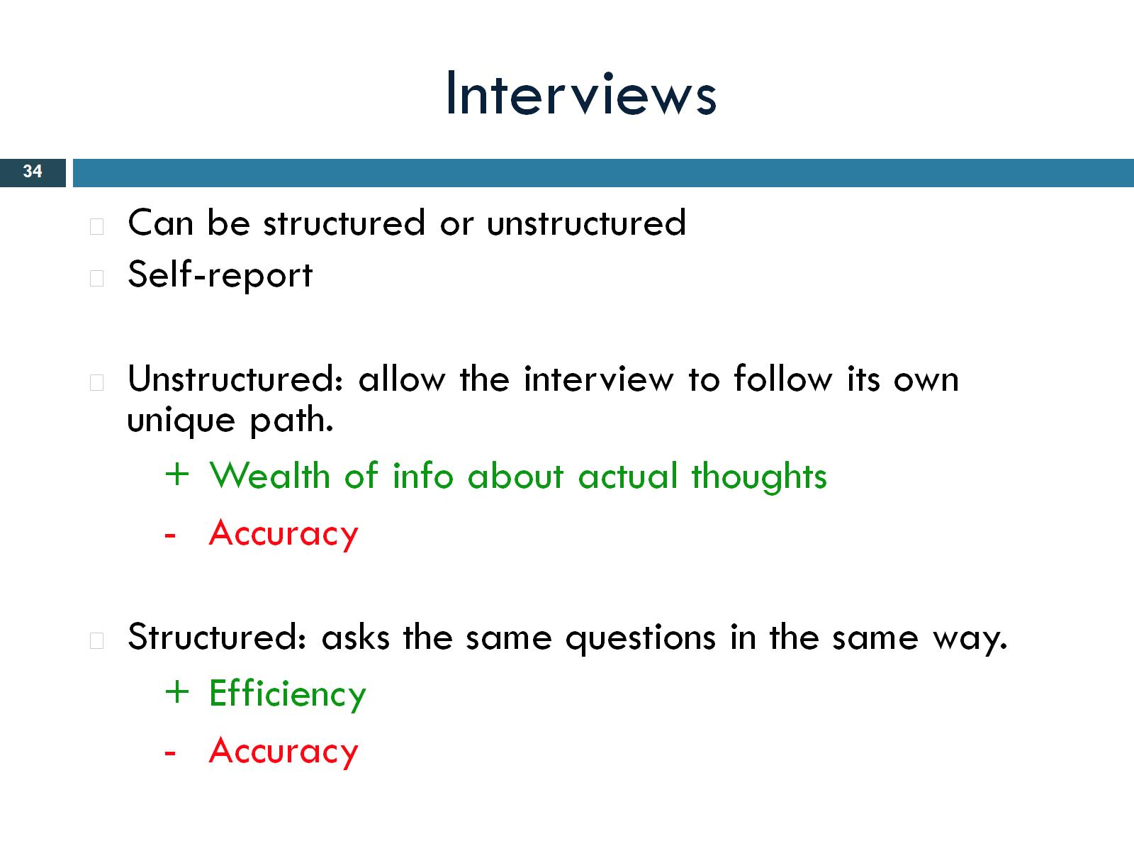
Interviews
Notes:
Unstructered ( clinical) only a few questions brought in, go with the flow. –accuracy, Lots of probability of respsonse bias.

Slide 35
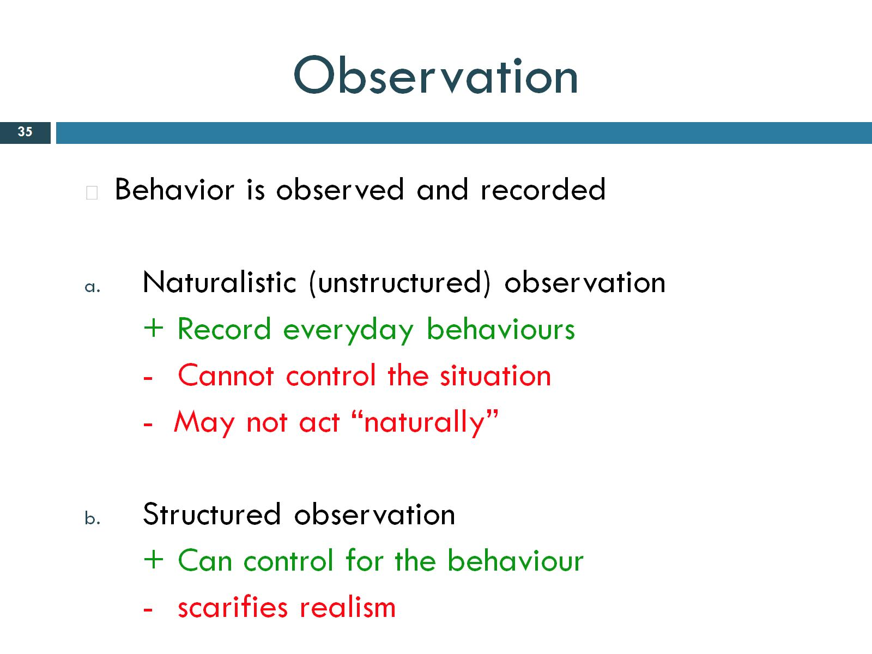
Observation
Notes:
Just watching behavior and recording.

Slide 36
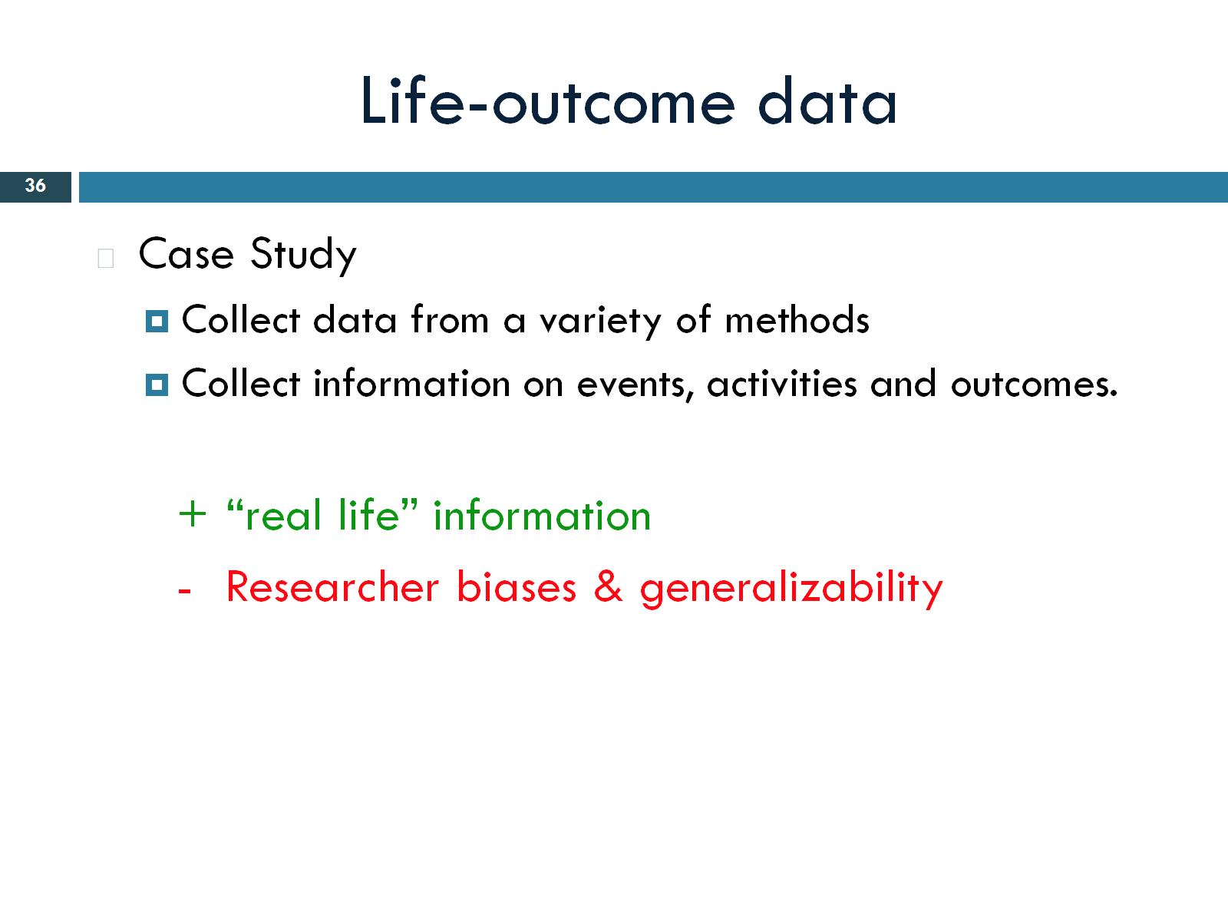
Life-outcome data
Notes:
Information from a variety of methods. Focused on one person. Combination of a whole bunch of things, ask friends and family, coworkers, etc. problem- people have biases.

Slide 37
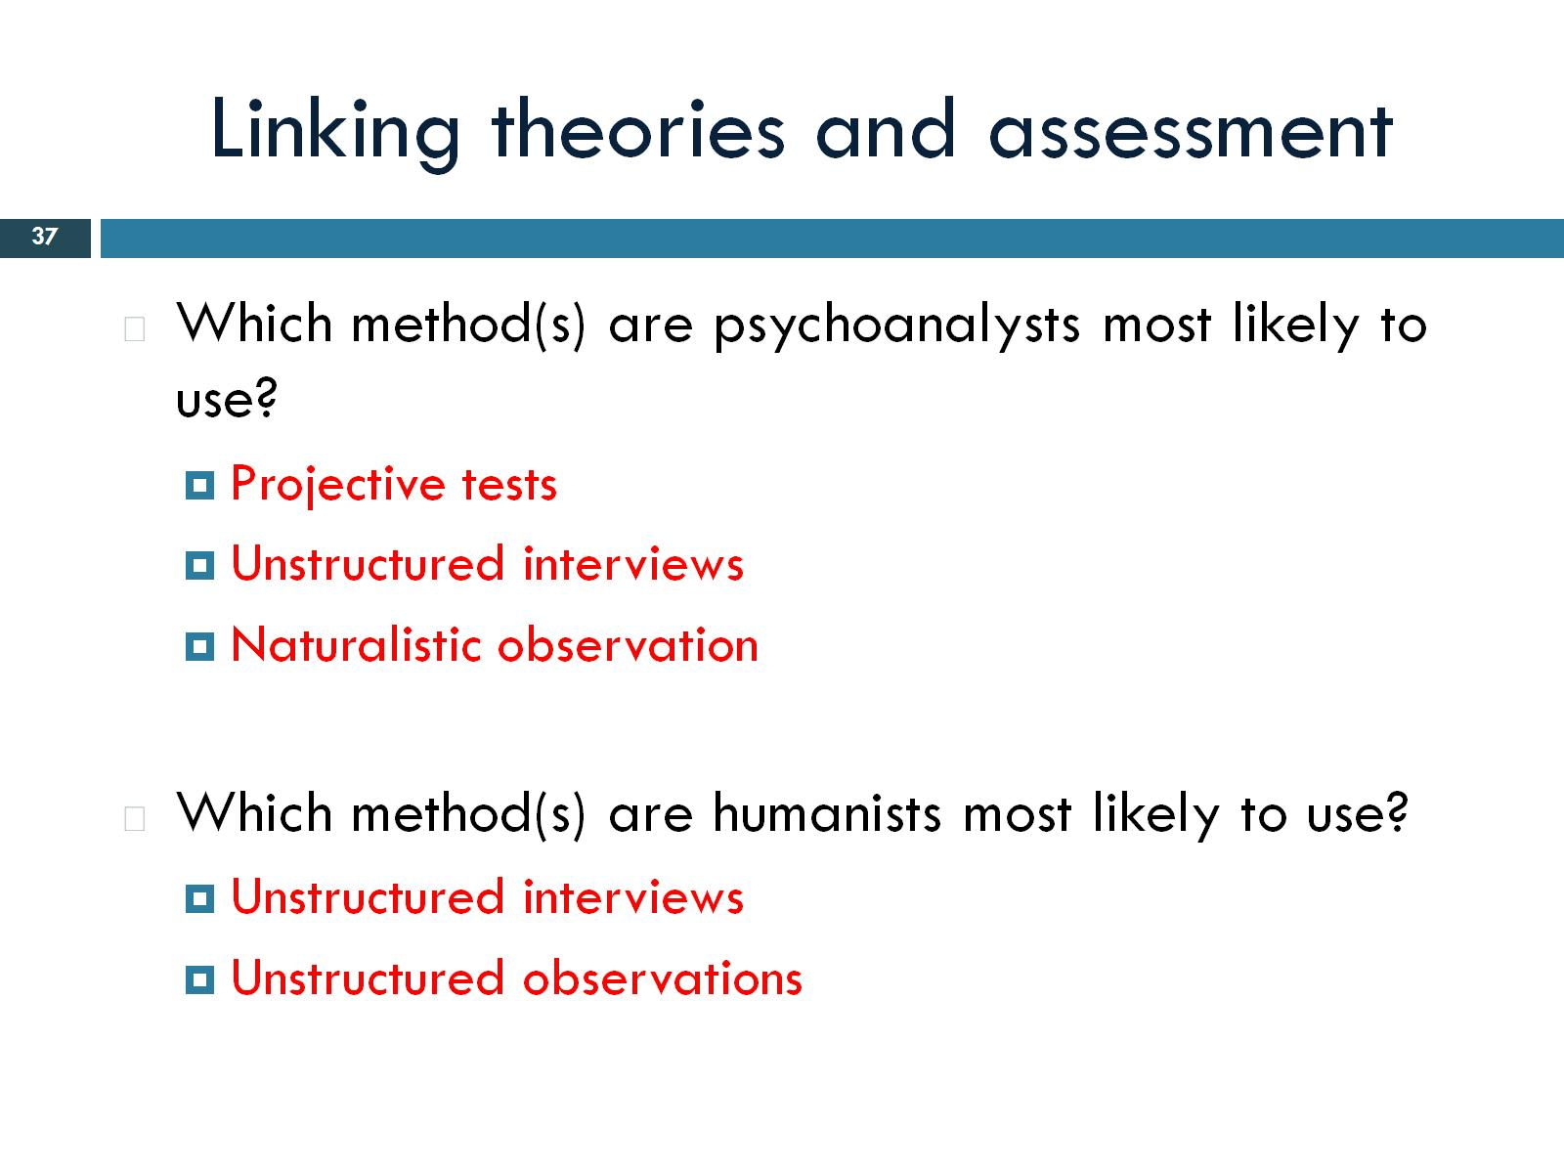
Linking theories and assessment

Slide 38
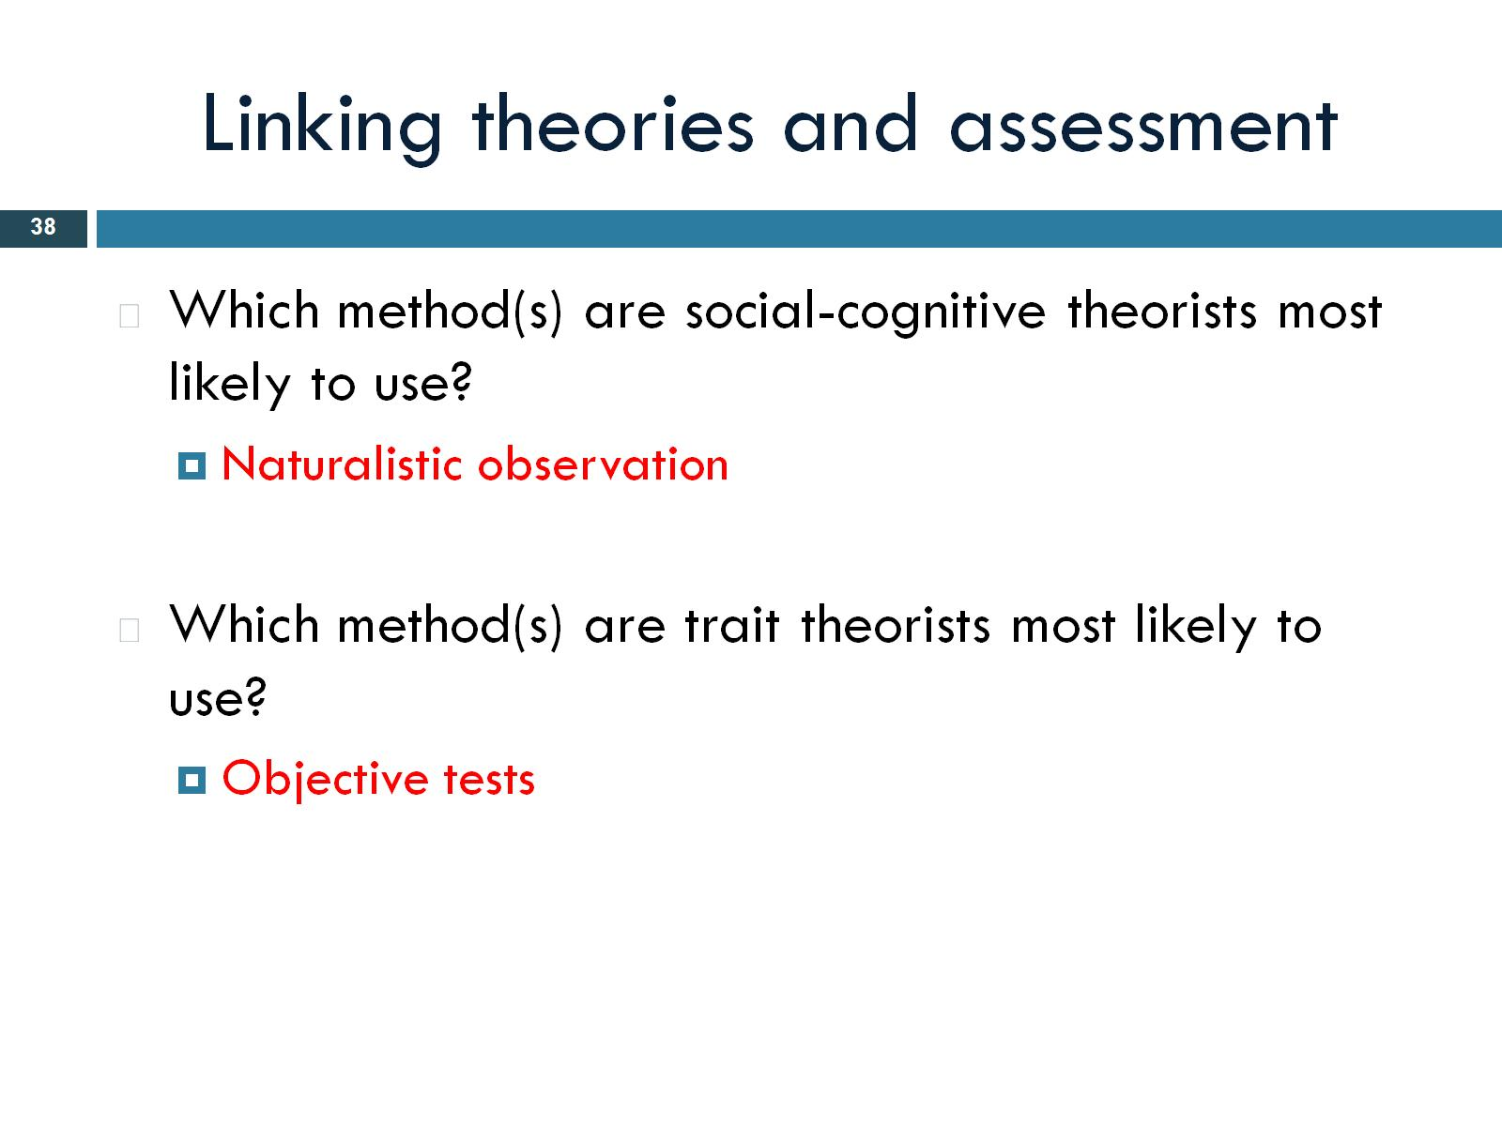
Linking theories and assessment

Slide 39
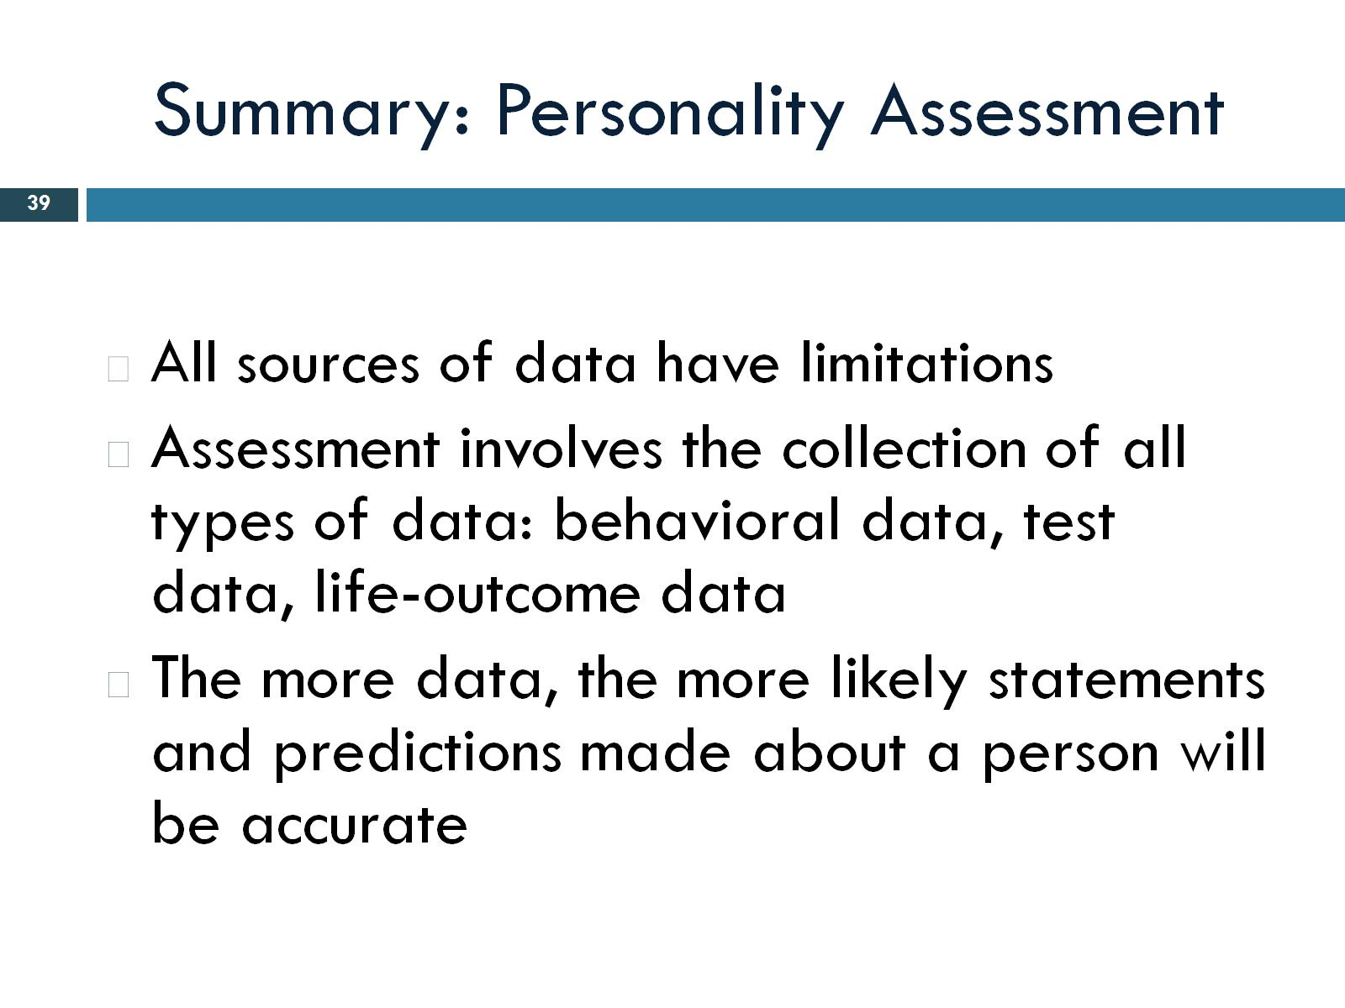
Summary: Personality Assessment

