Slide 1
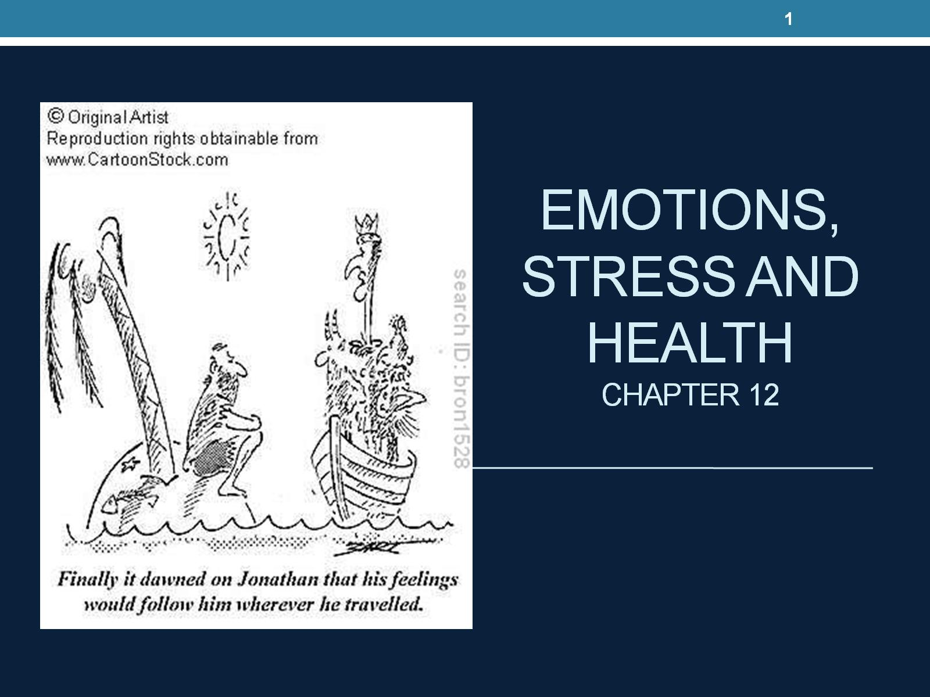
Emotions, stress and health
CHAPTER 12

Slide 2
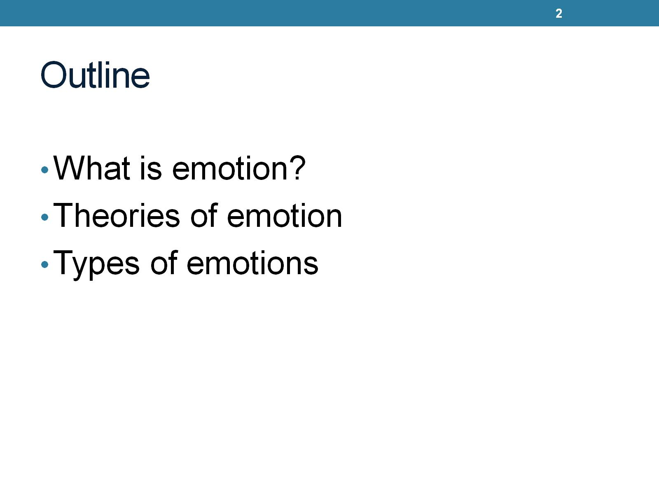
Outline

Slide 3
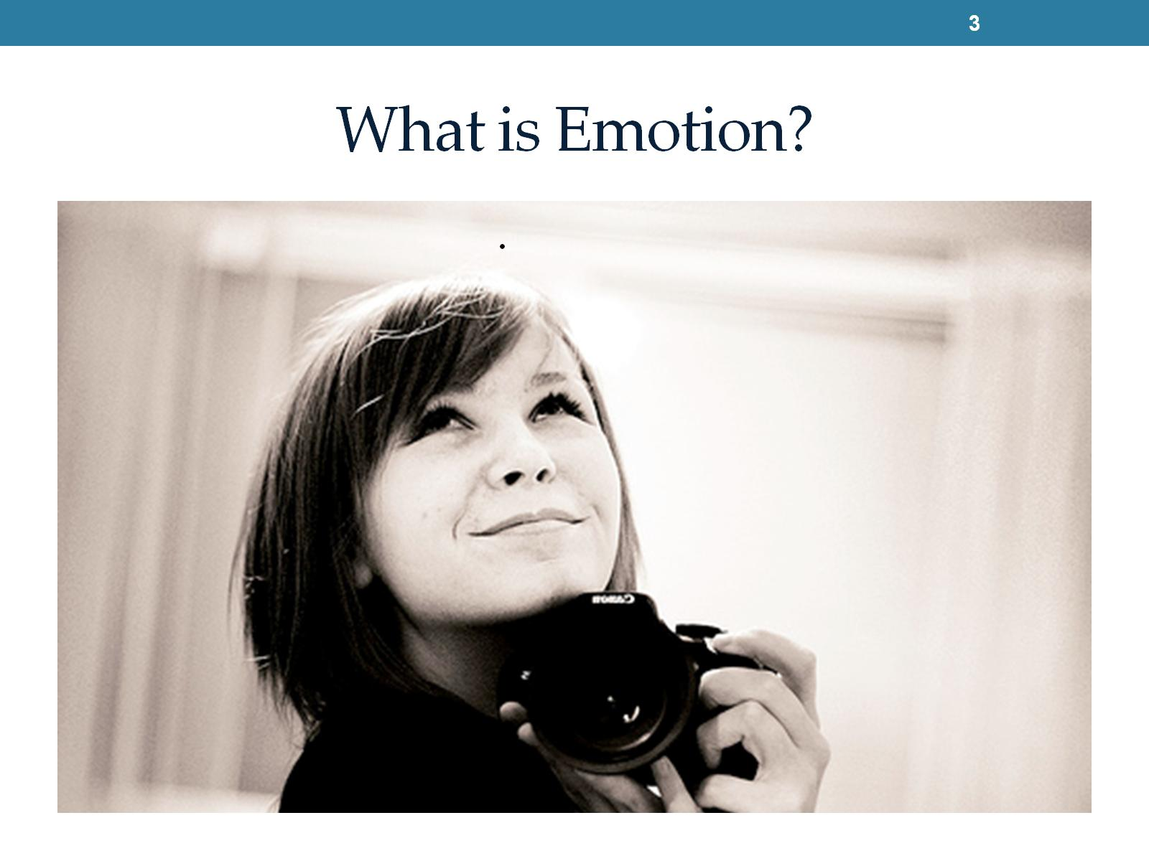
What is Emotion?
Notes:
Feeling, non visible. Reaction,

Slide 4
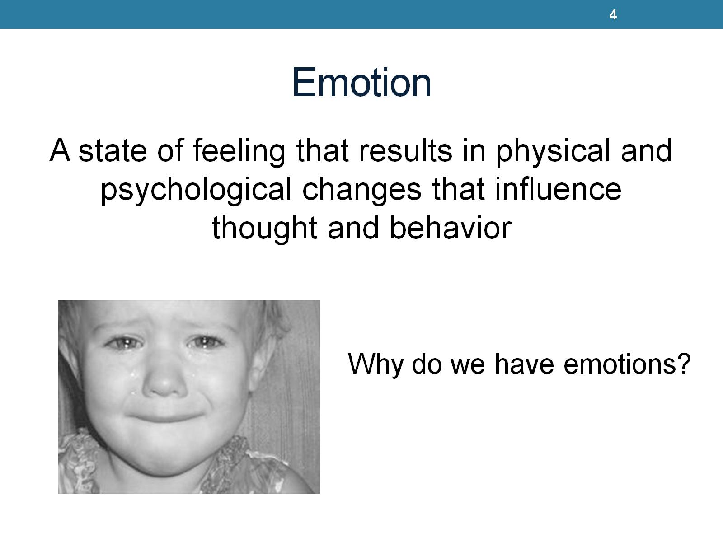
Emotion
Notes:
Influence our motivation. Adaptive. Ment to promote our survival.focus attention and stimulate action.

Slide 5
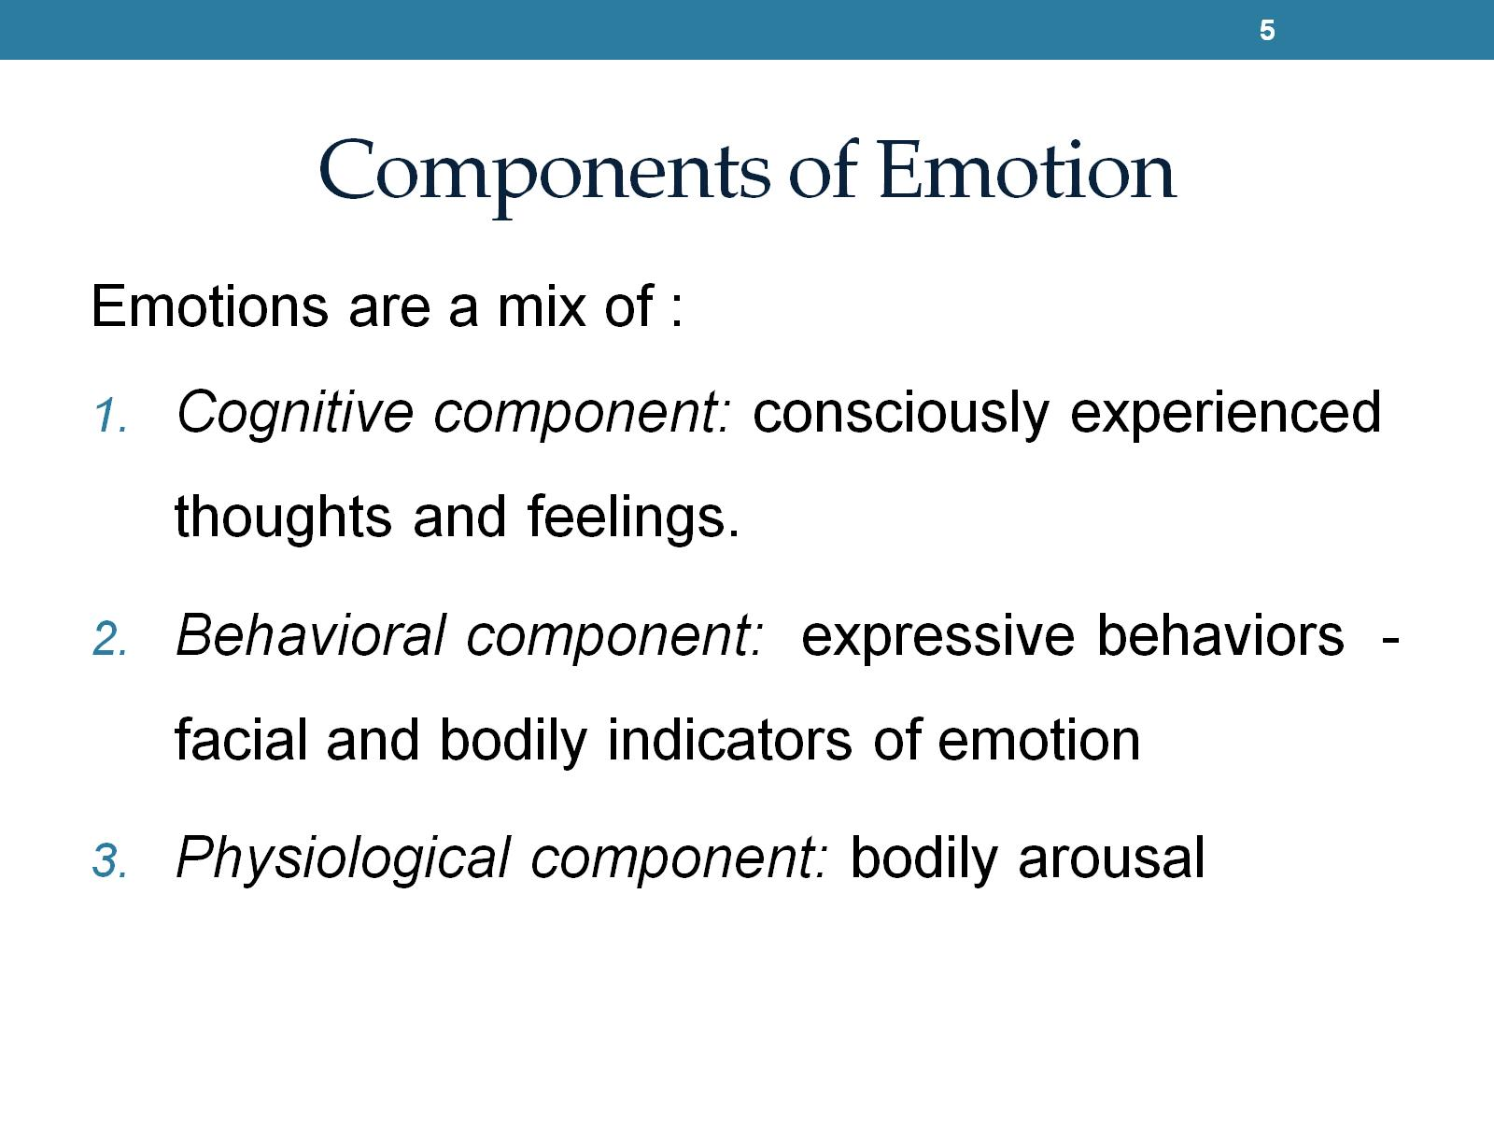
Components of Emotion
Notes:
1. The feeling piece. The passion or sensation. Also cognitive thought.
2. actions, facial and bodily expressions.
3.internal aspect. Changes caused by chemical hormones.

Slide 6
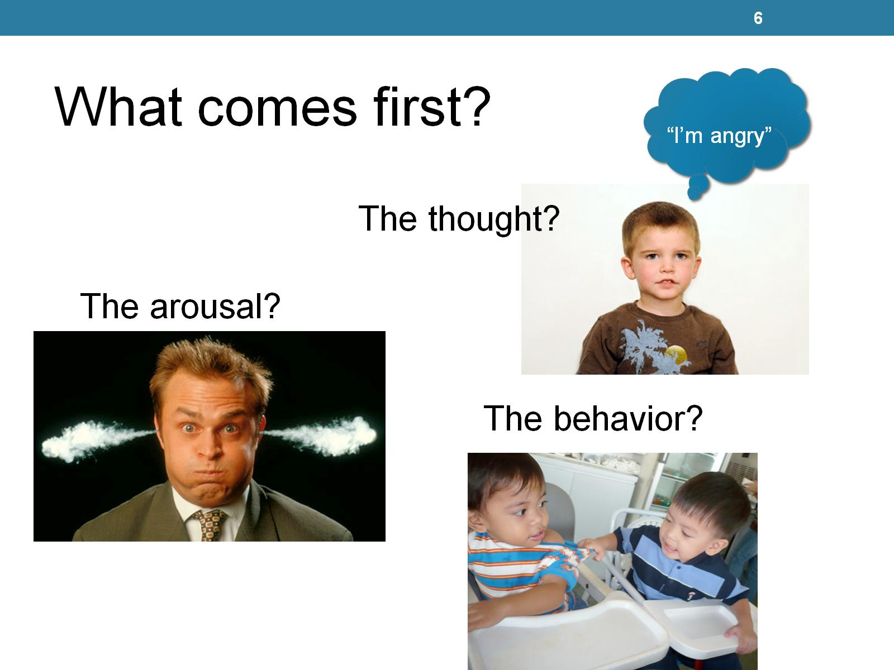
Notes:
Depends on situation.

Slide 7
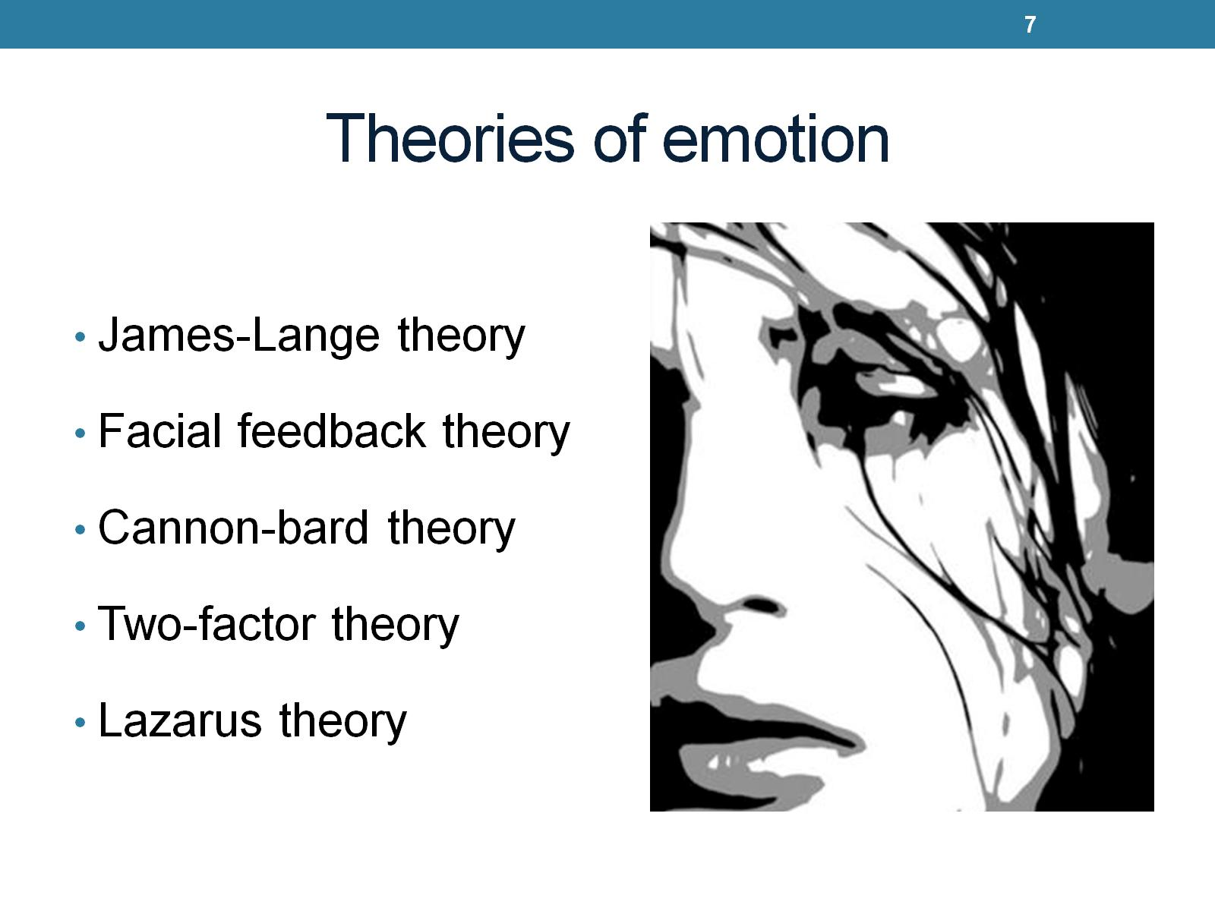
Theories of emotion

Slide 8
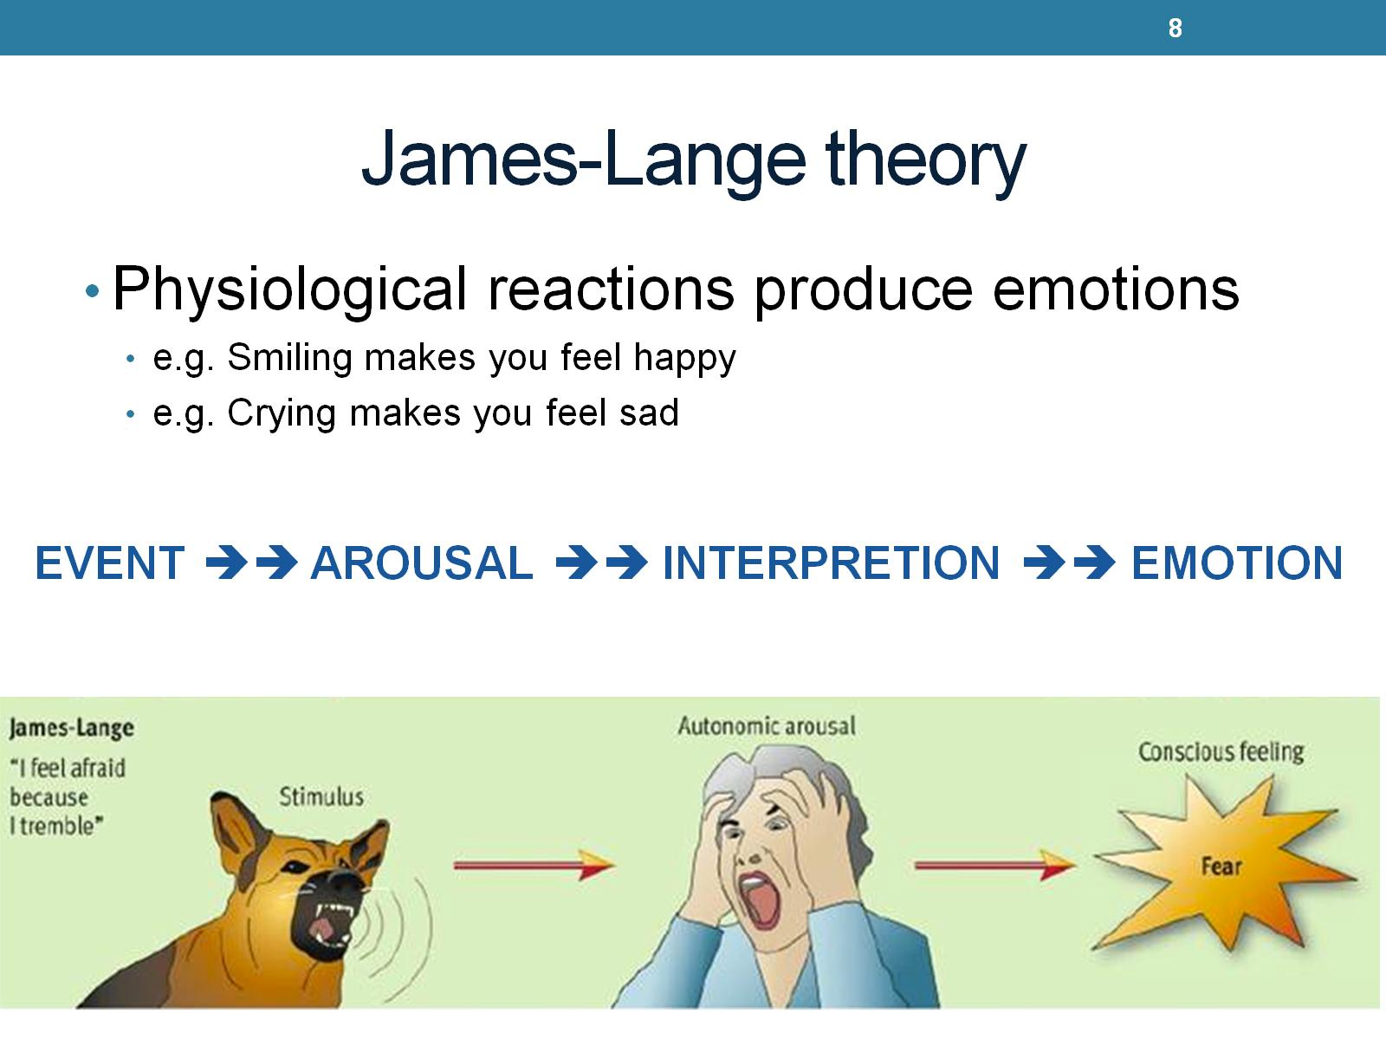
James-Lange theory
Notes:
When our heart rate increases it triggers our emotion. Event causes arousal. If arousal goes unnoticed you wont experience emotion. People paralyzed neck down had deminished emotions.

Slide 9
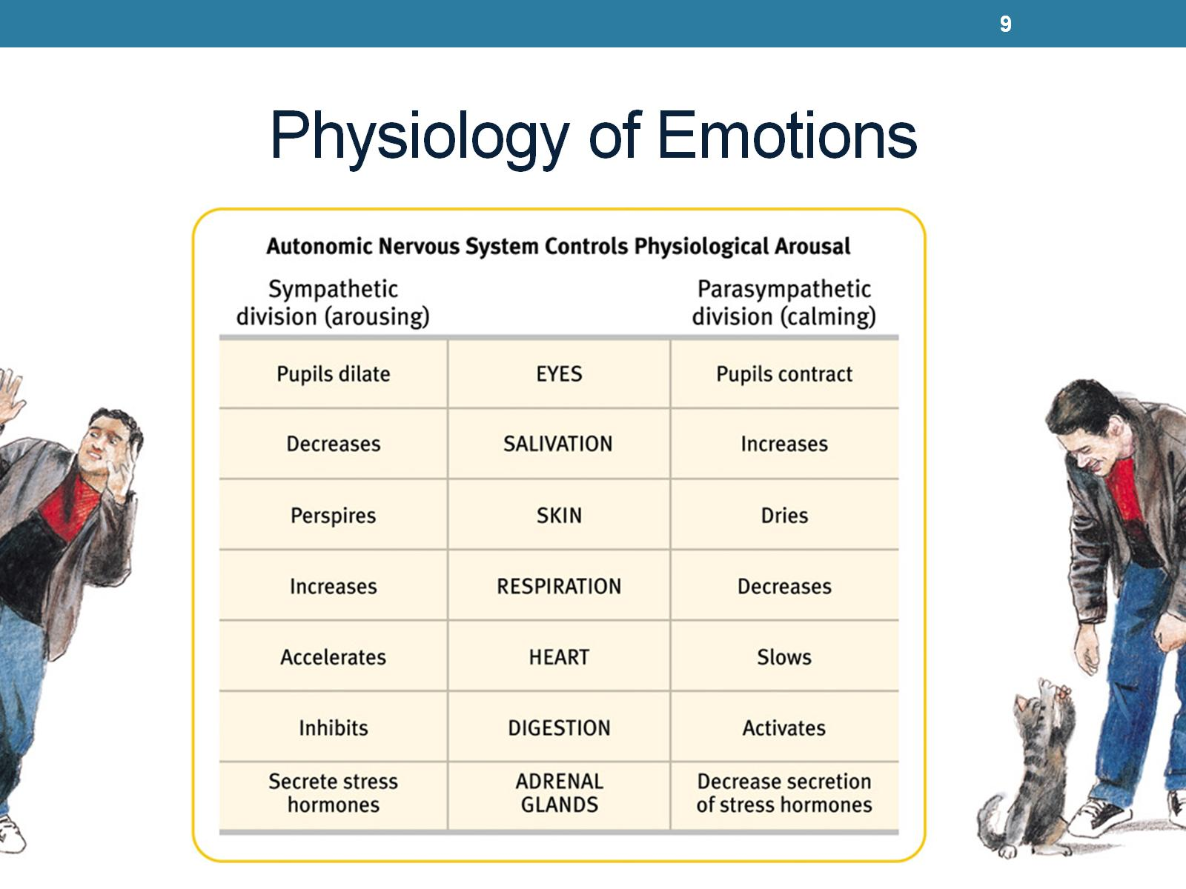
Physiology of Emotions
Notes:
Physiological controled by autonomic nervous system.

Slide 10
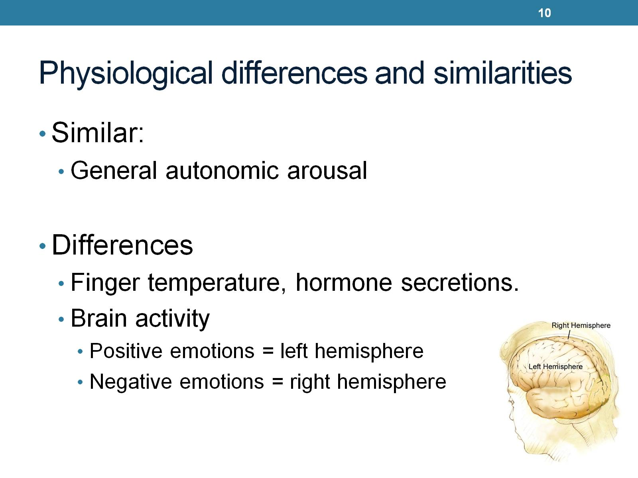
Physiological differences and similarities

Slide 11
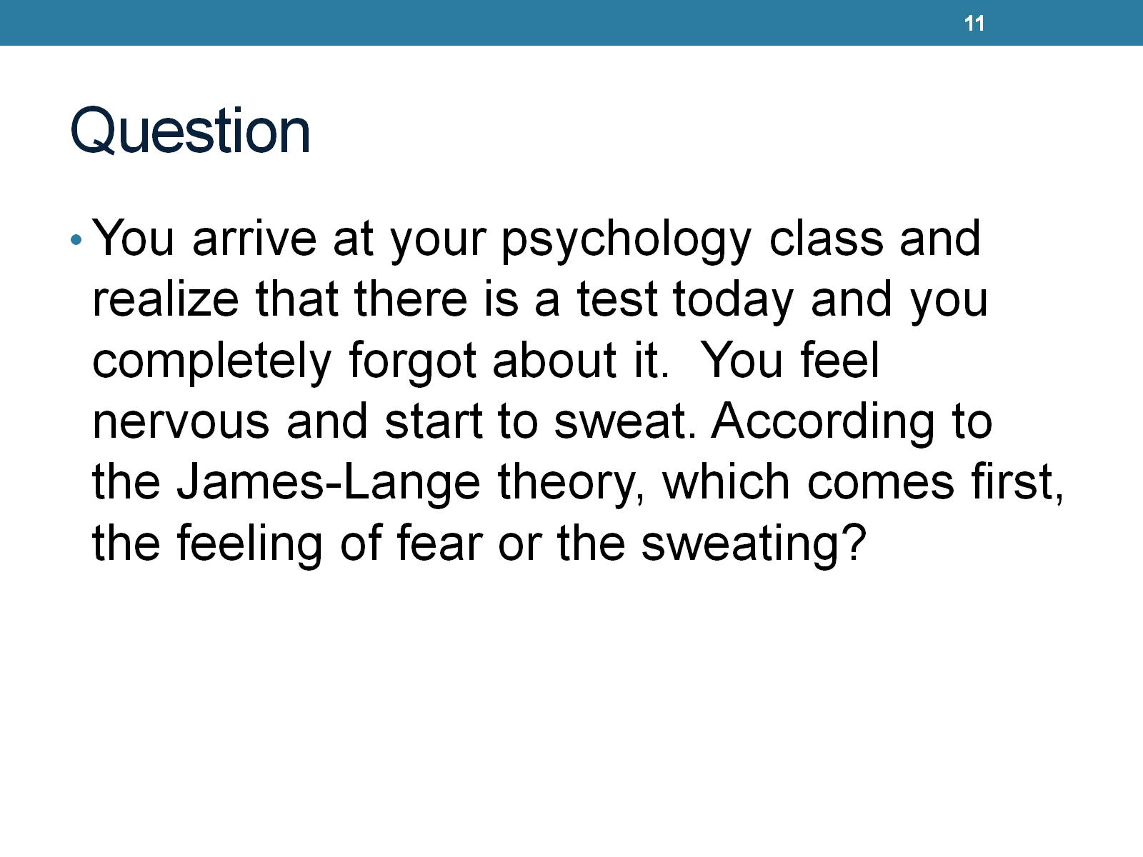
Question
Notes:
Sweating.

Slide 12
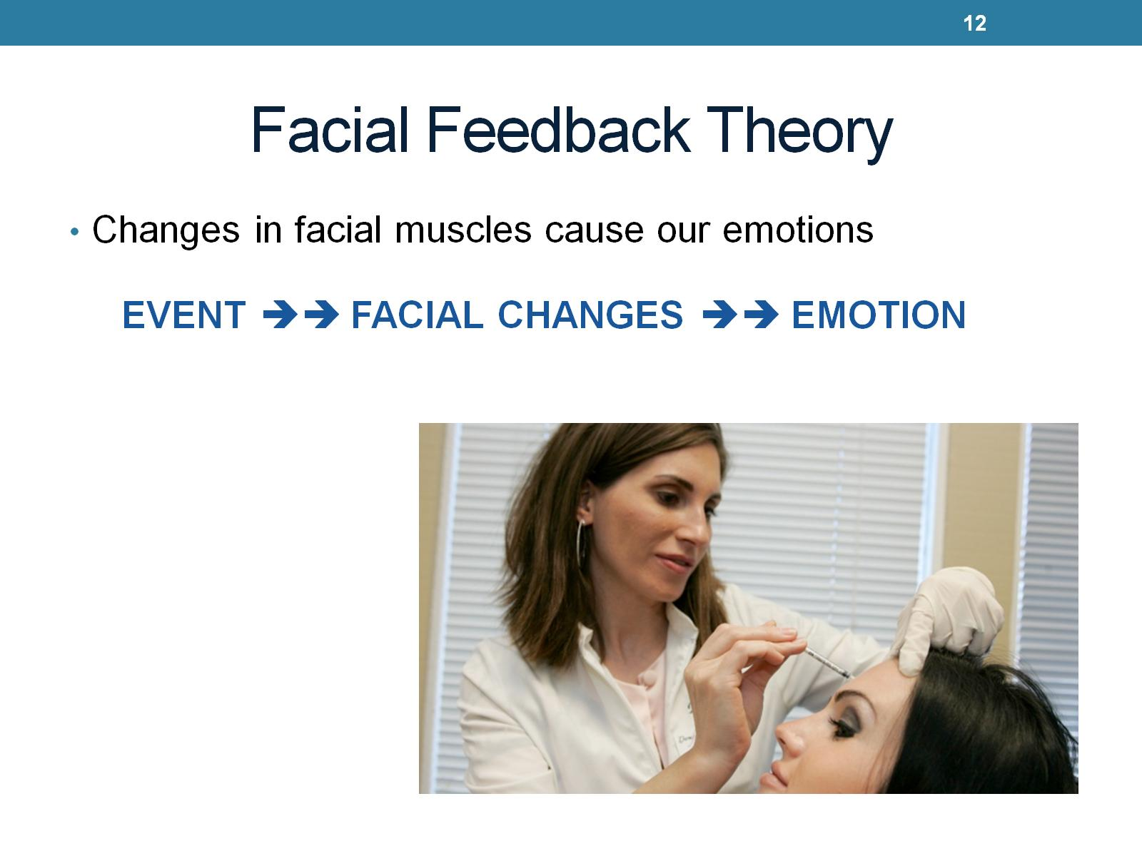
Facial Feedback Theory
Notes:
Believe we can change emotions by just acting a certain way. If you wish to be happy just smile. And you will experience the emotion. Did a study took depressed patients and used botox on face to paralyze frowning muscles. 9 out of 10 stated to no longer be depressed

Slide 13
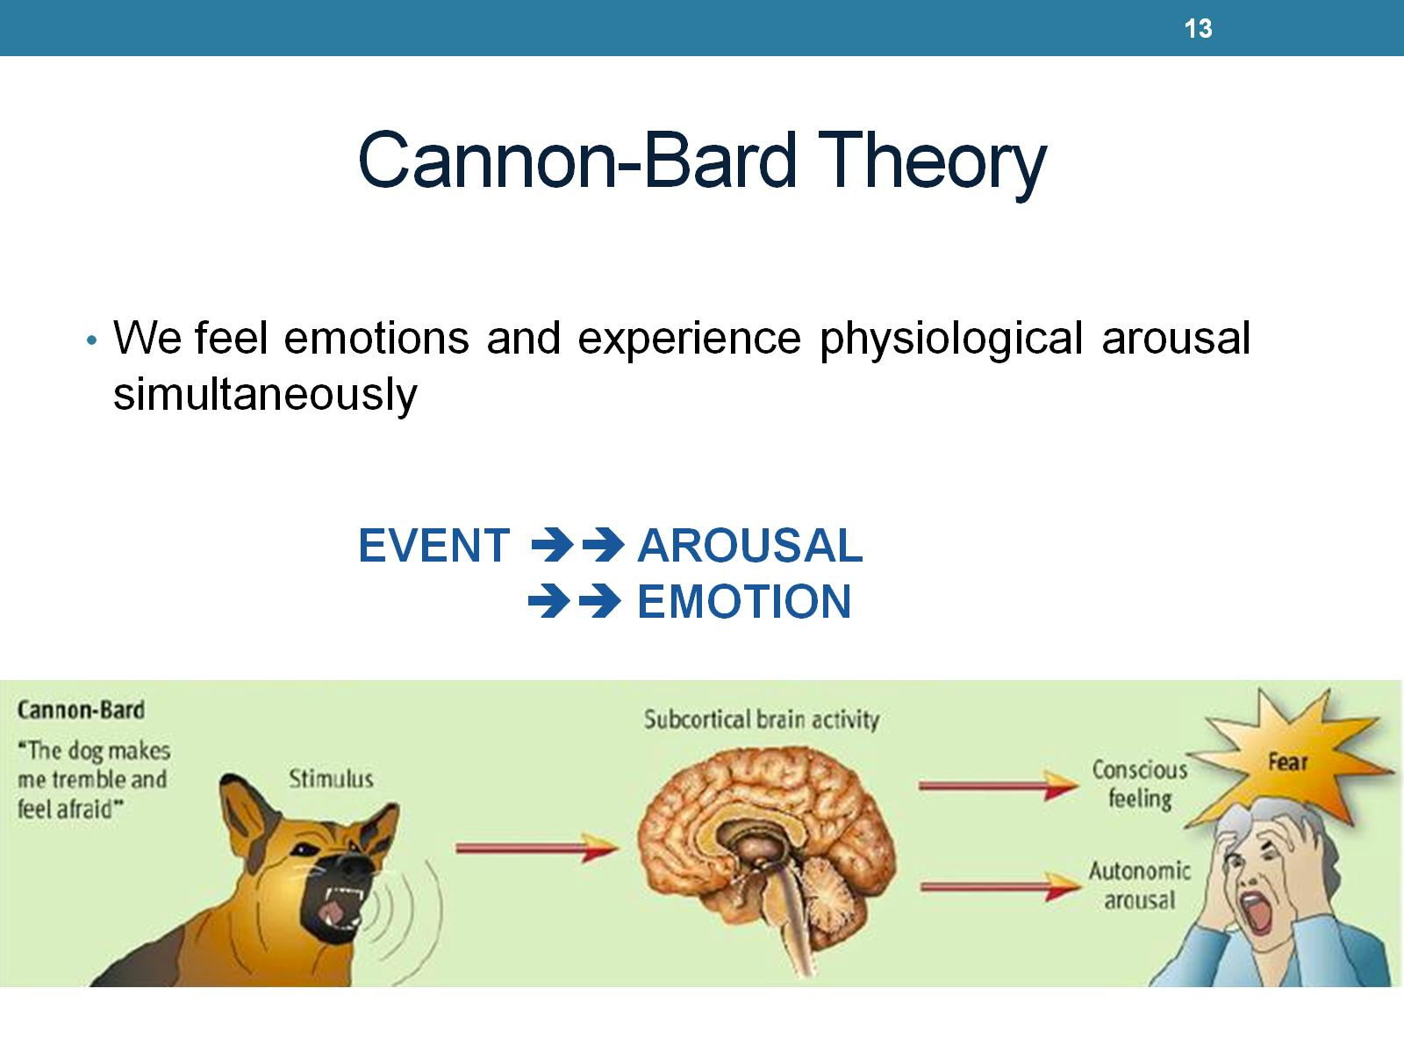
Cannon-Bard Theory
Notes:
Didn’t believe in langs theory because physiological isnt fast enough to keep up with instant experience. They stated physiological and emotion happen independantly.

Slide 14
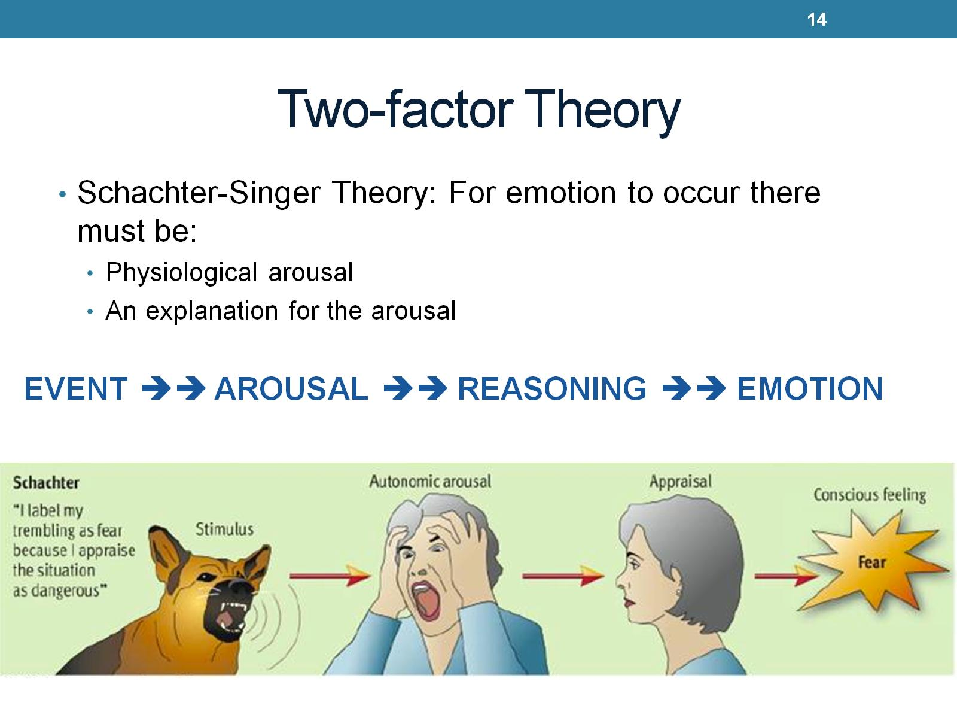
Two-factor Theory
Notes:
Emphasizes cognitive component. We think about our thoughts. Our thoughts affect our emotions. We must be able to explain our arousal. Determines intensity of emotion. Reasoning you use will determine which emotion you will feel.

Slide 15
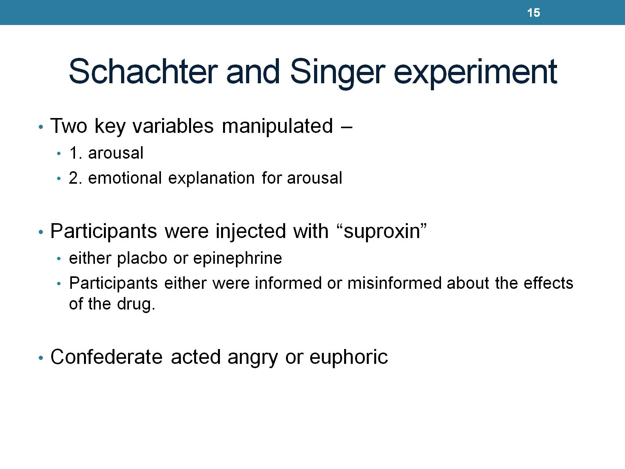
Schachter and Singer experiment

Slide 16
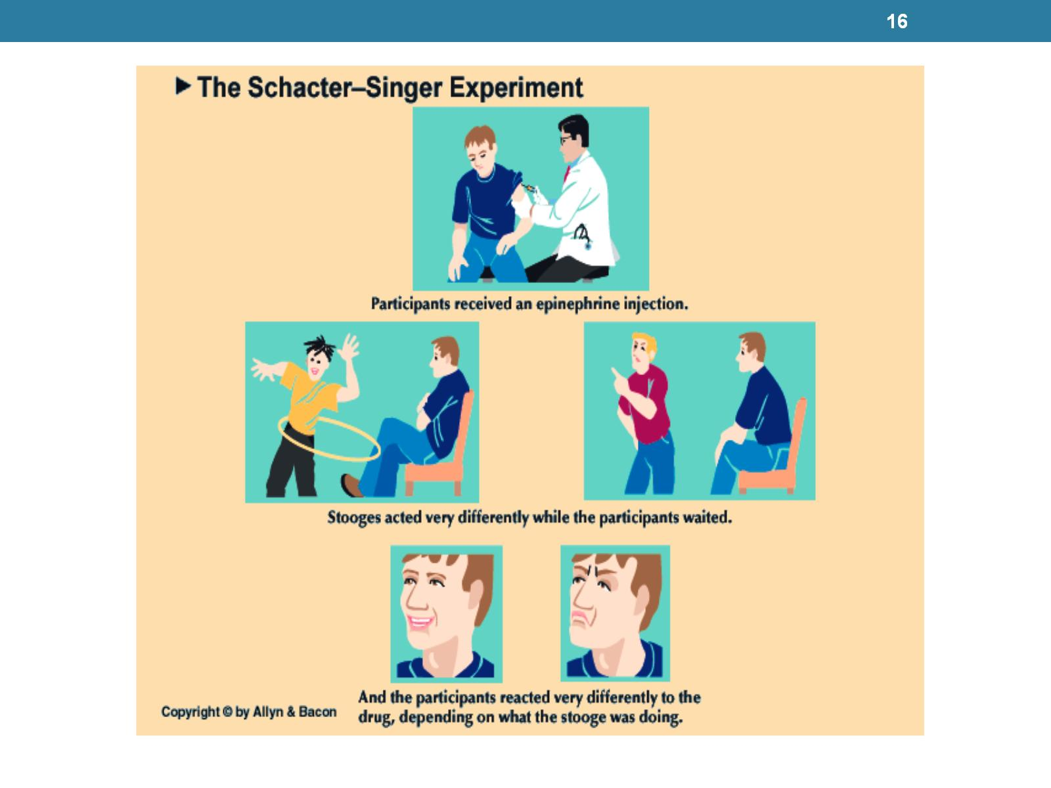

Slide 17
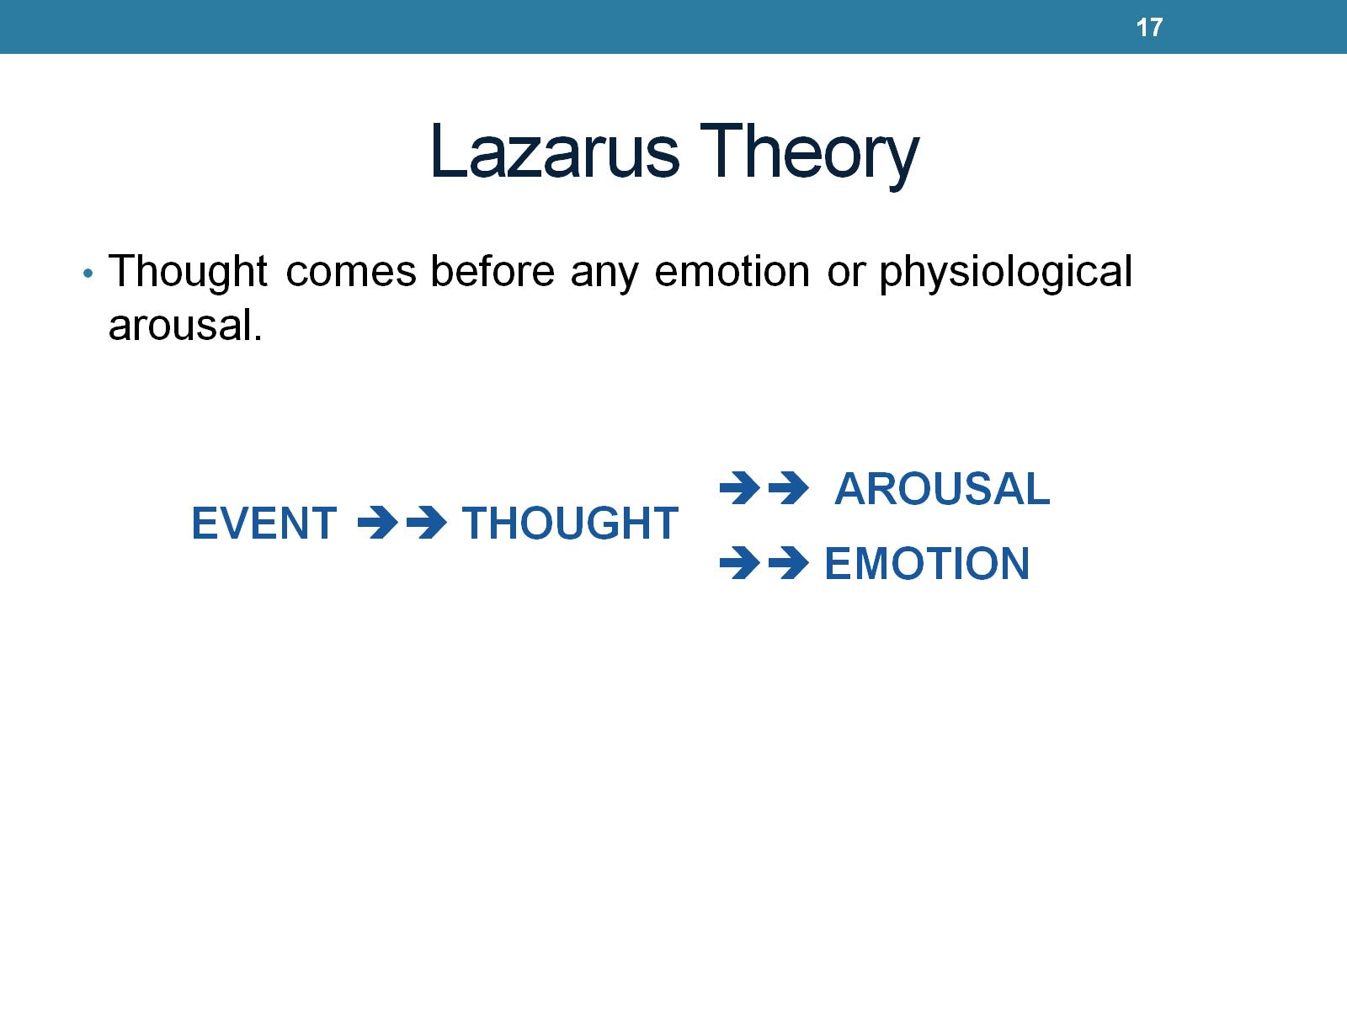
Lazarus Theory
Notes:
Cognitive. All emotions involve cognitive appraisal. Emotions are affected by memories expectations and so on. Cognitive apraisal does not have to be concious.

Slide 18
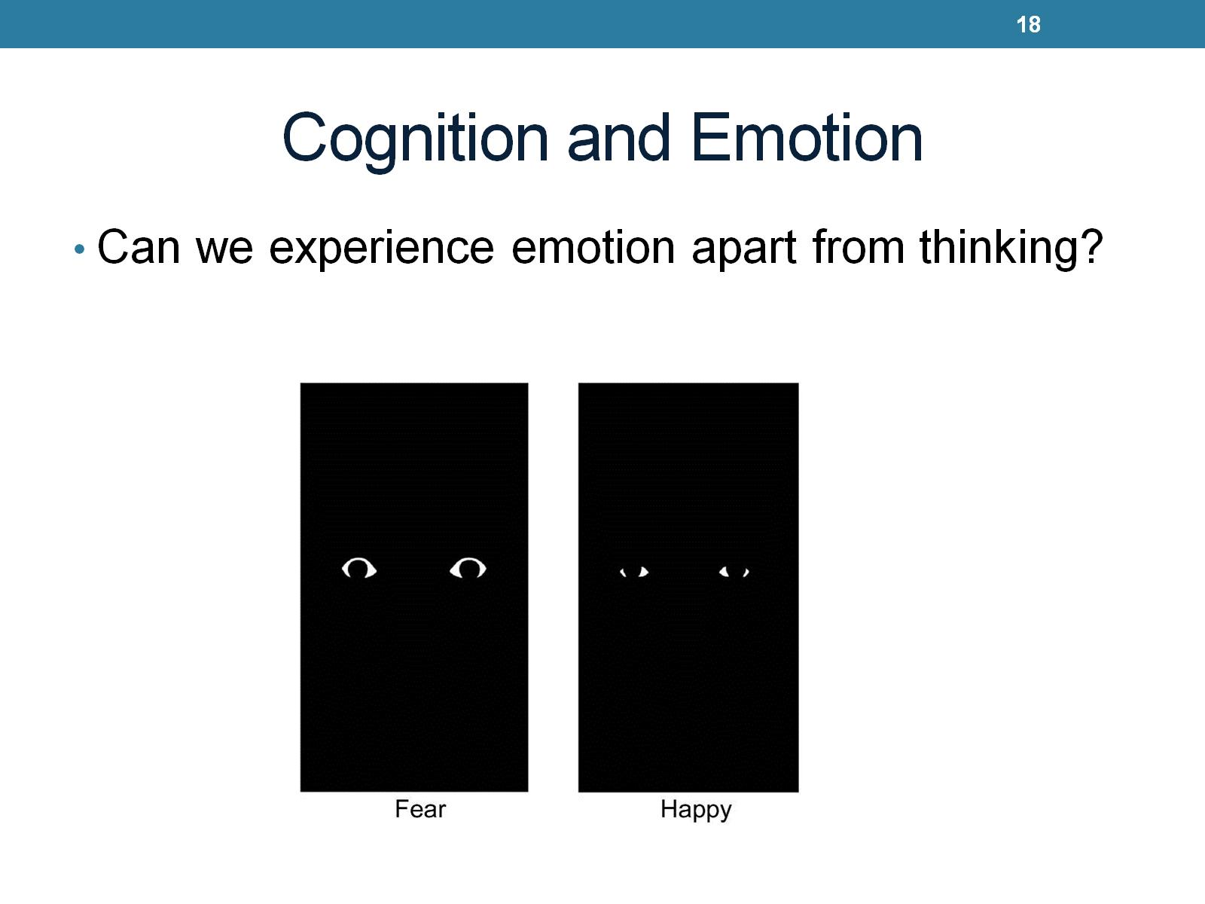
Cognition and Emotion

Slide 19
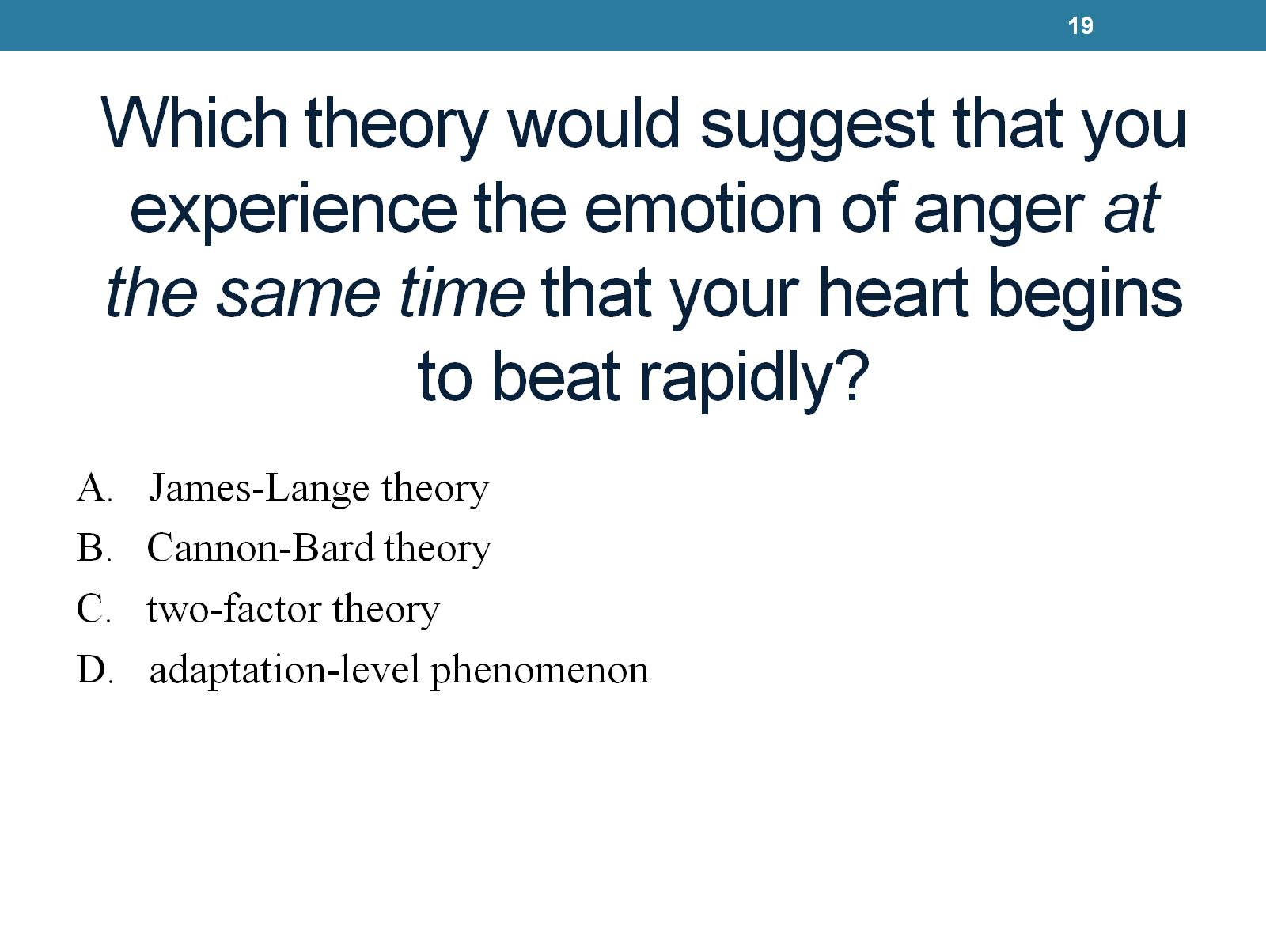
Which theory would suggest that you experience the emotion of anger at the same time that your heart begins to beat rapidly?

Slide 20
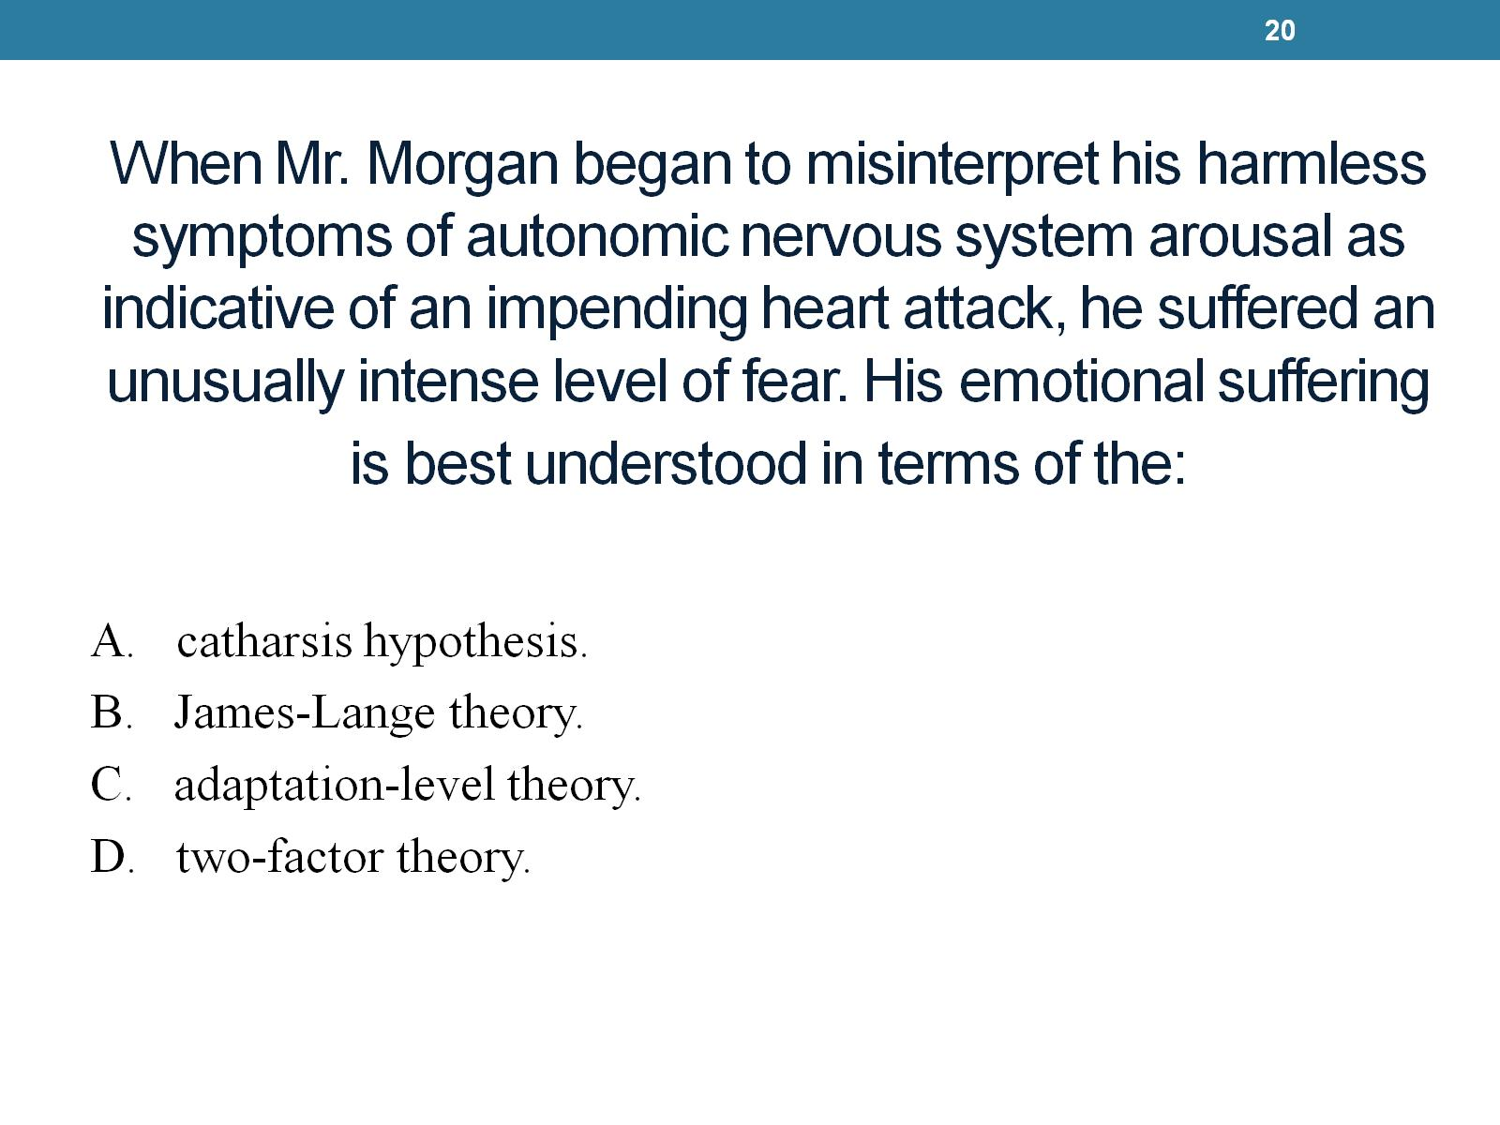
When Mr. Morgan began to misinterpret his harmless symptoms of autonomic nervous system arousal as indicative of an impending heart attack, he suffered an unusually intense level of fear. His emotional suffering is best understood in terms of the:
Notes:
D

Slide 21
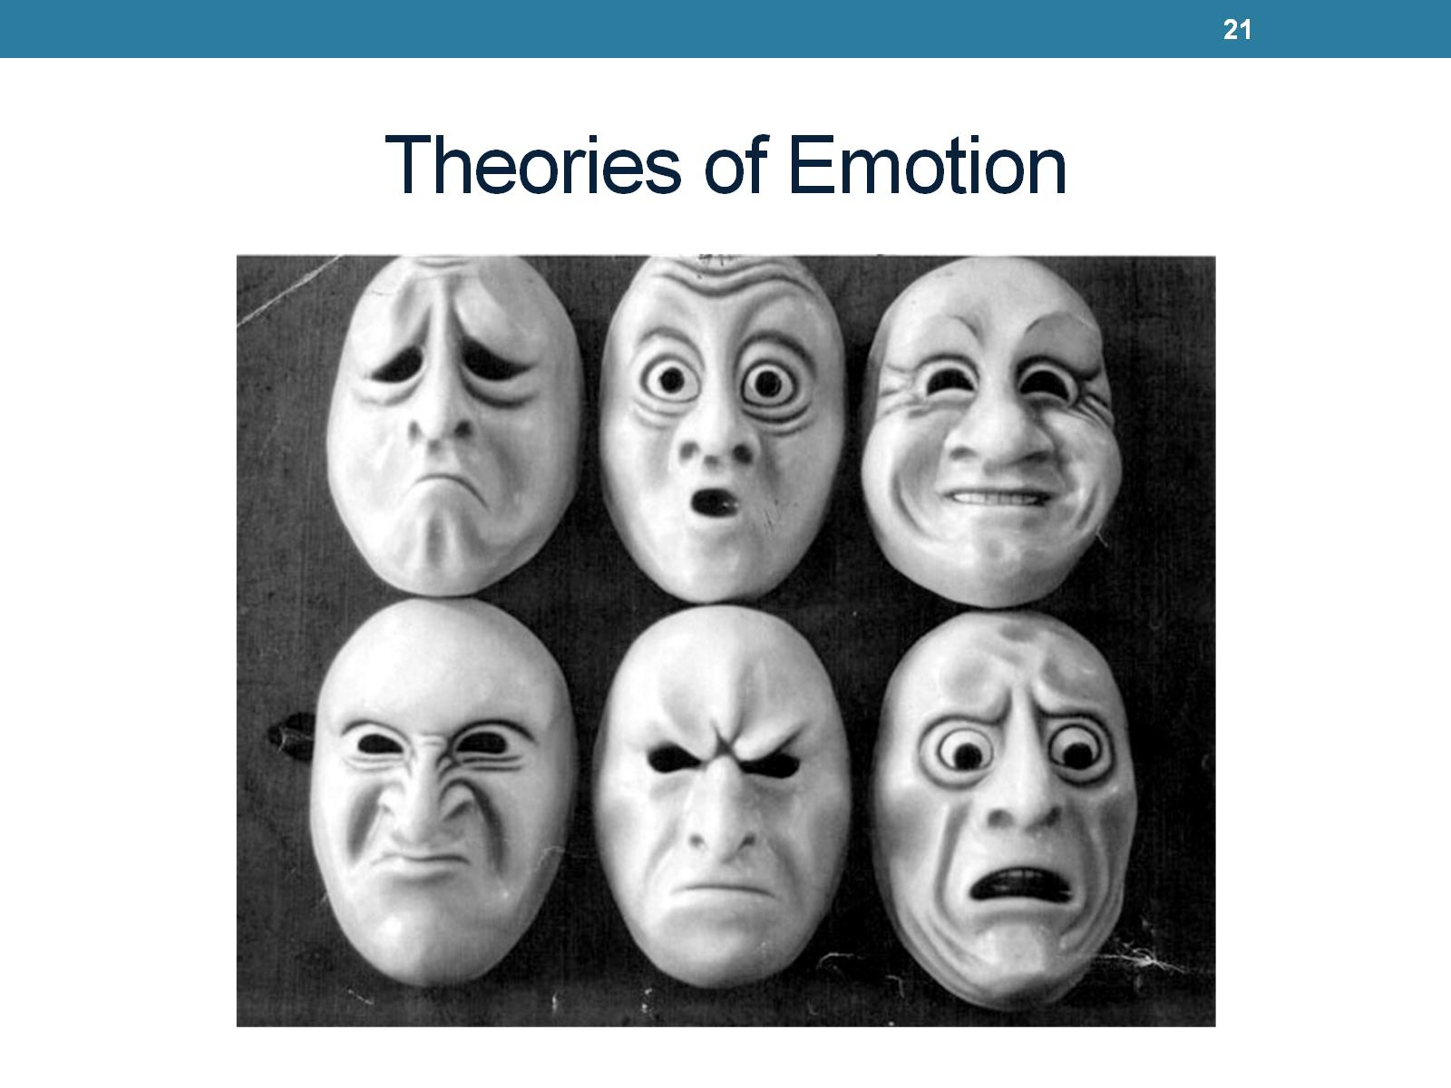
Theories of Emotion

Slide 22
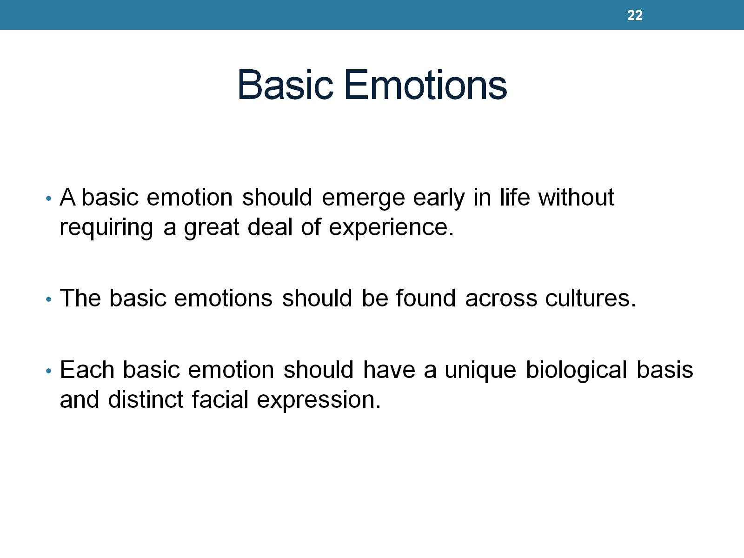
Basic Emotions
Notes:
Cultures should be able to interpret emotions similarly.

Slide 23
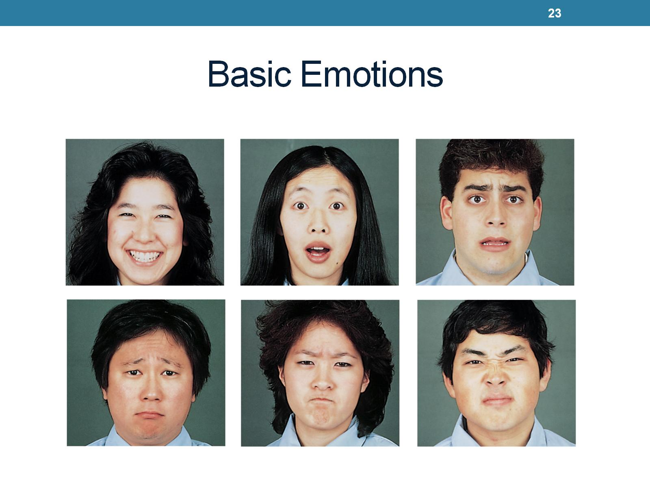
Basic Emotions
Notes:
Happiness surprise fear sadness anger disgust

Slide 24
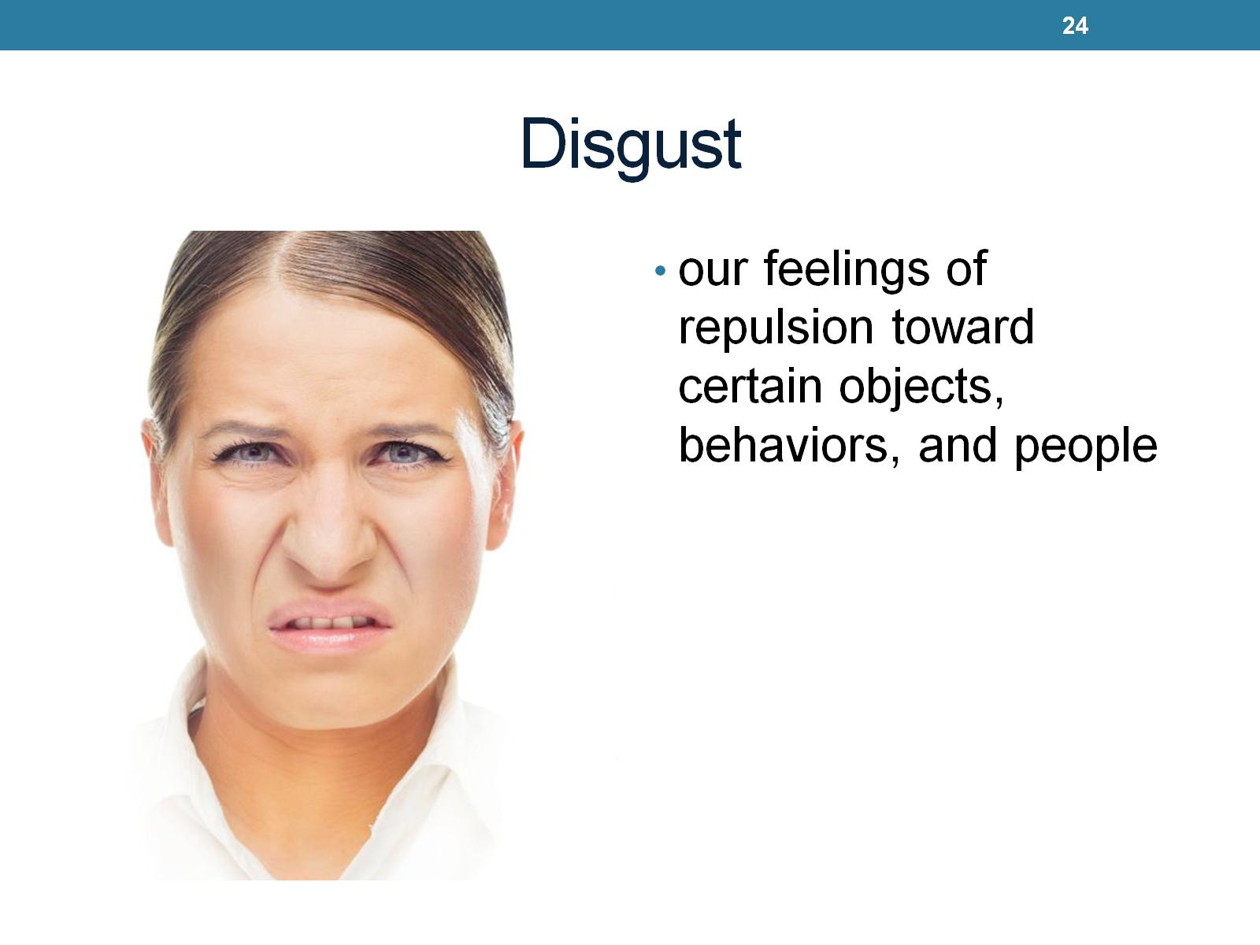
Disgust
Notes:
Typically invovles something unclean etc.

Slide 25
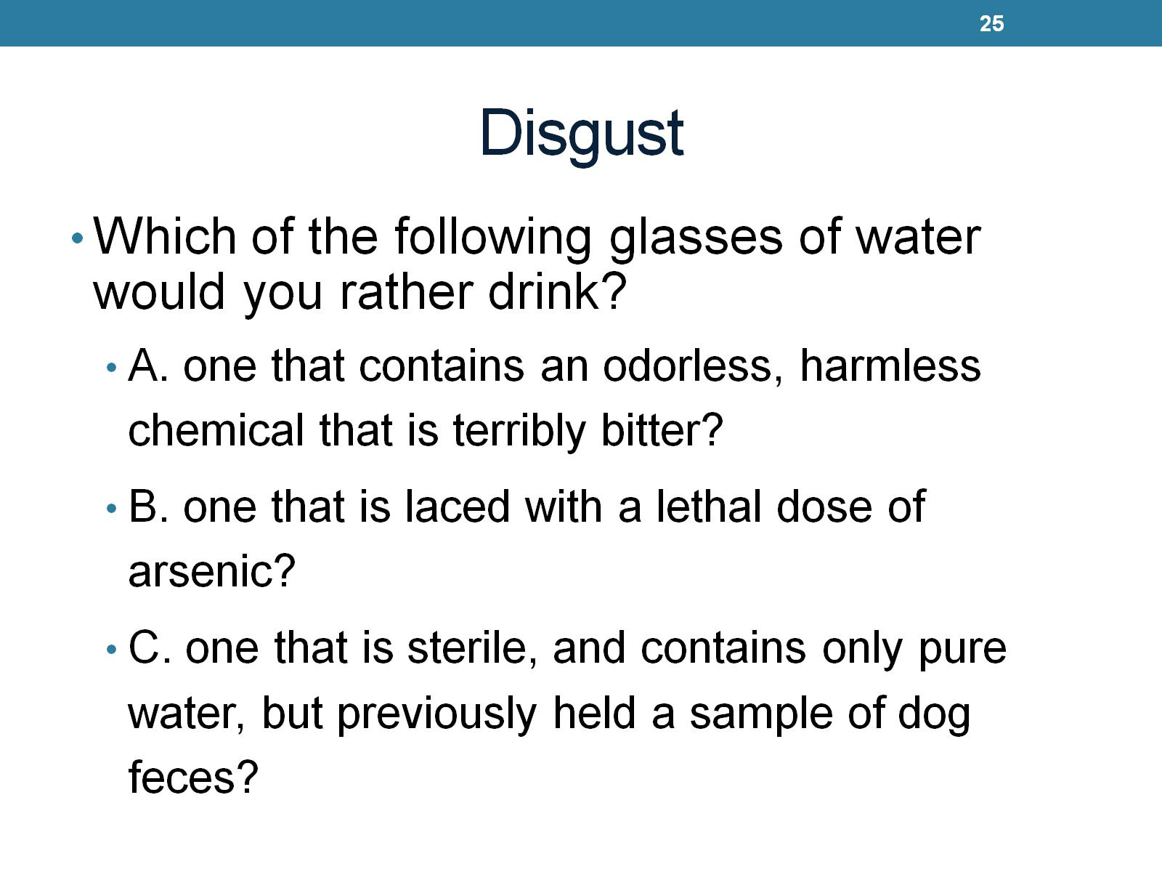
Disgust
Notes:
Disgust is not only based on senses. It is a reaction to our knowledge. Because disgust is so involved in our thoughts we have control over what we think is disgusting

Slide 26
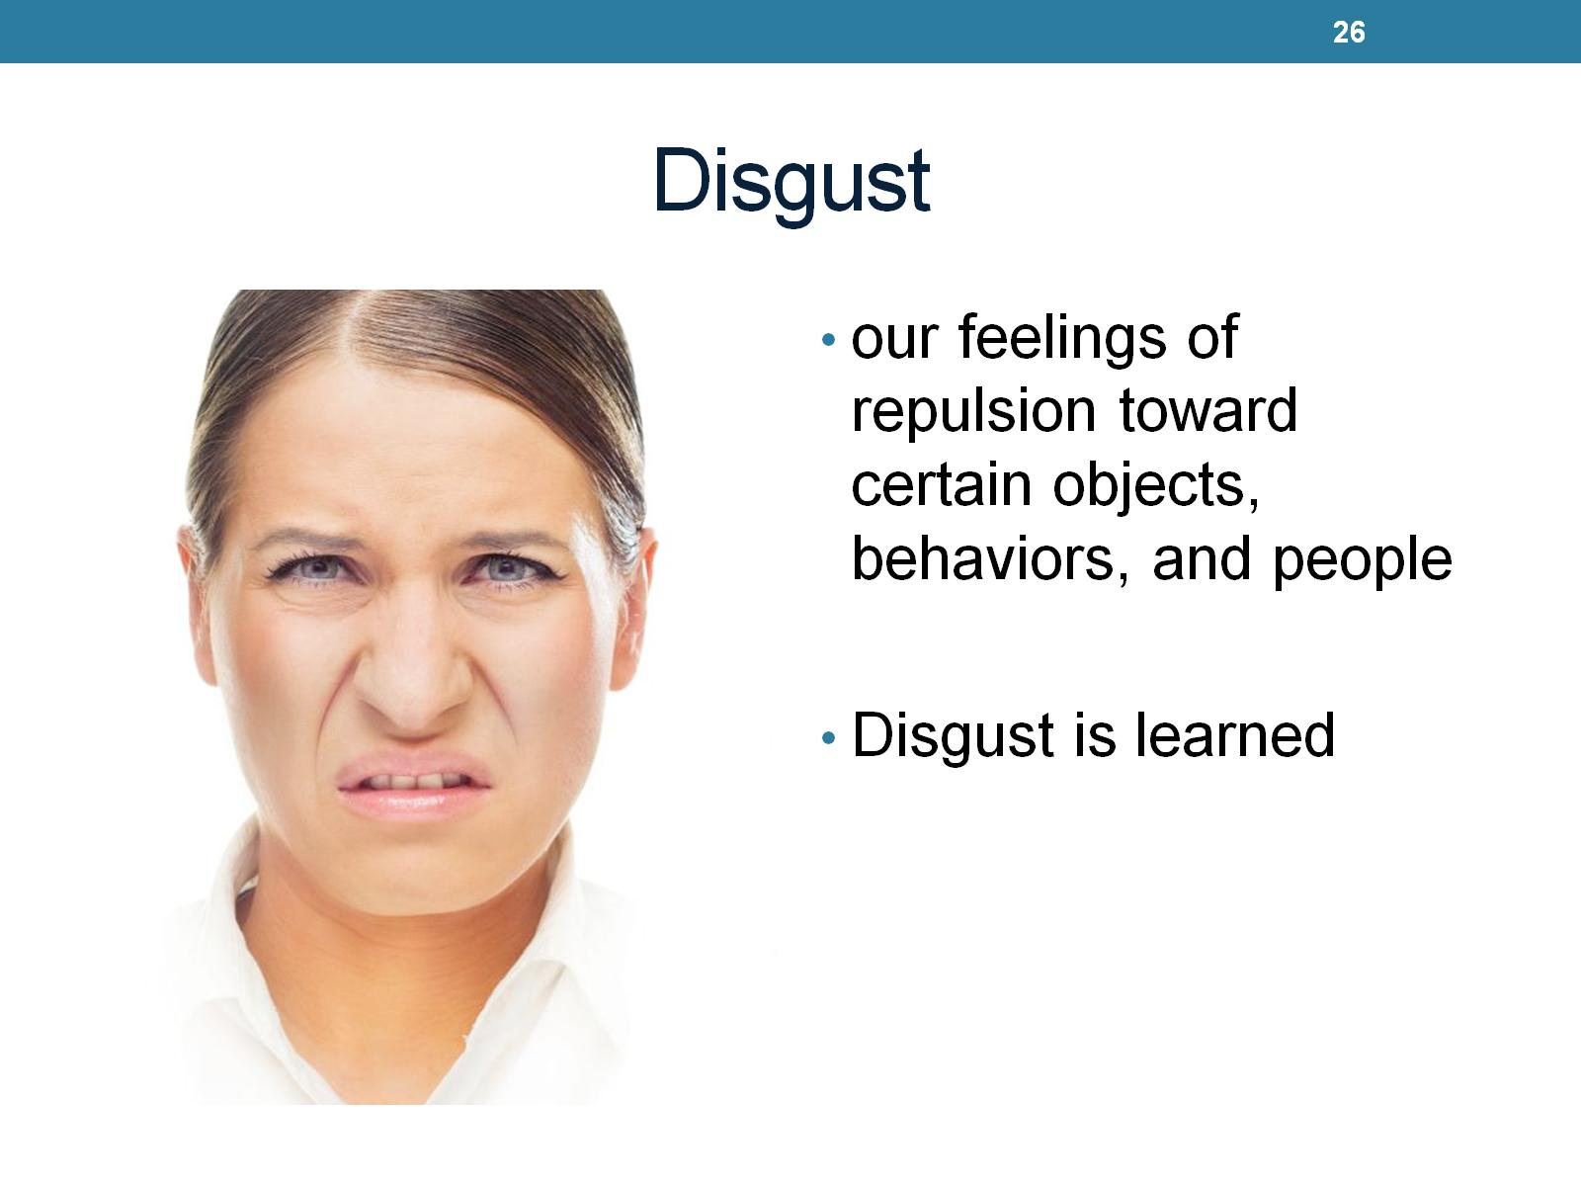
Disgust
Notes:
Learn disgust by learning what other people think is disgusting or from our own experiences.

Slide 27
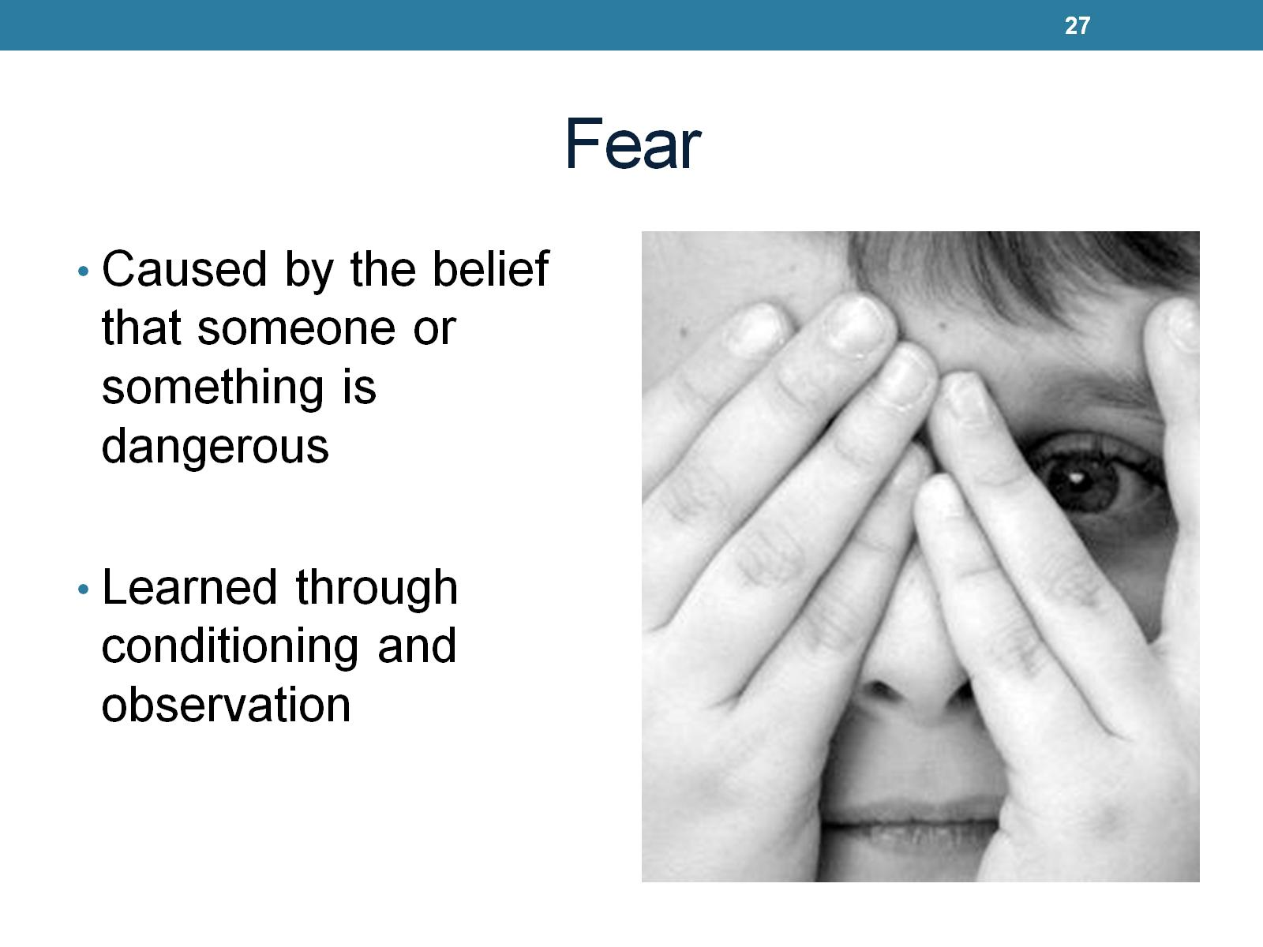
Fear
Notes:
Is likely to cause pain or is a threat. One of the most powerful emotion. Can haunt us and occupy our thinking. Its an alarm system. Most fears are not life or death. Learned threw conditioning. Experiences. A lot of fears are irrational. Fear can be adapted

Slide 28
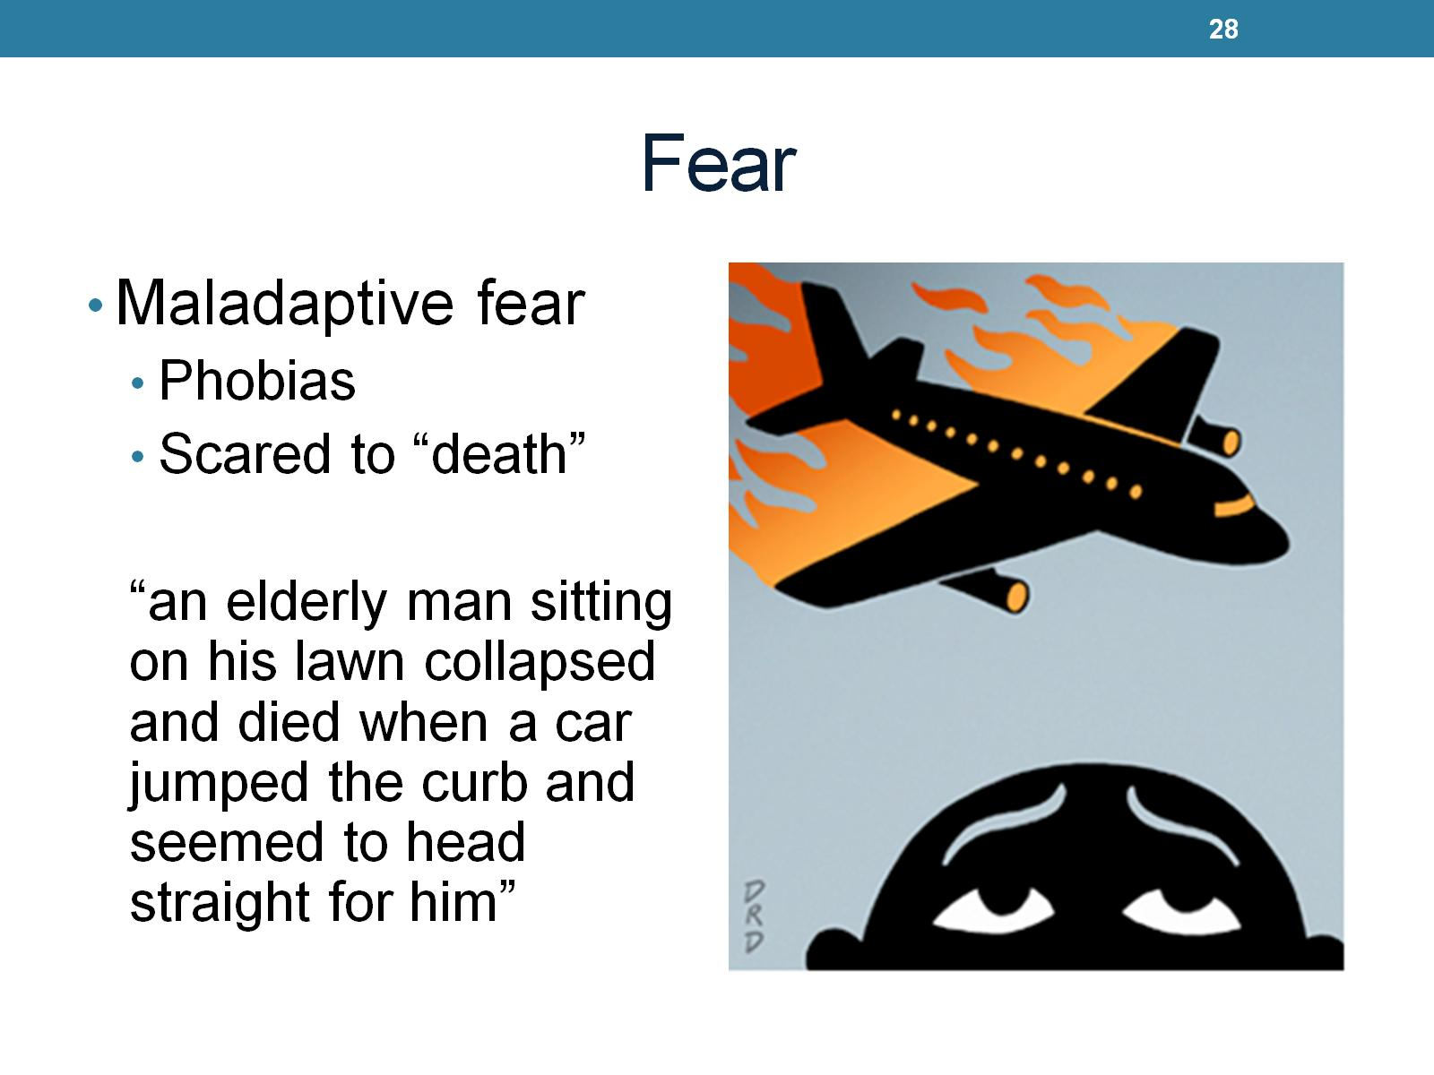
Fear
Notes:
Fear can also be maladaptive. Phobias inhibit us from being able to cope. Research is starting to show that you can be scared to death. Fear realeses a hormone like adrenaline called catacolomeans. These hormones can kill you.

Slide 29
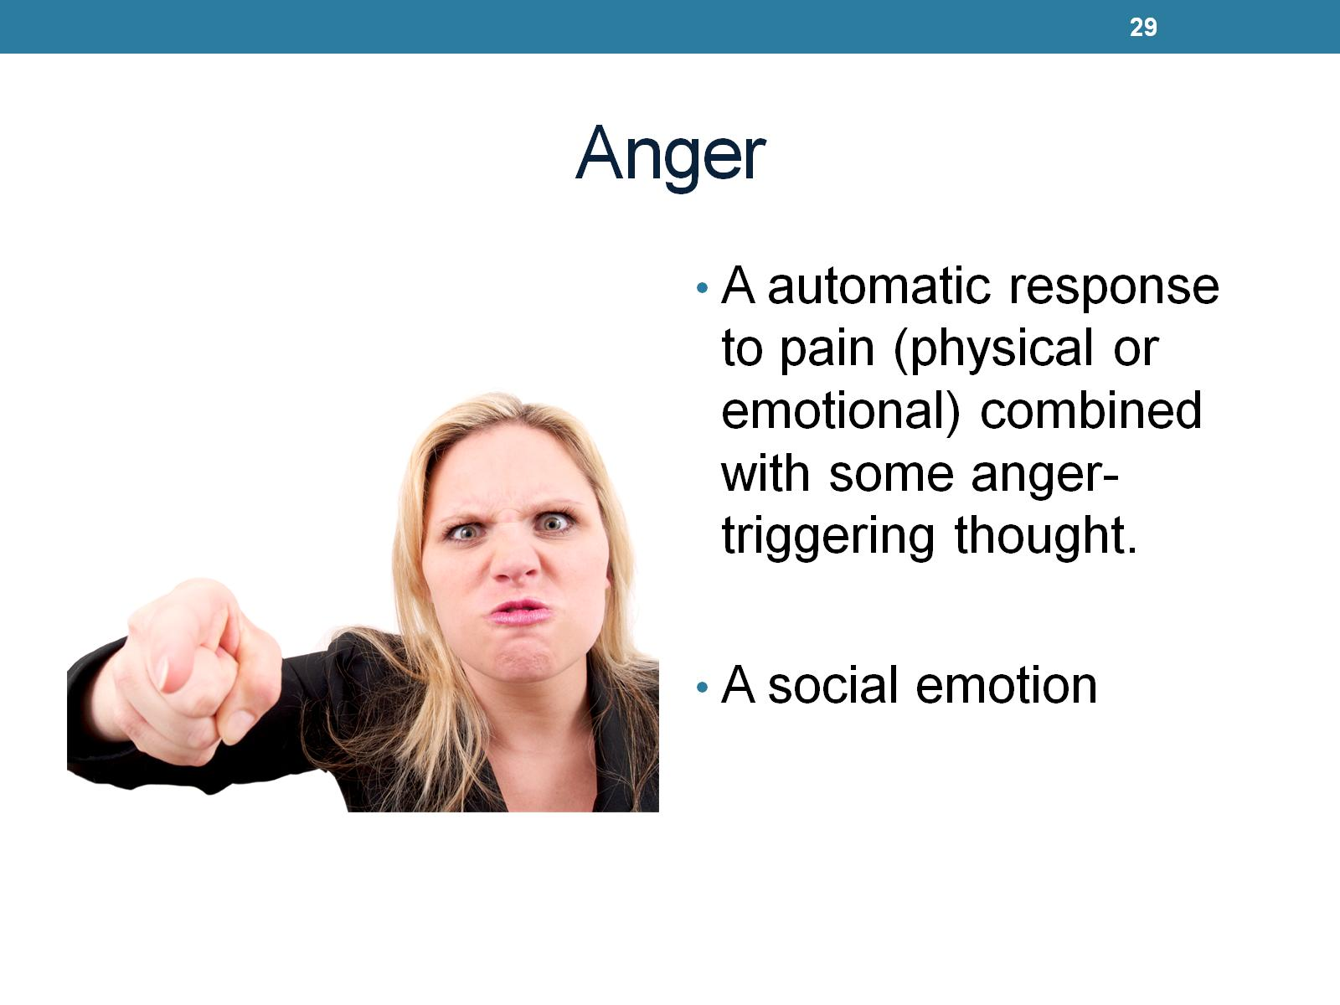
Anger

Slide 30
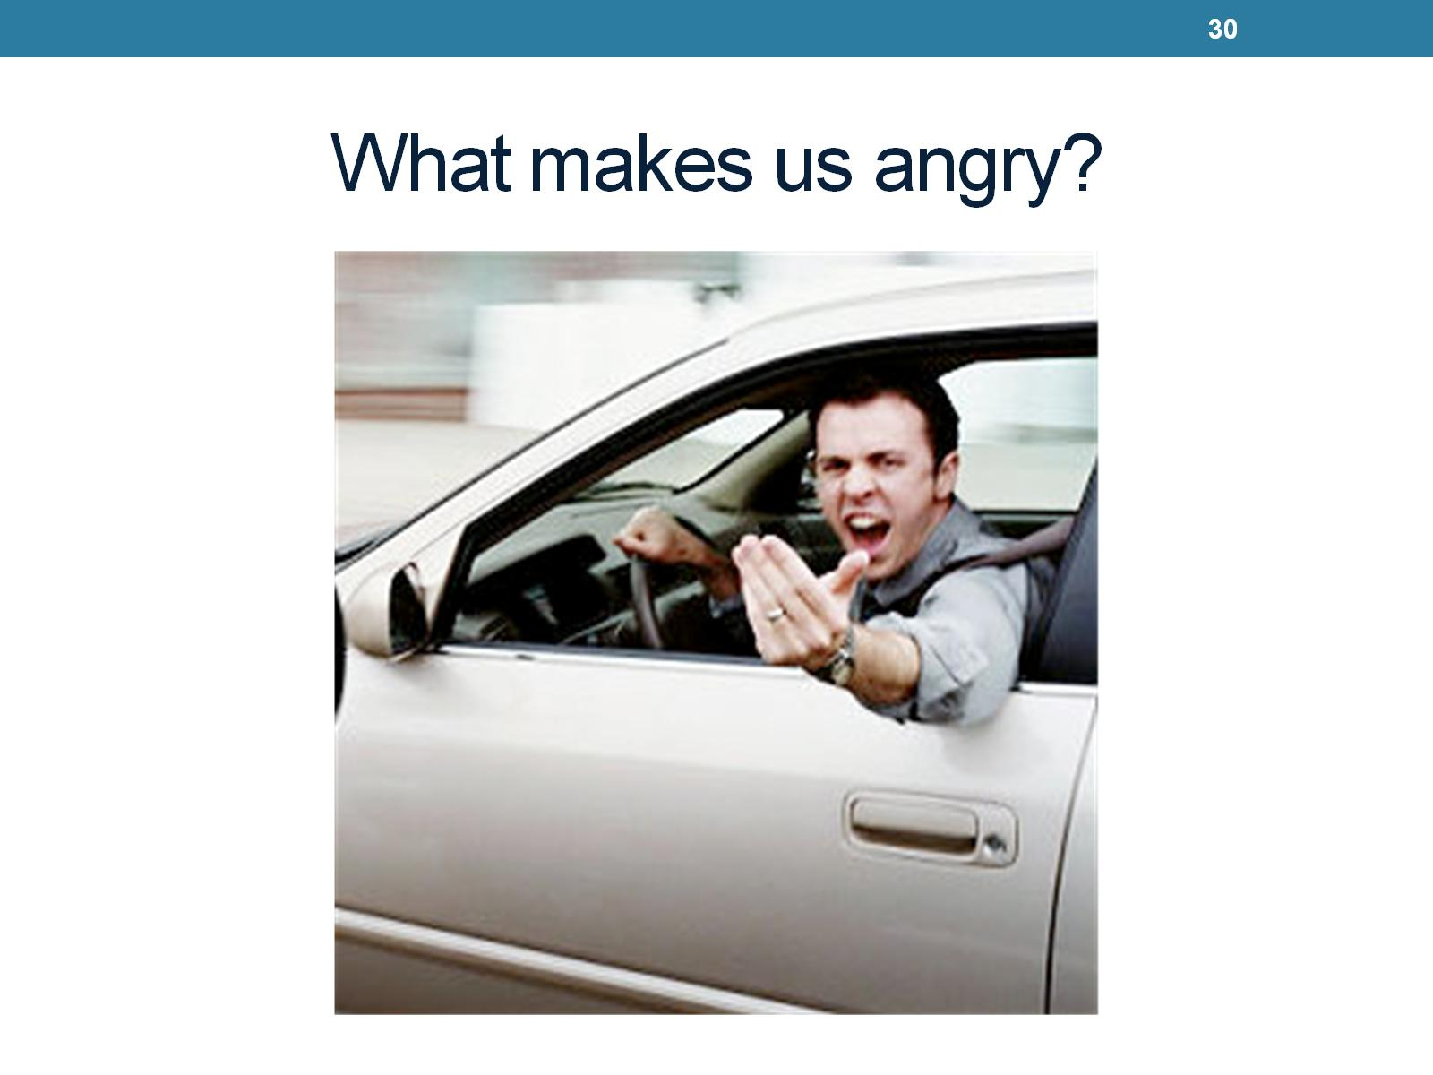
What makes us angry?

Slide 31
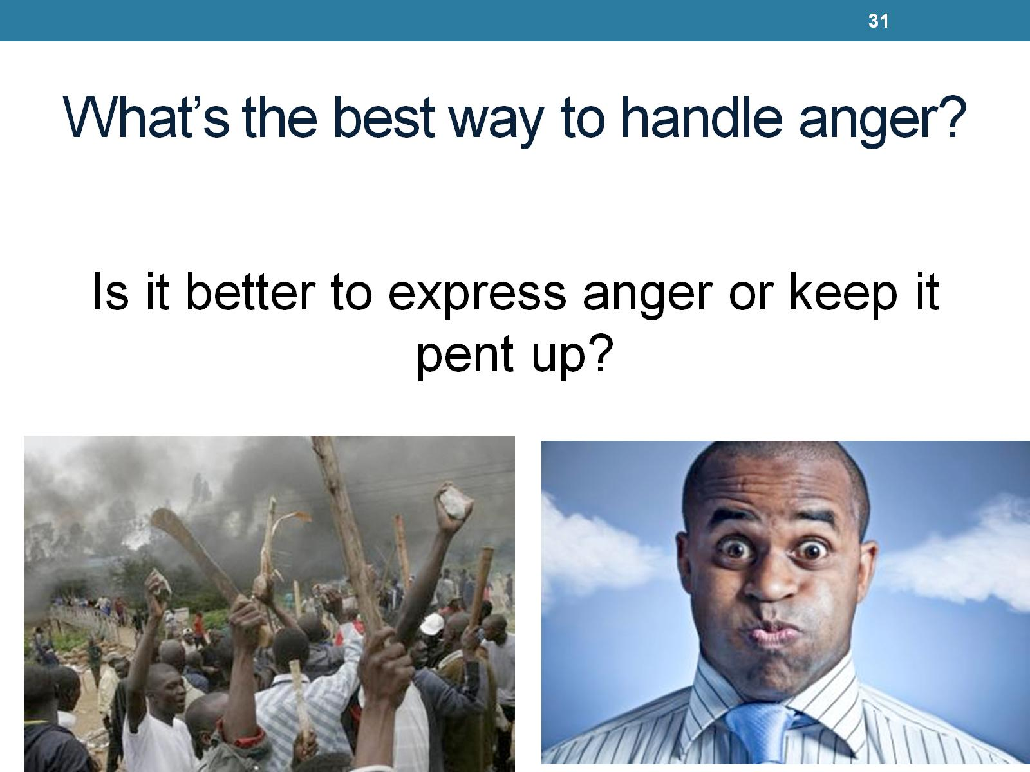
What’s the best way to handle anger?

Slide 32
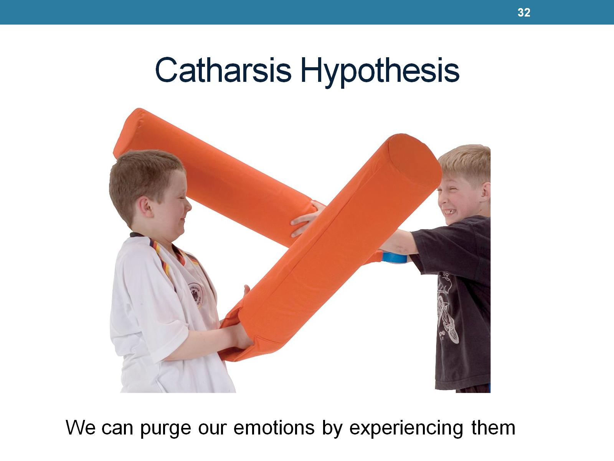
Catharsis Hypothesis

Slide 33
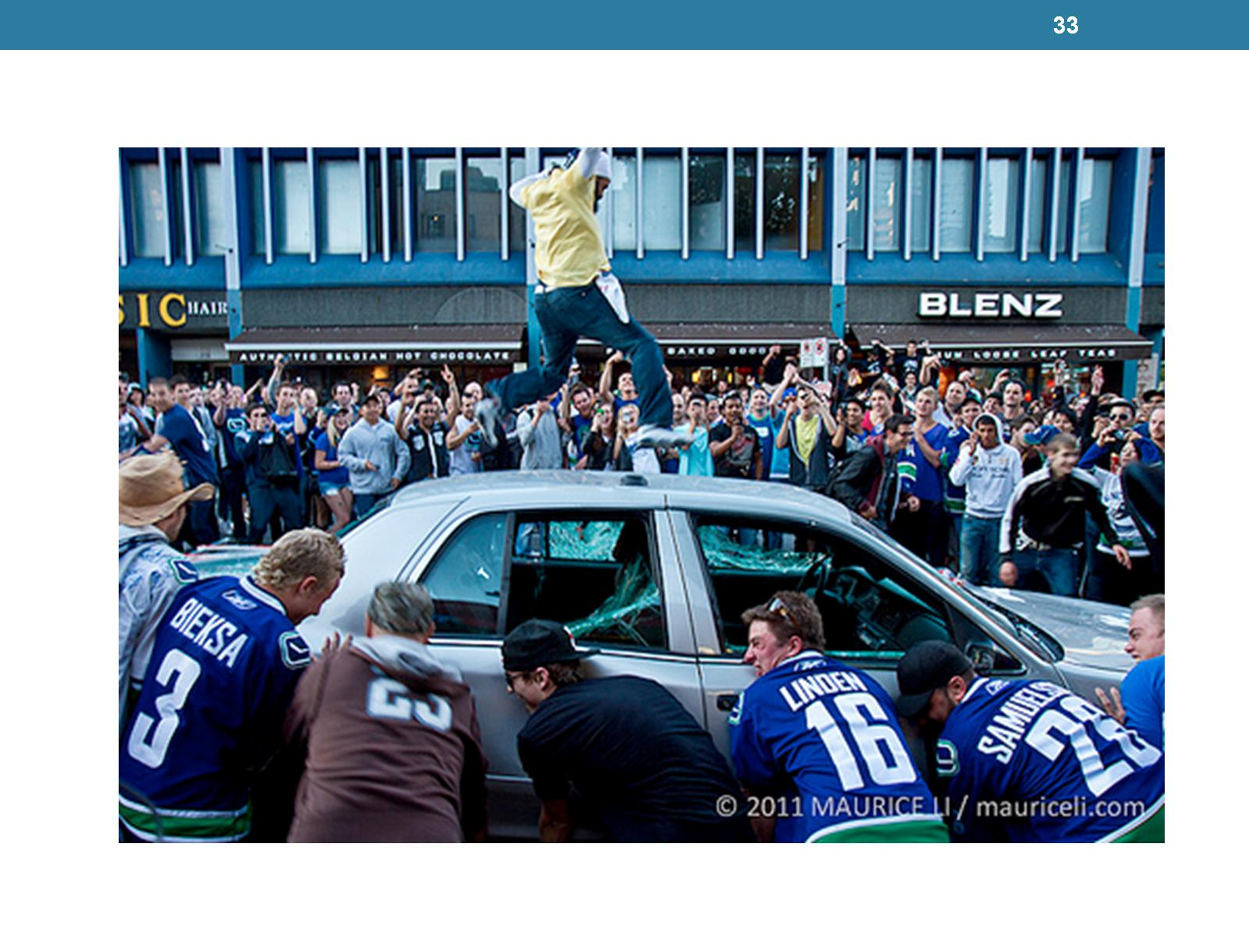

Slide 34
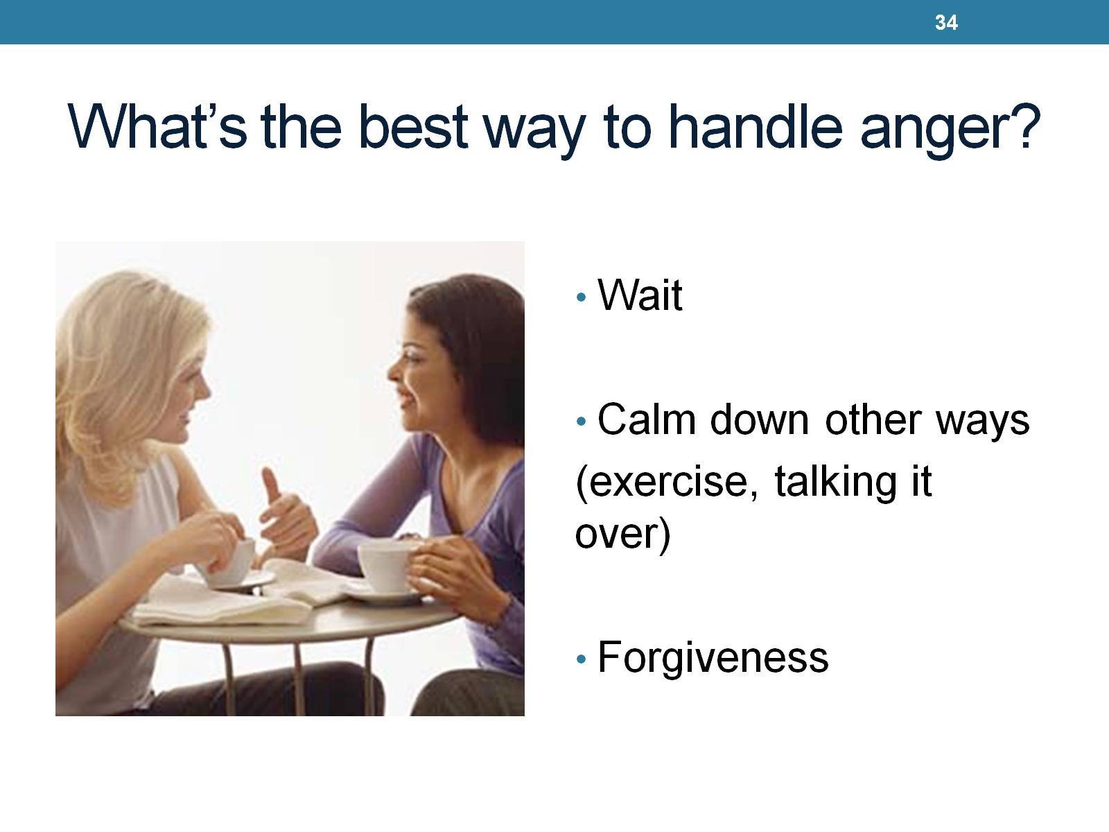
What’s the best way to handle anger?

Slide 35
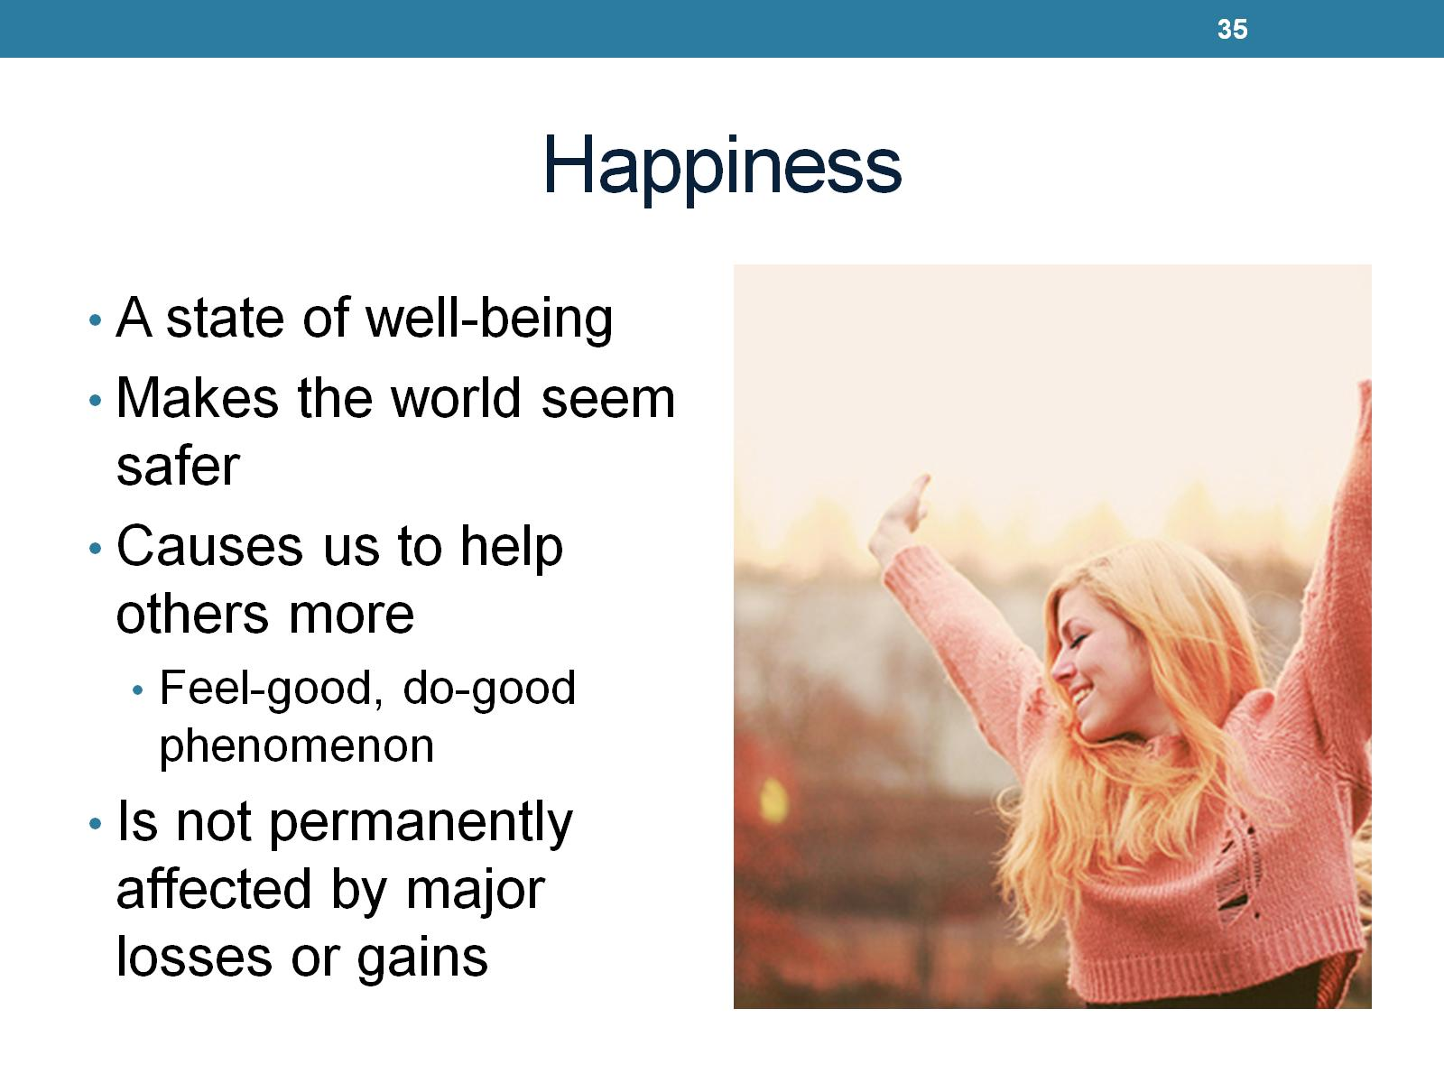
Happiness

Slide 36
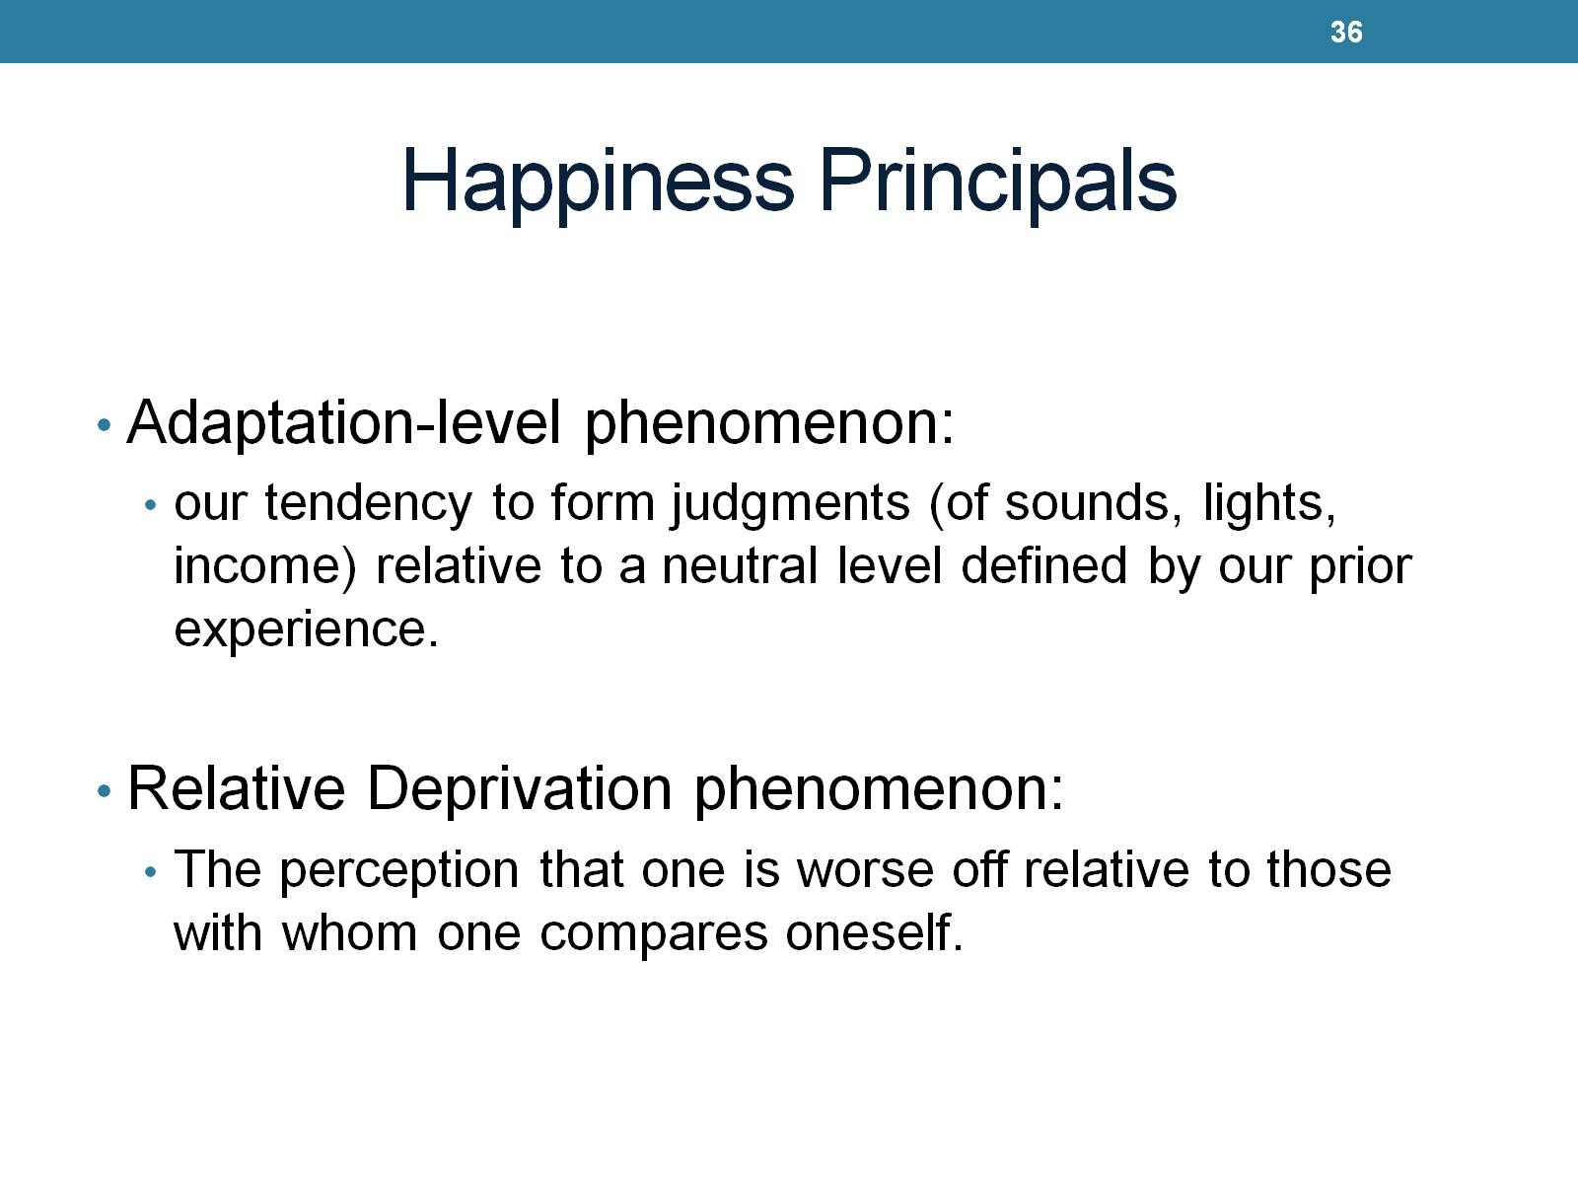
Happiness Principals

Slide 37
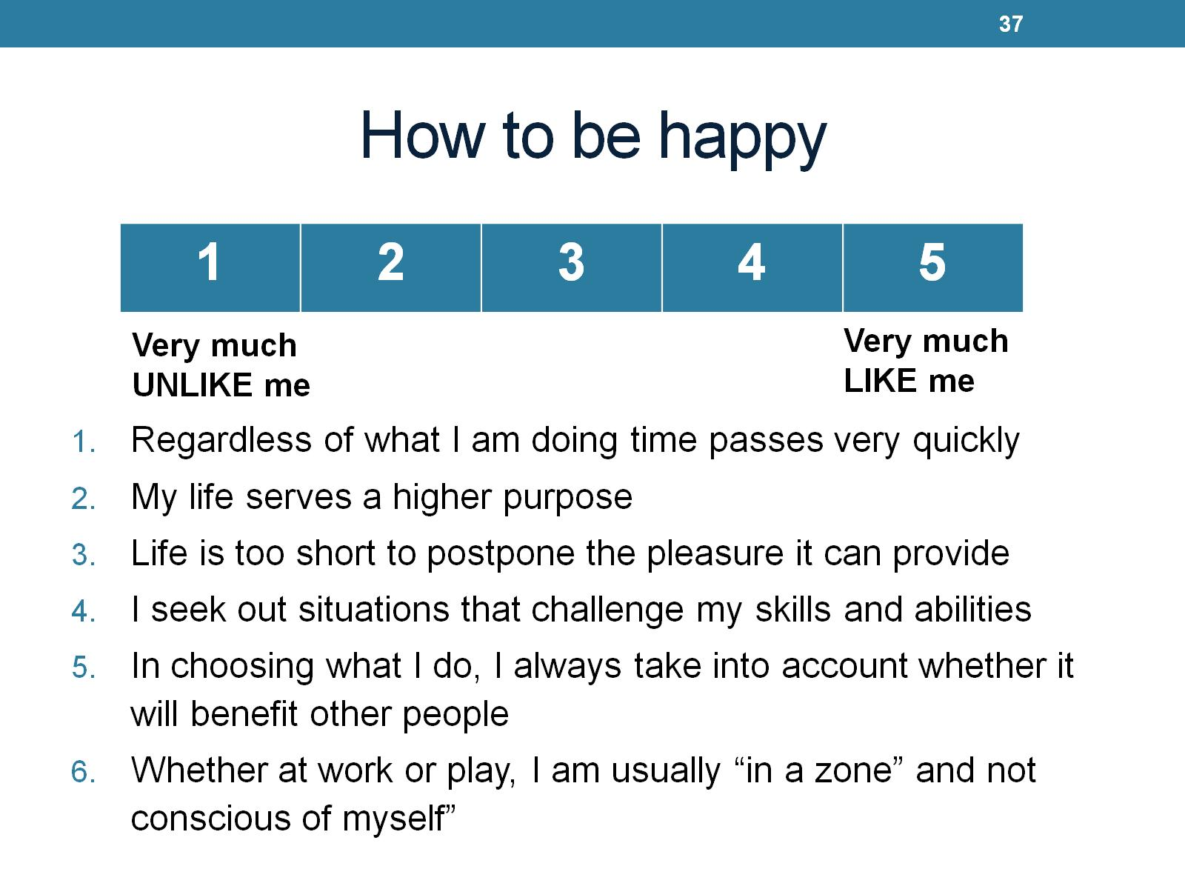
How to be happy

Slide 38
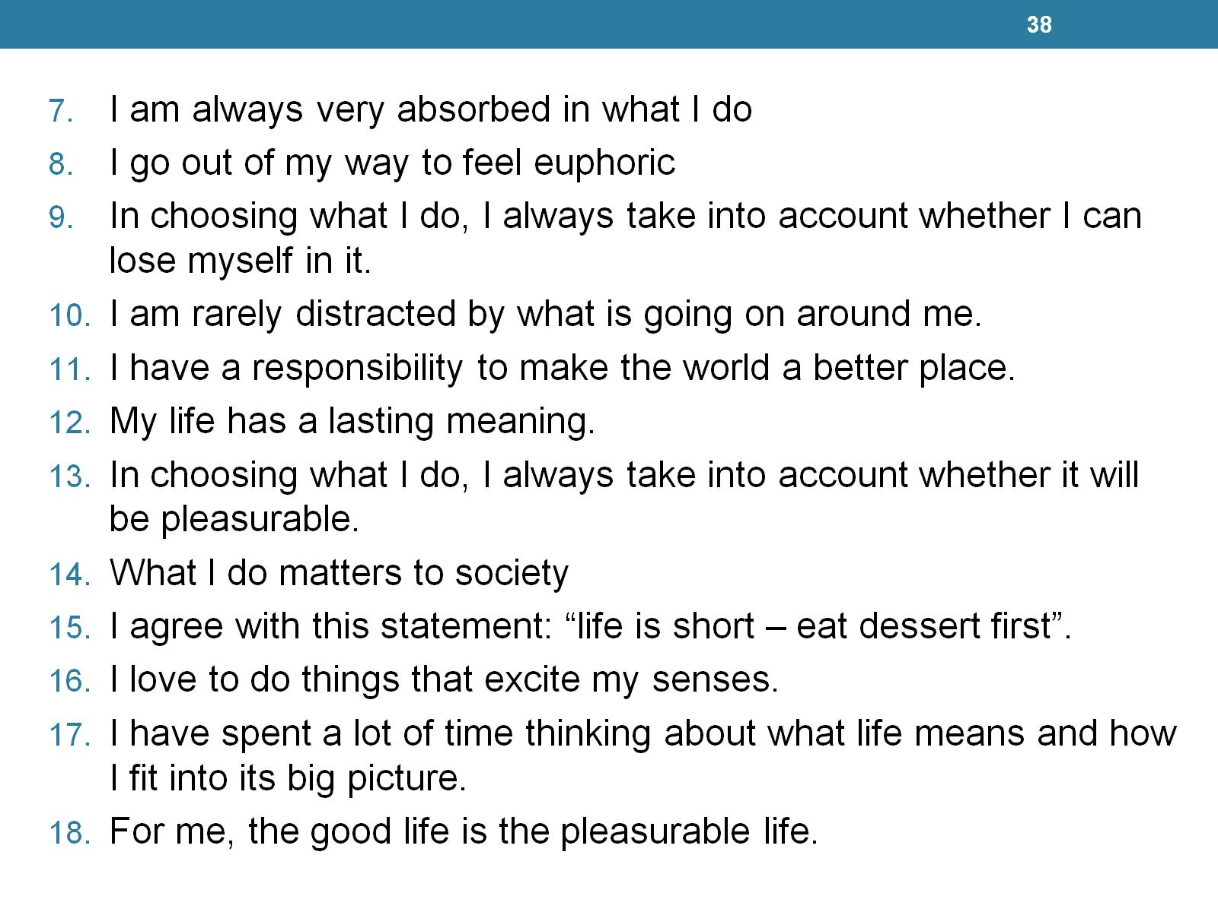

Slide 39
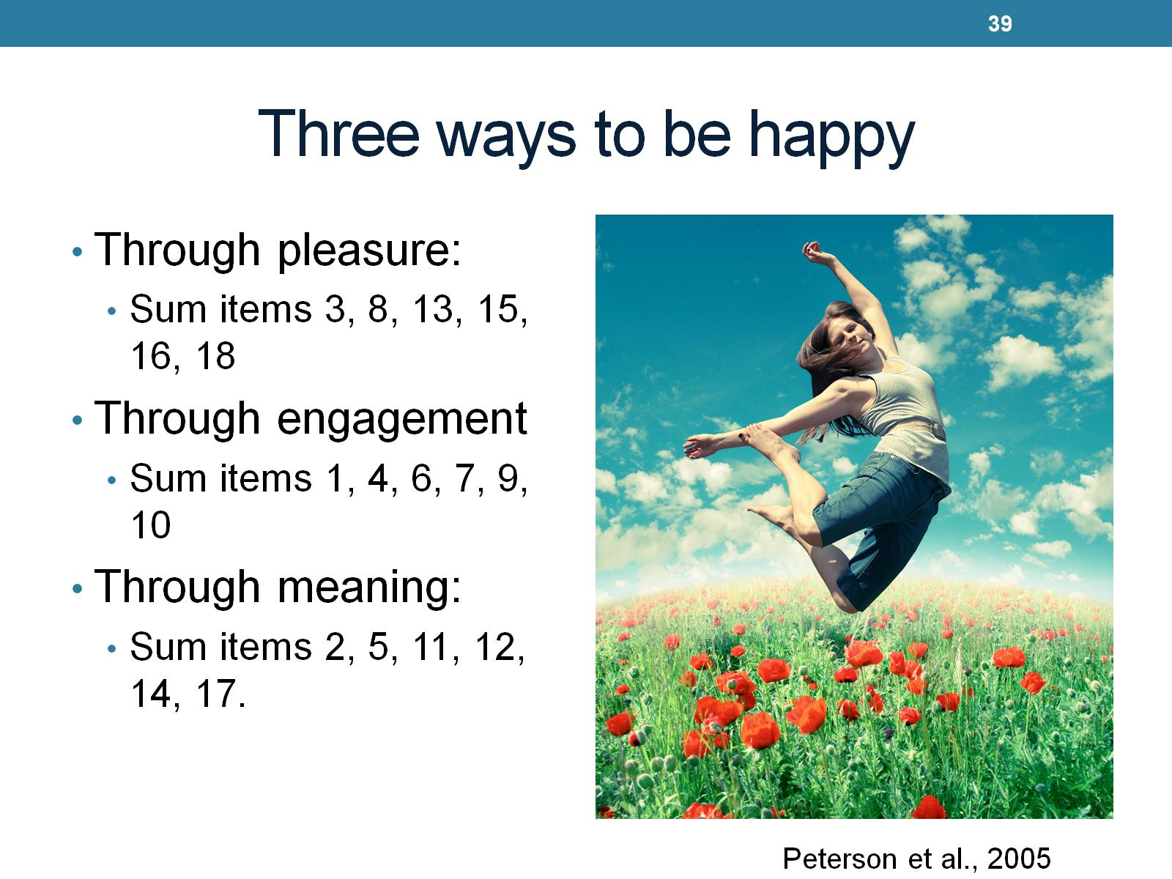
Three ways to be happy

Slide 40
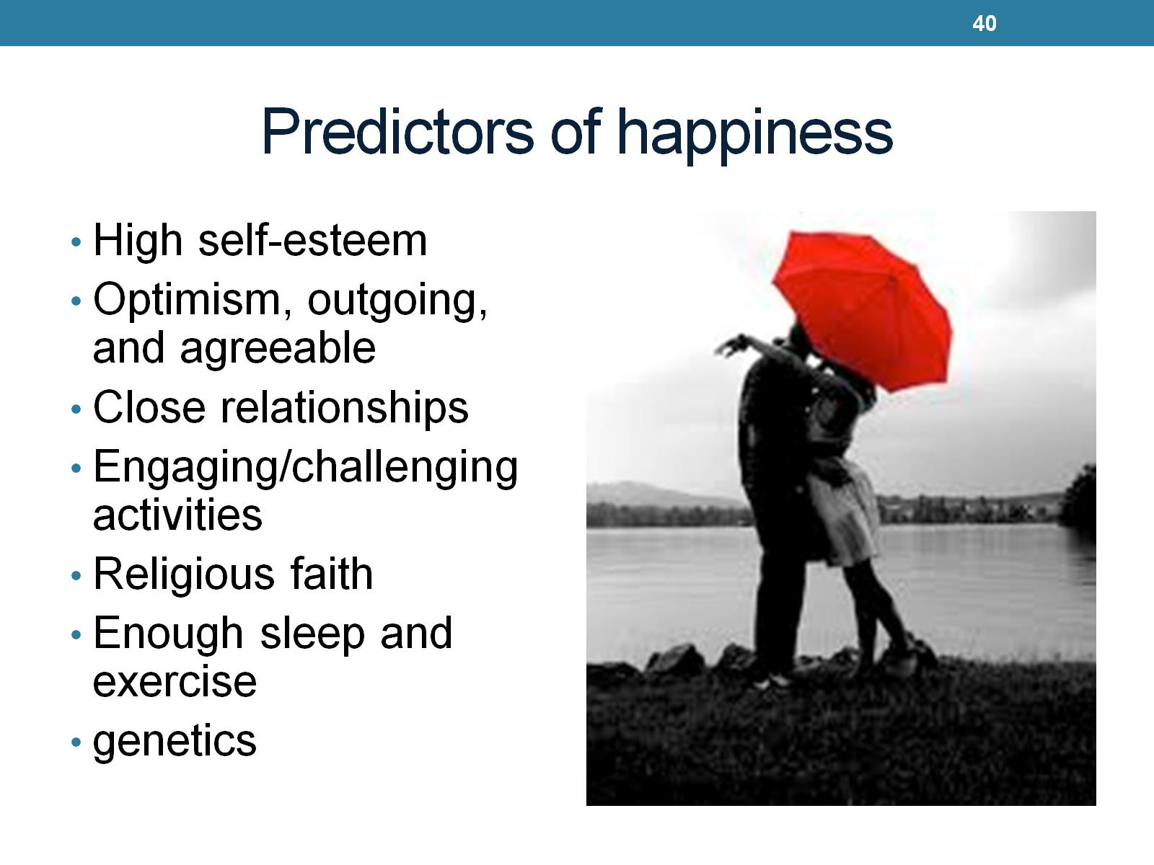
Predictors of happiness

