Slide 1
Sentencing and Offender Treatment
Chapter 9

Slide 2
Today’s Class
Purposes and principles of sentencing
Sentencing options
Sentencing disparity
Parole
Historical background
What works in offender treatment?
Punishment-based strategies
Principles of effective correctional treatment
Notes:
***need to know the principles to effective correctiona treatment** know all 3

Slide 3
Sentencing

Slide 4
Why Do We Sentence People?
Specific deterrence
General deterrence
Denunciation
Incapacitation
Reparation
Rehabilitation
Responsibility
Notes:
General deterrence: reduce probability that members of public will offender in the public.
Denunciation: disapproval of an act
Incapacitation: separate offenders from society
Reparation: make amends for wrong doing through compensation
Rehabilitation: provide treatment to decrease the likely hood of reoffending.
Responsibility:

Slide 5
Principles of Sentencing in Canada
Must be proportionate to the gravity of the offence and the degree of responsibility of the offender
Consider aggravating and mitigating factors
Consistency
Consider aggregate sentence
Use alternatives to incarceration if at all possible
Notes:
Need to look at background and the reasons why you committed the offences. Should be getting the same sentence, strived for consistancy so everyone is treated equally.

Slide 6
Sentencing Options in Canada
Absolute or conditional discharge
Probation
Restitution
Fines and community service
Conditional sentence
Imprisonment
  Additional options for high-risk offenders
Notes:
Incarceration is very expensive so look for other options, we don’t have room and there is over crowding.
Absolute: released into the community, no criminal record.
Probation: released into community with conditions.
Restitution: monetary payment to the victim or community
Fines: performing duty in the community, monetary payment to courts.
Conditional sentence: sentence served in the community

Slide 7
Dangerous Offenders
A dangerous offender application can be made for any offender convicted of a serious personal injury offence who constitutes a danger to others
Fewer than 500 in Canada
  1 woman
Notes:
-requires a deternination of dangerousness
-indeterminate sentence

Slide 8
Long Term Offenders
The long term offender designation is relatively new to Canada
Must meet several criteria:
Receives a sentence of at least 2 years followed by a period of supervision
Notes:
-sentence of 2+ years us appropriate
-risk of re-offending
-reasonable possibility of eventual control risk

Slide 9
Are the Goals of Sentencing Achieved?
Ongoing debate about deterrence and rehabilitation
Many researchers do not believe that get-tough strategies reduce crime
However, certain rehabilitative efforts do appear to reduce re-offending
Notes:
-

Slide 10
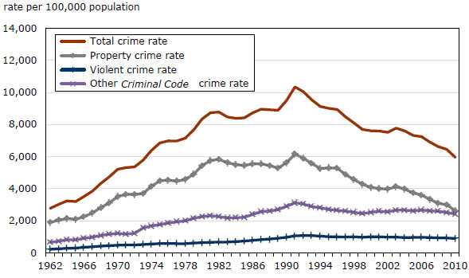
Crime Rates in Canada

Slide 11
Sentencing Disparity
Unwarranted sentencing disparity results from a reliance on extra-legal factors
These factors can be categorized as:
Systematic factors
Unsystematic factors
Notes:
Systematic:
→Consistent disagreement among judges, Sources; personality, philosophy, experience
Unsystematic:
→inconsistencies in a judges sentencing decisions over time when judging same offender types
-sources: fluctuations in mood, focus on irrelevant stimuli, way interpret facts

Slide 12
Studying Sentencing Disparity
Sentencing disparity is typically studied in one of two ways:
  Simulation studies
  Official sentencing statistics
Using either method it is clear that sentencing disparity exists in Canada
Notes:
Simulation studies; gives case studies and analyze the reason the judges give you in your mock case strudy.

Slide 13
Reducing Sentencing Disparity
Sentencing guidelines
In Canada, very broad and may not significantly reduce sentencing disparity

Slide 14
Simulation Study
(Palys & Divorski, 1986)
206 provincial court judges
Five cases
  Assault CBH, Impaired Driving, Armed Robbery, B & E, Theft > $200
Judges asked to
  impose a sentence
What sentence would you impose?

Slide 15
Parole in Canda
Parole involves:
  Conditional release into community
  Rehabilitation
  A high degree of supervision
  Return to prison if conditions are breached

Slide 16
Types of Release
Temporary absences
Day parole
Full parole
Statutory release

Slide 17
Parole Decision-Making
Decisions are made by members of Parole Board of Canada (PBC)
A formal hearing takes place between the offender and the PBC
  a formal risk assessment is conducted
List of things to consider, but little guidance on how

Slide 18
What Does a Hearing Look Like?
Most are held in institutions
People involved:

Slide 19
Conditions of Parole
All types of parole are supervised by CSC
Various conditions of parole must be met or the offender may go back to prison

Slide 20
Public Perceptions of Parole
Why are public perceptions important?

Slide 21
Factors That Influence Percpetions
Discrepancy between attitudes and reality
  Lack of understanding of the criminal justice system
  Effect of media

Slide 22
Public Attitudes Toward the CJS
There are three methods that are commonly used to study public attitudes towards the criminal justice system:

Slide 23
Common Attitudes
Results of public opinion polls indicate that Canadians:
  view the criminal justice system in a relatively positive light (especially the police)
  believe that offenders are treated too leniently (sentencing)
  support alternatives to sentencing under certain conditions

Slide 24
Treatment

Slide 25
Brief Historical Background
Extensive debate over “what works” in offender rehabilitation
Early literature reviews in the 1960s – 1970s did not present favourable conclusions
Martinson (1974) presented the “nothing works” conclusion

Slide 26
What Works in Offender Treatment?
Since Martinson’s time it has become clear that some things do work in offender treatment

Slide 27
Why Meta-Analysis?
A meta-analysis is the statistical aggregation of the results derived from many independent studies in order to integrate the findings
Primary unit of analysis is the effect size

Slide 28
Interpreting Effect Sizes
Effect sizes can vary in terms of:
  Magnitude
  Sign

Slide 29
Interpreting Effect Sizes
The magnitude of the effect size tells you how much of an effect there is

Slide 30
Interpreting Effect Sizes
The sign of the effect size tells you what type of effect the intervention had

Slide 31
Examples
Cognitive-behavioural treatment yields an effect size of +0.20
  What does this mean?
  The treatment group has a recidivism rate of 40% and your comparison group has a recidivism rate of 60%

Slide 32
Effectiveness of Punishment Based Strategies
Historically the CJS in North America has used “get tough” strategies to deal with offenders
These strategies vary in degree of severity from incarceration to intermediate sanctions (e.g., house arrest, curfews, restitution, etc.)

Slide 33
Effectiveness of Punishment Based Strategies
The objective with these strategies is to reduce recidivism by accomplishing both specific and general deterrence
Researchers have now used meta-analysis to review the evidence for a range of get tough strategies

Slide 34
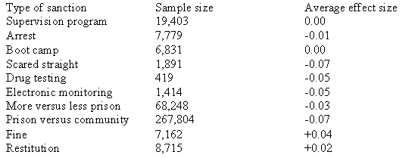
Gendreau et al., 2001

Slide 35
BUT Still More Punishment
Despite these findings, get tough strategies are still the most common response to crime and new strategies are being proposed on a yearly basis

Slide 36
Why Doesn’t Punishment Work?
Punishment is defined as a negative consequence to a behaviour that decreases the likelihood of the behaviour from re-occurring
We know that punishment can work to decrease behaviour (e.g., from lab-based studies) so why does it not work to decrease offending behaviour

Slide 37
6 reasons why punishment doesn’t work in the CJS
Intensity
Immediacy
Consistency
No escape
Person variables
Density

Slide 38
So Why Do We Still Punish?
People believe in the effect of punishment
Politicians think that getting tough on crime is what the public wants
Rehabilitation is seen as soft and ineffective
It takes time and energy to evaluate programs, find they are not working, and initiate new programs
Eye for an eye mentality

Slide 39
Principles of Effective Correctional Treatment
If not punishment, then what…
Psychologists have recently proposed ways of improving the effectiveness of correctional intervention (Andrews et al., 1990)
The following principles appear to be among those that are most important

Slide 40
Risk Principle
Consists of two components:
1.
2.
Recidivism rates will actually increase if we target low risk offenders
Why?

Slide 41
Need Principle
Criminogenic needs must be targeted in order to reduce recidivism
These needs represent dynamic risk factors that, when changed, will effect the likelihood of re-offending
Non-criminogenic needs are also dynamic and changeable but are unrelated (or at least weakly associated) with recidivism

Slide 42
Examples of Criminogenic Needs
Changing antisocial attitudes
Changing antisocial feelings
Reducing antisocial peer associations
Promoting identification with prosocial role models
Promoting familial affection/communication
Promoting familial monitoring and supervision
Increasing self-control, self-management, and problem- solving
Substance abuse
Academic and vocational deficits
Recognition of risky situations

Slide 43
Examples of Non-Criminogenic Needs
Increasing self-esteem (without reductions in antisocial thinking, feeling, and peers)
Focusing on vague emotional/personal problems
Increasing cohesiveness of antisocial peer groups
Neighborhood-wide improvements without touching the needs of higher risk individuals
Increasing conventional ambition (work/school) without concrete assistance to achieve them
Fear of official punishment (i.e. “Scared Straight”)
Physical training programs

Slide 44
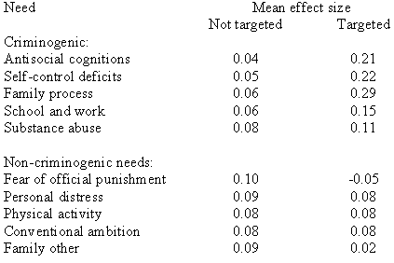

Slide 45
Responsivity Principle
General Responsivity:
  delivered in a style and mode

Slide 46
Responsivity Principle
Specific Responsivity:
  intervention should be tailored to specific characteristics of the offender

Slide 47
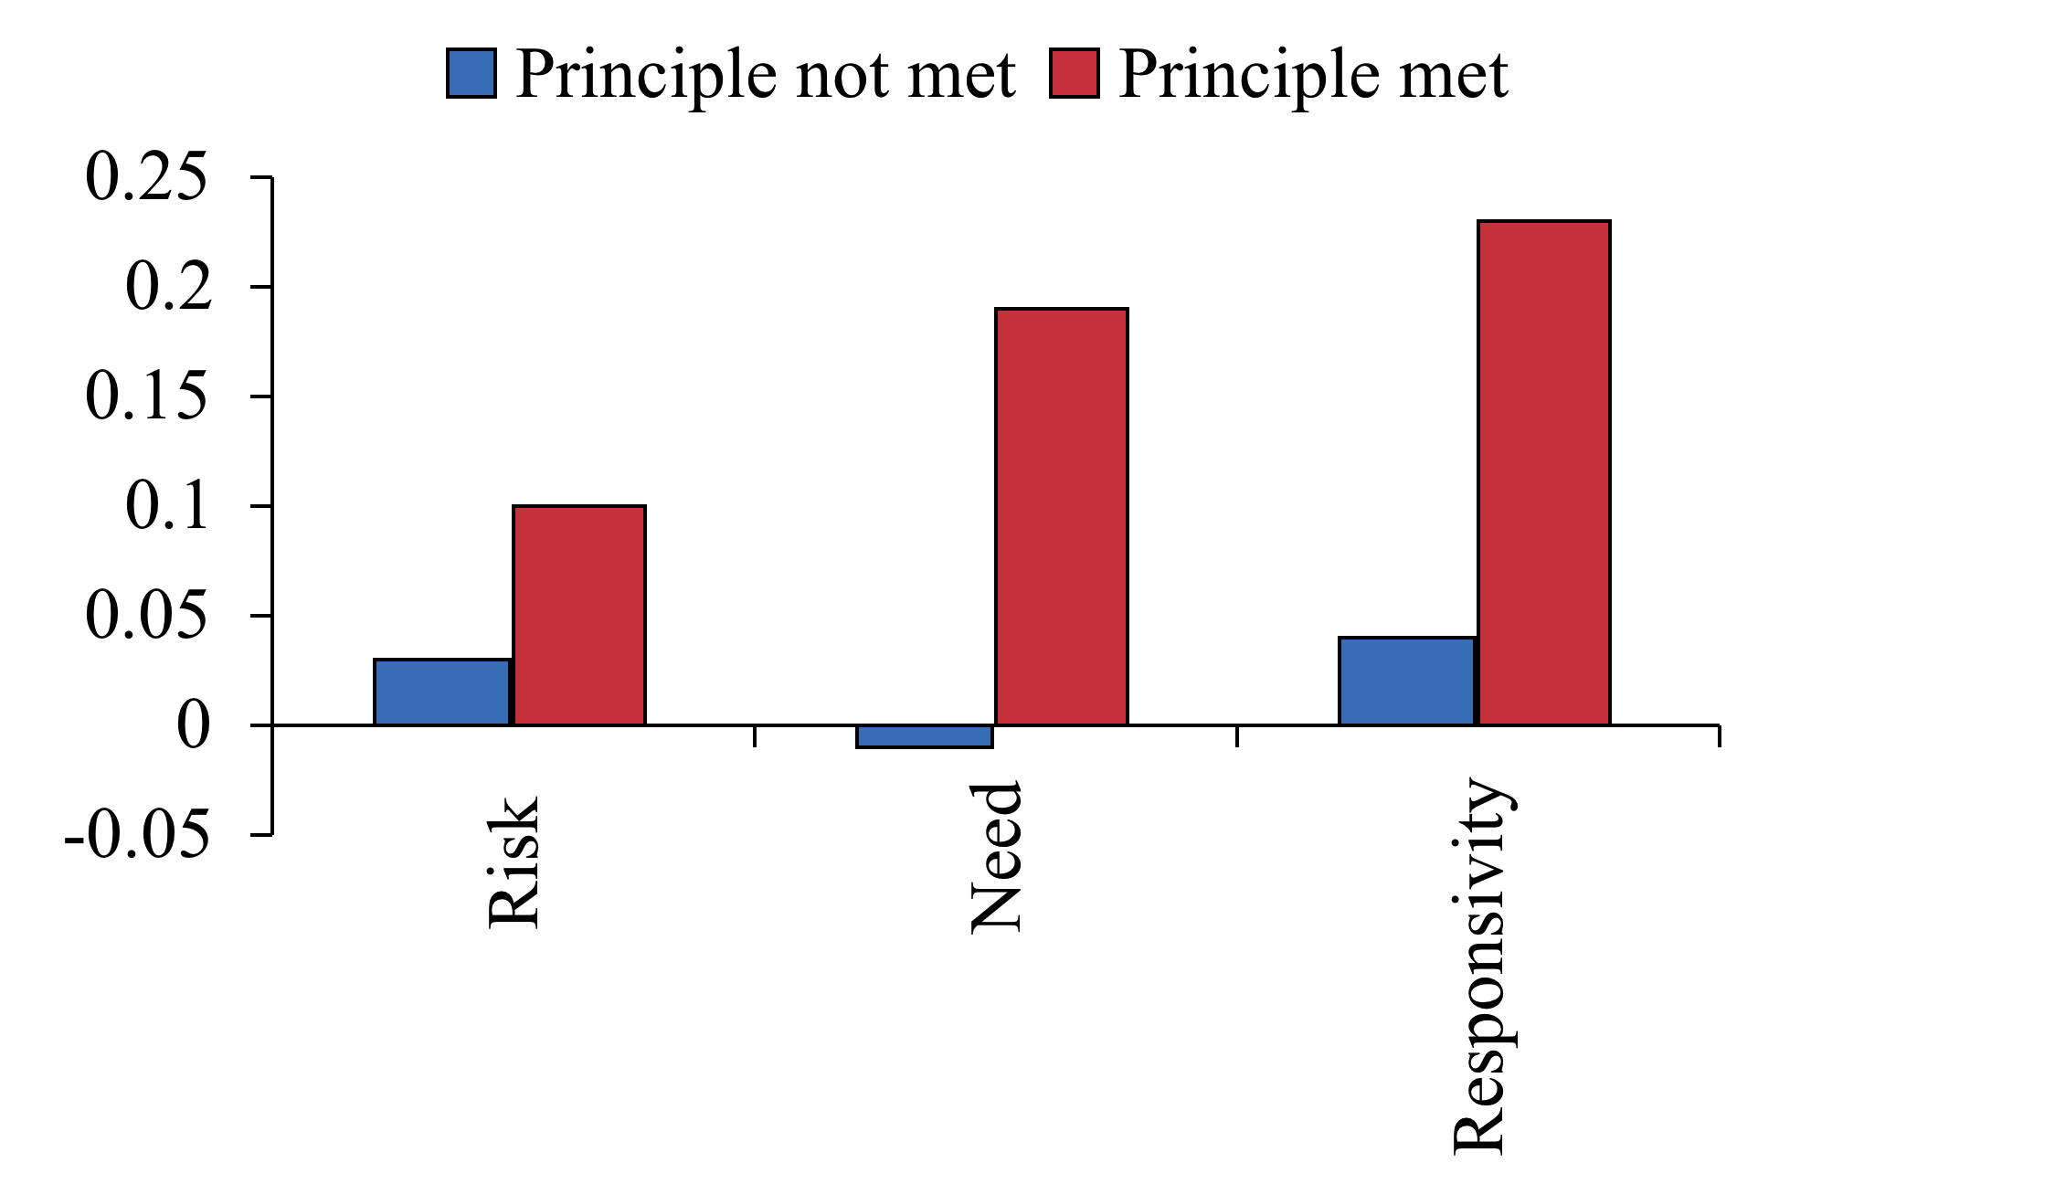
Evidence

Slide 48
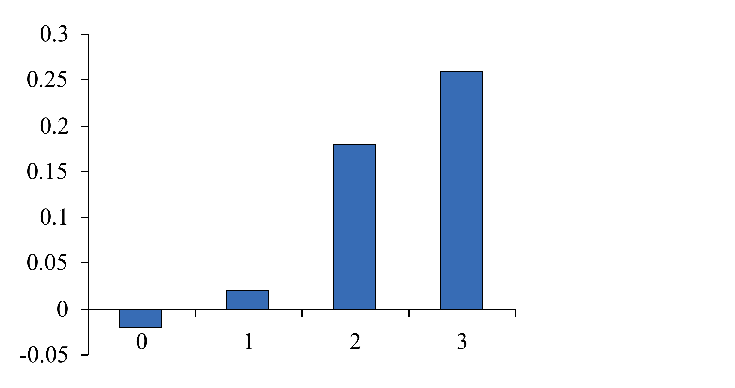
Evidence

