Slide 1
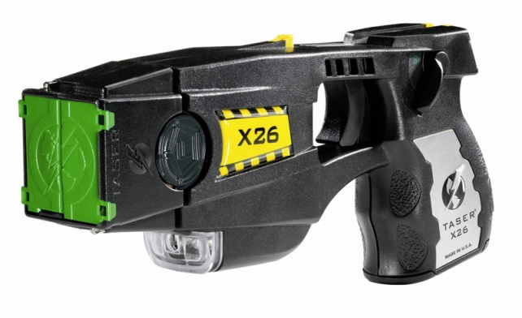

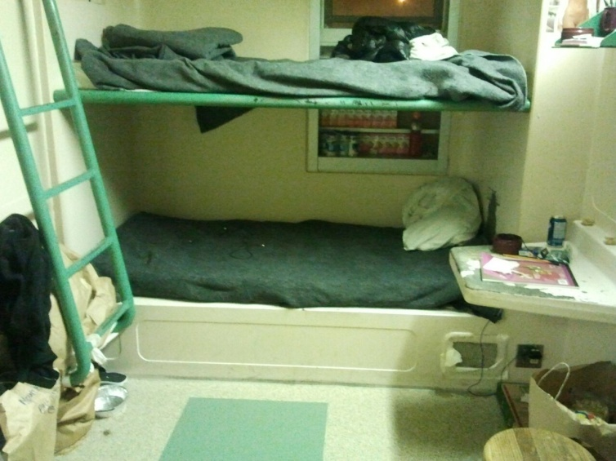
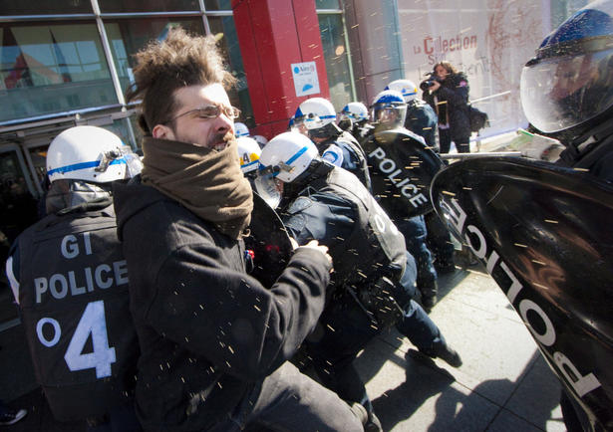
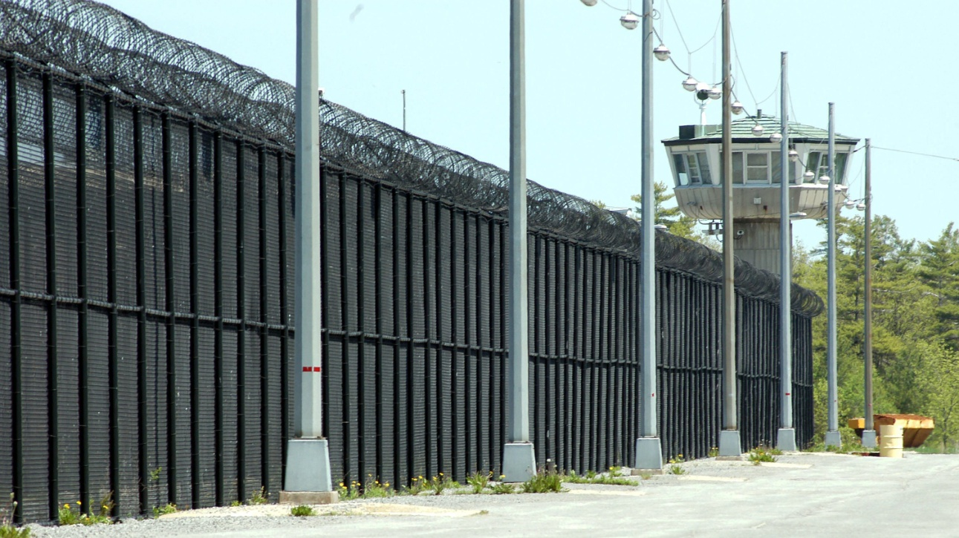
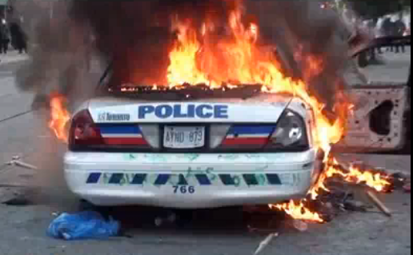
INTRODUCTION TO CRIMINOLOGY
& CRIMINAL JUSTICE
WINTER 2013
Notes:
TA Office hours: Thursdays 2-4 Loeb C577
Go volunteer ***ask where***
Norman Wells Northern teritories – 85,000 ****GO THERE****

Slide 2
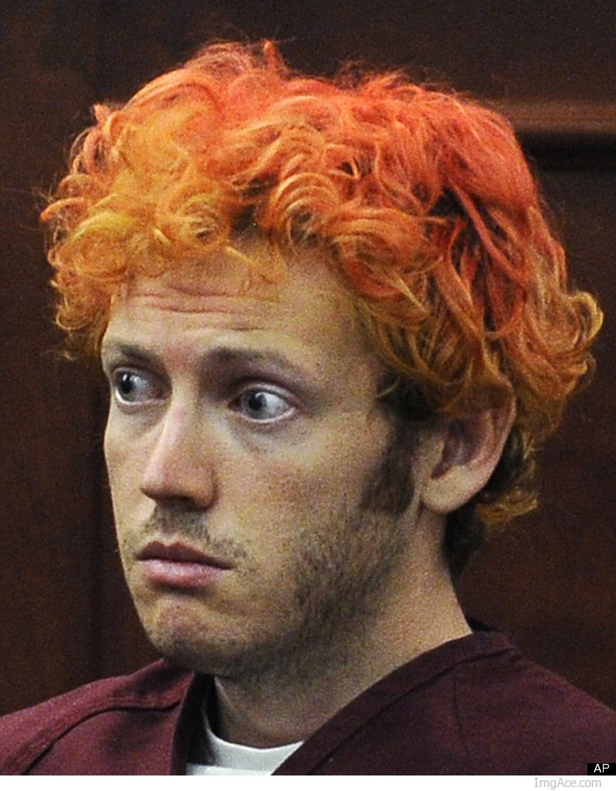
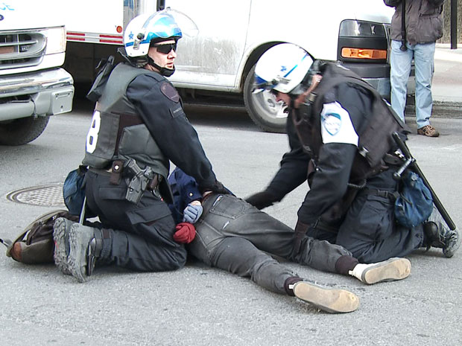
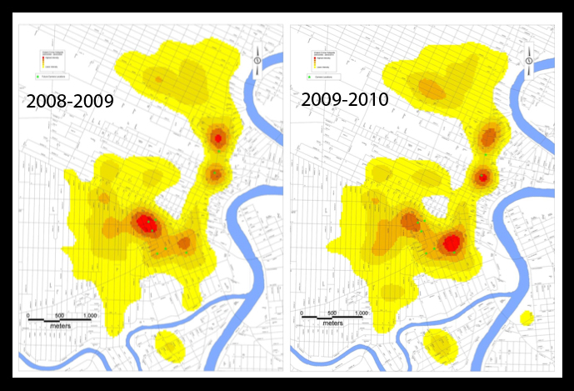
WEEK ONE
INTRODUCTION:
CRIME,
CRIMINALS,
CRIMINALIZATION
Notes:
Third biggest faculty, only three faculty members
What is Criminology?
About studying law making and breaking of laws and the reaction to the breaking of laws
Proposed definition: About studying crime, criminals and criminalization – how people do very nasty things
Positivist Criminology
Criminalization: studying the application of law

Slide 3
CRIME
How many?
Where?
Characteristics of the offenders?
Characteristics of the victims?
Evolution through time and space?
Epidemiological Approach
Epidemiology = Study of incidence and distribution
of diseases
Notes:
Where are they committed, the offense, pattern that can be identified, is it declining/increasing, who gets vicimized, what characteristics that can help us predict crimes
This makes is an unproblematic, there must be a crime or no crime, no in between.
Many criminologist will try to say that it is obvious to oberserve what crime it, that is is problematic.

Slide 4

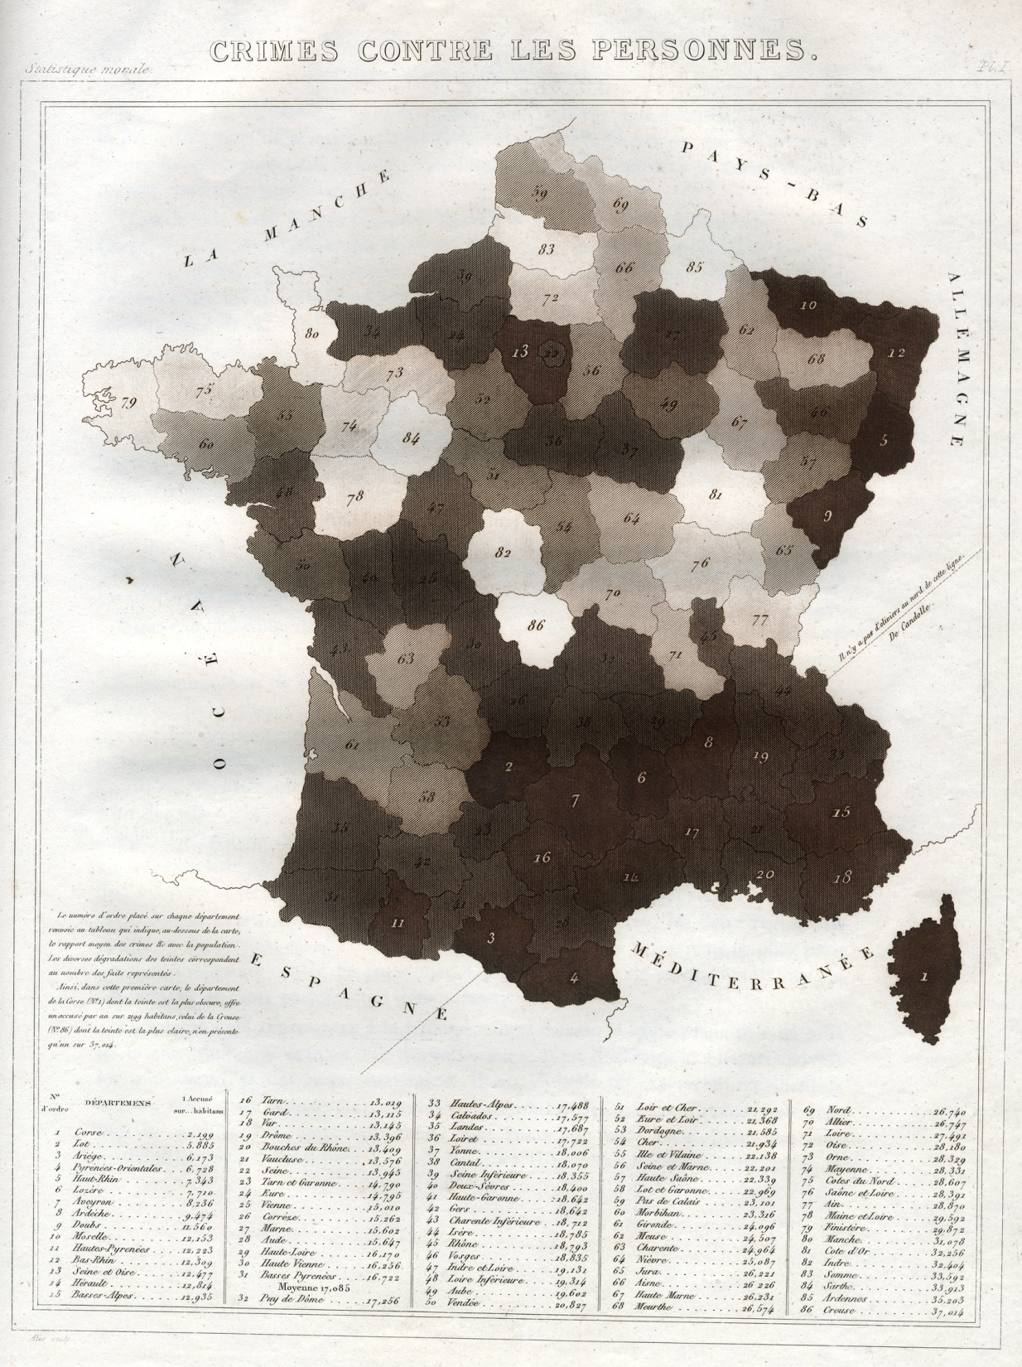
Adolphe Quetelet
(1796-1874)
André-Michel Guerry
(1802-1866)
“Social Physics”
“Moral Statistics”
Introduction of statistical methods in the sciences of the social
Notes:
Asked for the development of studying human behaviour
They were the first to find the relation between crime and age
Tried to discover an association with the climate/weather and crime, if in a pop. There is more people who like booze – what is the relation between crime and alcoholism at the level of generalization.
They took a broader scaled and made broad patterns of the social world in ties with crime

Slide 5
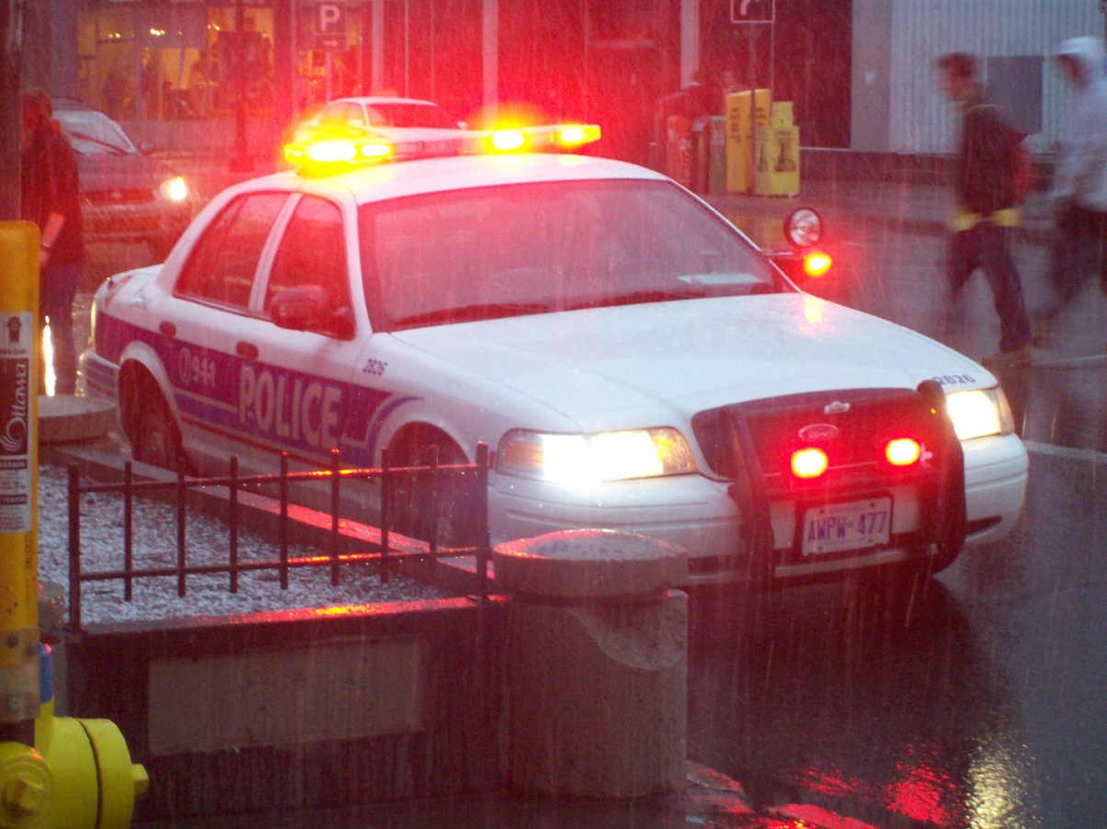
‘PREDICTIVE POLICING’
Software used to direct patrol activities
e.g. http://www.cbsnews.com/8301-18563_162-57412725/lapd-computer-program-prevents-crime-by-predicting-it
Notes:
There are new software's to develop policing strategies – predictive policing
Based on the map IBM produced software to help them to identify where are the most likely places for crime
Crimereports.com – site to see where places are more prone to crime.

Slide 6
3 Methodological Strategies
Official crime data (police-reported)
Self-report surveys
Victimization surveys
Notes:
Official Crime Data: this is the data that is used each year for the knowledge of crime of growth or decay, although this is somewhat limited, some cops do not always report everything and could be a crime.
Self report surveys: used with students, i.e have you beaten up recently, used heroin, steal something in the past x months. As a way to produce a picture of the reality crime that could escape police reports.
Victimization Surveys: At home enjoying KD, phone rings have you been raped/victumized in the past x months, this is another way to graph the figure of crime. Crims think this is the best way to get the unknown info. Have been helpful for the feminist critique in female brutalisation – sexual assault, etc. 9/10 do not appear in police reported surveys.
Many critiques thought crime could be studied by nature, Crims say the reality of crime is complex; that its social constructed by human practices. The production of crime will depends on the suspect and the officer – a lot of factors.
These surveys show that out of all people whom commit a crime only a minority get arrested/caught.
Not committing crime is somewhat abnormal

Slide 7
Criminals
Criminology of perpetration
CLASSICAL
ETIOLOGICAL
Notes:
Its to do crimonology prepertration, you must pick between the two approaches, the two can be distinguise between criminals and non criminals.
Classical: Crime is a rational choice, no different from any other choice
Etiological: Calls it some kind of abnormality, either they’re diffected in the body ie psychological, or a problem with society

Slide 8
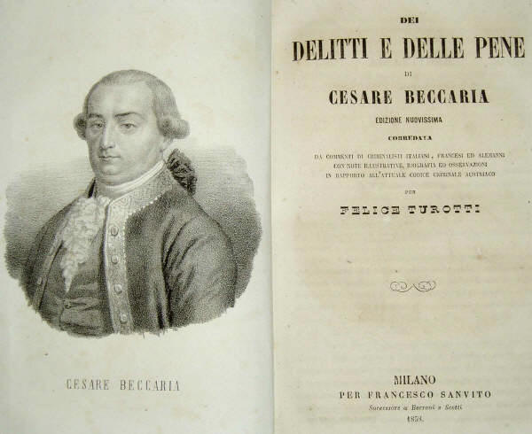
Classical Criminology
Cesare Beccaria
(1738-1794)
On Crime and Punishments, 1764
Utilitarianism
Normality and banality of the criminal choice
Notes:
His book helped the penal we have now?
Crime, just like any other form of behaviour, it is guided by the purist of pleasure and avoidance of pain. Crime is just one way to do so, avioiding the pain of work by stealing.
From a classical perspective there is no difference between profession to profession, crime is just a rational choice. It is a result of a calculization.
They will excuse the mentally ill/criminally insane
Geared to reform punishment, he wanted to change the way in which we punish so that it limits the ___ of crime. In a nutshell Utilitarianism. Maximize the utility of punishment, very brutal and gruesome ways of killing for punnishment. (more next week)
It is not something weird at all

Slide 9

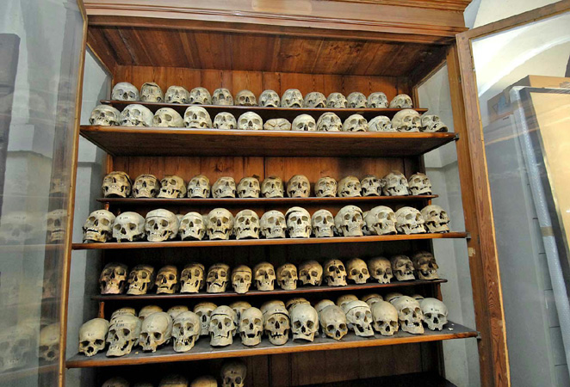
Etiological
Criminology
Cesare Lombroso
(1836-1909)
L’uomo delinquente,1876
Etiology (or aetiology) = cause(s) of a disease/condition
Born criminal
Atavistic = reversion to something ancestral
Crime as symptomatic
Notes:
Will try to identify the crime with something problematic – ie. Poverty
Try to find the causes of disease internal or external.
Lombroso This guy is sometimes represented as the father of Crim. He was convinced some people were born as criminals, and we could identify by measuring all parts of the body, such as head, ears etc were measured and compared to make them a some sort of species. That it is some how an organism that is adapted to pre-civilization – the fight to survival, but unable to control his/her compassion. Gave the idea that we should kill criminals so that they cannot reproduce.
They are hooked on the more primal use of existence.
They take crime as a symptom, a problematic body or society.
Positivist: a form of crim to object criminals and non criminals
This is where rehabilitation comes in, there needs to be something problematic about the person to fix them to be in a civilized society through therapies etc.

Slide 10
CRIMINALIZATION
LAW MAKING
Norms of behavior
Norms of sanction
REPRESSION & PUNISHMENT
Police
Judiciary
Penal
Notes:
How exactly crime happens in society, what is necessary for cultural agents to say “oh this is a crime”
Instead of trying to explain why, they try to explain the norms, and how they are created, and usage. Ie the usage of criminal law
It is difficult to identify a “mother” or “father” although ____ seemed to be influential
Celin? Felin?___ suggested that we should see crime as abnormal BUT only in the eyes of law. What we should be studying how the law constructed the behaviour as being criminal. How is crime produced by a legal point of observation. How the law constructs its objects and how its applied.
Law making – primary
Norms of Behaviour: what is it we cannot do
Norms of Sanction : how we are going to be punnished if we do what we cannot do
How do new crimes appear?
Police: how are they doing their job
Judiciary: who is thrown outside of the process, or thrown in,
Penal: how do we punnish, how do we explain the death penalty, why associate prison to justice, how do crims decide to grant parole.
This is more the critical forms of Criminology

Slide 11

Mainstream vs. Critical
Criminologies
Perpetration
Consensus
Universal
Crime is a wrong
Explain & predict
Natural sciences’ model
Management & control
Authoritarian paternalism
Utopia :
Homogeneity, conformity
& predictability
Social reaction
Conflict
Relative
Crime is a qualification
Understand & interpret
Cultural sciences’ model
Activism & emancipation
Egalitarian humanism
Utopia :
Plurality, equality
& freedom
Notes:
Mainstream left, Critical right side
Two different Utopias
Where everyone is more or less the same, but there is security (left)
The other hand, humanistic or anarchistic utopian (right)

