Slide 1
Sprott School of Business
BUSI 2701H - Fundamentals of International Business
Lecture 6 – Foreign Direct Investment
Instructor - Wade Rose, PhD

Slide 2
Questions
Midterm???
Other???

Slide 3
Globalization and FDI
Video: World Without Borders
  Vol 4, Disc 1, Part 1

Slide 4
Lecture 6 Overview
Understand the different theories of Foreign Direct Investment (FDI)
Understand how political ideology influences a nation’s attitude toward FDI
Understand the benefits and costs of FDI
Understand the policy instruments nations use to influence FDI

Slide 5
What Is FDI?
Foreign direct investment (FDI) occurs when a firm invests directly in facilities to produce and/or market in a foreign country
  the firm becomes a multinational enterprise
FDI can be in the form of
  greenfield investments - the establishment of a wholly new operation in a foreign country
  acquisitions or mergers with existing firms in the foreign country
The flow of FDI refers to the amount of FDI undertaken over a given time period
  Outflows of FDI are the flows of FDI out of a country
  Inflows of FDI are the flows of FDI into a country
The stock of FDI refers to the total accumulated value of foreign-owned assets at a given time

Slide 6
What Are The Patterns Of FDI?
Both the flow and stock of FDI have increased over the last 30 years
  Most FDI is targeted towards developed nations - United States and EU
  However, South, East, and South East Asia - China – and Latin America are now targets
FDI has grown more rapidly than world trade and world output
  firms still fear the threat of protectionism
  democratic political institutions and free market economies have encouraged FDI
  globalization is forcing firms to maintain a presence around the world

Slide 7
What Are The Patterns Of FDI?
Gross fixed capital formation - the total amount of capital invested in factories, stores, office buildings, roads, railways, and the like
  the greater the capital investment in an economy, the more favorable its future prospects are likely to be
So, FDI is an important source of capital investment and a determinant of the future growth rate of an economy

Slide 8
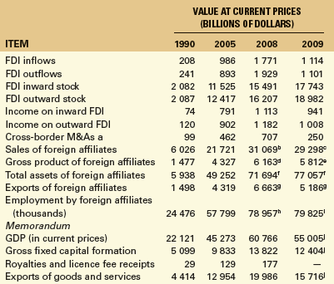
Growth of Global FDI 1990 - 2009
Source: UNCTAD. based on the FDI/TNC database .MF. 2007b)
Source: UNCTAD. based on the FDI/TNC database . UNCTAD GlobStat database. and IMF. 2007b)

Slide 9
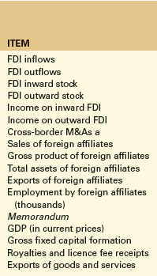
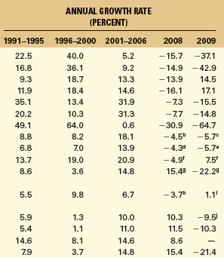
Growth of Global FDI 1990 - 2009
Source: UNCTAD. based on the FDI/TNC database . UNCTAD GlobStat database. and IMF. 2007b)

Slide 10
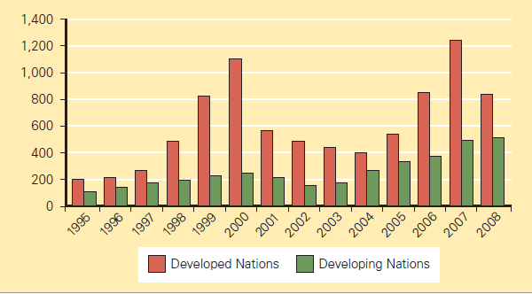
What Are The Patterns Of FDI?
FDI Inflows by Region 1995-2008 ($ billion)

Slide 11
What Are The Patterns Of FDI?
Inward FDI as a % of Gross Fixed Capital Formation 1992-2007

Slide 12
What Is The Source Of FDI?
Since World War II, the U.S. has been the largest source country for FDI
  the United Kingdom, the Netherlands, France, Germany, and Japan are other important source countries
  together, these countries accounted for 56% of all FDI outflows from 1998-2006, and 61% of the total global stock of FDI in 2007

Slide 13
What Is The Source Of FDI?
Cumulative FDI Outflows 1998-2007 ($ billions)

Slide 14

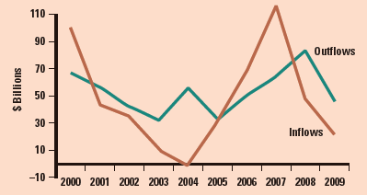
Canada’s Case
FDI Flows into Canada and Canadian Direct Investment, 2000 - 2009 ($ billions)
- Companies of other countries investing in Canada

Slide 15
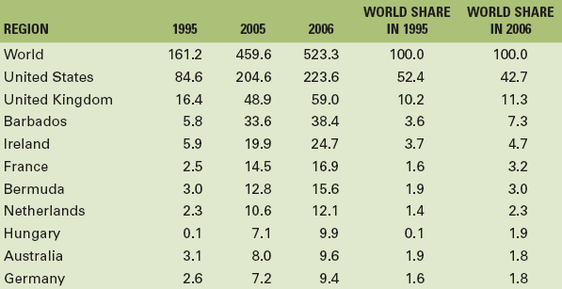
Canada’s Case
Canadian FDI outbound (stock) by Top-10 Destinations,
2006 ($ billions)
Source: Industry Canada

Slide 16
Why Choose FDI?
Exporting - producing goods at home and then shipping them to the receiving country for sale
  exports can be limited by transportation costs and trade barriers
  FDI may be a response to actual or threatened trade barriers such as import tariffs or quotas
Licensing - granting a foreign entity the right to produce and sell the firm’s product in return for a royalty fee on every unit that the foreign entity sells

Slide 17
Why Choose FDI?
Internalization theory (aka market imperfections theory) suggests that licensing has three major drawbacks compared to FDI
  firm could give away valuable technological know-how to a potential foreign competitor
  does not give a firm control over manufacturing, marketing, and strategy in the foreign country
    Limits the firm’s actions in the market against competitors etc.
  the firm’s competitive advantage may be based on its management, marketing, and manufacturing capabilities
    May not be reproducible under licensing

Slide 18
Why Do Firms Choose Acquisition Versus Greenfield Investments?
Most cross-border investment is in the form of mergers and acquisitions rather than greenfield investments
Firms prefer to acquire existing assets because
  mergers and acquisitions are quicker to execute than greenfield investments
  it is easier and perhaps less risky for a firm to acquire desired assets than build them from the ground up
  firms believe that they can increase the efficiency of an acquired unit by transferring capital, technology, or management skills

Slide 19
Why Does FDI In Services Occur?
FDI is shifting away from extractive industries and manufacturing, and towards services
The shift to services is being driven by
  the general move in many developed countries toward services
  the fact that many services need to be produced where they are consumed
  a liberalization of policies governing FDI in services
  the rise of Internet-based global telecommunications networks

Slide 20
What Is The Pattern Of FDI?
Why do firms in the same industry undertake FDI at about the same time and the same locations?
Knickerbocker - FDI flows are a reflection of strategic rivalry between firms in the global marketplace
  multipoint competition -when two or more enterprises encounter each other in different regional markets, national markets, or industries
Vernon - firms undertake FDI at particular stages in the life cycle of a product
  Advanced foreign markets first based on demand
  Later, as cost becomes an issue (standardized product), move production to developing world

Slide 21
What Is The Pattern Of FDI?
But, why is it profitable for firms to undertake FDI rather than continuing to export from home base, or licensing a foreign firm (i.e. FDI versus export or licensing)?
According to Dunning’s eclectic paradigm- it is important to consider
  location-specific advantages - that arise from using resource endowments or assets that are tied to a particular location and that a firm finds valuable to combine with its own unique assets
  externalities - knowledge spillovers that occur when companies in the same industry locate in the same area (e.g. clusters)

Slide 22
What Are The Theoretical
Approaches To FDI?
The radical view - the MNE is an instrument of imperialist domination and a tool for exploiting host countries to the exclusive benefit of their capitalist-imperialist home countries
The free market view- international production should be distributed among countries according to the theory of comparative advantage
  embraced by advanced and developing nations including Canada, the United States, Britain, Chile, and Hong Kong

Slide 23
What Are The Theoretical
Approaches To FDI?
Pragmatic nationalism - FDI has both benefits (inflows of capital, technology, skills and jobs) and costs (repatriation of profits to the home country and a negative balance of payments effect)
  FDI should be allowed only if the benefits outweigh the costs
Recently, there has been a strong shift toward the free market stance creating:
  a surge in FDI worldwide
  an increase in the volume of FDI in countries with newly liberalized regimes (e.g. former Soviet countries)

Slide 24
Case: Sudan approx 2007/8
Video: FDI into Sudan Oil
  Vol 4, Disc 1, Part 3

Slide 25
How Does FDI Benefit
The Host Country?
There are four main benefits of inward FDI for a host country
Resource transfer effects - FDI brings capital, technology, and management resources
Employment effects - FDI can bring jobs
Balance of payments effects - FDI can help a country to achieve a current account surplus
Effects on competition and economic growth - greenfield investments increase the level of competition in a market, driving down prices and improving the welfare of consumers
  can lead to increased productivity growth, product and process innovation, and greater economic growth

Slide 26
What Are The Costs Of
FDI To The Host Country?
Inward FDI has three main costs:
Adverse effects of FDI on competition within the host nation (especially with acquisitions)
  subsidiaries of foreign MNEs may have greater economic power than indigenous competitors because they may be part of a larger international organization
Adverse effects on the balance of payments
  when a foreign subsidiary imports a substantial number of its inputs from abroad, there is a debit on the current account of the host country’s balance of payments
Perceived loss of national sovereignty and autonomy
  decisions that affect the host country will be made by a foreign corporate parent that has no real commitment to the host country, and over which the host country’s government has no real control

Slide 27
How Does FDI Benefit
The Home Country?
The benefits of FDI for the home country include
The effect on the capital account of the home country’s balance of payments from the inward flow of foreign earnings and demand for components, capital equipment etc
The employment effects that arise from outward FDI (creates demand in host country)
The gains from learning valuable skills from foreign markets that can subsequently be transferred back to the home country

Slide 28
What Are The Costs Of
FDI To The Home Country?
The home country’s balance of payments can suffer
  from the initial capital outflow required to finance the FDI
  if the purpose of the FDI is to serve the home market from a low cost labor location
  if the FDI is a substitute for direct exports
Employment may also be negatively affected if the FDI is a substitute for domestic production
But, international trade theory suggests that home country concerns about the negative economic effects of offshore production (FDI undertaken to serve the home market) may not be valid (i.e. comparative advantage)

Slide 29
How Does Government
Influence Outward FDI?
Governments can encourage outward FDI
  government-backed insurance programs to cover major types of foreign investment risk, low-interest loans, eliminate double-tax, etc
Governments can restrict outward FDI
  limit capital outflows, manipulate tax rules (e.g. tax domestic earnings lower then foreign earnings), or outright prohibit FDI

Slide 30
How Does Government
Influence Inward FDI?
Governments can encourage inward FDI
  offer incentives to foreign firms to invest in their countries
    This allows governments to gain from the resource-transfer and employment effects of FDI, and capture FDI away from other potential host countries
Governments can restrict inward FDI
  use ownership restraints (e.g. 51% local) and performance requirements (e.g. local content, technology transfer, etc)

Slide 31
How Do International
Institutions Influence FDI?
Until the 1990s, there was no consistent involvement by multinational institutions in the governing of FDI
Today, the World Trade Organization is changing this by trying to establish a universal set of rules designed to promote the liberalization of FDI

Slide 32
What Does FDI
Mean For Managers?
Managers need to consider what trade theory implies about FDI, and the link between government policy and FDI
The direction of FDI can be explained through the location-specific advantages argument associated with John Dunning
  However, it does not explain why FDI is preferable to exporting or licensing. Must consider internalization theory
A host government’s attitude toward FDI is an important variable in decisions about where to locate foreign production facilities and where to make a foreign direct investment

Slide 33
What Does FDI
Mean For Managers?
A Decision Framework

Slide 34
Lecture 6 Overview
Understand the different theories of Foreign Direct Investment (FDI)
Understand how political ideology influences a nation’s attitude toward FDI
Understand the benefits and costs of FDI
Understand the policy instruments nations use to influence FDI

Slide 35
Questions??

