Slide 1
Lecture 2: Evolution of Brain and Behaviour

Slide 2
ReCap – Last Class
Mentalism is the view that behaviour is a product of an intangible entity called the mind (psyche); the brain has little importance
Dualism is the idea that the immaterial mind acts through the material brain to produce language and rational behaviour; brain alone responsible for “lower” behaviours that are common to other species

Slide 3
Materialism
Behavior can be fully explained by the workings of the nervous system, without explanatory recourse to an immaterial mind
Supported evolutionary theories of Alfred Wallace and Charles Darwin
  Both were struck at the many similarities among species
    E.g., skeletons, muscles, limbs
  All living things are related

Slide 4
Theory of Evolution
New species evolve:
  1) Fossil records;
  2) Structural similarities;
  3) Programs of selective breeding
Natural Selection: Variations in traits that increase fitness will increase the probability of that species’ survival
Sexual selection: Each sex has anatomical and behavioral features that favor reproductive success
  e.g., peacock feathers

Slide 5
How are traits selected naturally ?
Appearance of new trait
(e.g. via mutation)
Adaptive
Trait
Increases
Chances of
Survival
Trait Passed
on to Offspring

Slide 6
Implications for Brain and Behavior:
Because all animal species are related, so too must be their brains
  Rationale for studying simpler animals to understand humans
Because all species of animals are related, so too must be their behavior
  Emotional expressions in humans (across cultures) and other animals are similar
Both the brain and behavior changed bit by bit in animals that evolved to greater complexity, as humans obviously did
Today the evidence that the brain controls behavior is extremely strong: Brain Theory
  D.O. Hebb

Slide 7
Evolution of Brain and Behavior
Common Ancestor: A forebearer from which two or more lineages or family groups arise
  Example: Humans and apes are thought to share a common ancestor
Can trace our lineage by comparing the genes, brains, and behaviors of different animals

Slide 8
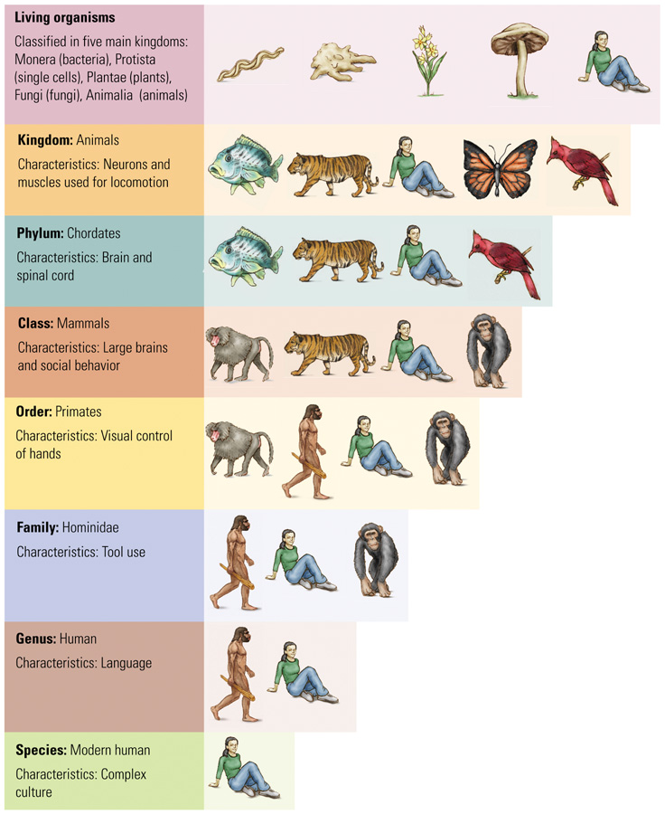
Classification of Life
Taxonomy:
  Branch of biology concerned with naming and classifying species
    Groups organisms with common characteristics
  Useful for helping us trace the evolution of brain cells and the brain

Slide 9
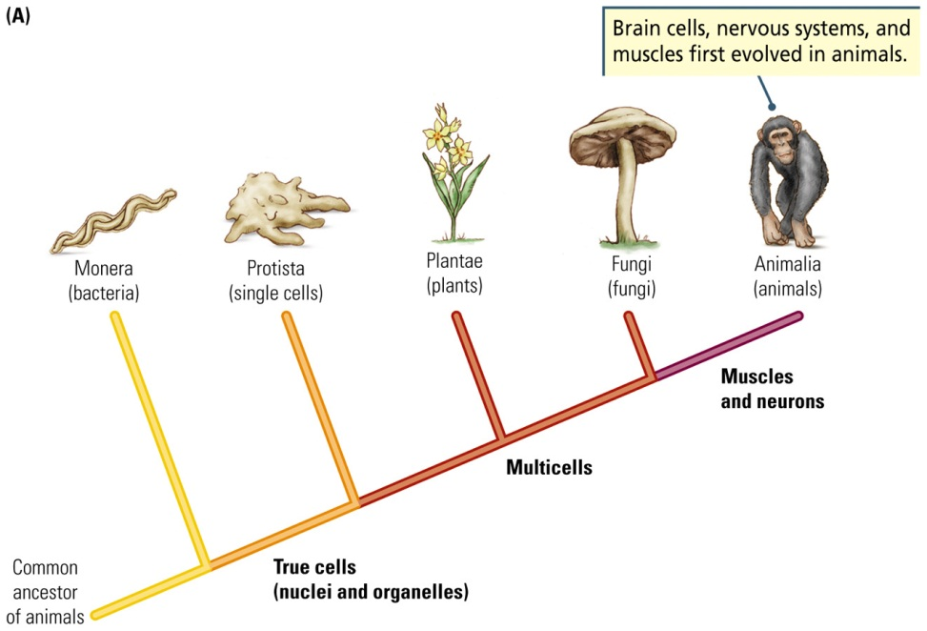
Classification of Life
Cladogram (“branch”)
  Display groups of related organisms as branches on a tree
Branch order represents how the groups are related evolutionarily, as well as the traits that distinguish them
Read from left to right; the most recently evolved organism or trait is located farthest to the right

Slide 10
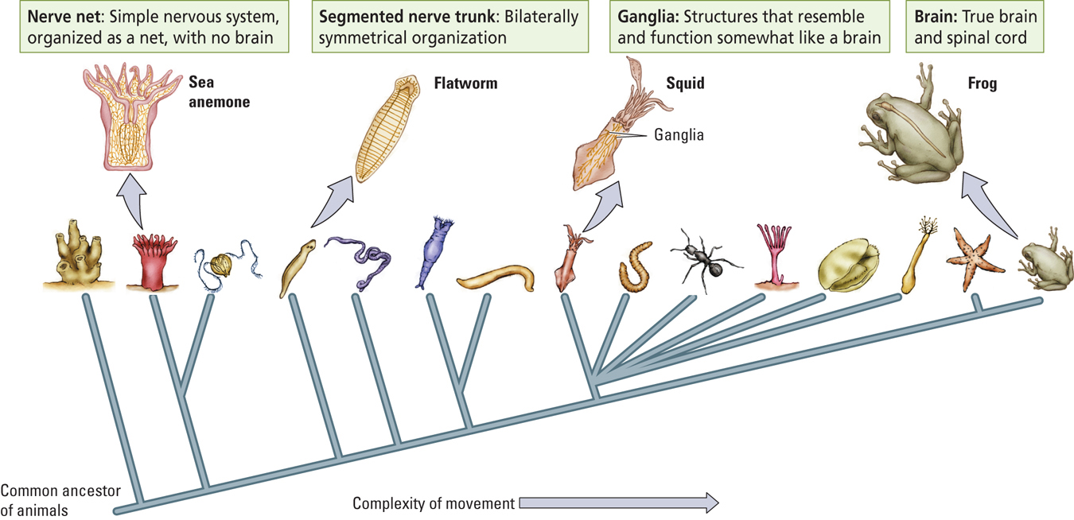

Slide 11
The Chordate Nervous System
Two features distinguish the chordates:
  Nervous system is crossed
  Chordate spinal cord lies behind heart and gut

Slide 12
Evolution of the Human Brain
Australopithecines were hominids that made and used tools
  Reduced the necessity for large jaws and teeth, and those became steadily smaller
As H. habilis evolved, brains became larger and faces got smaller
H. erectus made elaborate tools, used fire, and hunted
  Also expanded their area over three continents
H. Sapiens: brain volume reaches modern levels

Slide 13
Evolution of the Human Brain
Mammals share main brain structures
Humans:
  Increased in size during course of evolution
  Most of increase has occurred in the cerebrum
  Increased cerebrum resulted in increased convolutions

Slide 14
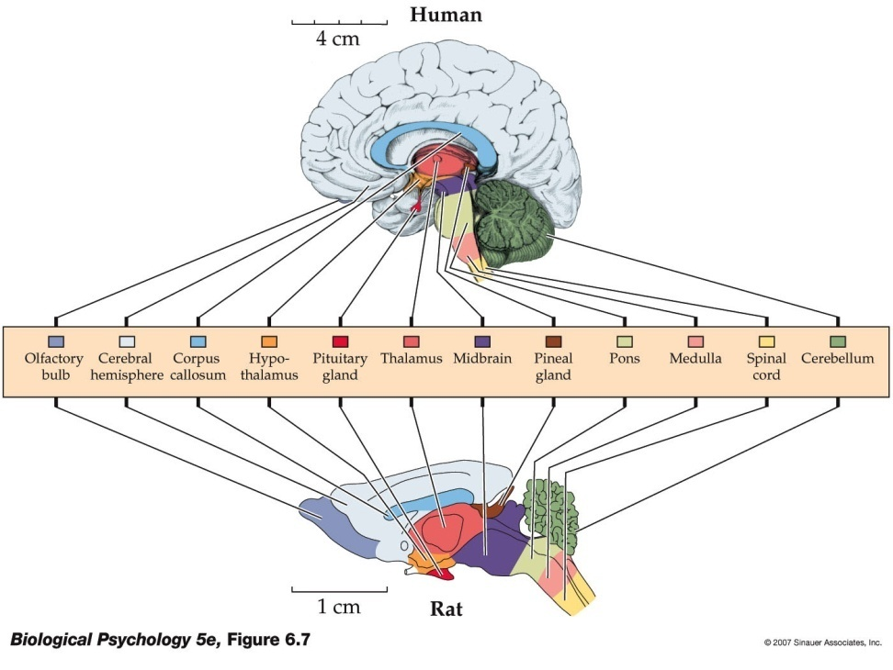
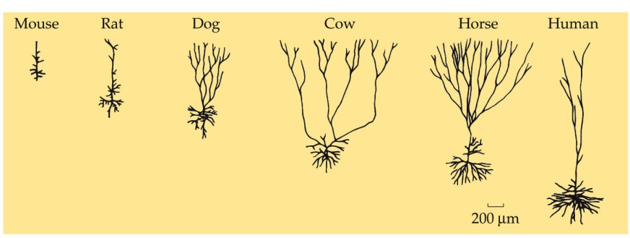
Evolution of the Human Brain
Differences between human and rat brains are in actual and relative size of regions, such as cerebral cortex and olfactory bulbs
Human neurons are larger

Slide 15
Relating Brain Size and Behavior
Jerison (1973), Principle of Proper Mass:
  Species exhibiting more complex behaviors will possess relatively larger brains
Jerison developed an index of brain size to allow comparisons among different species
  Used body size to predict brain size

Slide 16
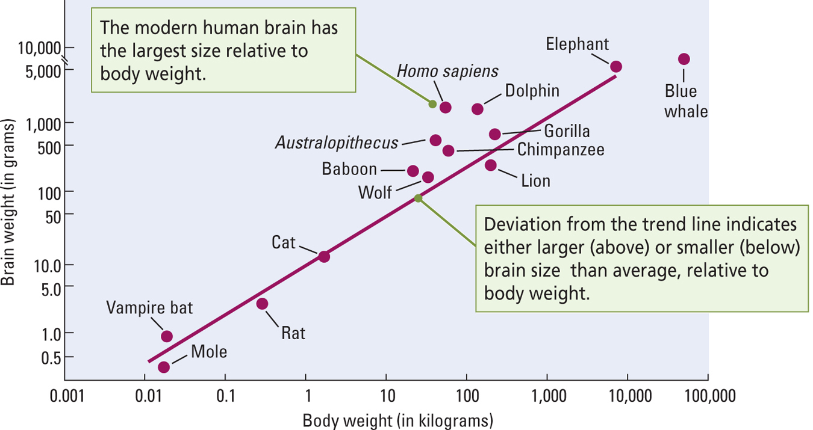
[Insert Fig. 1-14]

Slide 17
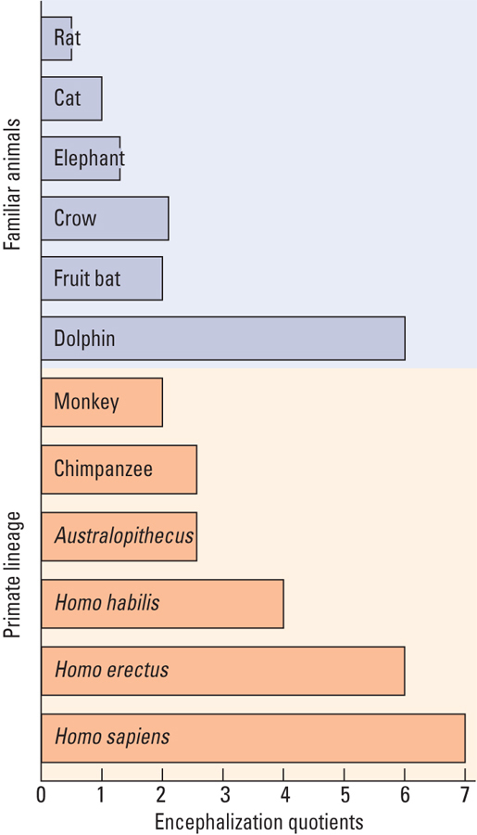
Encephalization Quotient (EQ)
Measure of brain size obtained from the ratio of actual brain size to the expected brain size for an animal of a particular body size
H. sapiens have the largest EQ

Slide 18
Climate Change and the Enlarging Hominid Brain
Three-fold increase in brain size over last 5 million years appears to have taken place in steps
  Evidence suggests each new hominid species appeared after new environments appeared due to climate changes
  Example: spreading grasslands and fewer trees increased the adaptiveness of an upright posture and tool-building skills

Slide 19
Why the Hominid Brain Enlarged
1. The Primate Lifestyle
The foraging behavior of primates is more complex than other animals
  Finding fruit is more difficult than eating grass or other vegetation on the ground
    Need good sensory, spatial, and memory skills
  Fruit eaters have larger brains

Slide 20
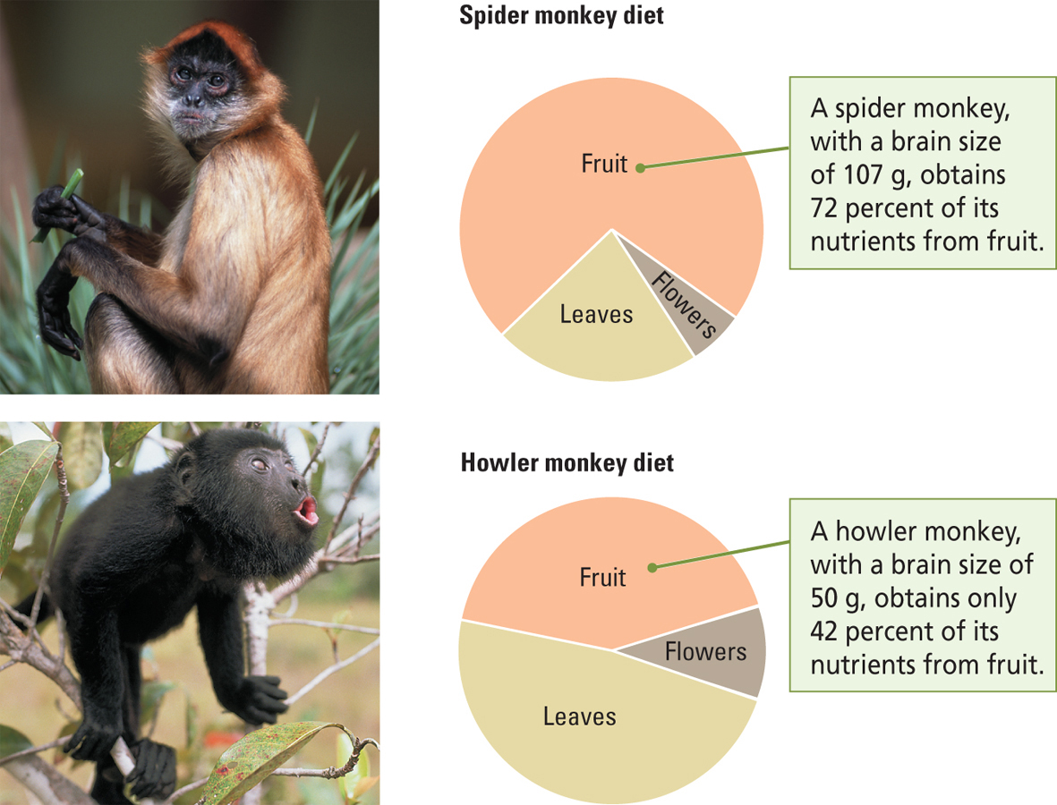

Slide 21
Why the Hominid Brain Enlarged
2. Changes in Hominid Physiology
Radiator Hypothesis (Falk, 1990)
  To increase the size of a car’s engine, must increase size of radiator to cool it
  The more active the brain is, the more heat it generates
  Homo species’ skulls had more widely dispersed blood flow, which allowed for increased brain size
Increased
Blood
Circulation
Improved
Brain
Cooling
Enabled Size of
Hominid brains to Increase

Slide 22
Why the Hominid Brain Enlarged
Stedman and colleagues (2004)
Genetic
Mutation
Smaller Facial
Muscles &
Bones
Change
in Diet
Increased Brain Size

Slide 23
Why the Hominid Brain Enlarged
3. Neoteny (“juvenilization”): juvenile stages of predecessors become the adult features of descendants
Rate of maturation is slowed
  Allows more brain cells to be produced
Adults retain some infant characteristics
Newly evolved species resemble the young of their common ancestors

Slide 24
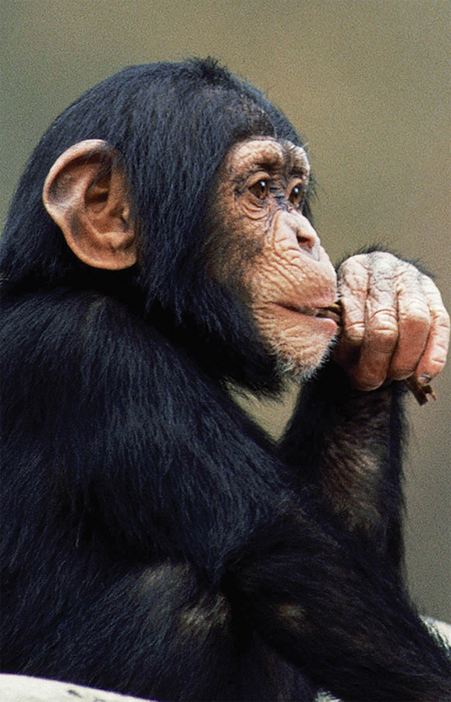
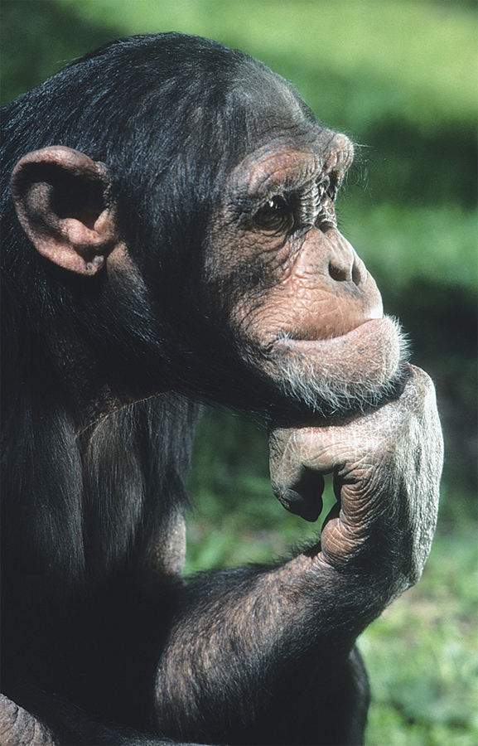
  Human heads look more like the heads of juvenile chimpanzees than adult chimpanzees

Slide 25
Modern Human Brain Size and Intelligence
Evolutionary Approach
  Make brain-behavior comparisons between different species
CAUTION:
  Difficult to make brain-behavior comparisons between members within the same species
    Example: Brain size and intelligence

Slide 26
Are people with larger brains more intelligent?
Problems:
How does one measure brain size?
  Control for skull thickness
  Volume versus weight
  Control for body weight
    Can fluctuate within an individual over time
  Effect of age, physical health, brain damage?

Slide 27
Problem of Causality
Large Brain Size
Greater Intelligence
?
Other Variable

Slide 28
Are people with larger brains more intelligent?
Problem: How does one measure intelligence?
  People vary enormously in their individual abilities, depending on the task
Person A
Excellent math abilities
Poor spatial abilities
Person B
Poor math abilities
Excellent spatial abilities
Which person is more intelligent?

Slide 29
Fallacies of Human Brain-Size Comparisons
Brain size and intelligence do not seem to be particularly related
  Research has shown that many smart people (e.g., Einstein) have average size brains
  Women’s brains weigh about 10% less than men, but the two sexes do not differ in measures of average intelligence

Slide 30
Culture and Evolution
Our large brains have allowed us to develop a rich culture:
  Complex learned behaviors that are passed on from one generation to the next through teaching and learning
The brain is highly flexible
  We perform many tasks today that our brains were not originally selected for early during evolution
    Example: programming computers

Slide 31
Is Bigger
Better?
Costs:
  Long gestation period
  Prolonged dependence on parents
  Metabolically costly
  Complex genes are vulnerable to mutation

Slide 32
Smarter is better!
Benefits:
  Increased survival and ability for group interaction
  Innovative behavior, use of tools, and social learning
  Predicts success in a novel environment
  Sexual selection pressures for ability to attract attention, artistry, and creativity may lead to increased brain size
    E.g.,

